Slide 1
SciPy
Introduction
scipy.cluster
scipy.constants
scipy.fftpack
scipy.integrate
scipy.interpolate
scipy.linalg
scipy.optimize
scipy.sparse
scipy.stats

Slide 2
Lesson Objectives
Introduction to SciPy
Brief introductions to various to sub-packages in SciPy

Slide 3
SciPy
Introduction
scipy.cluster
scipy.constants
scipy.fftpack
scipy.integrate
scipy.interpolate
scipy.linalg
scipy.optimize
scipy.sparse
scipy.stats

Slide 4
Introduction to SciPy
Scipy is a scientific library for Python and is open source
It depends on NumPy
Scipy website - https://www.scipy.org/

Slide 5
Why SciPy
Key advantage - Provides a very user friendly API to write code for various scientific computing domains including:
scipy.cluster – Vector Quantization
scipy.constants – Physical and mathematical constants
scipy.fftpack – Fourier Transform
scipy.integrate – Integration routines
scipy.interpolate - Interpolation
scipy.linalg – Linear Algebra routines
scipy.optimize – Optimization
scipy.sparse – Sparse matrices
scipy.stats - Statistics

Slide 6
Basics
Basic NumPy functions are included in SciPy, since NumPy is a part of (or the base of) SciPy
Examples of included functions:
np.zeros()
np.ones()
np.arange()
np.linspace()
np.array()
np.matrix()
and more…

Slide 7
scipy.cluster
Introduction
scipy.cluster
scipy.constants
scipy.fftpack
scipy.integrate
scipy.interpolate
scipy.linalg
scipy.optimize
scipy.sparse
scipy.stats

Slide 8
scipy.cluster
scipy.cluster is used for vector quantization and primarily K-Means clustering
K-Means clustering is an unsupervised machine learning algorithm to find clusters in unlabelled data (will be covered with machine learning)
Let’s do a whiteboard analysis on K-Means clustering algorithm

Slide 9
scipy.cluster
K-Means clustering
from scipy.cluster.vq import kmeans,vq,whiten
from numpy import vstack,array
from numpy.random import rand
# data generation with three features
data = vstack((rand(100,3) + array([.5,.5,.5]),rand(100,3)))
# whitening of data
data = whiten(data)
# print data
print(data)
# computing K-Means with K = 3
centroids,_ = kmeans(data,3)
# print centroids
print(centroids)
# assign each sample to a cluster
clx,_ = vq(data,centroids)
# check clusters of observation
print(clx)

Slide 10
scipy.cluster
K-Means outputs from previous slide (data in 3 clusters):
print(data)
print(centroids)
print(clx)
[[2.38038384e+00 2.12280702e+00 2.16947796e+00]
[2.88261030e+00 3.05264701e+00 2.32604159e+00]
[1.39628218e+00 2.67195040e+00 2.73329337e+00]
[1.85570613e+00 1.44755357e+00 1.37267120e+00]
[3.40103919e+00 1.83791819e+00 3.45083827e+00]
……………………
……………………
[[1.21886134 1.13825823 1.0813865 ]
[3.15339406 2.74945654 2.78052967]
[1.77053939 2.2379303 2.33445638]]
[2 1 2 0 1 1 2 2 1 2 1 1 1 1 1 2 1 2 1 1 1 1 1 1 1 1 1 1 1 2 2 1 1 1 2 1 2
2 1 2 0 1 1 1 0 1 1 1 2 1 1 2 2 1 1 2 1 2 2 2 2 2 2 1 2 1 2 2 2 1 2 2 1 1
1 1 1 1 1 2 2 2 2 2 2 1 2 2 2 1 1 1 2 1 1 2 2 1 2 1 0 2 0 0 0 0 0 2 0 0 2
0 0 0 2 0 0 0 0 0 0 0 0 0 0 0 0 2 0 0 0 0 0 2 0 0 0 0 0 0 0 0 0 0 0 2 0 0
0 0 2 0 0 0 0 2 0 0 0 0 0 0 0 0 0 0 0 0 0 0 0 0 2 0 0 0 0 2 2 0 0 0 0 0 0
0 0 0 0 0 0 0 0 0 0 0 0 0 2 0]

Slide 11
scipy.constants
Introduction
scipy.cluster
scipy.constants
scipy.fftpack
scipy.integrate
scipy.interpolate
scipy.linalg
scipy.optimize
scipy.sparse
scipy.stats

Slide 12
scipy.constants
This package provides various physical and mathematical constants
>>> from scipy.constants import *
>>> pi
3.141592653589793
>>> c
299792458.0
>>> h
6.62607004e-34
>>> e
1.6021766208e-19
>>> R
8.3144598
>>> k
1.38064852e-23
>>> m_e
9.10938356e-31

Slide 13
scipy.fftpack
Introduction
scipy.cluster
scipy.constants
scipy.fftpack
scipy.integrate
scipy.interpolate
scipy.linalg
scipy.optimize
scipy.sparse
scipy.stats

Slide 14
scipy.fftpack
scipy.fft is used for computing Fourier Transformations and Inverse Fourier Transformations
What is a Fourier Transformation?
https://www.youtube.com/watch?v=spUNpyF58BY

Slide 15
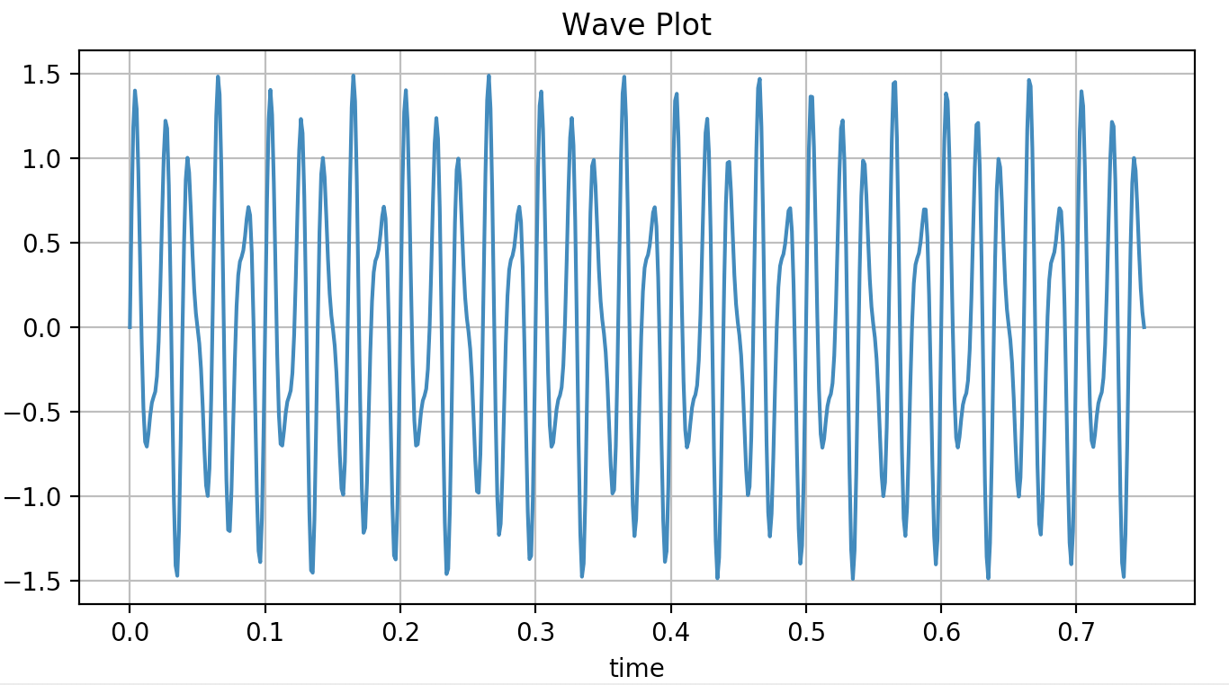
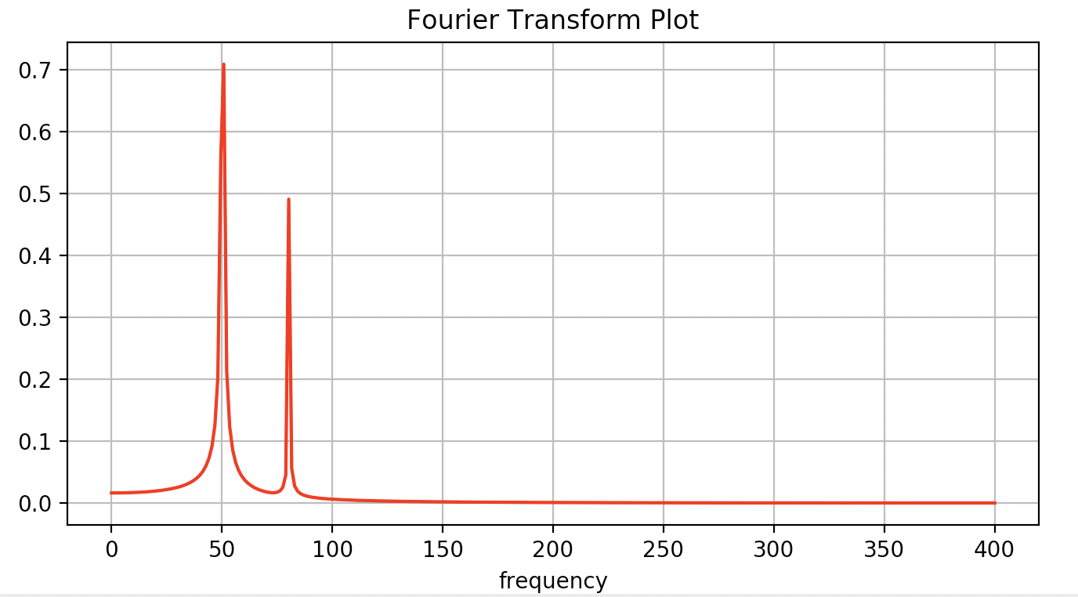
scipy.fftpack
Example:
from scipy.fftpack import fft
import numpy as np
# Number of sample points
N = 600
# sample spacing
T = 1.0 / 800.0
x = np.linspace(0.0, N*T, N)
y = np.sin(50.0*2.0*np.pi*x) + 0.5*np.sin(80.0*2.0*np.pi*x)
yf = fft(y)
xf = np.linspace(0.0, 1.0/(2.0*T), N//2)
import matplotlib.pyplot as plt
plt.figure(figsize=(8,2))
plt.plot(x, y)
plt.grid()
plt.figure(figsize=(8,2))
plt.plot(xf, 2.0/N * np.abs(yf[0:N//2]), color = "r")
plt.grid()
plt.show()

Slide 16
scipy.integrate
Introduction
scipy.cluster
scipy.constants
scipy.fftpack
scipy.integrate
scipy.interpolate
scipy.linalg
scipy.optimize
scipy.sparse
scipy.stats

Slide 17
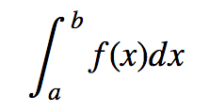
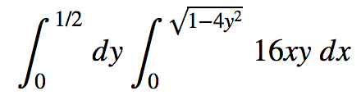
scipy.integrate
Example: Single Integrals –
Example: Double Integrals –
>>> import scipy.integrate
>>> from numpy import exp
>>> f = lambda x:exp(-x**2)
>>> i = scipy.integrate.quad(f, 0, 1)
>>> print(i)
(0.7468241328124271, 8.291413475940725e-15)
>>> f = lambda x, y : 16*x*y
>>> g = lambda x : 0
>>> h = lambda y : sqrt(1-4*y**2)
>>> i = scipy.integrate.dblquad(f, 0, 0.5, g, h)
>>> print(i)
(0.5, 1.7092350012594845e-14)

Slide 18
scipy.interpolate
Introduction
scipy.cluster
scipy.constants
scipy.fftpack
scipy.integrate
scipy.interpolate
scipy.linalg
scipy.optimize
scipy.sparse
scipy.stats

Slide 19
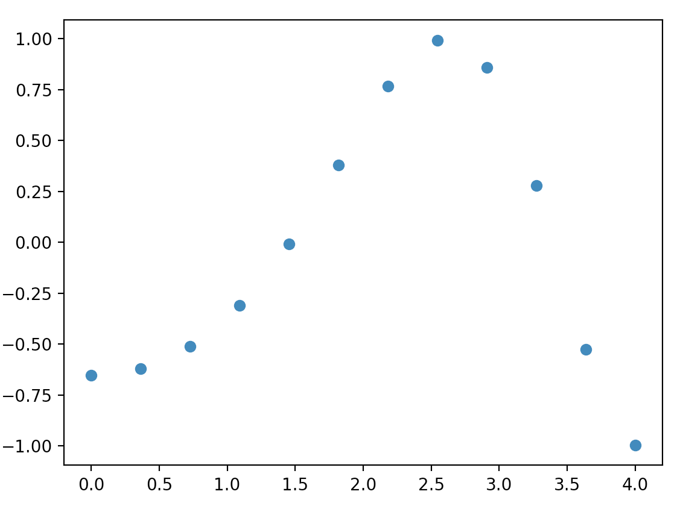
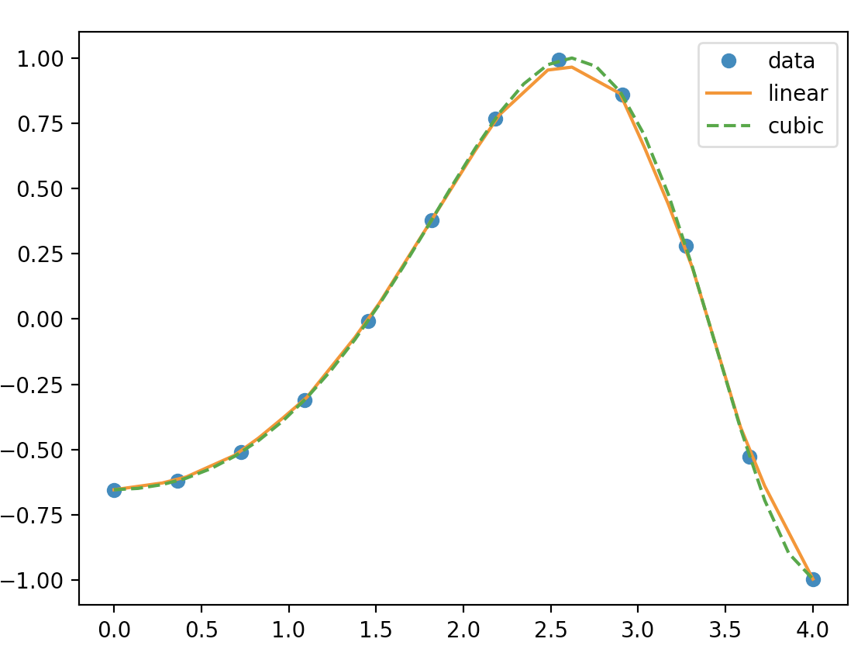
scipy.interpolate
Running interpolation – the code on the next slide will be able to perform a 1D interpolation using interp1d()

Slide 20
scipy.interpolate
Running interpolation – interp1d()
import numpy as np
from scipy.interpolate import interp1d
import matplotlib.pyplot as plt
x = np.linspace(0, 4, 12)
y = np.cos(x**2/3+4)
print (x,y)
plt.figure(num=1)
plt.plot(x, y,'o')
xnew = np.linspace(0, 4,30)
f1 = interp1d(x, y,kind = 'linear')
f2 = interp1d(x, y, kind = 'cubic')
plt.figure(num=2)
plt.plot(x, y, 'o', xnew, f1(xnew), '-', xnew, f2(xnew), '--')
plt.legend(['data', 'linear', 'cubic', 'nearest'], loc = 'best')
plt.show()

Slide 21
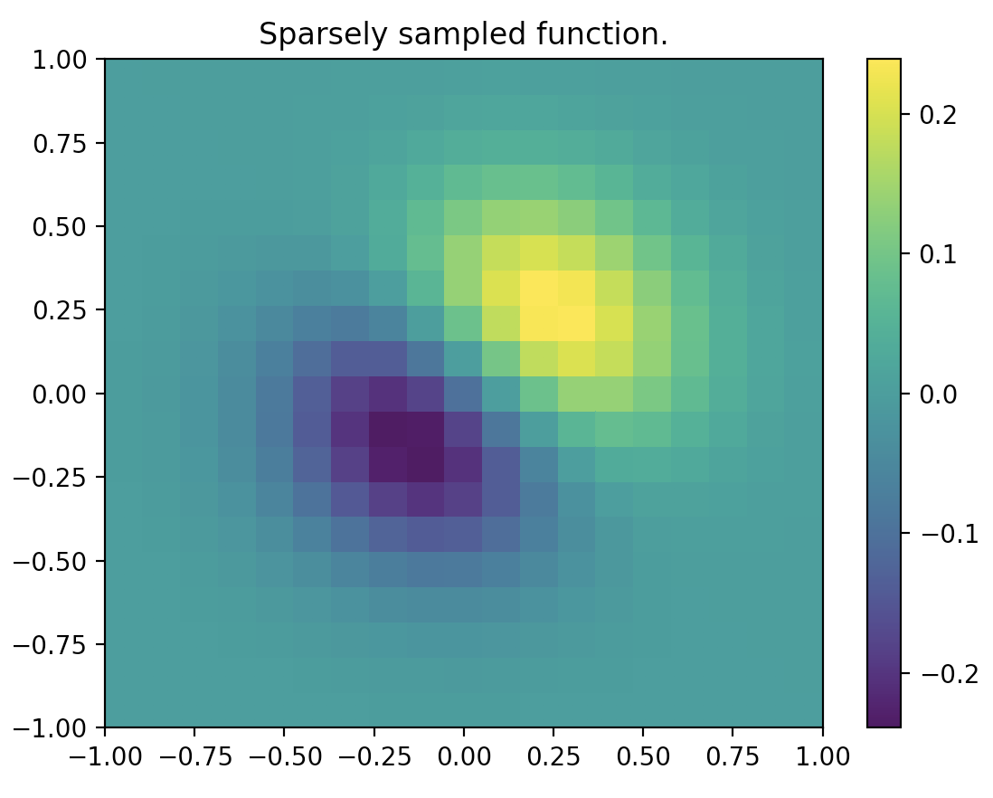
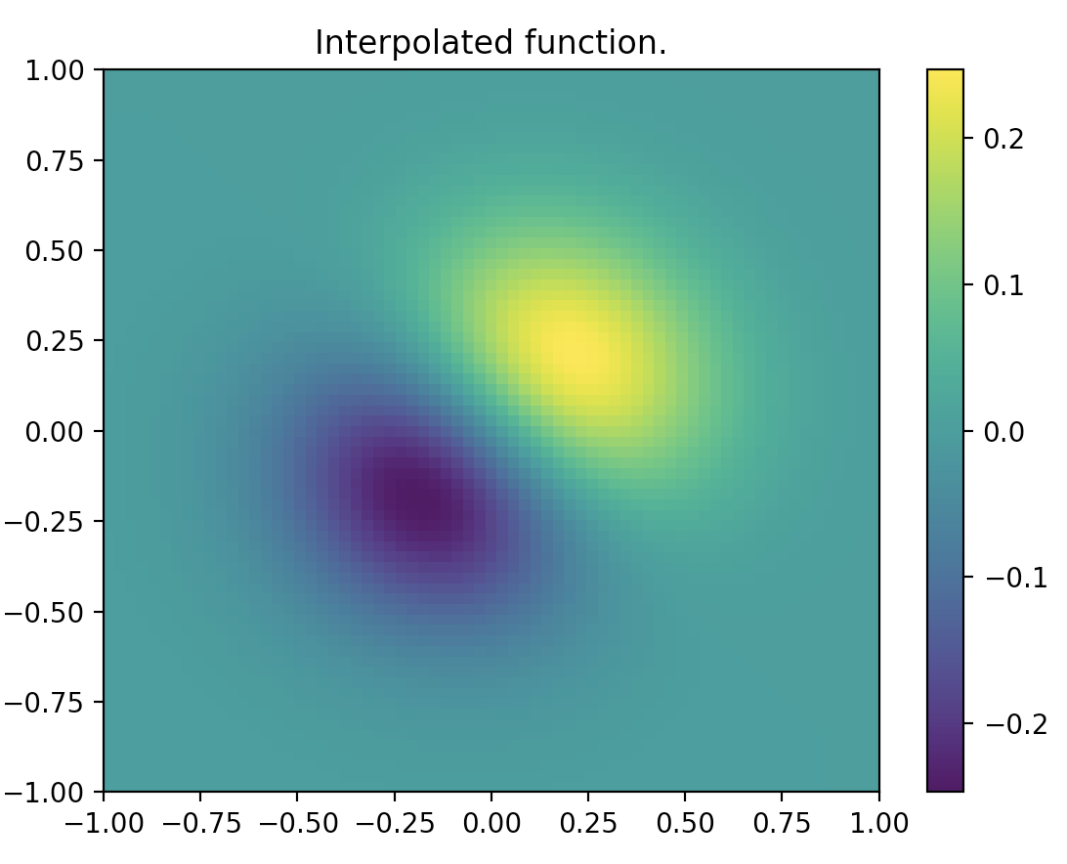
scipy.interpolate
Running interpolation – the code on the next slide will be able to perform a smooth spline fit for a 2D surface using bisplev() and bisplrep()

Slide 22
scipy.interpolate
Running interpolation – bisplev() and bisplrep()
from scipy.interpolate import bisplev
from scipy.interpolate import bisplrep
import numpy as np
import matplotlib.pyplot as plt
x, y = np.mgrid[-1:1:20j, -1:1:20j]
z = (x+y) * np.exp(-6.0*(x*x+y*y))
plt.figure()
plt.pcolor(x, y, z)
plt.colorbar()
plt.title("Sparsely sampled function.")
xnew, ynew = np.mgrid[-1:1:70j, -1:1:70j]
tck = bisplrep(x, y, z, s=0)
znew = bisplev(xnew[:,0], ynew[0,:], tck) plt.figure()
plt.pcolor(xnew, ynew, znew)
plt.colorbar()
plt.title("Interpolated function."
plt.show()

Slide 23
scipy.interpolate
Running interpolation – What are np.mgrid(), bisplev() and bisplrep()?
np.mdgrid()
Returns a multidimensional mesh grid
https://docs.scipy.org/doc/numpy/reference/generated/numpy.mgrid.html#numpy.mgrid
bisplev() and bisplrep()
bisplrep() takes x, y, z and outputs tck = [tx, ty, c, kx, ky].
bisplev() takes two 1D vectors whose cross product defines the domain of evaluation and the variable “tck”
https://docs.scipy.org/doc/scipy/reference/generated/scipy.interpolate.bisplev.html#scipy.interpolate.bisplev
https://docs.scipy.org/doc/scipy/reference/generated/scipy.interpolate.bisplrep.html#scipy.interpolate.bisplrep

Slide 24
scipy.linalg
Introduction
scipy.cluster
scipy.constants
scipy.fftpack
scipy.integrate
scipy.interpolate
scipy.linalg
scipy.optimize
scipy.sparse
scipy.stats

Slide 25
scipy.linalg
Example: solving a system of linear equations
from scipy import linalg
import numpy as np
a = np.array([[1, 0, 1], [0, -3, 1], [2, 1, 3]])
b = np.array([6, 7, 15])
# Passing the values to the solve function
x = linalg.solve(a, b)
# Printing the result array
print(x)
array([ 2., -1., 4.])

Slide 26
scipy.linalg
Example: finding eigen values and eigen vectors
from scipy import linalg
import numpy as np
A = np.array([[1,2],[3,4]])
# Passing the values to the eig function
l, v = linalg.eig(A)
# Printing the result for eigen values and vectors
print(l)
print(v)
[-0.37228132+0.j 5.37228132+0.j]
[[-0.82456484 -0.41597356]
[ 0.56576746 -0.90937671]]

Slide 27
scipy.optimize
Introduction
scipy.cluster
scipy.constants
scipy.fftpack
scipy.integrate
scipy.interpolate
scipy.linalg
scipy.optimize
scipy.sparse
scipy.stats

Slide 28
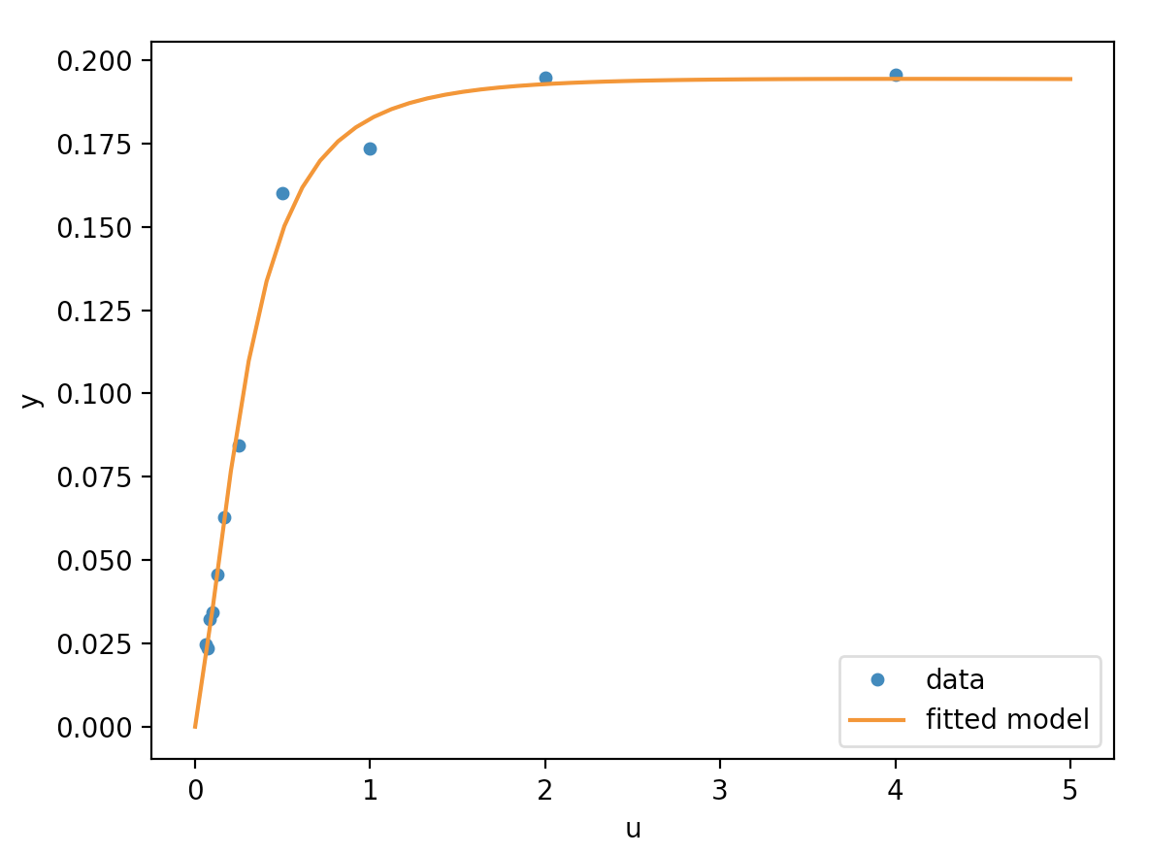
scipy.optimize
There are many optimization algorithms in scipy.optimize
What is least squares? (code not as relevant as the concept)
https://www.youtube.com/watch?v=yMgFHbjbAW8
from scipy.optimize import least_squares
import numpy as np
def model(x, u):
return x[0] * (u ** 2 + x[1] * u) / (u ** 2 + x[2] * u + x[3])
def fun(x, u, y):
return model(x, u) - y
def jac(x, u, y):
J = np.empty((u.size, x.size))
den = u ** 2 + x[2] * u + x[3]
num = u ** 2 + x[1] * u
J[:, 0] = num / den
J[:, 1] = x[0] * u / den
J[:, 2] = -x[0] * num * u / den ** 2
J[:, 3] = -x[0] * num / den ** 2
return J u = np.array([4.0, 2.0, 1.0, 5.0e-1, 2.5e-1, 1.67e-1, 1.25e-1, 1.0e-1, 8.33e-2, 7.14e-2, 6.25e-2])
y = np.array([1.957e-1, 1.947e-1, 1.735e-1, 1.6e-1, 8.44e-2, 6.27e-2, 4.56e-2, 3.42e-2, 3.23e-2, 2.35e-2, 2.46e-2])
x0 = np.array([2.5, 3.9, 4.15, 3.9])
res = least_squares(fun, x0, jac=jac, bounds=(0, 100), args=(u, y), verbose=1)
# `ftol` termination condition is satisfied.
# Function evaluations 130, initial cost 4.4383e+00, final cost 1.5375e-04, first-order optimality 4.92e-08.
print(res.x) import matplotlib.pyplot as plt
u_test = np.linspace(0, 5)
y_test = model(res.x, u_test)
plt.plot(u, y, 'o', markersize=4, label='data')
plt.plot(u_test, y_test, label='fitted model')
plt.xlabel("u")
plt.ylabel("y")
plt.legend(loc='lower right')
plt.show()

Slide 29
scipy.sparse
Introduction
scipy.cluster
scipy.constants
scipy.fftpack
scipy.integrate
scipy.interpolate
scipy.linalg
scipy.optimize
scipy.sparse
scipy.stats

Slide 30
scipy.sparse
To generate 2D sparse matrices
The scipy.sparse package is great for times where we have a large matrix with very few items entered (It doesn’t make sense to store a huge matrix with all zeros or NAs)
There are various types of sparse matrices. Two most common are:
csr_matrix – Compressed Sparse Row Matrix
csc_matrix – Compressed Sparse Column Matrix
>>> mtx = sparse.csr_matrix((3, 4), dtype=np.int8)
>>> mtx.todense() # Output is a matrix, not 2-D array
Matrix([0,0,0,0],
[0,0,0,0]
[0,0,0,0]])

Slide 31
scipy.sparse
Example: To fill in a csr_matrix:
>>> from scipy.sparse import csr_matrix
>>> import numpy as np
>>> data = np.array([1,2,3])
>>> rows = np.array([1,1,0])
>>> cols = np.array([0,2,2])
>>> mtx1 = csr_matrix((data, (rows, cols)), shape = (8,15))
>>> print(mtx1.toarray())
[[0 0 3 0 0 0 0 0 0 0 0 0 0 0 0]
[1 0 2 0 0 0 0 0 0 0 0 0 0 0 0]
[0 0 0 0 0 0 0 0 0 0 0 0 0 0 0]
[0 0 0 0 0 0 0 0 0 0 0 0 0 0 0]
[0 0 0 0 0 0 0 0 0 0 0 0 0 0 0]
[0 0 0 0 0 0 0 0 0 0 0 0 0 0 0]]

Slide 32
scipy.stats
Introduction
scipy.cluster
scipy.constants
scipy.fftpack
scipy.integrate
scipy.interpolate
scipy.linalg
scipy.optimize
scipy.sparse
scipy.stats

Slide 33
scipy.stats
There are various functions under scipy.stats to perform basic statistical funcitons such as those in the table
Function | Description
describe() | Computes several descriptive stats for the data
gmean() | Computes geometric mean along the specified axis
hmean() | Computes harmonic mean along the specified axis
kurtosis() | Computes kurtosis
mode() | Computes modal value
iqr() | Computes the IQR of the data along the specified axis
zscore() | Computes zscore of each value relative to the sample eman and standard deviation

Slide 34

Review

