Slide 1
Gensim
Gensim Intro
Building Vectors
Topic Modeling

Slide 2
Lesson Objectives
Learn about how to build Vectors

Slide 3
Gensim Intro
➔ Gensim intro
Section 2
Section 3

Slide 4
About Gensim
Gensim is an open-source Python package for topic modeling in Python
Open source
Great for modeling, machine learning, ad-hoc analytics

Slide 5
Vectorization
Why Gensim
➔ Vectorization
Topic Modeling

Slide 6
Vectorization
Natural langauge needs to be converted into a vector
A vector is some number of dimensions with numeric values
Natural language typicallly has a large number of dimensions.
Vectors Are Numeric

Slide 7
TF-IDF
"Term Frequency, Inverse Document Frequency"
It is a way to score the importance of words (or "terms") in a document based on how frequently they appear across multiple documents
Basic algorithm
If a word appears frequently in a document, it's important. Give the word a high score
But if a word appears in many documents, it's not a unique identifier. Give the word a low score.
Common words like "the" and "for", which appear in many documents, will be scaled down.
Words that appear frequently in a single document will be scaled up

Slide 8
Document Frequency
How many times a word occurs in a document
Document 1 : the brown dog likes the white cow
Document 2 : the grass is brown
Document 3 : the spotted cow likes green grass
 | brown | cow | dog | grass | green | is | likes | spotted | the | white
d1 (7) | 1 | 1 | 1 | 0 | 0 | 1 | 1 | 0 | 2 | 1
d2 (4) | 1 | 0 | 0 | 1 | 0 | 1 | 0 | 0 | 1 | 0
d3 (6) | 0 | 1 | 0 | 1 | 1 | 0 | 1 | 1 | 1 | 0

Slide 9
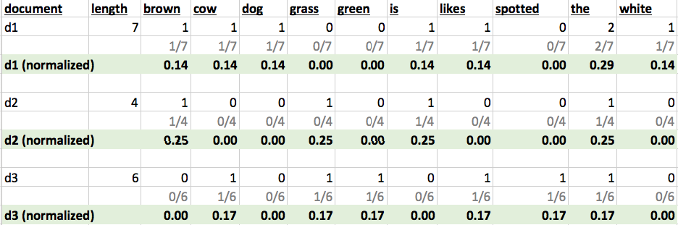
Term Frequency (TF)
A term would appear more times in a lengthier document
To normalize, divide the term count by total number of words in document
Number of times term 't' appears in a document
TF(t) = ----------------------------------------------
Total number of terms in the document
Notes:
Source : tf-idf.xls

Slide 10
Inverse Document Frequency (IDF)
IDF measures how important a term is
When computing TF (previous slide), all terms are considered equally important
How ever terms like 'the' and 'of' (stop words) may appear a lot of times, but have little importance.
We need to weigh down frequent terms, and scale up rare ones
We use logarithmic scale to get reasonable numbers
total number of documents
IDF(t) = log_e ( --------------------------------------- )
number of documents with term 't' in it

Slide 11
IDF Example
Number of words in document 1 | 100
The word 'cat' appears in document1 | 3 times
TF (cat) in document 1 | 3/100 = 0.03
Total number of documents in corpus | 1 million
Number of documents with 'cat' | 1000
IDF (cat) | LN (1,000,000/1000) = 6.91
TF-IDF (cat in document 1) | 0.03 * 6.91 = 0.21
Notes:
Source : http://www.tfidf.com/

Slide 12
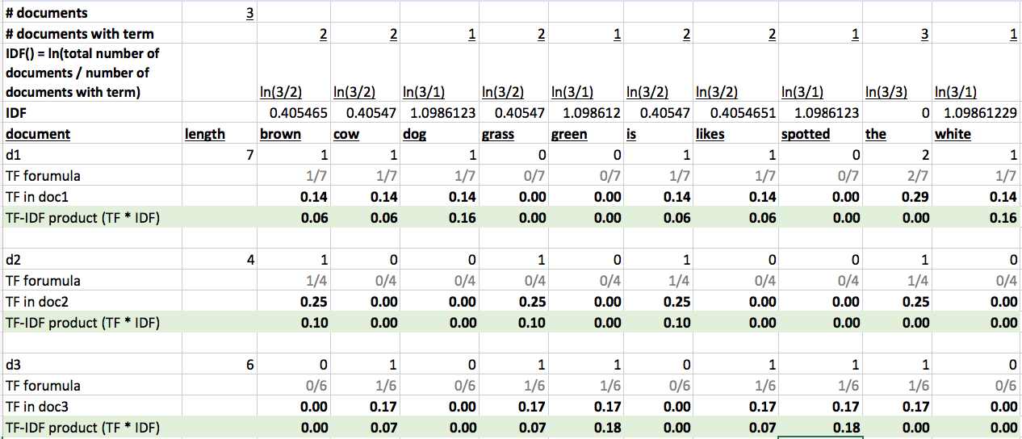
TF-IDF Example
Document 1 : the brown dog likes the white cow
Document 2 : the grass is brown
Document 3 : the spotted cow likes green grass
You can play with the excel spreadsheet

Slide 13
TF-IDF Example
Document 1 : the brown dog likes the white cow
Document 2 : the grass is brown
Document 3 : the spotted cow likes green grass
term | d1 | d2 | d3 | Document rank
brown | 0.06 | 0.10 | 0 | d2, d1
cow | 0.06 | 0 | 0.07 | d3, d1
dog | 0.16 | 0 | 0 | d1
grass | 0 | 0.10 | 0.07 | d2, d3
green | 0 | 0 | 0.18 | d3
is | 0.06 | 0.10 | 0 | d2
likes | 0.06 | 0 | 0.07 | d3, d1
spotted | 0 | 0 | 0.18 | d3
the | 0 | 0 | 0 | All zero
white | 0.16 | 0 | 0 | d1

Slide 14
Document Term Matrix (DTM)
DTM is a matrix - describes how terms appear in documents
Rows correspond to documents
Columns correspond to terms
It will be a sparse matrix (not all terms occur on all documents)
Libraries need to represent sparse matrix in memory-efficient manner
Terms → ← documents | brown | dog | black | cat
doc1 | x | x
doc2 |  |  | x | x

Slide 15
Term Document Matrix (TDM)
TDM is transposed DTM
Rows correspond to terms
Columns correspond to documents
Documents→ ← Terms | doc1 | doc2 | doc3
brown | x
dog | x
black |  | x
cat |  | x

Slide 16
Latent Semantic Analysis (LSA)
Extension of DTM
A Means of reducing dimensions on DTM
Uses SVD on DTM in order to get a lower dimensional representation

Slide 17
Word2Vec and Doc2Vec
Word2Vec:
Came out of Google
A deep neural network that transforms NLP data into vectors.
Trained on large multi-petabyte training corpora
Takes each individual word as input – can lead to large numbers of dimensions for large documents.
Doc2Vec:
Word2Vec takes each individual word as input, Doc2Vec takes enteire document as input.

Slide 18
Topic Modeling
Why Gensim
Vectorization
➔ Topic Modeling

Slide 19
What’s wrong with TF-IDF/ Word2Vec
Very high dimensionality (thousands – millions of dimensions!
Doesn’t really look at the relationship between documents in corpus.

Slide 20
Topic Modeling
Unsupervised Machine Learning Method
Finding n-grams that give clusters of documents coherence.
What are the key terms / n-grams that identify a cluster of documents?

Slide 21
Identity Matrix

