Slide 1
Python Intro
Introduction
Installing Python
Python Versions
IDEs
Jupyter Notebook

Slide 2
Lesson Objectives
Learn about Python
Learn “The Zen of Python”
Learn about Python 2.x vs Python 3.x
Python IDEs
Jupyter Notebook.

Slide 3
Introduction
Introduction
Installing Python
Python Versions
IDEs
Jupyter Notebook

Slide 4
About Python
Python is a general-purpose, object-oriented, dynamic programming language
Python is also language & environment for data science computing and graphics
Open source
Rich ecosystem (lots of libraries)
Great for modeling, machine learning, ad-hoc analytics
Used by app developers, web developers, but also popular among scientists and now data scientists

Slide 5
Why Python
Comprehensive
Pretty much any development can be done in Python
State-of-the-art graphics capabilities
Because picture IS worth a thousands words
Designed for interactive analysis
Most analysis is done this way
No time consuming edit / compile / run cycle
Can support scripting too
Open source
Commercial packages costs thousands

Slide 6
Why Python
Python can import from variety of formats (csv, excel, db, …)
Python is extensible
Thousands of libraries in PyPi (open source)
Python usually gets ‘bleeding edge’ routines before other commercial packages!!
Power of open source
Free IDEs (Spyder, Pycharm) are available
Easy to use / program
Runs on multiple platforms (Mac, Windows, Linux)

Slide 7
The Zen of Python
Beautiful is better than ugly.
Explicit is better than implicit.
Simple is better than complex.
Complex is better than complicated.
Flat is better than nested.
Sparse is better than dense.
Readability counts.
Special cases aren't special enough to break the rules.
Although practicality beats purity.
Errors should never pass silently.
Unless explicitly silenced.
In the face of ambiguity, refuse the temptation to guess.
There should be one -- and preferably only one -- obvious way to do it.
Although that way may not be obvious at first unless you're Dutch.
Now is better than never.
Although never is often better than *right* now.
If the implementation is hard to explain, it's a bad idea.
If the implementation is easy to explain, it may be a good idea.
Namespaces are one honking great idea -- let's do more of those!

Slide 8
Python History
Created By Guido Von Rossom in 1991
Designed as an alternative to ”scripting languages” like PERL
Fully OOP (Object Oriented Programming)
Dynamically Typed Language
“Duck Typing” – if it walks like a duck..
Automatic type conversion
JIT (Just in Time)
Code compiles and runs in real time
No compile – package – deploy – cycle
REPL Shell
Real time shell for analysis.
Notes:
The language was called Python because of Guido’s fascination with the Monty Python TV show. Python’s association with snakes gave rise to snake-like names, such as Anaconda.

Slide 9
Python Versus R
Python | R
General Purpose Language | Specialized for Statistics and Analytics
Object-Oriented Approach | Mixed Paradigm: Procedural/Functional
Large Package Repository: PyPI | Huge Package Repository; CRAN
Dynamic Language | Dynamic Language
Uses various editors, IDEs | Rstudio is highly integrated IDE for R
Favored by Computer Scientists | Favored By Statisticians
Summary: General Purpose Language now used widely in analytics | Summary: Specialized Language for Statistical Programming now used widely in analytics

Slide 10
Python Versus Java
Python | Java
Dynamically Typed Language | Statically Typed Language
Interactive REPL Shell | No REPL
Can’t build dependencies into object | Can build dependencies into a FAT JAR.
Good for interactive analytics | Good for “productionizing” analytics.
Relatively slow | Faster (but not as fast as native code).
Interpreted (from bytecode) | Usually JIT compiled.

Slide 11
Python vs Javascript/Node
 | Python | Javascript
Typing | Dynamic | Dynamic
Code Execution | Interpreted from Bytecode | V8: Interpreted from Bytecode
Runs client-side code in browser | No | Yes
Runs server side code | Yes | Yes (using node.js)
Standard Library | Extensive | Minimalistic
Package Management | via pip | via npm
Code Legibility | Generally good | Can be very unreadable
Native Code | Usually use native code in packages | Not common.
Summary | Good for science, data science, AI/machine learning, data munging | Good for web services and back-end for web development

Slide 12
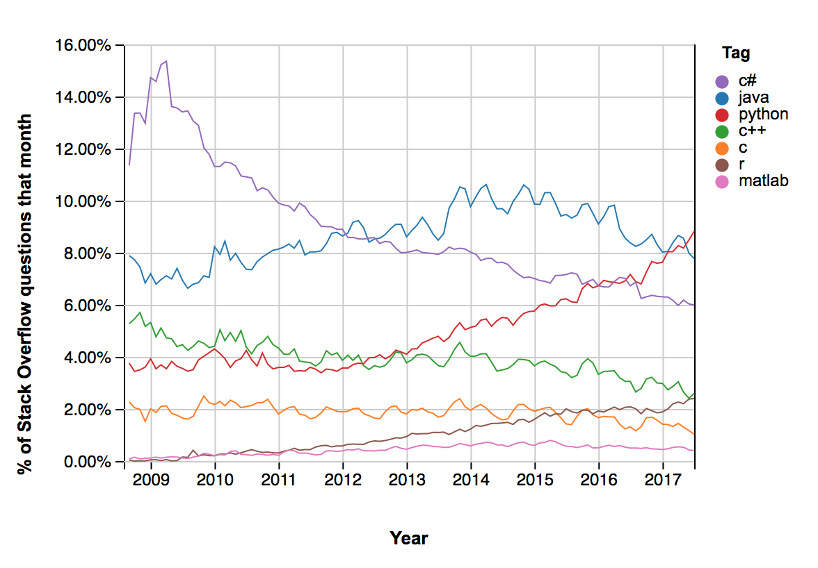
Python Popularity
Python Most popular language in 2018 on Stack Overflow
(Other than Javascript)

Slide 13
Python Use Cases
Who uses Python?
Python is very commonly used in the following areas:
Web Programming
Microservices
System Automation Tasks
Scientific Programming
Data Analysis / Data Science
Machine Learning and AI

Slide 14
Is Python Interpreted?
Standard Python (CPython) is byte-code interpreted
This means it will first just-in-time (JIT) compile the code to bytecode. (.pyc code)
Then, it will interpret (rather than compile) the bytecode
This allows for dynamic code and environment.
Cython (C + Python) is compiled much like C/C++
Cython will first translate the Python code into C/C++
It will then combine that code with custom C/C++ code
It will then compile it into native code.

Slide 15
Is Python Fast?
Pure python code is fairly slow
Faster than purely interpreted languages (LISP, Smalltalk, shell scripts)
But slower than managed languages like Java, .NET
And much slower than pure native code like C/C++/Fortran.
Python does allow users to write native code
Python integrates with C, C++, Fortran, etc.
Typically performance sensitive code is written in native code (usually C/C++)
Cython compiler: allows you to mix C, C++ and python code
Native code is Fast!
Write Native code (C/C++) for performance sensitive parts,
Everything else, pure python! Much easier

Slide 16
Installing Python
Recommend downloading Anaconda from Continuum Analytics.
Download Free version (Ananaconda Distribution)
http://www.anaconda.com/download
Anaconda
Python runtime

Slide 17
Why Anaconda?
Anaconda has hundreds of the most commonly used DS packages already built!
No need for C/C++ compilers
Good for Windows Users! (Hard to build on Windows)
Easy to Install Bundle
Platform Native bundling (MSI: Windows, DMG: Mac, etc)
Commercially Available Support
Good for Enterprise Users
Easy for IT Services to “Certify” entire distribution including packages
Separate from System Python
Anaconda is separate from your system python
So it won’t break anything else you may be doing on your machine in Python

Slide 18
Do I really need Anaconda?
No, using your system python is fine (if you have one)
Most Mac and Linux users already have Python
However, it may not be the latest version
On Linux, python 3.x is often called python3
You may want to use ”virtualenv” to create a virtual environment for your data science work
You will have to download and install your own packages as-needed

Slide 19
Lab: Install Anaconda
Lab
Overview: Install Anaconda for Python 3.x
Approximate time: 10 mins
Instructions: 01-helloworld /

Slide 20
Python Console
We can also use Python from console
Though Spyder is a much better interface
$ python
# now we are in Python shell
>>> help
# exit
>>> quit() # or control-D

Slide 21
Getting Started With Python REPL (Lab)
Lab: 01-helloworld/1.1-REPL.md
# prints to screen
print("hello world")
# create variables (= and = are equivalent)
a = 10
b = 3.1
c = "hello world"

Slide 22
Running Python
To run Python, we can just run the from the command line.
$ nano myprogram.py
#!/usr/env/python3
print(”Hello World!”)
$ python myprogram.py
Hello World!

Slide 23
Lab: Run a Script
Lab
Overview: Quick intro to running a script.
Approximate time: 10 mins
Instructions: 01-helloworld / 1.2-Script.md

Slide 24
Python Versions
Introduction
Installing Python
Python Versions
IDEs
Jupyter Notebook

Slide 25
Python Versions
Python v1.x : Not used, (1994-2000)
Python v.2.x: Still Used! (2000-2007+)
Still some older libraries are Python 2.x only
Lots of older legacy code
Most new features back-ported into Python 2.x
Python x.3.x: Current Version(2007-Present)
Most new features
Most libraries support python 3 now.

Slide 26
Python 2 vs Python 3 Incompatibilities
 | Python 2 | Python 3
print semantics | Statement: print x #no paren | Built-in function Print(x) #note parens
input vs raw_input() | input() evaluates input as code. raw_input returns data as string() | Input() returns data as string – there is no raw_input.
Map | returns list | Returns iterator
reduce | Statement in base namespace | Built-in function in functools namespace
Annotations | Specified annotation only | User-defined annotations
Unicode | separate “str” (ascii) vs ”unicode” types | All strings are internally stored as Unicode.
Integer Division | 5 / 2 = 2 | 5 / 2 = 2.5 #float convert 5 // 2 = 2 #note the //
Native Code (C/C++) | API differs | API differs

Slide 27
Should you use Python 2 or Python 3?
You should use python 2 only if you have the following;
You inherit a large codebase of legacy python 2 code.
You need a python package that only supports python 2.
(These are becoming increasingly rare).
The community will continue to support Python 2 indefinitely.
But new features will always show up in Python 3 first.
Python 3 is the future (and present) of Python.
New development done here.

Slide 28
IDEs
Introduction
Installing Python
Python Versions
IDEs
Jupyter Notebook

Slide 29
IDEs
Python Has Many IDEs
We will discuss some common ones:
Spyder
PyCharm
PyDev
Visual Studio Code
Sublime Text / Other Text Editors.

Slide 30
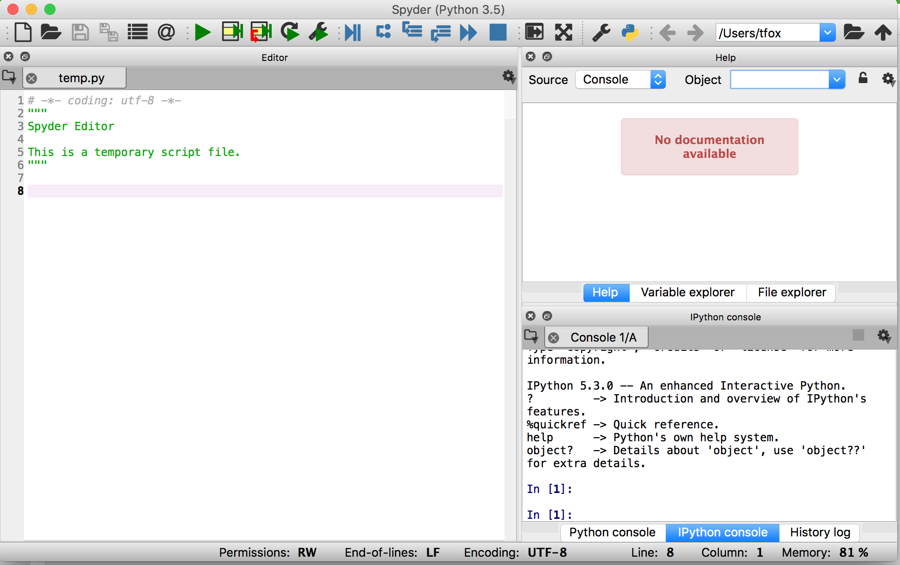
Spyder
Rstudio-like IDE for data science and scientific programming
Lightweight
Included with Anaconda

Slide 31
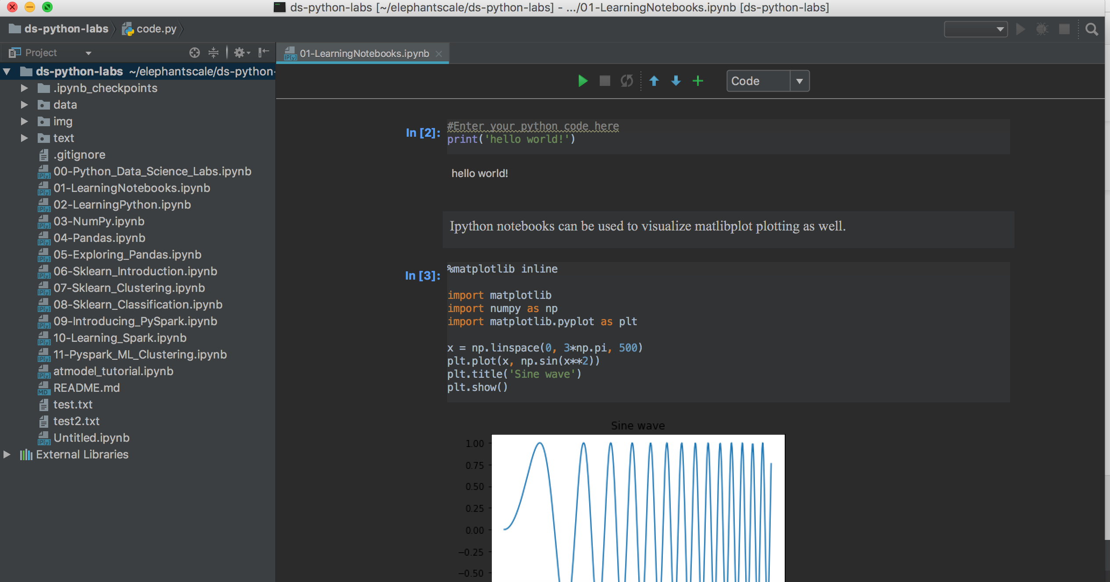
Pycharm
There are many other IDEs:
Example: PyCharm from JetBrains
Pretty Heavyweight

Slide 32
PyDev / Eclipse
PyDev is an extension to eclipse

Slide 33
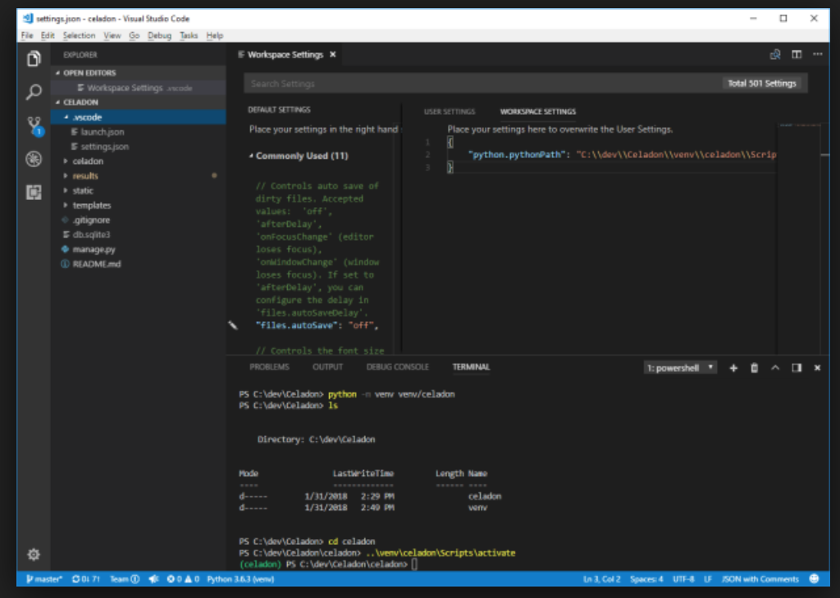
Visual Studio Code
For all the Microsoft Fans out there:
Surprisingly lightweight, but fully-featured IDE!

Slide 34
Other options
Some just like text editors
Vi(m)
Sublime Text
Advantages:
Lightweight and agile
Fast
Limited interactive debugging / breakpoints

Slide 35
Lab: Introducing Spyder
Lab
Overview: Quick intro lab to Spyder IDE
Approximate time: 10 mins
Instructions: 01-helloworld / 1.3-Spyder.md

Slide 36
Jupyter Notebook
Introduction
Installing Python
Python Versions
IDEs
Jupyter Notebook

Slide 37
Jupyter Notebooks
Jupyter notebooks are a great way to showcase working python code.
Jupyter Notebooks allow us to combine:
Text
HTML / Images
Visualizations
Runnable Python Code
Document Centric View
We do jupyter notebooks in this class!
NOT an IDE.
Good for exploratory data analysis
Showcasing code

Slide 38
Using Jupyter Notebooks
Go to directory and type jupyter notebook
$ cd /path/to/my/notebooks
$ jupyter notebook
[I 22:28:59.637 NotebookApp] The Jupyter Notebook is running at: http://localhost:8888/?token=YOURTOKEN
[I 22:28:59.637 NotebookApp] Use Control-C to stop this server and shut down all kernels (twice to skip confirmation).
[C 22:28:59.639 NotebookApp] Copy/paste this URL into
your browser when you connect for the first time, to login with a token: http://localhost:8888/?token=YOURTOKEN

Slide 39
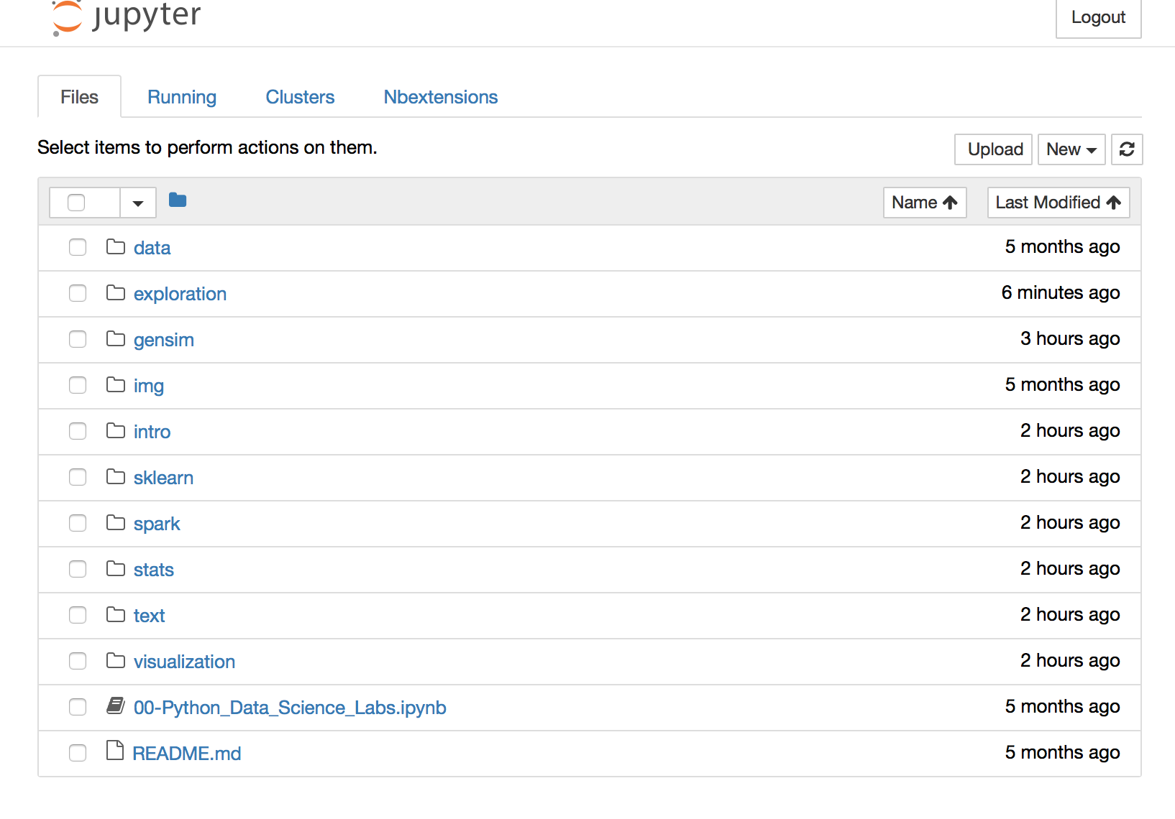
Browser for Jupyter Notebook

Slide 40
Lab: Running Jupyter
Lab
Overview: Run Jupyter Notebook
Approximate time: 10 mins
Instructions: 02-notebooks / 2.1-install-jupyter.md

Slide 41
Lab: Introducing Notebooks
Lab
Overview: Quick intro lab to Jupyter Notebook
Approximate time: 10 mins
Instructions: 02-notebooks / 2.2-LearningNotebooks.ipynb

