Slide 1
Python : Visualization
Pandas Visualizaiton
Matplotlib
Seaborn
ggplot

Slide 2
Lesson Objectives
Learn about Python Visualization
Many different packages and options.

Slide 3
Pandas Visualization
➔ Pandas
Matplotlib
Seaborn
ggplot

Slide 4
Pandas Visualization
Pandas has built–in visualization.
Basically aliases similar functionality in matplotlib
Good for representing plots of dataframes
Can do things like add labels, etc through matplotlib.pyplot

Slide 5
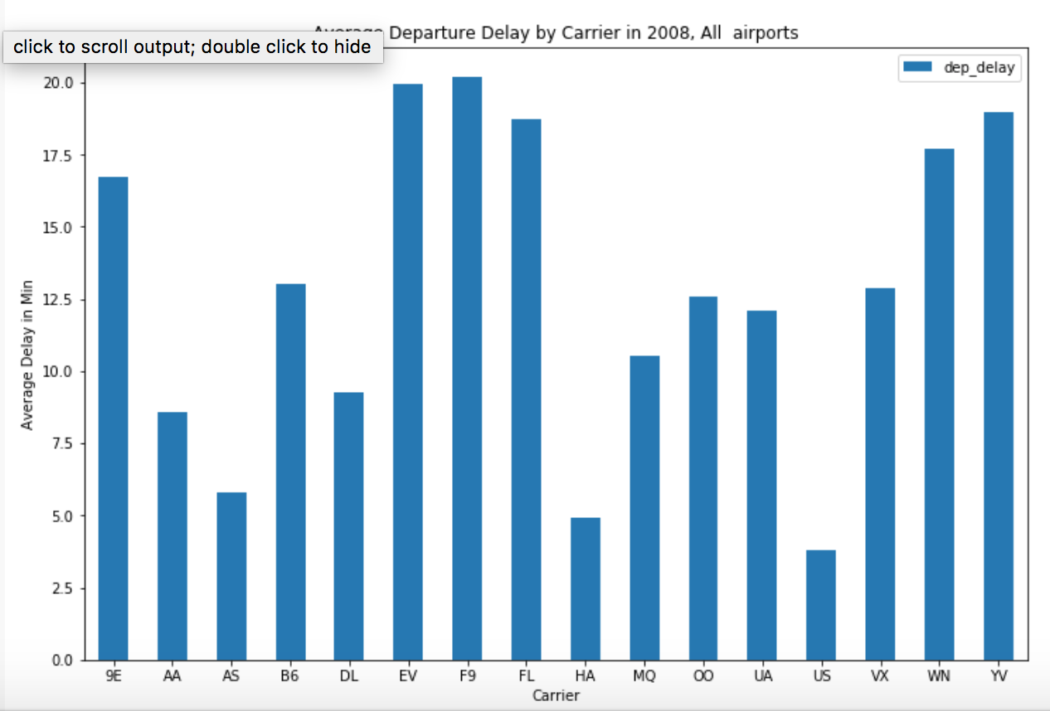
Pandas Bar plot
df.groupby('carrier').mean().plot(kind='bar', figsize =(12,8))
plt.xticks(rotation=0)
plt.xlabel('Carrier’)
plt.ylabel(‘Delay’)
plt.title('Average Arrival Delay')

Slide 6
Matplotlib
➔ Matplotlib
Seaborn
ggplot2

Slide 7
Matplotlib
Matplotlib is python’s native plotting library
Powerful, with lots of options
Not necessarily focused on aesthetics
Import like this:
To show inside jupyter
Saving to file
import matplotlib.pyplot as plt
%matplotlib inline%
plt.savefig(‘test.png’)

Slide 8
Performing and Showing plot
Call plot on the items you want to plot
You can show the plot in a external window:
plt.plot(x, y) # Pass in ndarrays that you want to plot
plt.show()

Slide 9
Plot labels and options
plt.xlabel : Label on x-axis
plt.ylabel : Label on y-axis
plt.title : Title on plot
plt.grid = true # Start grid

Slide 10
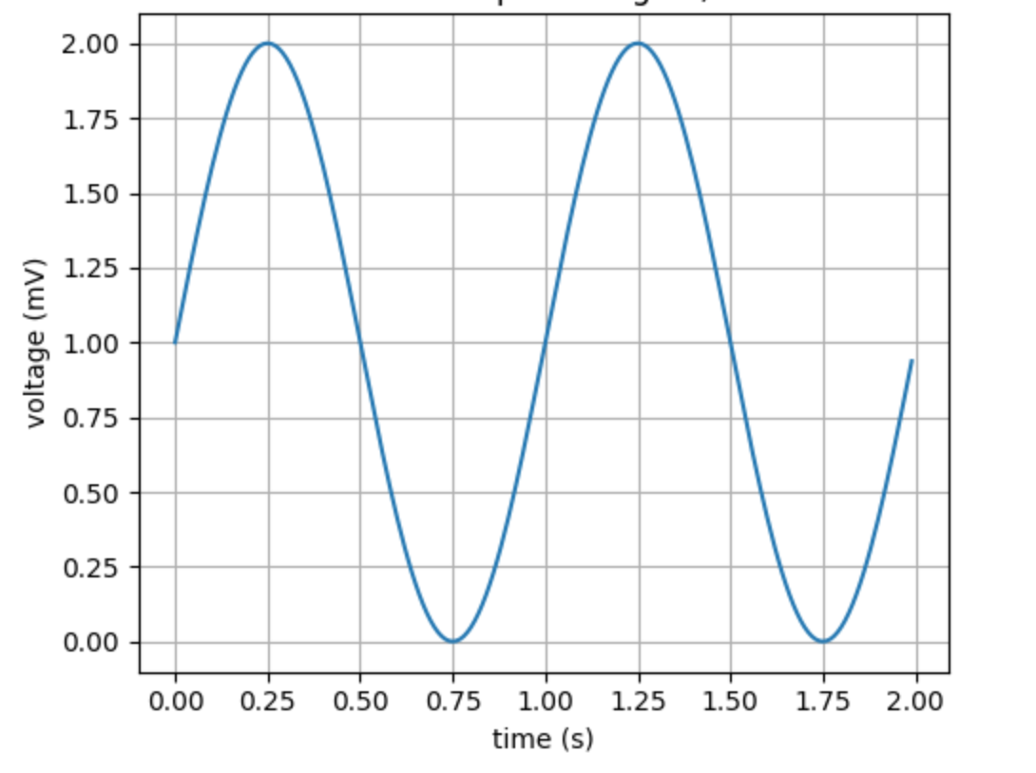
Matplotlib Simple Example
t = np.arange(0.0, 2.0, 0.01)
s = 1 + np.sin(2*np.pi*t)
plt.plot(t, s)
plt.xlabel('time (s)’)
plt.ylabel('voltage (mV)’)
plt.title(‘Sine wave’)
plt.grid(True)
plt.savefig("test.png")

Slide 11
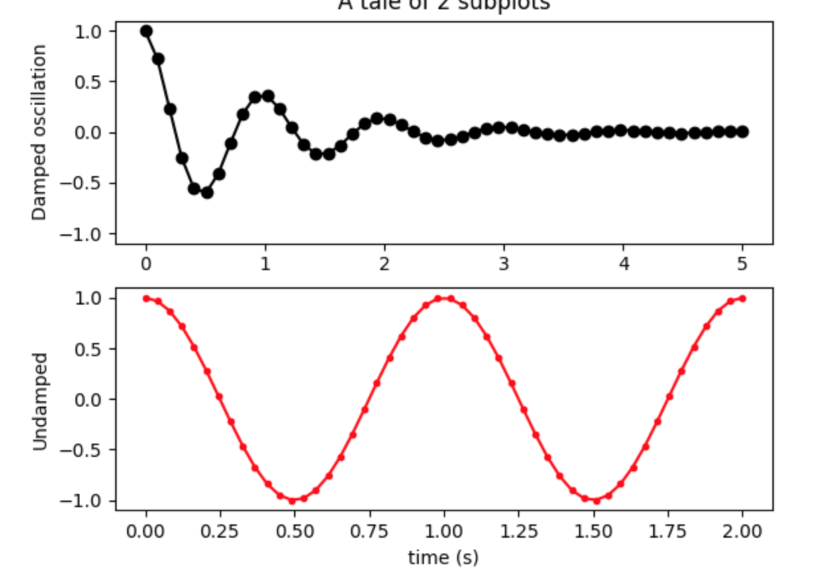
Matplotlib subplots
Matplotlib allows us to create subplots
# Create two subplots sharing y axis
fig, (ax1, ax2) = plt.subplots(2, sharey=True)
ax1.plot(x1, y1, 'ko-')
ax2.plot(x2, y2, 'r.-')
ax2.set(xlabel='time (s)', ylabel='Undamped')

Slide 12
Figure Versus Axes
The figure object is the entire plot
Typically used if we want to save the figure
The axes represent the plots
We can have more than one (subplots)
Here’s how we get one:
More than one (subplots)
import matplotlib.pyplot as plt
fig,ax = plt.subplots() # Just one plot
import matplotlib.pyplot as plt
fig, (ax1,ax2) = plt.subplots(2) #Two subplots

Slide 13
Seaborn
Pandas
Matplotlib
➔ Seaborn
ggplot

Slide 14
Seaborn: pretty graphs
Matplotlib graphs are powerful but not very beautiful.
Seaborn makes some pretty plots
Based on Matplotlib
Allows a number of aesthetic parametres.

Slide 15
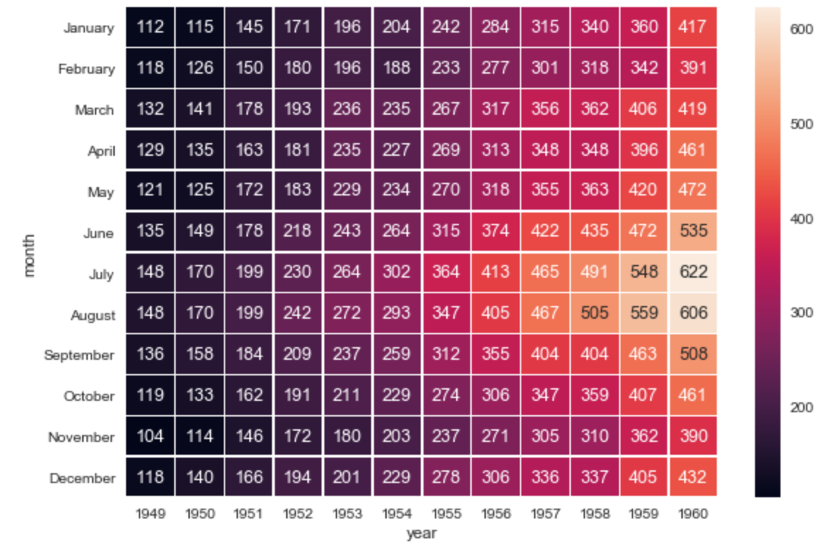
Seaborn Heatmap
import matplotlib.pyplot as plt
import seaborn as sns
sns.set()
f, ax = plt.subplots(figsize=(9, 6))
sns.heatmap(flights, annot=True, fmt="d", linewidths=.5, ax=ax)

Slide 16
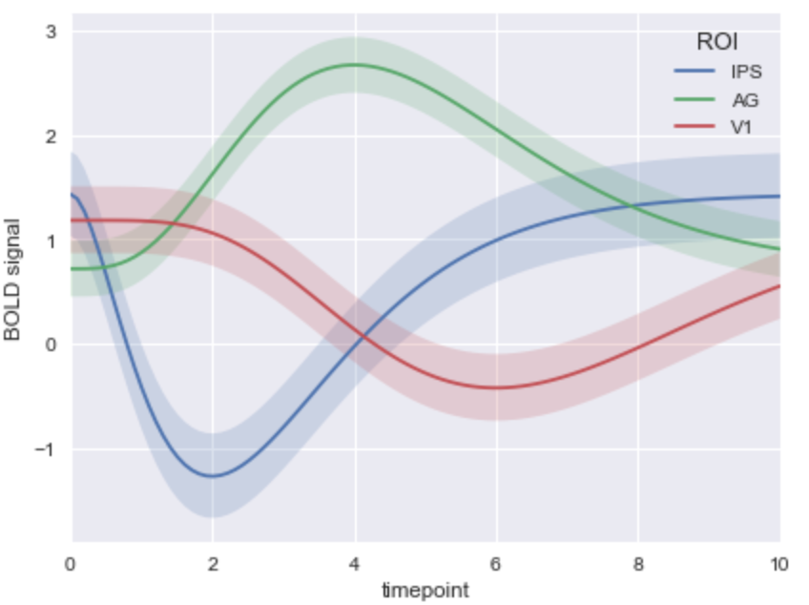
Seaborn time series plot
# Plot the response with standard error
sns.tsplot(data=gammas, time="timepoint", unit="subject”
condition="ROI", value="BOLD signal")

Slide 17
ggplot
Pandas
Matplotlib
Seaborn
➔ ggplot

Slide 18
ggplot
ggplot package is a very popular graphics package
Based on ggplot2 package in R
Provides very readable graphics
Has a ‘grammar’ to describe graph
Excels at graphing complex data sets
Mastering ggplot can be ‘challenging’ ☺
Recommended book : “ggplot2: Elegant Graphics for Data Analysis”
http://www.ling.upenn.edu/~joseff/rstudy/summer2010_ggplot2_intro.html

Slide 19
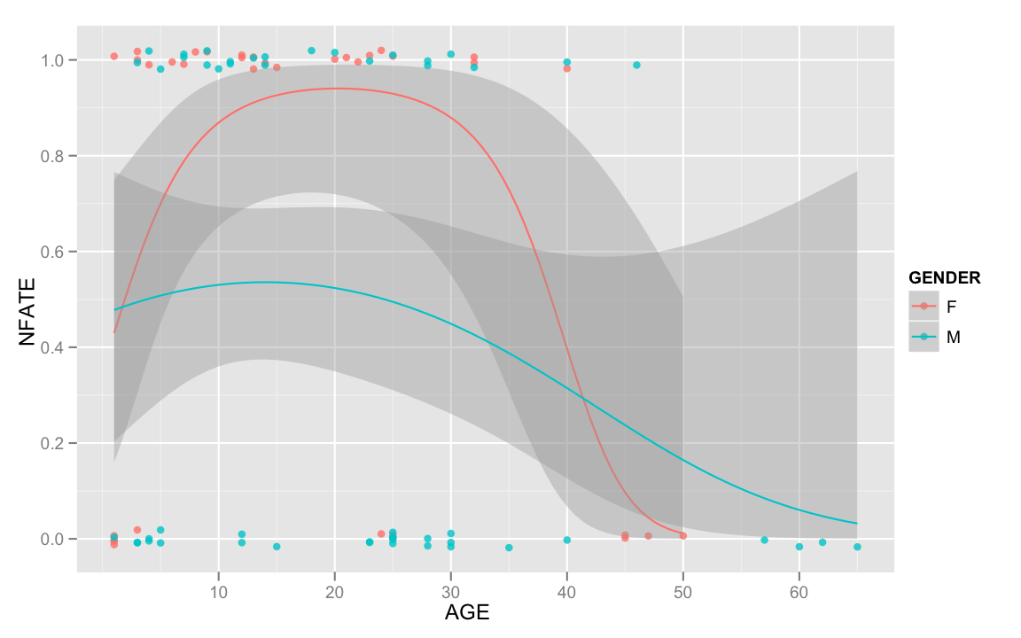
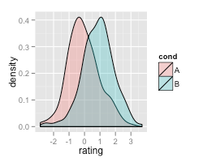
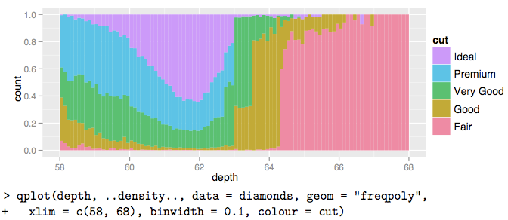
ggplot examples

Slide 20
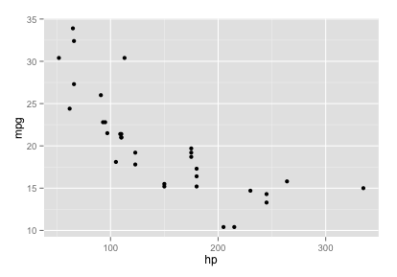
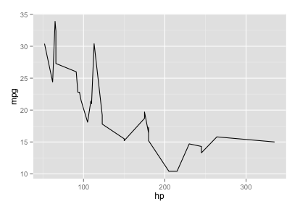
ggplot Quick Example
import ggplot ggplot(mtcars, aes(hp, mpg)) # Error: No layers in plot
# add a layer ggplot(mtcars, aes(hp, mpg)) + geom_point() # try a different layer ☺ ggplot(mtcars, aes(hp, mpg)) + geom_line()

Slide 21
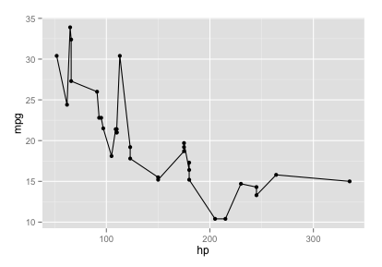
ggplot Quick Example: Layers
g = ggplot(mtcars, aes(hp, mpg)) g # Error: no layers
# add a layer g = g + geom_point() g # wow!
# add another layer g = g + geom_line() g # ☺

Slide 22
ggplot Syntax
ggplot (data, aesthetics, layers)
Data: data frame, vector, etc.
Aesthetics (aes)
Maps how elements get converted to graph
X position / x-y position / shape / color
Layers
Geometric shapes
Points / lines / bars

Slide 23
Lab: Graphs / ggplot-qplot
Lab
Overview: Exploring graphing with Python
Approximate time: 30 minutes
Instructions :
9.3-ggplot1.md (qplot)
9.4-ggplot2.md (ggplot)

Slide 24
Lab: Graphs / ggplot-qplot
Lab
Overview: Exploring graphing with Python
Approximate time: 30 minutes
Instructions :
9.3-ggplot1.md (qplot)
9.4-ggplot2.md (ggplot)

Slide 25
Statistical Graphs
Pandas
Matplotlib
Seaborn
Ggplot
Examples
Statistical Graphs

Slide 26
Visualizing Data
Method | Description
Boxplot | A quick way to visualize the data
Frequency table | Count number of data points that fall into intervals (bins)
histogram | Plot of frequency table
Density plot | Smoothed version of histogram. (Kernel Density Estimate)

Slide 27
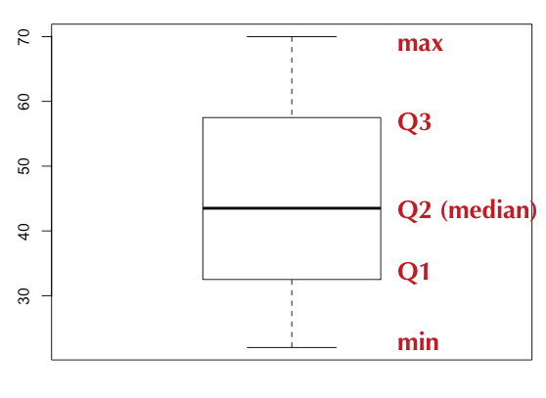
Boxplot / Box-and-Whisker Plot
Boxplot displays 5 measures : min, Q1, Q2 (median), Q3, max
Smallest / Largest values are measured within upper/lower fences
Fences are 1.5 times IQR
Income data (sorted): [22k, 25k, 30k, 35k, 40k, 42k, 45k, 50k, 55k, 60k, 65k, 70k]

Slide 28
BoxPlot : Sample Code (R)
income = c(22, 25, 30, 35, 40, 42, 45, 50, 55, 60, 65, 70)
bp = boxplot(income)
bp
$stats
[,1]
[1,] 22.0
[2,] 32.5
[3,] 43.5
[4,] 57.5
[5,] 70.0
$n
12

Slide 29
BoxPlot : Sample Code (Python)
%matplotlib inline import numpy as np import matplotlib.pyplot as plt salaries = np.array([22, 25, 30, 35, 40, 42, 45, 50, 55, 60, 65, 70]) plt.boxplot(salaries)

Slide 30
Histogram (R)
Histogram counts data points per bin
income = c(22, 25, 30, 35, 40, 42, 45, 50, 55, 60, 65, 70)
hist(income)

Slide 31
Histogram (Python)
Histogram counts data points per bin
%matplotlib inline import pandas as pd import numpy as np import matplotlib.pyplot as plt salaries = np.array([22, 25, 30, 35, 40, 42, 45, 50, 55, 60, 65, 70]) plt.hist(salaries, rwidth=0.7)

Slide 32
Scatter Plot (Python)
Histogram counts data points per bin
%matplotlib inline import numpy as np import matplotlib.pyplot as plt bills = np.array([50,30,60,40,65,20,10,15,25,35]) tips= np.array([12,7,13,8,15,5,2,2,3,4]) plt.xlabel("bill amount") plt.ylabel("tip") plt.scatter(bills, tips)

Slide 33
Examples
Pandas
Matplotlib
Seaborn
Ggplot
Statistics
Examples

Slide 34
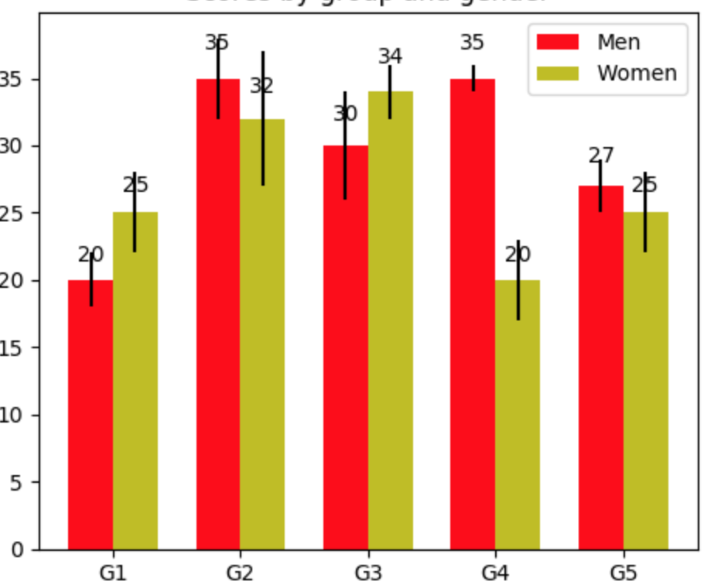
Bar Plots: Matplotlib
Example of a barplot
fig, ax = plt.subplots()
rects1 = ax.bar(ind, men_means, width, color='r’,yerr=men_std)
rects2 = ax.bar(ind + width, women_means, width, color='y’, yerr=women_std)
# add some text for labels, title and axes ticks
ax.set_xticks(ind + width / 2)
ax.legend((rects1[0], rects2[0]), ('Men', 'Women'))

Slide 35
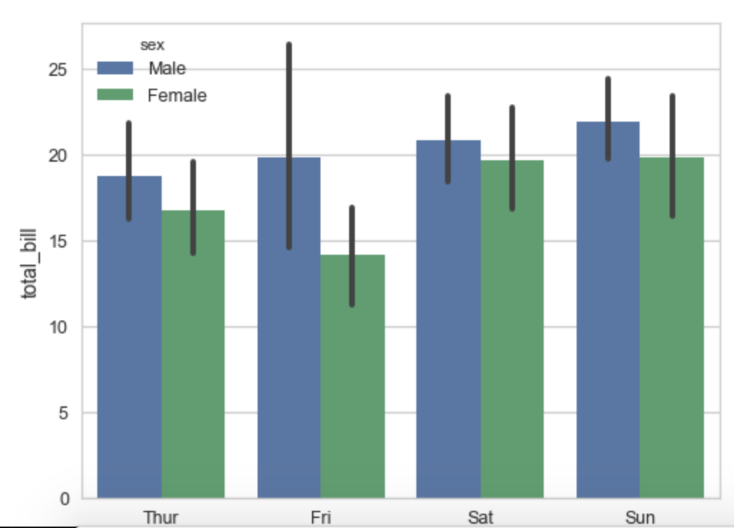
Barplot: Seaborn
Seaborn is easier!
ax = sns.barplot(x="day", y="total_bill", hue="sex", data=tips)

