Slide 1
SOUTHERN WATER CORP. Q4 SURJEK PLANT MAINTENANCE PROPOSAL by Tim Fujisaki

Slide 2
The Surjek plant’s operational inefficiencies have resulted in a disproportionately high expense total in order to maintain desalinization production. Despite contributing nearly 46% of the company’s annual revenue, Surjek only contributes 20% in annual profit. Quarter-long maintenance is required to return Surjek to normal profitability.
Maintenance during Q4 would retain the best-case-scenario 78% or $157.7million of Surjek’s total annual revenue.

Slide 3
EXECUTIVE SUMMARY
KEY INSIGHTS
Why Surjek?
1. HIGHEST EXPENSE TOTAL: 56% of SWC’s annual expenses, while contributing 46% in annual revenue.
2. LOWEST PROFIT MARGIN: Surjek’s 11%, Jutik 45%, Kootha 28%.
3. HIGHEST PRODUCTION COST per ML: $54.23 per mL is almost as much as Kootha and Jutik combined.
Why Q4?
1. HIGHEST QUARTERLY EXPENSE TOTAL:
Q4 is 29% of Surjek’s annual total, 4% higher than Q1
2. HIGHEST PRODUCTION COST: $72.81 per mL which is 53% higher than Q1 at $47.68, and 32% higher than the lowest Q2 at $44.66.
3. 2nd LOWEST QUARTERLY MARKET PRICE: $74.40/mL, 12% lower than highest Q1 $84.84
4. LOWEST QUARTERLY DEMAND:
2219 ml, which is 2% lower than 1st place Q1.
5. RETAINED EARNINGS: Q4 maintenance would retain the best-case-scenario $29,884,988.55 gross profit(25.85% of SWC annual total) and the highest annual profit margins, 19% Surjek and 31% for SWC.
Notes:
Why SURJEK?
-Highest annual Expense bill
-Highest Desalinisation Cost
-Lowest profit contribution
-Worst Profit margin
-Only plant with a Quarterly Net Loss
REVENUE EXPENSES PROFIT DESALINISATION/ml
JUTIK $163.6m / 37% $90.7m / 28% $72.9m / 63% $35.80/ml
KOOTHA $70.9m / 16% $51.2m / 16% $19.7m / 17% $25.00/ml
SURJEK $202.2m / 46% $179.3m / 56% $22.9m / 20% $54.23/ml
Highest Retained
Retained Rev Lost Rev SAVED EXPENSES PROFIT
Q3 Outage $154m (76%) of $202m $48m $39m / 11% $13.7m / 11.83%
Q4 Outage $157.5m (78%) of $202m $44.5m $51,5m / 15% $29.9m / 25.85%
Q1 Outage $141.5m (70%) of $202m $60.5m $45.5m / 13% $7.8m / 6.77%
Q2 Outage $153m of (76%) $202m $49m $43.5m / 13% $17.4m / 15.07%
-Annual Profit Margin
Q1 Outage Q2 Outage Q3 Outage Q4 Outage
Surjek Annual 6% 11% 9% 19%
Collective Annual 27% 28% 27% 31%
Current Profit Margin
Q1 Q2 Q3 Q4 Annual
JUTIK 49% 45% 40% 44% 45%
KOOTHA 36% 9% 29% 34% 28%
SURJEK 25% 11% 19% -16% 11%

Slide 4
WHY SURJEK? – Expenses & Profit Margin
KEY INSIGHT:
HIGHEST EXPENSE TOTAL: 56% of SWC’s annual expenses, while contributing 46% in annual revenue.
PROFIT MARGIN
JUTIK
KOOTHA
SURJEK
45%
28%
11%
Notes:
Expenses consist of:
Plant Outages (002)
Plant Op. Costs (003)
Plant Admin Costs (004)
Labour-Costs (001)):

Slide 5
WHY SURJEK? – Highest Desalinization Production Costs
KEY INSIGHT:
3. HIGHEST PRODUCTION COST per ML: $54.23 per mL is almost as much as Kootha and Jutik combined.
COST TO PRODUCE
KOOTHA $25.00/mL
JUTIK $35.80/mL
SURJEK $54.23/mL
Notes:
DESAL COST TO PRODUCE PER PLANT - ANNUAL - FROM REAL DATA
Kootha Jutik surjek
exp $51.2 million $ 90.7 million $179.3millon
Prod 2040 mL 2534 mL 3307 mL
DESAL OVERALL $25.00 $35.80 $54.23

Slide 6
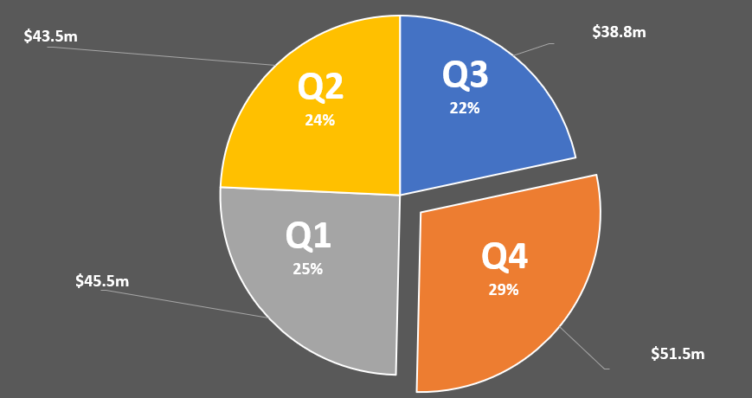
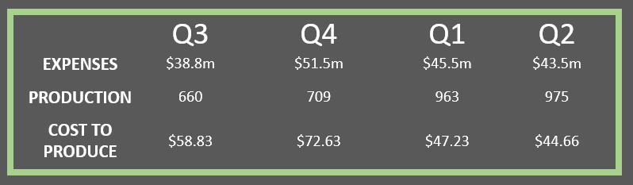
WHY QUARTER 4? – Expenses & Production Costs
KEY INSIGHT:
HIGHEST PRODUCTION COST: $73 per mL which is 53% higher than Q1 at $48, and 32% higher than the lowest Q2 at $45.
Notes:
5. Highest Production Cost/ML: Q4 has the highest average Desalinization cost to produce $72.81 which is 53% higher than Q1 at $47.68

Slide 7
WHY QUARTER 4? – Market Conditions
KEY INSIGHT:
2nd LOWEST AVERAGE QUARTERLY PRICE: $74.40/mL, 12% lower than highest Q1 $84.84
LOWEST QUARTERLY DEMAND: 2219 ml, which is 2% lower than 1st place Q1.
Notes:
DEMAND: Q4 has the lowest Average Quarterly Water Demand Per Trading Period at 2219.03ml, which is 2% lower than 1st place Q1
MARKET PRICE: Low Market Price: Q4 has the 2nd lowest Average Quarterly Price Per Trading Period at $74.40, which is 12% lower than Q1 which has the highest price.

Slide 8
WHY QUARTER 4? – Highest Retained Earnings
KEY INSIGHT:
Q4 maintenance would retain the best-case-scenario $29.9 Million gross profit (26% of SWC annual total) and the highest annual profit margins, 19% Surjek and 31% for SWC.
RETAINED REVENUE LOST REV SAVED EXPENSES PROFIT % of SWC
Q3 Outage $154m (76%) of $202m $48m $39m (11%) $13.7m 11.83%
Q4 Outage $157.5m (78%) of $202m $44.5m $51.5m (15%) $29.9m 25.85%
Q1 Outage $141.5m (70%) of $202m $60.5m $45.5m (13%) $7.8m 6.77%
Q2 Outage $153m of (76%) $202m $49m $43.5m (13%) $17.4m 15.07%
Notes:
Overall, electing to perform maintenance during Q4 would result in a 78% or $157,707,855.47 retained annual revenue, 8% or $16,032,195.43 more than if Q1 was selected
In other words, Q4 would result in the lowest reduction in annual revenue at 22% or $44,547,493.70, 8% better than a Q1 outage, which would result in a 30% or $60,579,689.13 annual reduction.

Slide 9
SUMMARY
REVIEW
-Surjek, consumes 56% of SWC’s annual expenses while contributing 46% of the company’s annual revenue, and only contributes 20% in annual profit.
-Quarter-long maintenance is required to return Surjek to normal profitability, in line with Jutik and Kootha.
-Q4 would retain 78% Surjek’s total annual revenue.
NOTE:
-Product Differentiation: As studies have shown Soft water to be more elastic, we have investigated the possibility that Q4 maintenance could negatively affect the Soft water market. Since Surjek splits production 50/50 between Hard and Soft water throughout the year, there is no significant retractors from performing maintenance in Q4 versus other quarters.
MOVING FORWARD:
-The analytics teams strongly recommends Southern Water Corp management commit the necessary funds and preparations for quarter long maintenance during Q4.
-During the following Q1, the Analytics team will review the cost and production effectiveness of the maintenance process and produce a report for management to review.
-During this meeting next year(between Q2 and Q3) the analytics team will provide a follow up report including Q1 and Q2 post-maintenance in order to compare the profit margin.
Notes:
Overall, electing to perform maintenance during Q4 would result in a 78% or $157,707,855.47 retained annual revenue, 8% or $16,032,195.43 more than if Q1 was selected
In other words, Q4 would result in the lowest reduction in annual revenue at 22% or $44,547,493.70, 8% better than a Q1 outage, which would result in a 30% or $60,579,689.13 annual reduction.

Slide 10
1. Prepared to explain how to execute 2-3 times faster
-Not possible with the current maintenance personnel, equipment and funding. Commitment for quarter long maintenance from management is crucial.
2. What do you need from management?
-Commitment, budget.
3. What happens if we do nothing
Gradually increasing Maintenance
Highest volume unit will continue to produce at the lowest return rate
Continue to lose -$6,948,738.42 every Q4
4. How will our competitors react?
Competition will optimize their production in order to lower costs, lower prices and under cut the market below the Break-even point for Surjek.
Might run specials during Q4 to capitalize on market.
5. What is your opinion?
Q4 Maintenance must be confirmed immediately.
6. What are your assumptions
a. Quarterly maintenance costs will gradually continue to increase -> Cost to produce will gradually increase to Break-even point
b. Quarter long maintenance will greatly increase efficiency and lower production costs
c. Conditions contributing to a negative profit every Q4 will remain consistent
7. How will this help our customers and not just us?
Customers will be spared from the inevitable price increase once Surjek eclipses the break even point.
SOURCES: Springboard.com

