Slide 1

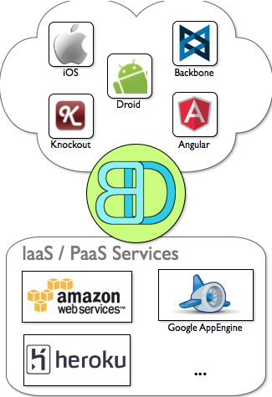
Big Data Framework
Ties front end frameworks to cloud infrastructure
Keeps application code in the apps
Shortens release cycles and time to market
Tools and conventions making Big Data easy
App developers write apps, we take care of the backend

Slide 2
Key Drivers
Mobile usage continues to grow
Mobile apps are connected, free or nearly so, and popular
Even moderately successful apps have huge traffic volumes
It's rapidly getting worse
Supporting these volumes is currently a large technical challenge
This is the basis of Big Data
http://www.kpcb.com/insights/2013-internet-trends

Slide 3


Current Landscape
Hadoop & R are the two major Big Data solutions
Both are low level technologies; expert-only systems
  Requires an advanced degree level of comprehension in either computer science (Hadoop) or statistics (R).
Last major technical innovation in this space was 10 years ago
No higher level framework currently exists to lower this barrier

Slide 4
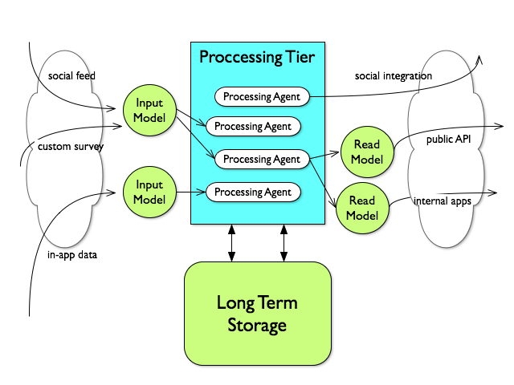
Technical Analysis
Big Data is all about performance
Three ways Big Data drags down performance:
Concurrency
Data volume
Data complexity
All solved using the same pattern
Split the data into task specific chunks
Optimize data storage for each task
Transform data between task specific storage models
Wash, rinse, repeat until performance is acceptable
Time & resource intensive process

Slide 5
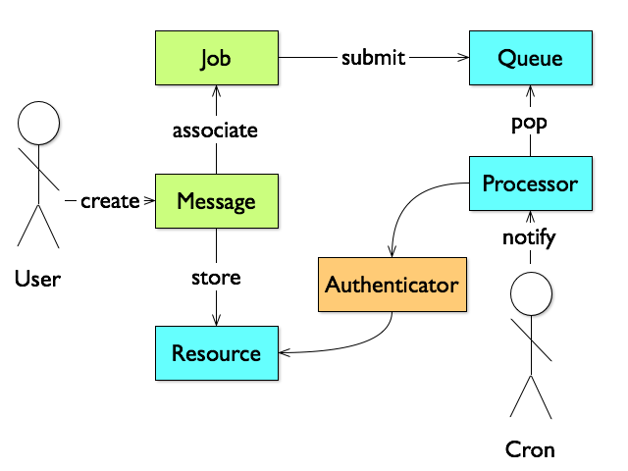
Solution
Develop a high level Big Data Framework
Integrate with major mobile & web technologies
Provide detailed howto documentation
  Search, shopping cart, video on demand, etc.
Apps begin life with task specific data models, performant from day one.
Significantly lowers Big Data's barrier to entry

Slide 6
Path Based Storage
Leverages highly scalable key/value storage
Large collections of data are spread over a search space
The search space is represented by a path
Paths are hierarchal; query higher up the path for a bigger chunk
Good for capturing training data from users for machine learning
App records a user's tap metadata at an input path:
/in/2014/02/19/13/10/24/N/34/1/16/W/118/23/44
Processed input is cascaded through a read path:
/suggestions/2014/02/19
/suggestions/2014/02/19/13
/suggestions/2014/02/19/13/10
/suggestions/2014/02/19/13/10/24
Another device can see what has happened in the last hour:
/suggestions/2014/02/19/13

Slide 7
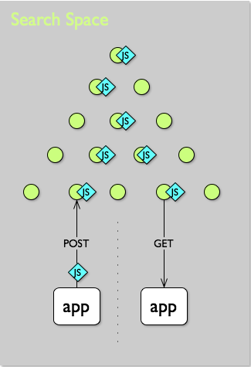
Behavior + Data
Hadoop and R both process data in batches
  Resembles a regression to a function/data design
Can lead to an unresponsive, error prone system
  Fully testing a batch job running for hours is impossible
Real Innovation:
Move processing out of the batch
Data events cascade updates through the search space
Move processing code into the app
Apps associate functional behavior in JavaScript when updating data

Slide 8

Big Data Wants You!
Looking for motivated and talented contributors
Offering highly visible, highly relevant work experience
Training on GitHub, issue tracking and other current best practices
Makes for a great resume addition
Professional references available for successful contributions
Development advice & support available for academic / freelance / personal projects using the Big Data Framework
Great alternative to larger, more competitive internship programs.

