Slide 1
Data Processing and Modeling Overview

Slide 2
Removed and Modified Features
Initial shape – 101,767 observations, 50 features
Weight – 97% missing, removed from analysis
Payer Code – 40% missing, removed
Admission type/source and disposition (release) type:
Numerically-coded columns; curated and condensed into categories
Removed patients who died in the hospital
Patient diagnosis codes:
Series of numeric codes XXX.xx. Converted these to categorical diagnosis types (respiratory, neurological, oncology, injury, etc)
24 medications – removed 7 with essentially no values.
Converted [‘No’, ‘Steady’, ‘Up’, ‘Down’] to [‘No’, ‘Yes’]
Is the patient taking this medication or not?

Slide 3
Feature Creation
Diabetic features:
Diabetic patient codes were 250.xx
Xx reveals additional info about the patient’s diabetes
250.1 – Diabetes with ketoacidosis
Categorized and dummified this information when available
Diabetic medicine change:
Since we converted medicine codes to a simple [Yes, No], created an extra feature, “diabchange”, indicating if the patient changed their dosage of any diabetic medication
Primary diagnosis:
Specified the primary diagnosis for which patient was admitted to the hospital

Slide 4
Removal of Train Set Observations
We have a middle group (returned >30 days to the hospital)
These are “No” values for our model, but can offer some information to the model
Base AUC with everything: ~0.6662
Removed them from the train set (TrainHL)
AUC: 0.6587
Performed linear regression on TrainHL, added
back only middle observations with linear predict<X
X = 1.0 – 0.6672
X = 0.75 – 0.6675 -- about 2% of observations removed
X = 0.5 – 0.6661
X = 0.25 – 0.6622
No return
=0
Return >30
Linear regression 0-1
Return <30
=1
Returns >30
Very similar to returns <30 removed from train set

Slide 5
Testing and Feature Selection
11% of observations were a “Yes” (patient readmitted < 30 days)
3 models used for hyperparameter tuning:
5 K-fold random hyperparameter search – AUC scoring
Logistic regression – C=0.1, class weights = 0.2/0.8
AUC = 0.668
Random forest – n_trees = 1000, min_samples_split=5, min_samples_leaf=1, max_features = ‘sqrt’, max_depth=60, class_weight=0.2/0.8
AUC = 0.671
XGBoost – n_trees = 500, min_child_wt=10, max_depth=5, gamma=5
AUC = 0.680

Slide 6
Model Stacking
AUC optimization – Mapping of true positive vs false positive rate over the range of possible probability threshholds (0.0 – 1.0)
AUC/F1 scores are better measurements of performance for rare classifiers than accuracy
Max accuracy is to essentially guess “No” for almost everything
Stacking – Grid search (i, j, k) 0:100
Represent percentages of LR, RF, XGB input
Max AUC score obtained with 56% XGB, 23% RF, 21% LR
AUC = 0.684
Used this stacked model to generate probability of return for each patient observation

Slide 7
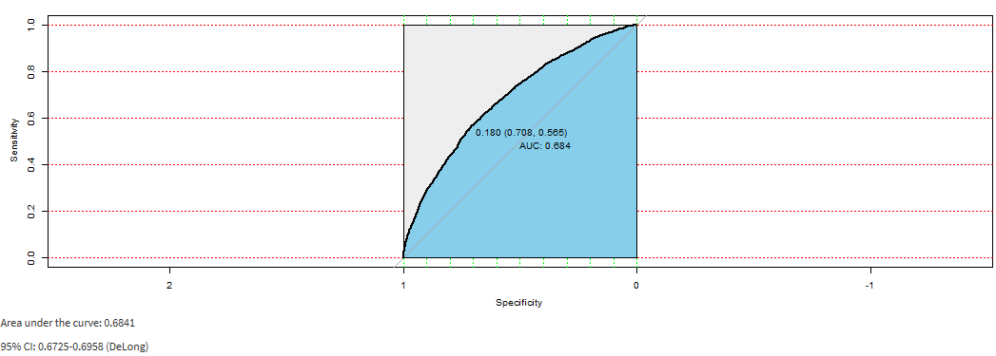
AUC – Visualization of true/false positive rates at different probability threshholds
- Decision about who to target for a possible readmission reduction plan will depend on various factors, including:
Resource availability, balance of true/false positives, possible downstream benefits

Slide 8
Flask Pipeline

Slide 9
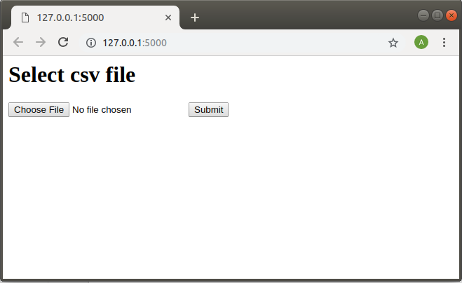
Pipeline
Input: a csv file with patient information
Output: the same csv file with the predictions for each patient and probability of patient being readmitted according to stacked model

Slide 10
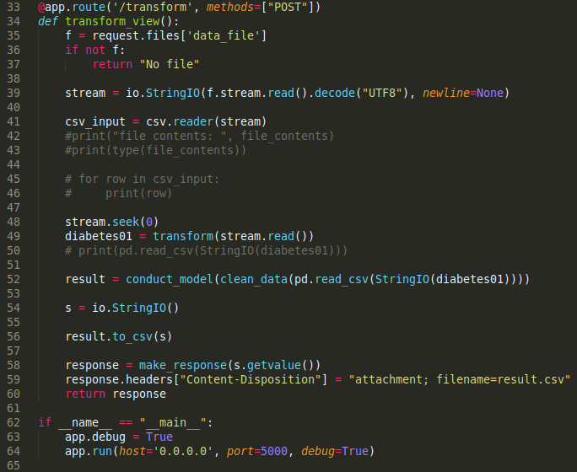
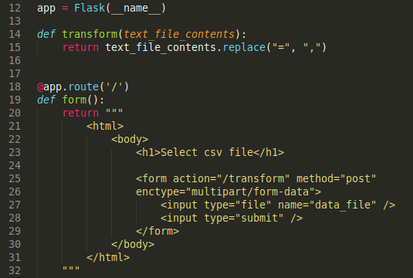
Flask code

Slide 11
Questions?

