Slide 1
Mobilizing your applications with Azure Search
Tim Gabrhel
Application Developer
Modern Applications

Slide 2
What’s the problem?
Data comes in a variety of
Technologies
Schemas
Geo Locations
Performance
Data is consumed by
Dashboards
Web
Mobile Clients

Slide 3
Full Text Search
In a full-text search, a search engine examines all of the words in every stored document as it tries to match search criteria (text specified by a user)
Full text searching is expensive
Varied implementations across systems
Aggregated results don’t convey the right meaning
Suggested Approach:
Index then Search

Slide 4

Azure Search
PaaS Service
Scalable
Full text Search
.NET & REST APIs
Push or Pull data into Search
OData Expression Syntax

Slide 5
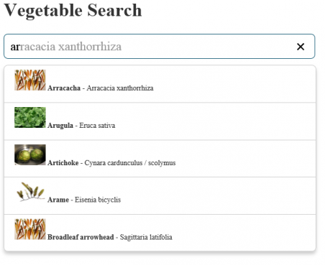
Features - Suggestions
Type ahead/autocomplete
Suggests terms matching input
Prefix & Infix matching

Slide 6
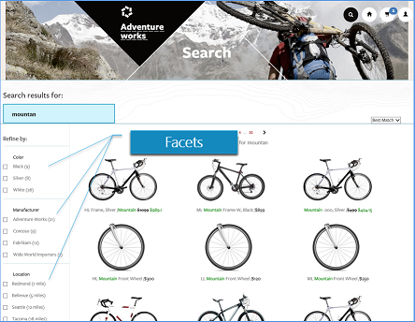
Features – Faceted Navigation
Drill down experience
Concise view of choices & count
Numeric facets provide range
Geospatial Filtering

Slide 7
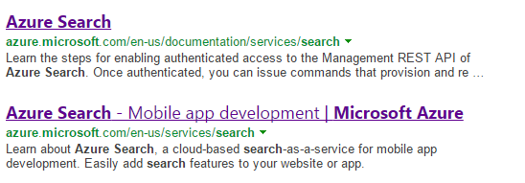
Features - Highlighting
Places emphasis on pattern that matches input
Assists user while eye scanning results

Slide 8
Features – Text Searches
Search Operators
+ AND wifi+luxury
| OR wifi|luxury
- NOT wifi –luxury
* Suffix lux*
“ Phrase “Roach Motel”
() Precedence model+(wifi|laundry)

Slide 9
Features – Filters
Odata Expressions with $filter
Logical and, or, not
Comparison eq, ne, gt, lt, ge, le
Collections any, all
Geospatial geo.distance, geo.intersects
Examples
$filter=baseRate lt 100.0 and rating ge 4
$filter=(category eq 'Luxury' or parkingIncluded eq true) and rating eq
$filter=parkingIncluded eq true and smokingAllowed eq false
$filter=hotelName ne 'Roach Motel' and lastRenovationDate ge 2010-01-01T00:00:00Z

Slide 10
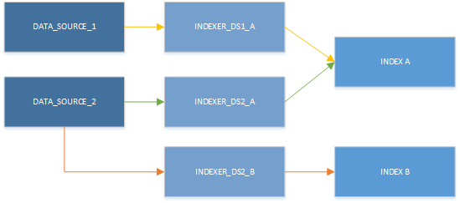
Indexers & Data sources (Pull Approach)
Indexer
Connects data sources with search indexes
Pulls from data sources
Sync: One time, scheduled, on demand
Data source
Azure SQL & DocumentDB
Reusable by multiple indexers

Slide 11





Demo Scenario
Process Tweets Web Job
Get Tweets Web Job
Search Service
Client Applications
Storage Queue

Slide 12
Demo - Create the Prerequisites
Storage Account
Twitter Developer Key
Get Tweets Job

Slide 13
Demo - Creating a Search Service
Create in the preview portal
Create Search Index
Process Tweets Job

Slide 14
Demo - Windows Client Application
Demo App
Create a Search Client with SDK
ViewModel
UI Controls

Slide 15
Additional Azure Search Points
HTTPS only
Authentication via API keys
Optional query-only keys
Search requests limited to 1 index

Slide 16
Advanced Concepts & Scenarios
Geospatial - https://photosynth.net/preview/map
Tag Boosting
Scoring System
Internal Only Fields
Scale – Replicas – Increase query performance
Scale – Partitions – Increase document capacity

Slide 17
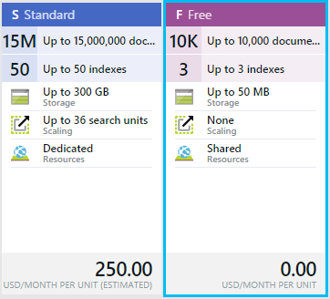
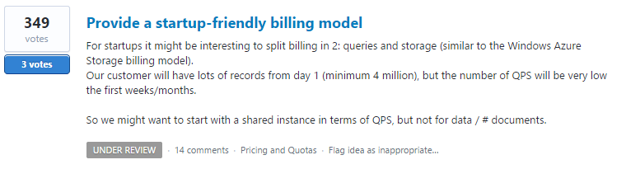
Pricing

Slide 18
Resources
OData Expressions - https://msdn.microsoft.com/en-us/library/azure/dn798921.aspx
Simple Query Syntax - https://msdn.microsoft.com/en-us/library/azure/dn798920.aspx
Suggestions - http://azure.microsoft.com/blog/2015/01/20/azure-search-how-to-add-suggestions-auto-complete-to-your-search-applications/
Scoring Profiles - http://azure.microsoft.com/en-us/documentation/articles/search-get-started-scoring-profiles/
Geospatial - http://channel9.msdn.com/Shows/Data-Exposed/Azure-Search-and-Geospatial-Data
Facets - http://azure.microsoft.com/en-us/documentation/articles/search-faceted-navigation/
Tag Boosting - http://azure.microsoft.com/blog/2015/02/05/personalizing-search-results-announcing-tag-boosting-in-azure-search
Filter Operators - https://msdn.microsoft.com/en-us/library/azure/dn798920.aspx
Data sources - https://msdn.microsoft.com/en-us/library/azure/dn946876.aspx
Azure Search User Voice - http://feedback.azure.com/forums/263029-azure-search
Azure Storage Queues - http://azure.microsoft.com/en-us/documentation/articles/storage-dotnet-how-to-use-queues/
Azure Web Jobs & Storage - http://azure.microsoft.com/en-us/documentation/articles/websites-dotnet-webjobs-sdk-storage-queues-how-to/
Azure Search .NET SDK - http://azure.microsoft.com/en-us/documentation/articles/search-howto-dotnet-sdk/
REST API - https://msdn.microsoft.com/en-us/library/azure/dn798935.aspx

Slide 19

Questions
Tim Gabrhel
Application Developer
tim.gabrhel@outlook.com
@timgabrhel
Fork it
https://github.com/timgabrhel/NewCC2015.AzureSearch

