Slide 1
Mobilizing your applications with Azure Search
Tim Gabrhel
Application Developer
Modern Applications

Slide 2
What’s the problem?
Data comes in a variety of
Technologies
Schemas
Geo Locations
Performance
Data is consumed by
Dashboards
Web
Mobile Clients
Notes:
Technologies
Database
SQL Server, MySql, Oracle, Access, Excel
Azure
Event Hubs, DocumentDB, SQL Azure, IoT devices (pushing to event hubs)
Schemas – Every system has their own data structure and format for like data
Geo Locations – Different systems in different data centers.
Performance – Above concerns lead to this

Slide 3
Full Text Search
In a full-text search, a search engine examines all of the words in every stored document as it tries to match search criteria (text specified by a user)
Full text searching is expensive
Varied implementations across systems
Aggregated results may not be accurate
Suggested Approach:
Index then Search
Notes:
Modern DBMS may handle efficiently
Variety of systems require variety of implementation
Not possible without application code for things like Excel
Reports that require calculations may be missing data unless you can get everything from all systems

Slide 4

Azure Search
PaaS Service
Scalable
Full text Search
Push or Pull data into Search
.NET SDK & REST APIs
OData Expression Syntax

Slide 5
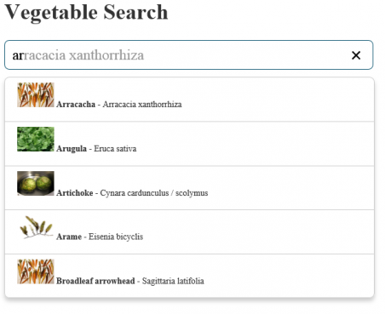
Features - Suggestions
Type ahead/autocomplete
Suggests terms and results matching input
Prefix & Infix matching
Fuzzy matching
Notes:
Prefix matches the beginning of a string, Infix matches expression inside of a string
Fuzzy matching will suggest results in case you have a misspelling, but can reduce performance

Slide 6
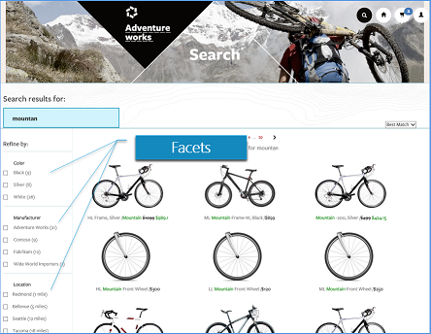
Features – Faceted Navigation
Drill down experience
Concise view of choices & count
Numeric facets provide range
Geospatial Filtering
Notes:
Geospatial Point/Polygon where a document is within a range
Geo functions are in kilometers

Slide 7
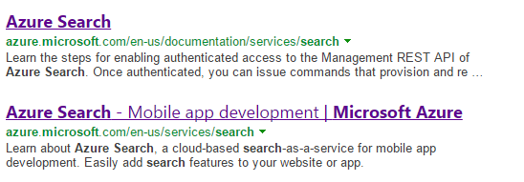
Features - Highlighting
Places emphasis on pattern that matches input
Assists user while eye scanning results
Supply custom pre & post fix characters around highlights
Notes:
Supply pre & post fix strings to be applied to each word in the result that matches the search.

Slide 8
Features – Text Searches
Search Operators
+ AND wifi+luxury
| OR wifi|luxury
- NOT wifi –luxury
* Suffix lux*
“ Phrase “Roach Motel”
() Precedence model+(wifi|laundry)

Slide 9
Features – Filters
Odata Expressions with $filter
Logical and, or, not
Comparison eq, ne, gt, lt, ge, le
Collections any, all
Geospatial geo.distance, geo.intersects
Examples – Hotel Search
$filter=baseRate lt 100.0 and rating ge 4
$filter=(category eq 'Luxury' or parkingIncluded eq true) and rating eq 3
$filter=parkingIncluded eq true and smokingAllowed eq false
$filter=hotelName ne 'Roach Motel' and lastRenovationDate ge 2010-01-01T00:00:00Z

Slide 10
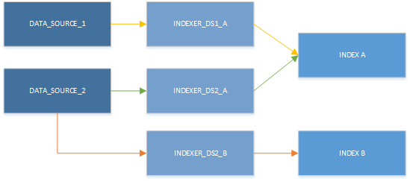
Indexers & Data sources (Pull Approach)
Indexer
Connects data sources with search indexes
Pulls from data sources
Sync: One time, scheduled, on demand
Data source
Azure SQL & DocumentDB
Reusable by multiple indexers

Slide 11





Demo Scenario
Process Tweets Web Job
Get Tweets Web Job
Search Service
Client Applications
Storage Queue
Notes:
Web job to get #MarchMadness tweets
Web job to process tweets into search
Windows 10 app to consume search

Slide 12
Demo - Create the Prerequisites
Storage Account
Twitter Developer Key
Get Tweets Job

Slide 13
Demo - Creating a Search Service
Create in the preview portal
Create Search Index
Process Tweets Job
Notes:
How to create
Show existing dashboard, index, schema, and suggesters.
Create Search index console app.

Slide 14
Demo - Windows Client Application
Demo App
Create a Search Client with SDK
ViewModel
UI Controls

Slide 15
Additional Azure Search Points
HTTPS only
Authentication via API keys
Optional query-only keys
Search requests limited to 1 index
Indexes non-modifiable once declared
Notes:
In the current release, any re-indexing operations require a complete rebuild of the index, which in turn deletes the data.

Slide 16
Advanced Concepts & Scenarios
Geospatial - https://photosynth.net/preview/map
Scoring
Internal Only Fields
Scale – Replicas – Increase query performance
Scale – Partitions – Increase document capacity
Notes:
Scoring = Relevance. Boost relevance based off of rules. “Last Updated within 30 days”

Slide 17
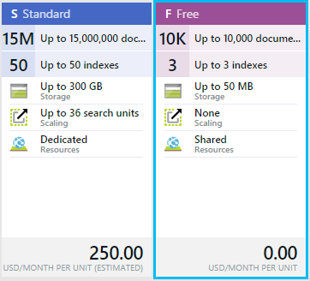
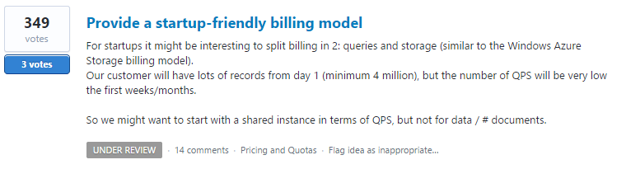
Pricing
Notes:
Cannot scale between free and standard

Slide 18

Questions
Tim Gabrhel
Application Developer
Modern Applications
tim.gabrhel@outlook.com
@timgabrhel
Fork it
https://github.com/timgabrhel/NewCC2015.AzureSearch

Slide 19
Resources
OData Expressions - https://msdn.microsoft.com/en-us/library/azure/dn798921.aspx
Simple Query Syntax - https://msdn.microsoft.com/en-us/library/azure/dn798920.aspx
Suggestions - http://azure.microsoft.com/blog/2015/01/20/azure-search-how-to-add-suggestions-auto-complete-to-your-search-applications/
Scoring Profiles - http://azure.microsoft.com/en-us/documentation/articles/search-get-started-scoring-profiles/
Geospatial - http://channel9.msdn.com/Shows/Data-Exposed/Azure-Search-and-Geospatial-Data
Facets - http://azure.microsoft.com/en-us/documentation/articles/search-faceted-navigation/
Tag Boosting - http://azure.microsoft.com/blog/2015/02/05/personalizing-search-results-announcing-tag-boosting-in-azure-search
Filter Operators - https://msdn.microsoft.com/en-us/library/azure/dn798920.aspx
Data sources - https://msdn.microsoft.com/en-us/library/azure/dn946876.aspx
Azure Search User Voice - http://feedback.azure.com/forums/263029-azure-search
Azure Storage Queues - http://azure.microsoft.com/en-us/documentation/articles/storage-dotnet-how-to-use-queues/
Azure Web Jobs & Storage - http://azure.microsoft.com/en-us/documentation/articles/websites-dotnet-webjobs-sdk-storage-queues-how-to/
Azure Search .NET SDK - http://azure.microsoft.com/en-us/documentation/articles/search-howto-dotnet-sdk/
REST API - https://msdn.microsoft.com/en-us/library/azure/dn798935.aspx

Slide 20
Thank you

