Slide 1


Welcome to Northeast WI Code Camp 2015!
#newcodecamp @newdug
Hosted by Northeast WI Developers User Group
Meets monthly on a variety of topics.
Sign up for our newsletter at NEWDUG.org!
Find us on LinkedIn.com
Like us on facebook.com/newdug
Follow us at twitter.com/newdug

Slide 2
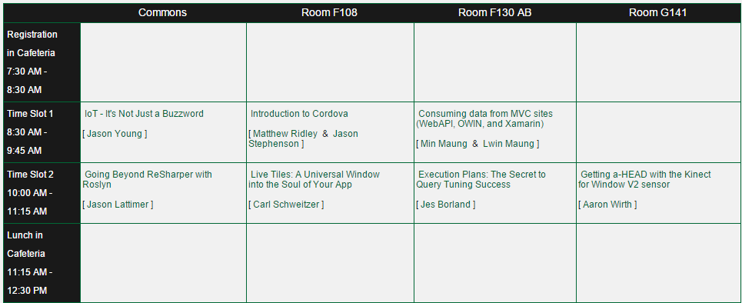
Morning Sessions

Slide 3
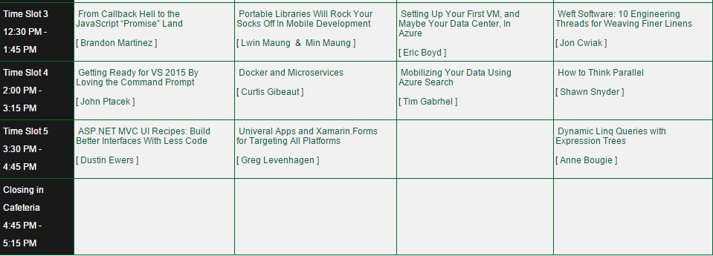
Afternoon Sessions

Slide 4

Platinum Sponsor
Thank our Platinum Sponsor by tweeting and following
@SkylineTweets

Slide 5




Bronze Sponsors
Media Sponsors

Slide 6


Community Sponsors
Professional Developer Conference
Summer Camp for Geeks
ThatConference.com
Kalahari Resort
Wisconsin Dells
August 10-12, 2015
Microsoft Developer Podcast
MSDevShow.com
Local Hosts:
Carl Schweitzer
Jason Young

Slide 7


August 10th – 12th 2015
Kalahari Resort, Wisconsin Dells
http://www.ThatConference.com

