Slide 1
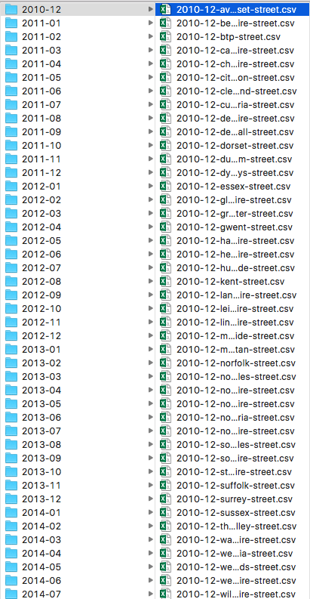
Spark
Collapse Data
62 folders (months) with ~50-150 datasets in each (45 police departments/constabularies with 1-3 types of data each)
About 6000 files
Hard to work with
Small files problem (<500k-3mb each)
Used Spark to collapse into 3 main files
Obtain counts by year/crime type/LAD
PySpark saved a lot of time
Especially with EMR v4.4

Slide 2
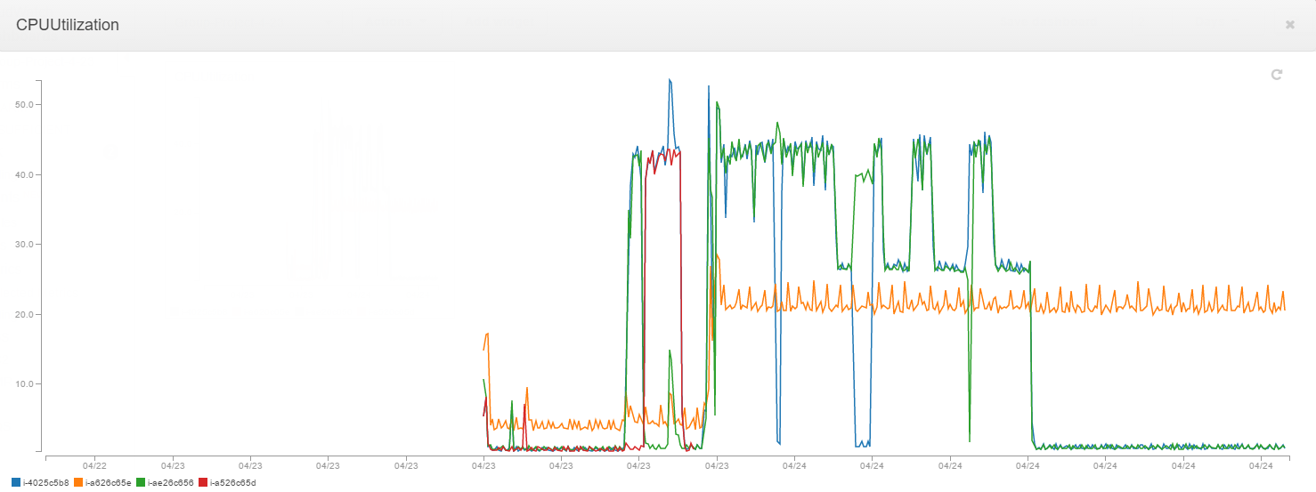
EMR 4.3 (Spark 1.6.0)
Spark
Nodes barely break 50% CPU utilization. Master node not pictured

Slide 3
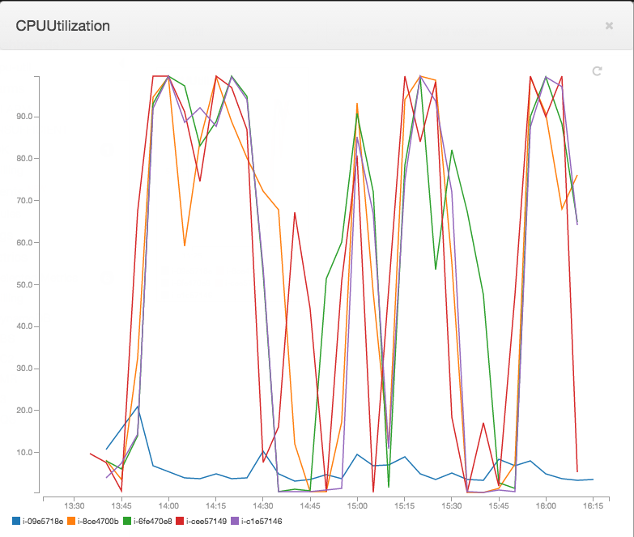
EMR 4.4 (Spark 1.6.0)
Spark
Most nodes over 90% CPU utilization most of the time. Master node shown in blue

