Slide 1
Hunt the Wumpus
Implemented using Python

Slide 2
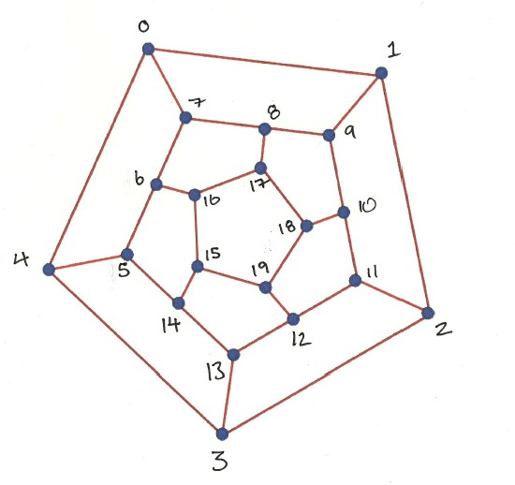
Cave Structure
Used a list of lists to store cave numbers and their links. Map out links at the start.
caves[0] = [1,4,7] & caves[0] = [0,2,9]
1st list contains cave ref
2nd list contains links
to that cave

Slide 3
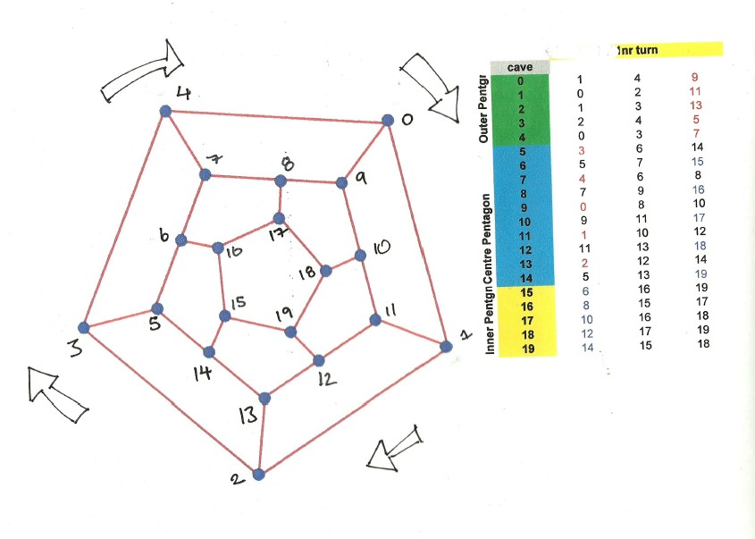
Randomly turn Pentagons to change links
Use unit testing to check algorithm works

Slide 4
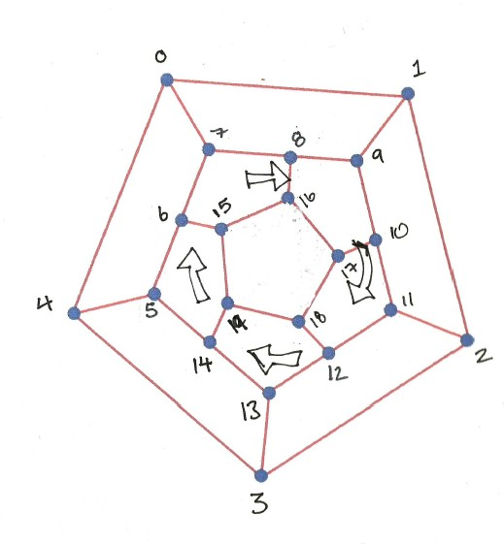
Algorithm to turn Pentagons
#turn outer pentagon clockwise and re-do links
def turn_outer_pent(caves):
#swaps points 0-4 on outer pent.
#c = place holder for 1st point to change
c = caves[0][2]
for i in range(0,4):
caves[i][2] = caves[i+1][2]
caves[4][2] = c
#swaps points 5,7,9,11,13 on centre pentagon
d = caves[13][0]
for i in range(13,5,-2):
caves[i][0] = caves[i -2][0]
caves[5][0] = d
return caves

Slide 5
Keep track of items in game
Use python lists to store Wumpus, bat and pit locations (in python lists == arrays)
Use python intersection method to compare two list sets
Make sure no item is placed in same cave position, as in each list is unique.
Write functions that update these lists based on game mechanics

Slide 6
Game Logic
Simple game loop that allows the player to continue as long as
1. not eaten by wumpus
2. still has arrows
3. not fallen in a pit
4. Wins game by killing wumpus

