Slide 1
Congressional District Snapshot
Ashwini Nadig, Carré Perkins, Thomas Hague, Tim Geraghty
THE TANKS
Notes:
Tim speaker
Intro Team
We developed a congressional; district snapshot

Slide 2
Objectives
Display relevant congressional district data to a potential candidate
Provide flexibility – adaptable to any district
Provide a more user friendly and informative data source than current options
Notes:
Tim speaker
Start with the end point in mind
Focuses on improvement vs defferent

Slide 3
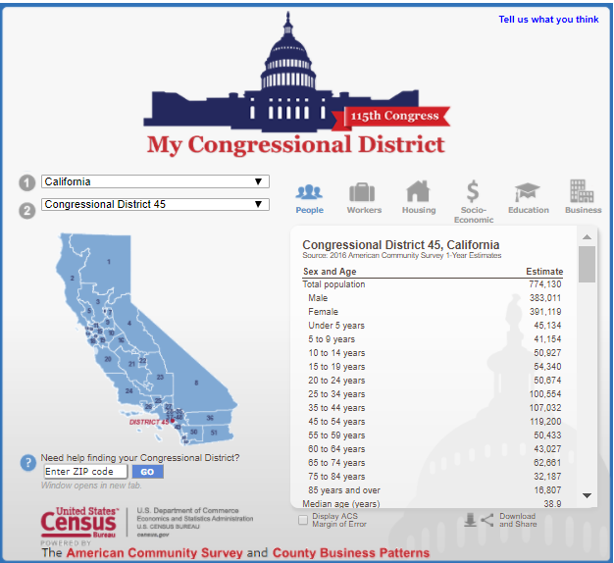
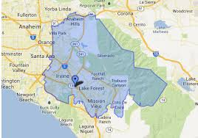
What’s available now?
Case Study:
45th U.S Congressional District
Notes:
Tim speaker
Tabular
Not comparitive Case study on congressional district 45

Slide 4
Key Census Categories
Population
Ethnicity
Education
Citizenship
Poverty
Employment
Industry
Notes:
Tim speaker
Why did we choose these categories?

Slide 5
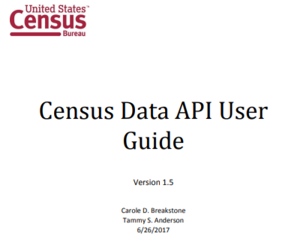
Where Did We Get Our Data?
Source: US Census American Community Survey 2013
Why: Large, Reliable Data Set
Notes:
Carre
The American Commununity Survey, 2013.
Every year, the U.S. Census Bureau contacts over 3.5 million households across the country to participate in the American Community Survey.
Unlike the every-10-year census, this survey continues all year, every year. They randomly sample addresses in every state, the District of Columbia, and Puerto Rico.
Answers are collected to create up-to-date statistics used by many federal, state, tribal, and local leaders. The information helps to determine how more than $675 billion dollars of federal funding each year is spent on infrastructure and services. Through the ACS, we know more about jobs and occupations, educational attainment, veterans, whether people own or rent their home, and many other topics. Public officials, planners, and entrepreneurs use this information to assess the past and plan the future.

Slide 6
Census API
Base url = 'https://api.census.gov/data/2013/acs1?get=NAME&for=congressional%20district:*&key='
Components:
Year = 2013
Survey = ACS1
Queries = Codes after “get=”
Area = code after “for=”
User API Key is concatenated after “key=”
Notes:
Carre
We looked at other years and felt that this contained the most robust recent data
Walk through our base url. All the variables we put in live between the “get” and “NAME”
Queries are “Variables” that we obtained from the ACS developers website. We combed through the variables to determine which ones would provide the best data for the questions we wanted to answer - the questions a potential political candidate would want to know

Slide 7
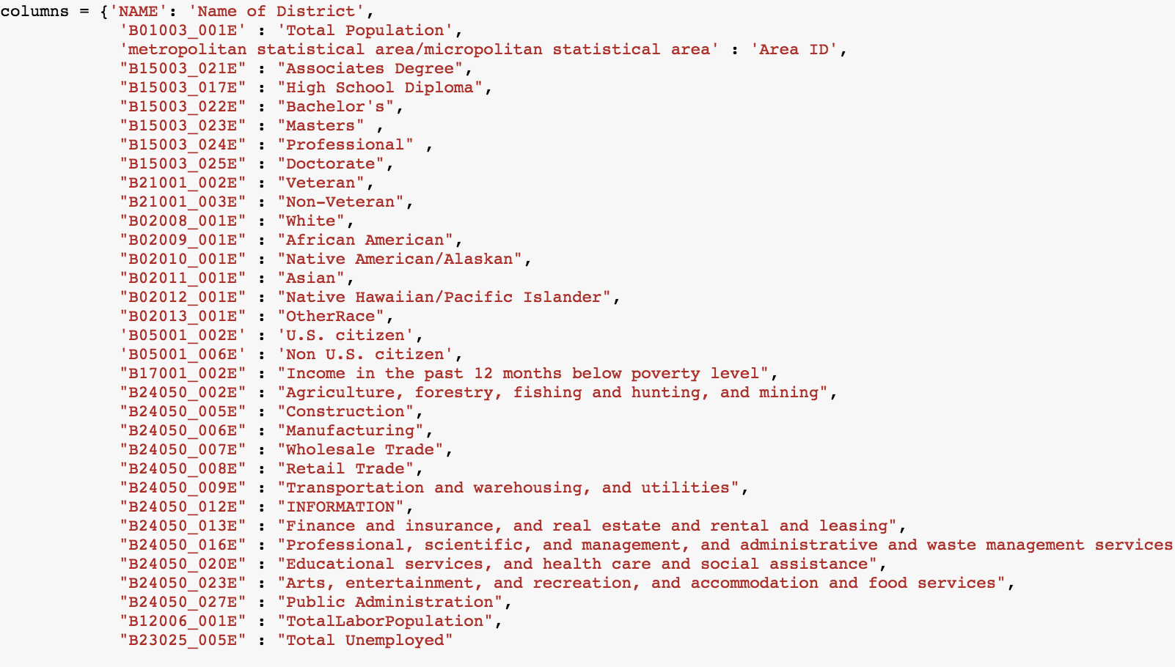
Query URL Variables
Notes:
Ashwini
Pulled data from Census Data API and identified relevant variables. We constructed dictionary with key variables to define our Dataframe. These were the variables that were included in our query string after “get=”

Slide 8
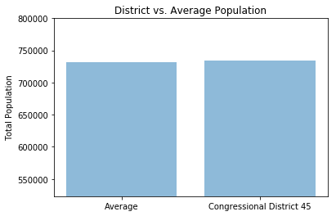
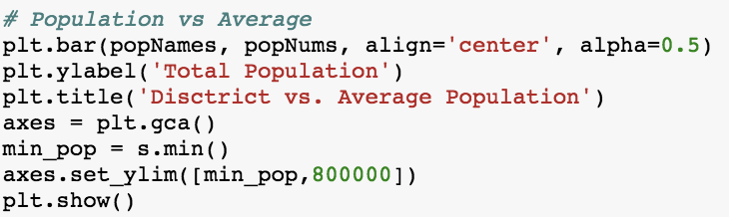
Total Population
Notes:
Thomas
Why: To determine how much ‘power’ a representative should have in Congress based on the relative population size
How: First pulled all populations for all districts into a data frame. Took the mean of that column to get the avg population in all districts. Then isolated district 45
What: The total population for this district is close to the average population for all districts -- nothing special.

Slide 9
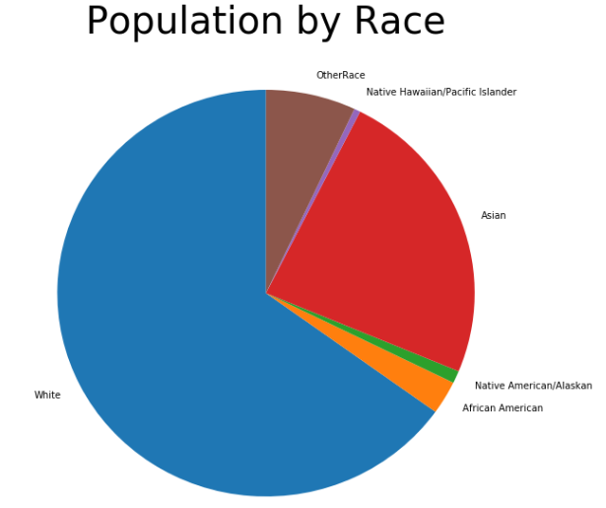
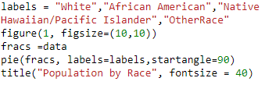
Population by Race
Notes:
Carre
Why did we choose this variable: We believe the racial make-up of a district would be useful for a potential candidate. We want to answer for the candidate: What race is the majority? What race makes up the smallest slice of the pie. What is the make up relative to each other?
How did we find it: Using ACS, we pulled population data for each of the categories listed above: White, Asian, African America, Native American/Alaskan, Native Hawaiian/Pacific Islander and “Other”. ACS was already set up into these buckets. The data represents how each person identifies, for example if a participant selected 2 different races, they would appear in both sects.
What did we find: People identifying at least in part as white make up approximately ⅔ of the population of the 45th Congressional District. Asian makes up about 25%.

Slide 10
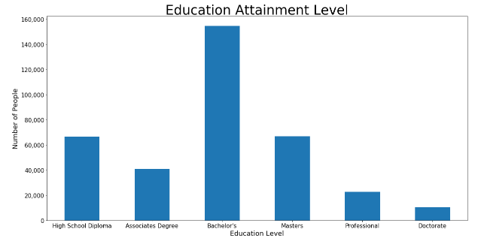
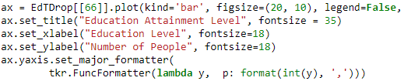
Educational Attainment
Notes:
Carre
Why did we choose this variable: We believe the education level for a district is relevant for someone considering running for political office. This would help indicate to a politician resources to devote to education and at what level.
How did we find it: Total Population for each degree indicated. “Some” was not considered.
What did we find: Majority have at least a bachelor’s degree

Slide 11
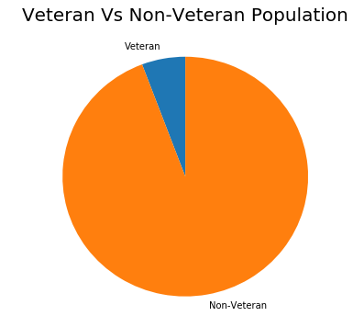

Veteran vs Non-Veteran
Notes:
Carre
Why did we choose this variable: Veteran affairs is often a political talking point. Indicates the importance of funneling resources into programs beneficial to veterans.
how did we find it: Veteran vs non Veteran variable.
What did we find: As suspected, the population is mostly non-veteran, but veterans make up approx 10% of district population. We can theorize that those most interested in/affected by veteran affairs takes up a larger portion of the pie. For each veteran, we can assume friends and family are also concerned with/about veteran resources/programs.
Population is mostly Non-Veteran

Slide 12
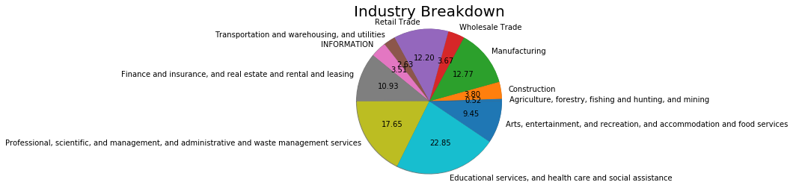
Industry Breakdown
Notes:
Thomas
Why: Knowing what industries your voters work in can help you focus your fiscal policies on the community’s most important industries.
How: Pulled variables for each industry, using the census’ standard list of industries. Added them to dataFrame. Converted them from obect to numeric. Created pie with array of variables as x.
What: Education is unusually large segment of workforce. Manufacturing is fairly significant. No agriculture, forestry, fishing, hunting, and mining.

Slide 13
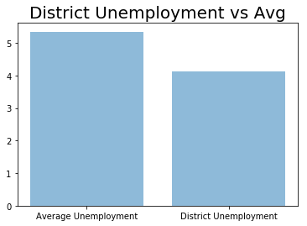
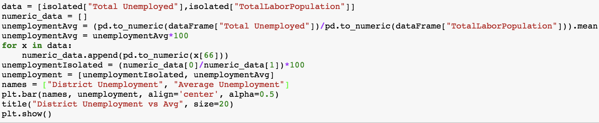
Unemployment
Notes:
Thomas
Why: Unemployment rates are often used to gauge economic vitality and growth
How: Created column using totalUnemployed/totalLaborPopulation for each district. Took mean of that to get average unemployment. Then extracted only 45th district. Created Bar graph
What:
This District has a healthier work force and economy than the average

Slide 14
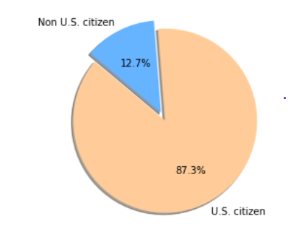
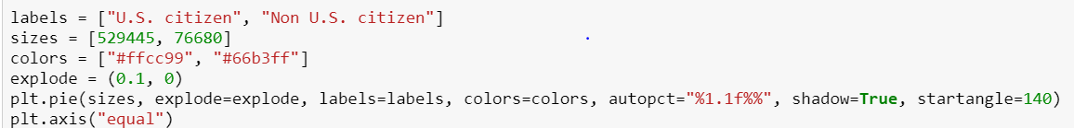
US Citizens vs Non-Citizens
Notes:
Ashwini
Why did we choose this variable : It is important to find out the ratio of Citizens Vs Non-citizens to indicate the number of eligible voters
How did we find it: Identified variables for Citizen and Non Citizens from Census Data - American Community survey API
What was the conclusion: Population consists mainly of US Citizens

Slide 15
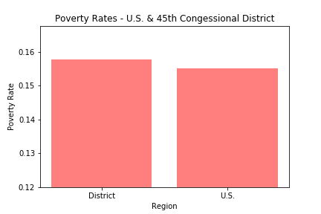
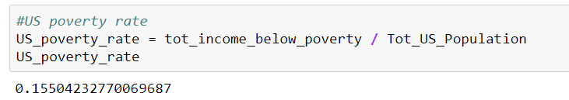
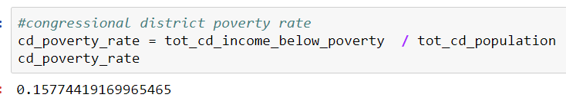
Income Below Poverty Levels
U.S. = 15.5%
45th Dist = 15.8%
Notes:
Tim speaker

Slide 16
What We Could Have Done Better
Notes:
We could have looked at changes over time by using datasets from other years. This could give the politician a better idea about the trends and what problems to focus on if any trends are undesirable.
We could have added a feature to make it very easy to use this tool for districts other than #45
We could have provided comparisons to the national average for each graph. We assumed the candidate knew the averages

Slide 17
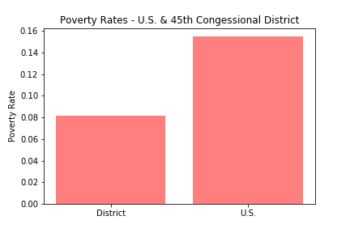
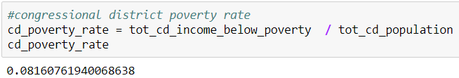
Income Below Poverty Levels
U.S. = 15.5%
45th Dist = 8.2%
Notes:
Tim speaker

Slide 18
Conclusion

