Slide 1
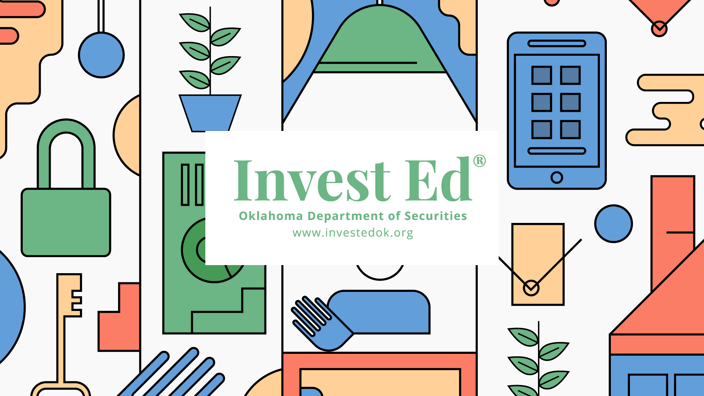
Bonds & Fixed Income Securities

Slide 2
The Oklahoma Department of Securities Invest Ed® program has provided this information as a service to investors. Invest Ed does not recommend any particular investment strategy or plan, any type of product, or any securities professional over another. No part of Invest Ed shall be taken as investment and/or legal advice.

Slide 3
Fixed income securities
Investments that pay a fixed amount and promise to return your principal at some point in the future
Bonds CDs Preferred Stock
Notes:
Investments that pay a fixed amount of interest each period and promise to return your principal at some point in the future are “fixed income securities”. These investments include bonds, certificates of deposit, and preferred stock. Investors can receive interest payments monthly, quarterly, semiannually, or annually, depending on the type of fixed-income security owned. Many investors use these payments as a source of income, especially retirees.

Slide 4
Bonds
securities that investors purchase that represent a loan to a company or government…
Notes:
Bonds are securities that investors purchase that represent a loan to a company or government.

Slide 5
A bond is a financial contract where one party, the creditor, loans money to the borrower, or debtor, in return for a series of fixed interest payments and the return of the face value, or par value, of the bond. The par value is paid to the investor on the maturity date of the bond.
Notes:
A bond is a financial contract where one party, the creditor, loans money to the borrower, or debtor, in return for a series of fixed interest payments and the return of the face value, or par value of the bond. The par value is paid to the investor on the maturity date of the bond.

Slide 6
5-year maturity bond example
Notes:
For example, suppose a 5-year maturity bond has a par value, also known as the face value, of $1000 with an annual coupon of $80. The owner of the bond receives $80 at the end of every year for 5 years, and then $1000 on the last day of ownership (the maturity date). Notice how the payments are “fixed”

Slide 7
Bondholders have priority over stockholders
Bondholders
Stockholders
Rank higher in the capital structure than stockholders, that is why bonds are considered less risky than stocks
Will typically receive a fraction of the original investment as a cash payment or ownership in a restructured company
Usually are left with nothing if a company goes bankrupt
Notes:
Bonds rank higher in the capital structure than stock. Bondholders have priority over stockholders if a company runs into financial trouble and files for bankruptcy. This is the primary reason that bonds are less risky than stocks. The bond holders typically receive a fraction of the original investment as a cash payment or ownership in a restructured company; equity holders are usually left with nothing.

Slide 8
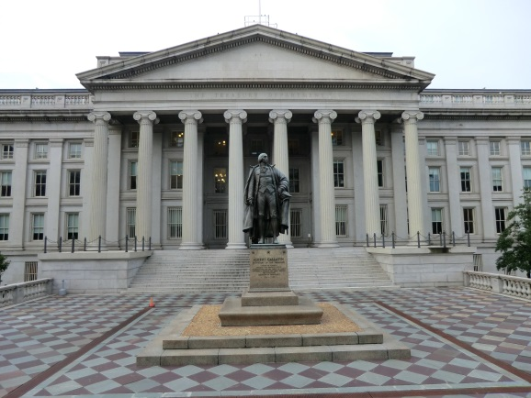
United States Treasury
Largest issuer of debt securities in the world
These investments are called:
Treasury bills
Treasury notes
Treasury bonds
To learn more visit treasurydirect.gov
© Benoît Prieur / Wikimedia Commons
Notes:
The largest issuer of debt securities in the world is the United States Treasury. These investments are called Treasury bills, Treasury notes, and Treasury bonds.
Investors who want to learn more about bonds issued by the United States Treasury can visit treasurydirect.gov . This site has information about different government securities; Treasury auctions dates, and data on the public debt.
When you loan money, the interest rate you are paid is related to likelihood of getting your money back. For example, a United States Treasury Note will have a low yield compared to a bond issued by a company, since the risk of default is almost zero for the US government.

Slide 9
Bond yield
the rate of return if you hold the bond until maturity.
Notes:
When investors refer to the bond’s yield, this is the rate of return if you hold the bond until maturity.

Slide 10
If you sell a bond before its maturity date
Your rate of return is composed of the interest payments to date and the capital gain or loss. The bond price you receive upon selling may be higher or lower than your original investment.
Notes:
If you sell a bond before its maturity date, your rate of return is composed of the interest payments and the capital gain or loss. The bond price you receive upon selling may be higher or lower than your original investment.

Slide 11
Market interest rates and bond prices move in opposite directions
Interest rates
Bond prices
Bond prices
Interest rates
Notes:
It is important to know that market interest rates and bond prices move in opposite directions. If interest rates go up, bond prices go down and vice-versa.

Slide 12
Who issues bonds?
Governments, municipalities, corporations
The interest payments on bonds issued by municipalities are not taxed by the federal government.
Notes:
Who issues bonds?
Governments (England), municipalities (the state of Oklahoma), corporations (Ford Motor).
Bond issued by municipalities are known as “tax-free”, since the interest payments are not taxed by the federal government.

Slide 13
Mortgage-backed securities (MBS)
Are backed by pools of home mortgages and are part of a class of bonds called asset–backed securities.
MBS can vary in risk.
Notes:
Some bonds are backed by pools (or groups) of home mortgages; these are known as mortgage-backed securities (MBS), which are part of a class of bonds called “asset-backed” securities. MBS can vary in risk and are an important part of the banking system.

Slide 14
Bond Investments
mutual funds
ETFs that track a bond index
Individual issues from the government or a corporation
Notes:
Where can you buy bonds?
An investors can buy:
Bond mutual funds. These funds will specify which types of bonds the manager is authorized to purchase.
ETFs (Exchange Traded Funds) that are designed to track a bond index
individual issues from the government or a corporation through your brokerage firm
Bonds are often given a “credit rating” by a third-party organization like Standard and Poor’s and Moody’s . Similar to a credit score, a credit rating indicates the safety of the investment. The better the rating, the safer the investment, but the lower the yield.

Slide 15
What is a “call” feature?
The issuer can call away your bond in exchange for cash payment in excess of the face value, before the maturity date.
Notes:
Some bonds have a “call” feature. That means that the issuer can call away your bond in exchange for cash payment in excess of the face value, before the maturity date. This allows the company to refinance their bonds when interest rates go down.

Slide 16
Three types of risk
Default risk - not paid your interest or principal in the future
Inflation risk - reduced buying power of your future fixed cash flows
Interest rate risk - interest rate increase will cause bond prices to decrease
Notes:
There are three types of risk:
Default risk (the likelihood of the bond not paying your interest and principal in the future)
inflation risk (if inflation rises, it reduces the buying power of your future fixed cash flows)
interest rate risk (if market interest rates rise, bond prices fall)

Slide 17
Certificate of Deposit- CD
Is simply a loan to a bank
At maturity pays interest plus the return of initial investment
Early redemption may cause fees or penalties
Notes:
A certificate of deposit is a loan to a bank. If an investor purchases a certificate of deposit (a CD) at a bank, the bank promises a fixed return over a specific amount of time. When the CD matures, the bank return the initial investment plus any earned interest. You can redeem a certificate of deposit early, but there may be fees or penalties for early withdrawal.

Slide 18
Preferred Stock
Preferred stock is a class of ownership in a corporation that has a higher claim on its assets and earnings than common stock. Preferred shares generally have a dividend that must be paid out before dividends on common shareholders, and the shares usually do not carry voting rights.

Slide 19
Where do fixed-income securities fit in a portfolio?
As investors get older, and become more risk-averse, they tend to have a higher proportion of their wealth in fixed-income securities. For example, an 80 year old grandmother with low risk tolerance may have most of her money in low-risk bonds. She doesn’t want to hold something that can drop significantly in value and therefore can’t hold a large proportion of her assets in risky stocks.

Slide 20
Terms
mortgage-backed securities
credit rating
Standard & Poor’s
call
default risk
inflation risk
interest rate risk
preferred stock
Treasury bills
Treasury notes
Treasury bonds
bond
principal
interest
income
creditor
fixed income
par value
maturity date
yield
debtor
CD

