Slide 1

FinTech

Slide 2
The Oklahoma Department of Securities Invest Ed® program has provided this information as a service to investors. Invest Ed does not recommend any particular investment strategy or plan, any type of product, or any securities professional over another. No part of Invest Ed shall be taken as investment and/or legal advice.

Slide 3
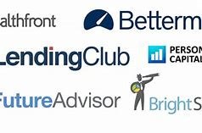
FinTech
Robin Hood, Betterment, Zelle
Wealthfront, Venmo, Prosper, Lending Club…
Notes:
Slideshow Presentation Note: The slides advance on a click, but so do the individual parts of the slides. These were created for the definition to appear first on the screen and the title of the slide last. The reason for this is because you can use the slides as a review with the whole class or students can review themselves on the terms. The slides can be rearranged also to provide extra proof of learning. In addition, the slides can be combined with other slide shows to do a comprehensive review of terms.
INFORMATION FOR THIS SLIDE: When we want to know how the stock market is performing, we need to look at a stock market index. A stock market index represents the value of a collection, or basket, of stocks.
The three most popular indices are the S&P 500, the Dow Jones Industrial Average, and the Nasdaq Composite.

Slide 4
What is FinTech?
Financial Technology
Fastest growing ecosystem in modern finance
Represents the intersection of financial services and technology
Aims to reduce high fees & excessive paperwork
Changed traditional banking, brokerage, lending and commerce operations
Notes:
FinTech is short for “Financial Technology”. It has emerged as one of the fastest growing ecosystems in modern finance. FinTech represents the intersection of financial services and technology, and aims to reduce the frictions that exist in business, like high fees and excessive paperwork. It has changed the way that traditional banking, brokerage, lending and commerce operate in the modern economy.

Slide 5
Benefits of FinTech
Speed of financial transactions
Reduction in transaction costs-elimination of the “middleman”
Mobility in financial transactions
Notes:
FinTech has brought several benefits to individual customers:
1.The speed of financial transactions
2. Reduction in transaction costs, especially the elimination of the “middleman”
3. Mobility in financial transactions

Slide 6
Companies have benefitted…
Through use of algorithms and advanced shopping analytics, market directly to known customer needs
Can reach customers’ mobile devices making in store shopping less important. Consumers can now use their phones for a multitude of transactions.
Notes:
Companies have benefitted from the FinTech revolution in the following ways:
1.Through the use of algorithms and advanced shopping analytics, they know what their customers want to buy and can market to them accordingly.
2The companies can provide services directly to customers’ mobile devices, making in-store shopping less important. Individuals can now use their phone to make a multitude of transactions.

Slide 7

Impact of FinTech on
Banking and Commerce
FinTech has changed operations of mature companies
Bank customers do not have to appear in a branch location to make transactions; deposits & withdrawals can occur on a mobile device
Example:
Notes:
FinTech has impacted industries across the spectrum of financial services. Older, more mature firms have seen their businesses disrupted by innovations in the FinTech universe.
Banking and Commerce:
Banks no longer require customers to appear in a branch office to make transactions; deposits and withdrawals can occur on a mobile device. Example: Simple

Slide 8
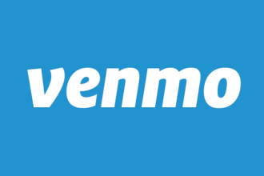
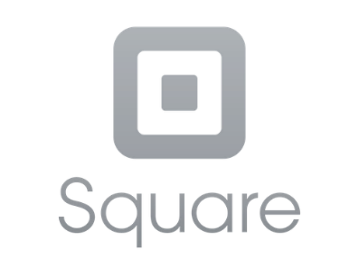
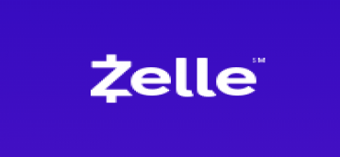
Money transfers from person to person via phone app
7% of adults in the U.S. and 20% of the world population are “unbanked”. FinTech allows the “unbanked” to make financial transactions without a bank account.
Businesses can use mobile banking services such as Square to collect customer funds from all sources.
Growth in “Big Data” allowed companies to collect marketing info to enhance revenues.
FinTech has allowed borrowers to access a huge pool of lenders through “peer to peer” networks.
Notes:
Money transfers (from person to person) can be accomplished via a phone application. These platforms reduce the need to carry cash. Example: Venmo, Zelle
Research has shown that 7% of adults in the U.S. and 20% of the world population are “unbanked”, that is, have no formal bank account. FinTech allows the “unbanked” to make financial transactions without a bank account.
Businesses can use mobile banking services such as Square to collect customer funds from credit cards, instead of cash or checks.
FinTech firms use advanced analytics to understand their customers’ shopping habits. The growth of “Big Data” has allowed companies to collect marketing information in order to enhance revenues.
FinTech has allowed borrowers to access a huge pool of lenders through “peer to peer” networks. Companies such as Prosper and Lending Club provide a platform for borrowers to directly borrow money from lenders, without visiting a bank. These peer-to-peer companies act as intermediaries that take a small fee for their services. The borrower’s money comes from investors who can choose which individuals on the network that will receive their loans.

Slide 9

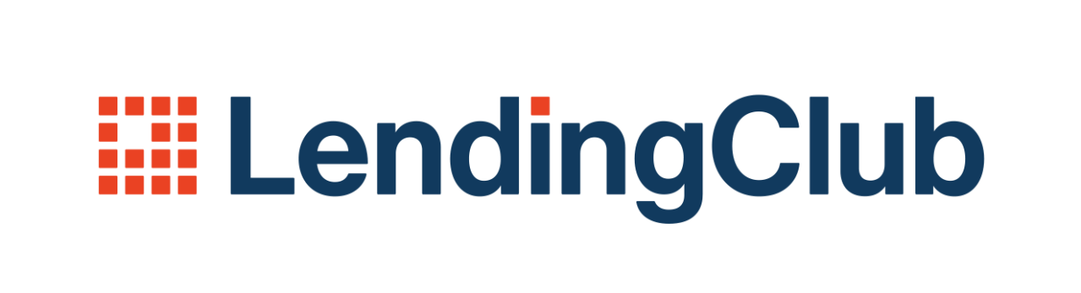
FinTech has allowed borrowers to access a huge pool of lenders through “peer to peer” networks.
The networks act as intermediaries that take a small fee for their services.
Lenders can choose the recipients of their loans on the network.
Notes:
Companies such as Prosper and Lending Club provide a platform for borrowers to directly borrow money from lenders, without visiting a bank. These peer-to-peer companies act as intermediaries that take a small fee for their services. The borrower’s money comes from lenders who can choose which individuals on the network that will receive their loans.

Slide 10
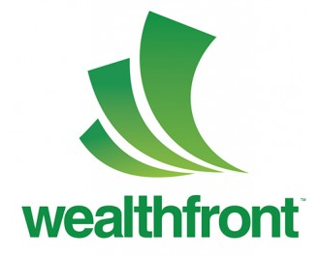


FinTech Impact on
Investment Services
Online brokerage platforms utilize a variety of automated strategies to make investment decisions.
Financial software that makes the decisions is the “robo” in robo-investing.
The platform that provides this service is a robo-advisor.
If an investor wants to actively trade stocks, FinTech, like “Robin Hood”, can accommodate their needs without a commission which has become the standard.
Notes:
Investment Services
FinTech has introduced new terms to investors: “Robo-investing” and “Robo-advisors”.
Investors can enter their personal financial information such as their risk tolerance, wealth, and years until retirement into an online brokerage platform. The broker has software that has tested a variety of automated strategies using low-cost index investing that have generated optimal risk-adjusted historic returns. The financial software that makes the decisions is the “robo” in robo-investing, which refers to the automation of the investing process. The brokerage firm that provides this service is a “robo-advisor”.
Example: Betterment, Wealthfront
With robo-investing, a stockbroker does not make the choices of where the money goes, rather a computer algorithm (or “robot”) makes the decisions. These passive strategies are extremely low-cost and low-touch, since most robo-advisor plans require automated payments with no required interaction with humans.
When investors want to actively trade stocks, FinTech provides low-cost mobile trading platforms to accommodate their needs. In fact, zero-commission trading is now the standard thanks to Robin Hood.

Slide 11


FinTech Impact on Consumers
Insurance markets have expanded
Financial institutions have invested extensively in blockchain technology
Entrepreneurs can raise capital through crowdfunding on sites like Kickstarter. The owner does not have to give up equity to get money as in the past.
Notes:
FinTech and Consumers
Insurance markets have also expanded as part of the FinTech universe. Firms like Lemonade provide rental and home insurance. Many other companies, some of them well known like GEICO and Progressive, are using mobile technologies to enhance the user experience.
Financial institutions have invested extensively in blockchain technology. The blockchain is an electronic ledger that records transactions on a peer-to-peer network. The benefits of the blockchain include a reduction in transaction costs, removal of various intermediaries, and enabling the exchange of digital currencies like Bitcoin. Many FinTech advocates can envision a time when clearing and settlement of securities trades will be made with blockchain technology.
In the past, in order to raise capital an entrepreneur needed to contact a bank for a small business loan, or ask friends or family for equity capital to fund a business venture. Today, the FinTech alternative is “crowdfunding” on sites like Kickstarter where individuals can post their business ideas on a public online platform and then the “crowd” can fund as little or as much as they like. The owner of the business does not need to give up equity to get money from online contributors.
As more and more transactions take place online via mobile devices, vendors and customers protect themselves against hackers and online theft.

Slide 12
Key Terms
robo-investors
robo-advisors
peer to peer network
FinTech
crowdfunding
blockchain
unbanked
Big Data
revenue
algorithm
Notes:
Key Terms – Fintech
robo-investors
robo-advisors
peer to peer network
FinTech
crowdfunding
unbanked
Big Data
revenue
algorithm
blockchain

