Slide 1
Acceptance By Example Tim Gifford

Slide 2























Slide 3
Expectations?
It’s probably too late, but I figured I should ask.

Slide 4
…But first, a Story

Slide 5
Parable
The last release was awful! We added a new feature to the User Profile that broke the Rating Engine and the Scheduler. Now the management team wants us to manually regression test the entire system before each release. How can we do that? The developers already wait until the last moment to finish the new features and now we’re required to regression test everything else too. My spouse is already upset about the long hours at work.
Notes:
Last release was AWFUL!
new feature to the User Profile module
Broke Rating Engine and the Scheduler
Mgmt regression test
developers wait until the last moment
Next release is a new Security Sub-system
My spouse it upset about the long hours

Slide 6
Lessons Learned
Releasing software should be avoided
Developers procrastinate
QA is the final (and only) quality gate
Surplus of Distrust
Our spouse doesn't like us
working long hours!

Slide 7
Costs of Defects
Production defects cost 5x-100x than defects discovered in Requirements/Design Phases
Block other features
Damage "Trust"
Cause rework and disrupt flow
Team morale/turnover

Slide 8
Cause of Defects
Fuzzy Requirements
Incomplete
Conflicting
Unknown Dependencies
“inside-out”
Complexity
Duplication

Slide 9
Pop Quiz
Painless…I promise ☺

Slide 10

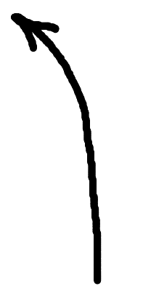
Coriolis Effect

Slide 11
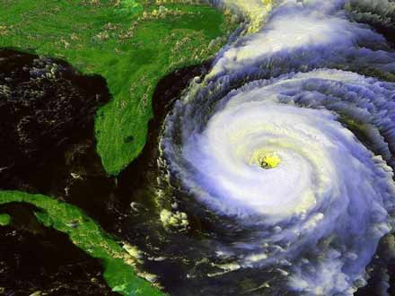

Slide 12
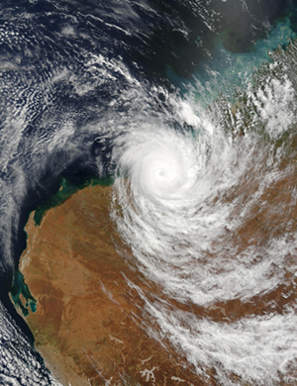

Slide 13
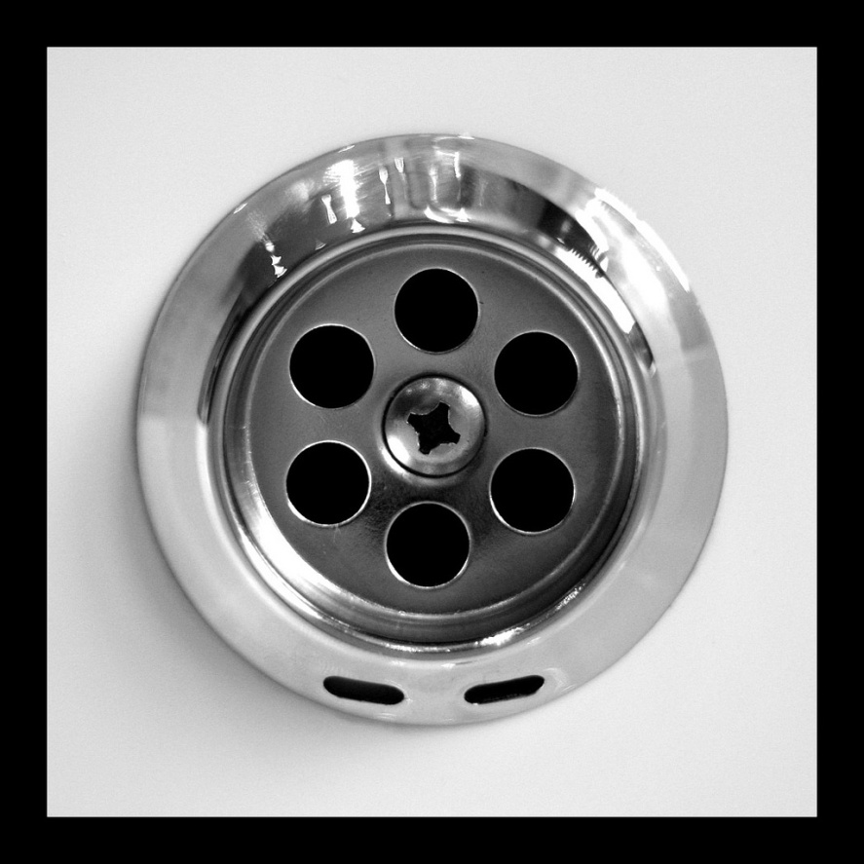
What direction does water drain in the USA?
1.) Counter clockwise
2.) Clockwise
3.) All the above

Slide 14
Coriolis effect
"Because the Earth rotates only once per day, the Coriolis force is quite small, and its effects generally become noticeable only for motions occurring over large distances and long periods of time, such as large-scale movement of air in the atmosphere or water in the ocean."
http://en.wikipedia.org/wiki/Coriolis_effect

Slide 15
Contextual Interpretation
Experiences
Culture
Frame of Reference
Location
Time

Slide 16
What if…

Slide 17
we had a “Blueprint”?
Notes:
Construction industry has “Explicit Context” defined via a Blueprint
It is the Specification for a building

Slide 18
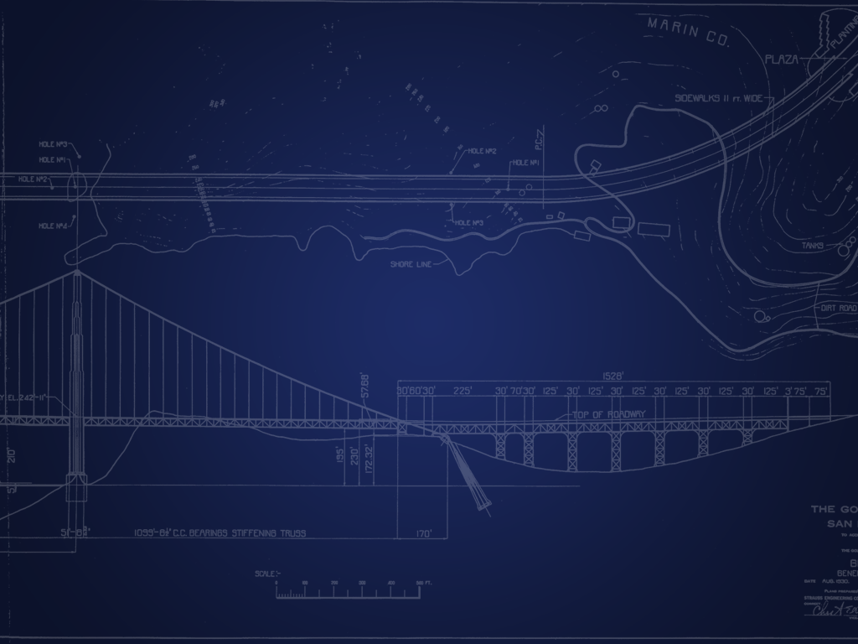
Software Blueprint
Specifies requirements
Sharable/Tangible/Correct
Understood by fellow professionals
Communicates a design

Slide 19
Construction Analogy
 | Construction | Trad Software | Agile Software
Requirements | Market Research Budget Customer Value ($$$) | Market Research Budget Customer Value ($$$) | Market Research Budget Customer Value ($$$)
Design | Blueprint ($) | BRD, HLD, DD, UC ($$$)
Construction | Labor Materials Equipment ($$$$$) | Developers Source Code Code Reviews ($$$$$)
Verification | Manual Inspections ($) | Manual Automated UI ($$$) | Manual Automated Testing ($$$)
Maintenance | ($) | (?) | (?)
Software
?

Slide 20
Construction Analogy
 | Construction | Trad Software | Agile Software
Requirements | Market Research Budget Customer Value ($$$) | Market Research Budget Customer Value ($$$) | Market Research Budget Customer Value ($$$)
Design | Blueprint ($) | BRD, HLD, DD, UC ($$$) | Source Code Tests ($$$$$)
Construction | Labor Materials Equipment ($$$$$) | Developers Source Code Code Reviews ($$$$$) | Build (~Free)
Verification | Manual Inspections ($) | Manual Automated UI ($$$) | Manual Automated Testing ($$$)
Maintenance | ($) | (?) | (?)
Software

Slide 21
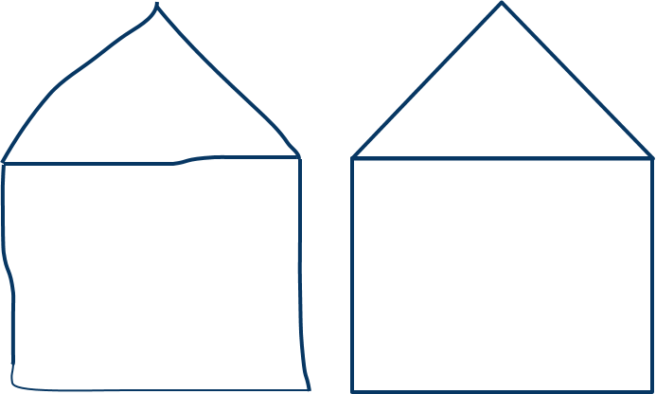
Software’s “T-Square”
It Compiles!
[Test]
void Width_is_15_feet()
[Test]
void Height_is_10_feet()
[Test]
void Depth_is_12_feet()

Slide 22
Single Source of “Truth”
Requirements are “stored” in the system
Documents are temporary
“Artifacts” are context-free snapshots

Slide 23
Where/What to Test?

Slide 24
Traditional Testing Triangle
UI
Integration
Unit
*Manual
QA
BA
*Manual
Dev
*Manual

Slide 25
Cohn’s Testing Triangle
*Manual
Selenium
Watir
BA
QA
UI
Integration
Unit
FIT/Fitnesse
Cucumber Rspec
BA
QA
Dev
RSpec
xUnit
Dev

Slide 26
Tim’s Testing Rectangle
UI
Data
Cost
Risk

Slide 27
Where to Test
UI
Acceptance Test
Presentation Logic
Business Logic
Business Process
Data Services

Slide 28
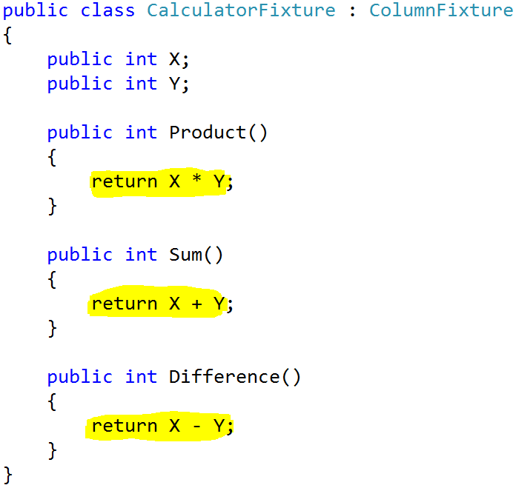

Slide 29
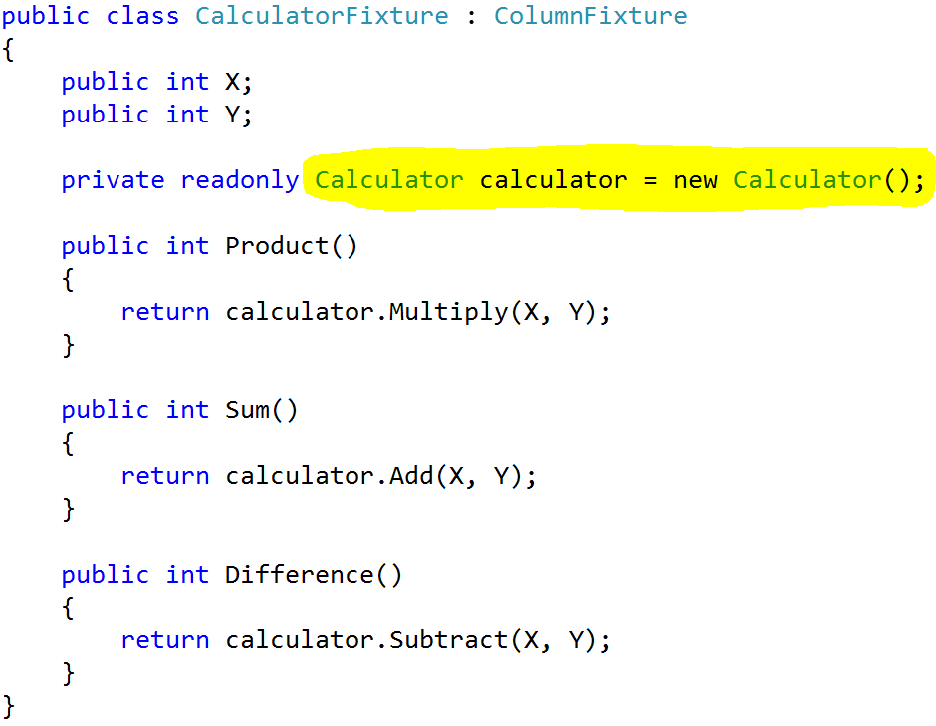

Slide 30
Acceptance Test Driven Development (ATDD)

Slide 31
Terms
Traditional Software | Agile Software
Requirement Use Case | Feature User Story
Use Case Test Case | Acceptance Criteria
Test Case | Acceptance Test Scenario Example

Slide 32
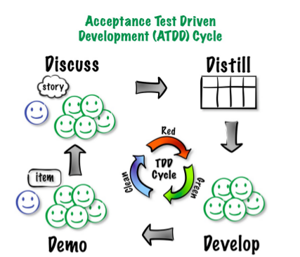
ATDD
(ATDD cycle model developed by James Shore with changes suggested by Grigori Melnick, Brian
Marick, and Elisabeth Hendrickson.)
Notes:
Discuss
Review User Story with Project Stakeholders
Customer/BA/QA/PM/Devs
Define Acceptance Criteria
Sketch out examples
Distill - Acceptance Criteria to Examples

Slide 33
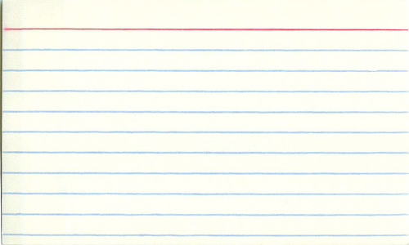
Feature: Import Multiple Users
As a User Admin
I want to import multiple users from a file
So that I can integrate with other systems
Acceptance Criteria
Only the User Admin is able to perform this action
All valid users in the file are in the system
Invalid users are sent back to the User Admin to correct

Slide 34
Use Case: Import Multiple Users
Actors: | User Admin
Description: | This use case describes the main way a User Admin will import multiple users into the system using a file. The User Admin will interact with a website to upload a file, and will be notified via email when the file has been processed.
Preconditions: | Web browser opened, User Admin logged in, and Import Users File Import Upload URL opened
Postconditions: | User navigates from User File Import Upload web page.
Normal Course: | Open browser Navigate to User File Import Upload URL Upload User File Navigate to another page Receive email when file is processed

Slide 35
Use Case: Import Multiple Users
Alternative Courses: | None
Exceptions: | None
Priority: | High
Frequency of Use: | Once per visit.
Business Rules | TBD…
Special Requirements: | 24/7 access 1 Second response times Standard accessibility requirements Standard security requirements
Assumptions: | Internet Connection, Gravity
Notes and Issues:
Use Case Graphic | Reference: System Use Case Diagram

Slide 36
ATDD
(ATDD cycle model developed by James Shore with changes suggested by Grigori Melnick, Brian
Marick, and Elisabeth Hendrickson.)
Notes:
Discuss
Review User Story with Project Stakeholders
Customer/BA/QA/PM/Devs
Define Acceptance Criteria
Sketch out examples
Distill - Acceptance Criteria to Examples

Slide 37
Good Acceptance Criteria
High level
Behavior not Implementation
One per expected result

Slide 38
Dude…where’s my detail?
Discovered in conversation
Persisted in the Code (aka Blueprint)
Validated with Acceptance Tests (AT)
Code and AT are versioned together
DO NOT CREATE A CARD MANAGEMENT SYSTEM!

Slide 39
Acceptance Test
Acceptance Criteria + Examples (Scenarios & Data)
Explicit Context
“Real”
Independent
No Duplication

Slide 40
Acceptance Test
Readable Business Language
Given [Pre-condition]
When [action performed]
Then [observable result]

Slide 41
Cucumber/Specflow
Feature: Import Multiple Users
In order to integrate user from external systems
As a User Manager
I need to import multiple users from a file
Scenario: Require last name
Given a user row:
| Username | First Name | Last Name |
| tgifford | Tim | |
When row is imported
Then validation error should be "Last Name Required"

Slide 42
ATDD
(ATDD cycle model developed by James Shore with changes suggested by Grigori Melnick, Brian
Marick, and Elisabeth Hendrickson.)
Notes:
Discuss
Review User Story with Project Stakeholders
Customer/BA/QA/PM/Devs
Define Acceptance Criteria
Sketch out examples
Distill - Acceptance Criteria to Examples

Slide 43
ATDD Cycle: Develop
“Given a development environment”
Source Control System
Source Code & Libraries
Database Schema
Automated Tests
Build & Deployment Scripts
Continuous Integration

Slide 44
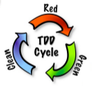
ATDD Cycle: Develop
Fail – Missing Code Fixture
Wire AT to automated fixture
Wrong
Multiple TDD Cycles
Correct

Slide 45
ATDD
(ATDD cycle model developed by James Shore with changes suggested by Grigori Melnick, Brian
Marick, and Elisabeth Hendrickson.)
Notes:
Discuss
Review User Story with Project Stakeholders
Customer/BA/QA/PM/Devs
Define Acceptance Criteria
Sketch out examples
Distill - Acceptance Criteria to Examples

Slide 46
ATDD Cycle: Demo
Review with Business Stakeholders
Release to QA
Create examples for missing scenarios

Slide 47
Demo: Cucumber/SpecFlow

Slide 48
Cucumber/Specflow
Feature: Import Multiple Users
In order to integrate user from external systems
As a User Manager
I need to import multiple users from a file
Scenario: Require last name
Given a user row:
| Username | First Name | Last Name |
| tgifford | Tim | |
When row is imported
Then validation error should be "Last Name Required"

Slide 49
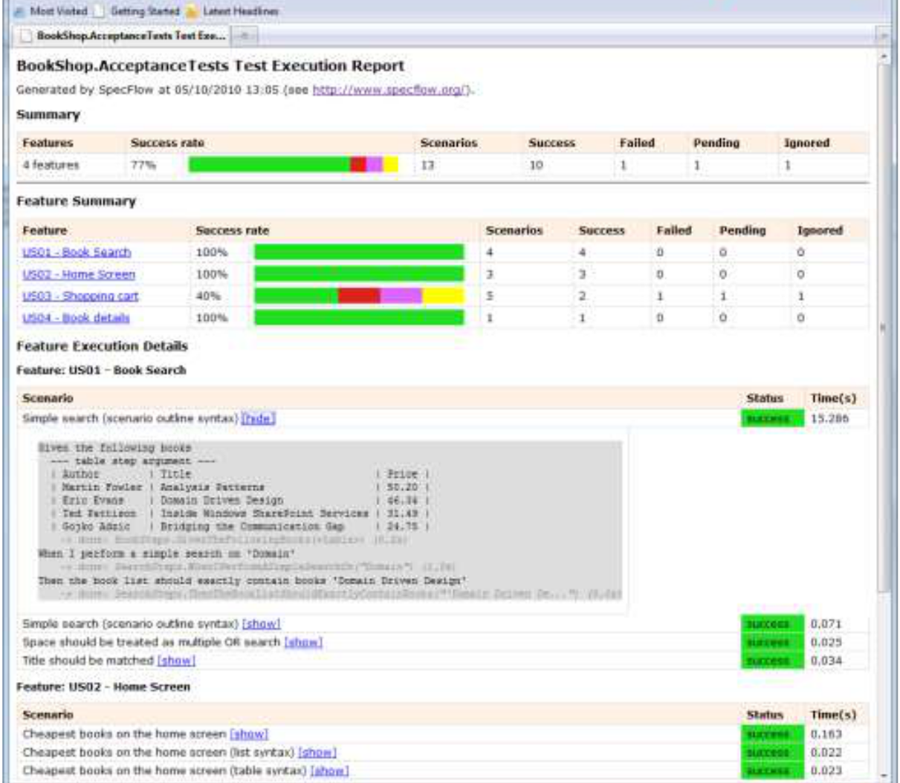

Slide 50
Demo: FitNesse

Slide 51
|Import Multiple Users|
|Given |
|Login as|User Manager|
|When|Users Imported from a file|
|Then |
|Import users from file |
|Username|First Name|Last Name|Error Message! |
|tgifford|Tim |Gifford |blank |
|superman|Clark |Kent |blank |
|batman |Bruce |null |Last Name Required|
|blank |Bruce |Wayne |Username Required |

Slide 52
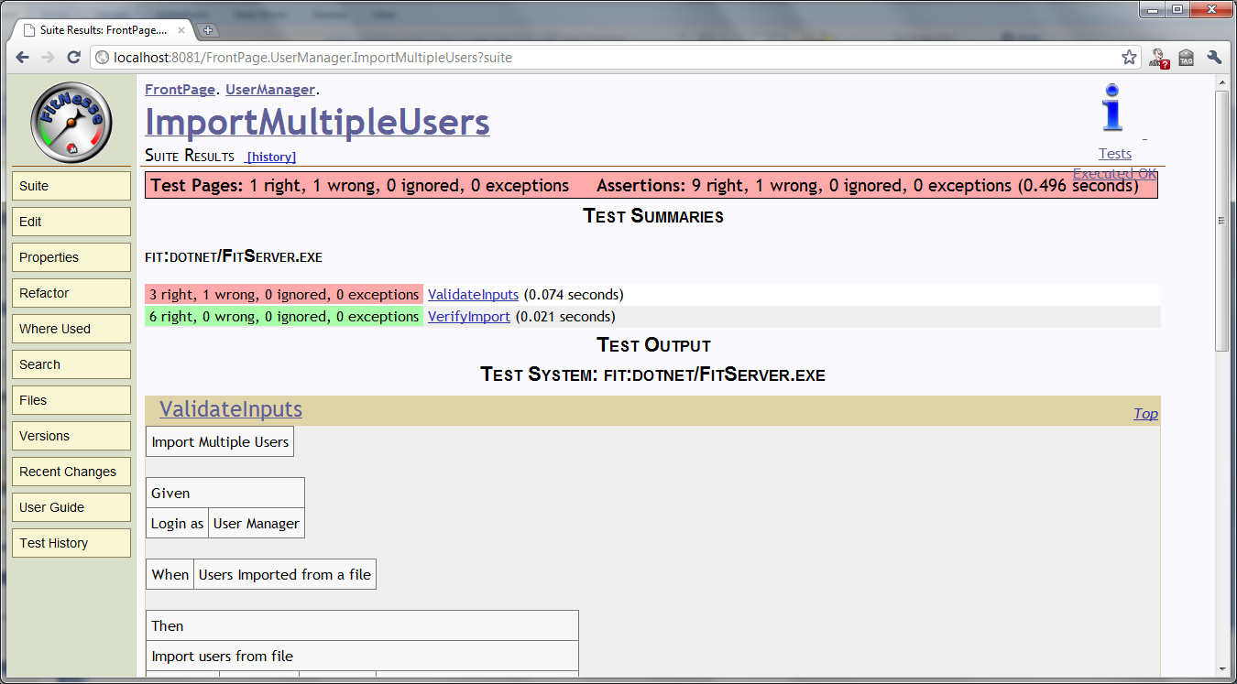

Slide 53
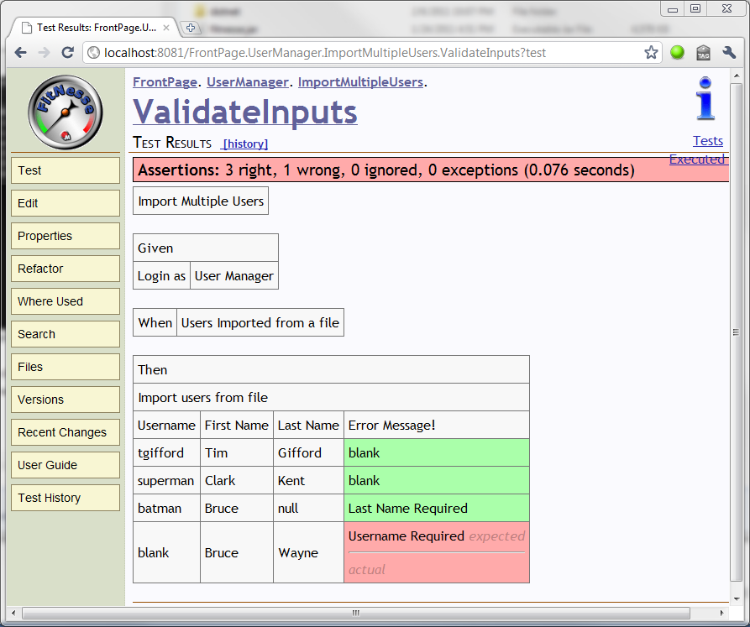

Slide 54
ATDD
(ATDD cycle model developed by James Shore with changes suggested by Grigori Melnick, Brian
Marick, and Elisabeth Hendrickson.)
Notes:
Discuss
Review User Story with Project Stakeholders
Customer/BA/QA/PM/Devs
Define Acceptance Criteria
Sketch out examples
Distill - Acceptance Criteria to Examples

Slide 55
Test Driven Development
You are your first consumer (Outside-in)
Verifies (low level) Design
Decoupled
Reusable

Slide 56
Unit Test F.I.R.S.T
Fast
Isolated
Repeatable
Self-Verifying
Timely
Source: Tim Ottinger, Brett Shuchert
Notes:
Fast – 100 tests/sec
Isolated – Fails for single reason
Repeatable – Database Transaction
Self-Verifying – Pass/Fail
Timely - Before the code

Slide 57
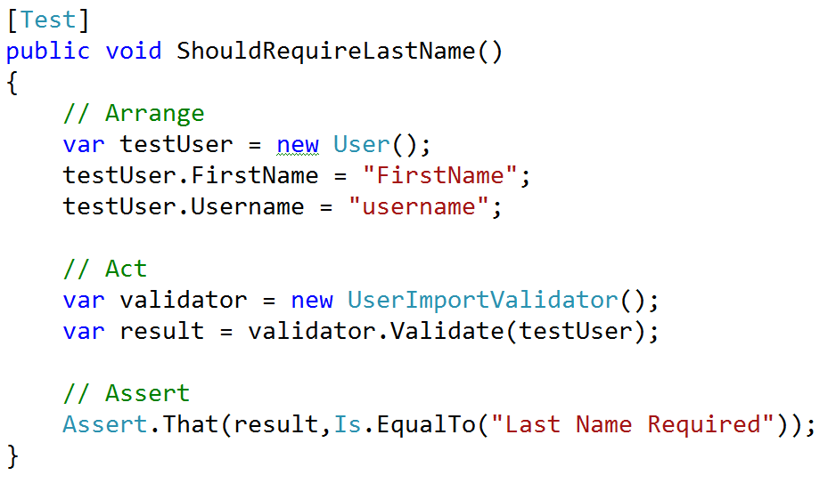
Arrange/Act/Assert

Slide 58
Test Driven Development
Uncle Bob’s 3 Rules of TDD
1.) You are not allowed to write any production code unless it is to make a failing unit test pass.
2.) You are not allowed to write any more of a unit test than is sufficient to fail; and compilation failures are failures.
3.) You are not allowed to write any more production code than is sufficient to pass the one failing unit test.

Slide 59
Refactoring: The “R” word!
Restructure code without changing the external functional behavior
Verified with
Automated Tests
Refactoring without Tests is just…
Changing “Stuff”

Slide 60
Mitigate the Cause of Defects
Fuzzy Requirements
Incomplete
Conflicting
Unknown Dependencies
“inside-out”
Complexity
Duplication
Scenarios & Examples
TDD
Automated Regression

Slide 61
Requirements
Elaborate
Verify
Examples
Become
Tests
Gojko Adzic

Slide 62
Thanks! Tim Gifford tim@giffordconsulting.com http://github.com/timgifford/ twitter: @timgifford

