Slide 1

/now
Group 4
Alex, Gero, Igor, Rouven, Tim

Slide 2
/now
What is it?

Slide 3
/now
spontaneous trip to Munich and no place to crash?

Slide 4
/now
get the best locale offers directly from the hoteliers

Slide 5

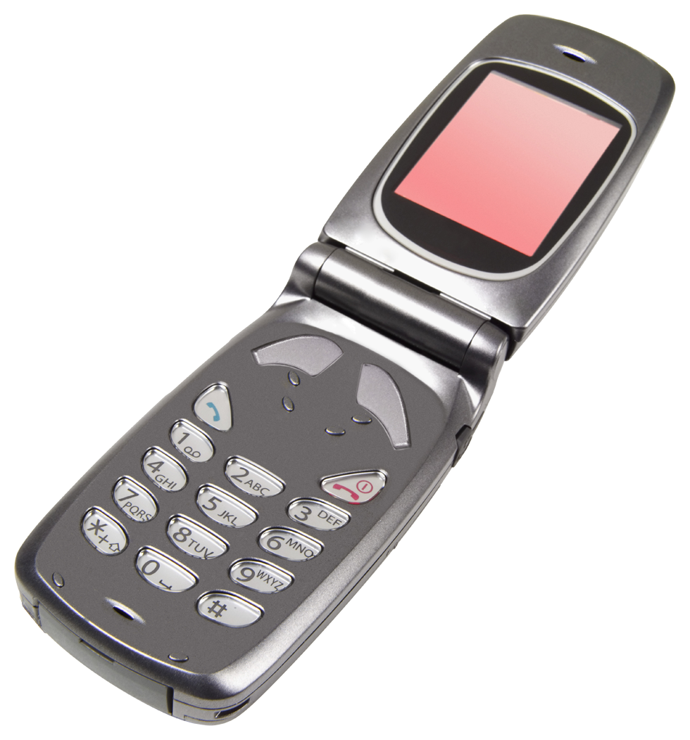
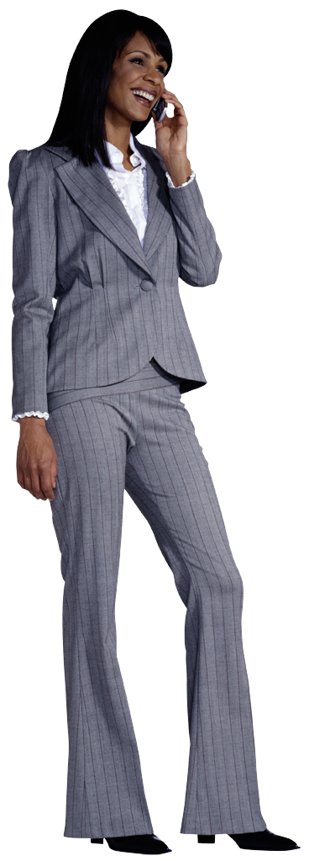
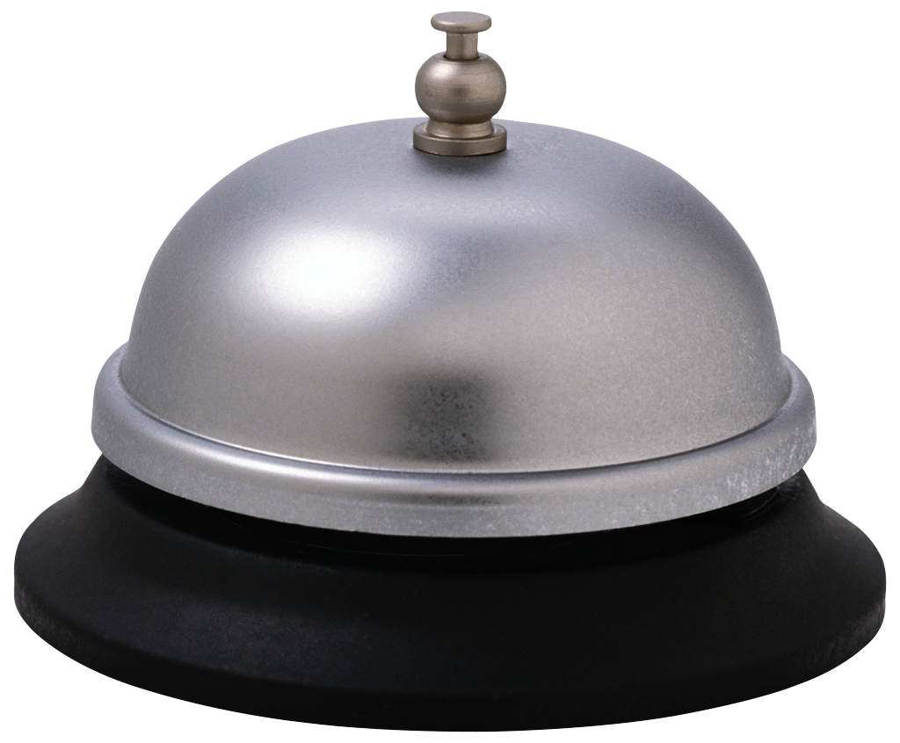
How it works?
/now
?
20
20 €

Slide 6
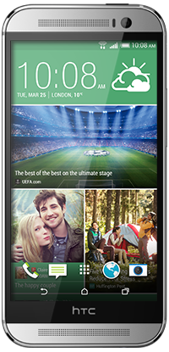
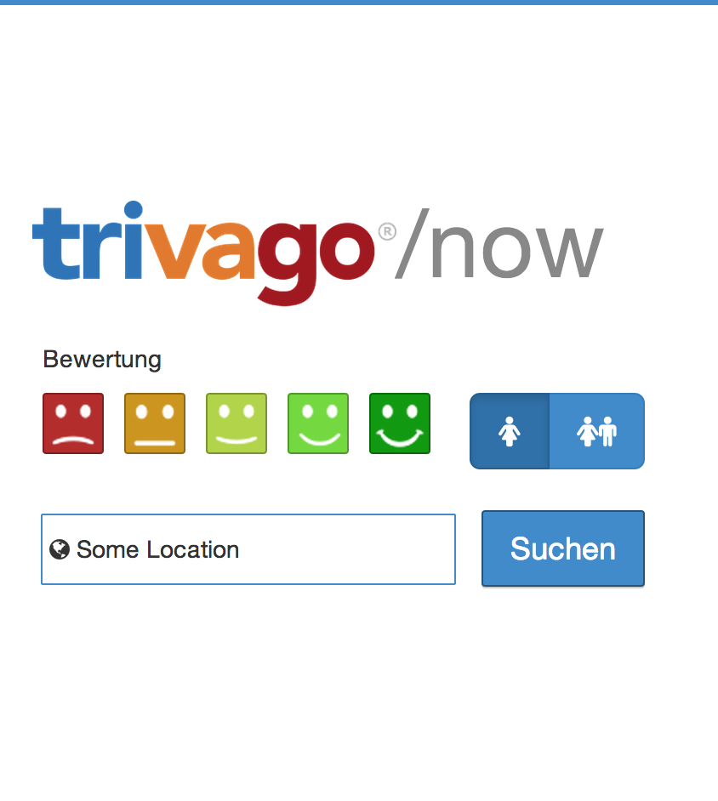
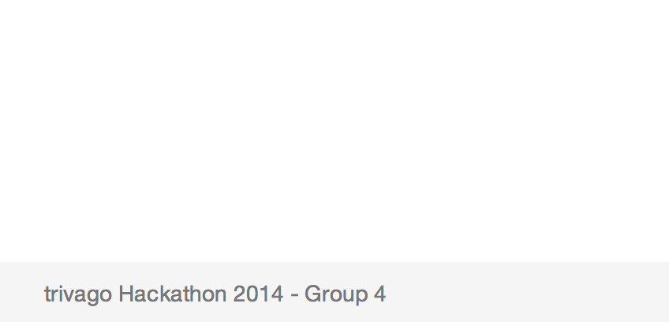
Live demo
/now

Slide 7








Technologie
/now
Maps / Places

Slide 8
Who participates?
/now
Group 4
Alex
Gero
Igor
Rouven
Tim
Thank you!

