Slide 1
Dry/Gems in 3 acts
Timo Sulg
Source: https://github.com/timgluz/dryrb_talk

Slide 2
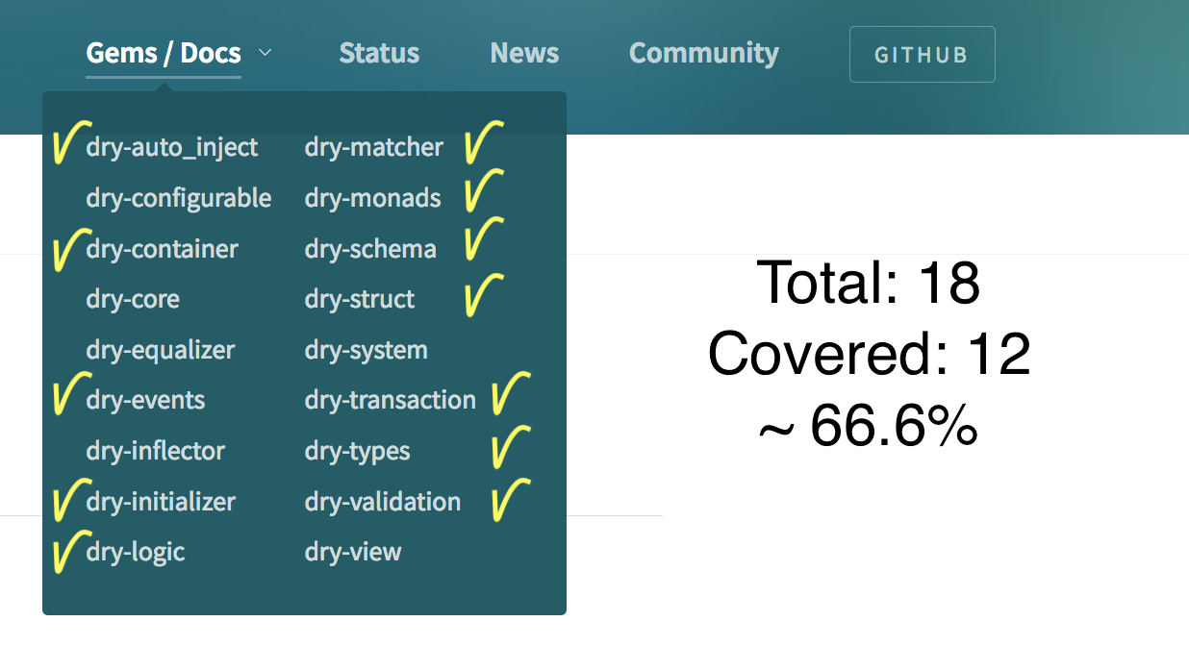
Dry-rb is goldmine

Slide 3
Programm
Dry-Task
Task monad
Demo
Dry-Service
Validations
DI
Demo
Dry-Transaction
Observers
Demo

Slide 4
1.
Dry-Task

Slide 5
Dry-Task
Dry-Monads gem
Thin wrapper around `concurrent-ruby` gem
Concurrent-ruby:
https://github.com/ruby-concurrency/concurrent-ruby
Notes:
The dry-monads library exposes the Task monad which is built on top of
concurrent-ruby gem;

Slide 6
Dry-Task
Single purpose - 1public method
Basic error handling
Minimal pre-conditions
Mostly for side-effects
May not return anything useful

Slide 7
Dry-Task
3 types of executors:
For IO-bound tasks
For CPU-bound tasks
Immediate/local for testing
Notes:
As soon as Task is initialized , it begins running in its own thread;
It will not block the main thread of execution;
use the ˋvalue! or to_result methods to block until result comes back;
nb! the bind is non-blocking and returns another task
fmap - is blocking and returns value

Slide 8
DEMO.1
Multisearch
Notes:
bat app/tasks/multisearch_task.rb
bat multisearch_task_example.rb
ruby multisearch_task_example.rb

Slide 9
2.
Dry-Service

Slide 10
Dry-Service: Service object
Three rules of services
only to 1 public method
avoid dependencies from another service
return something meaningful
Notes:
bat app/services/base_dry_service.rb

Slide 11
Dry-Service: intro
Plain Service Object in the Dry-sauce
Validations
Class-method `call` wraps into Result
Check: app/services/base_dry_service.rb
Notes:
bat app/services/base_dry_service.rb

Slide 12
Demo.2
Prepare Pizza: validations
Notes:
bat app/services/prepare_pizza.rb
bat prepare_pizza_example.rb
ruby prepare_pizza_example.rb

Slide 13
Demo.3
Bake Pizza: Dependency Injection
Notes:
bat app/services/bake_pizza.rb
bat bake_pizza_example.rb
ruby bake_pizza_example.rb

Slide 14
Dry-Service: DI
A class accepts the objects it requires from an injector instead of creating the objects directly.
Notes:
Simply means passing dependencies into an object instead of instantiating them within it; Using DI makes code more flexible and easier to test because we can swap out the dependency for another object with same interface;

Slide 15
3.
Dry-Transaction

Slide 16
Dry-Transaction: intro
business transaction DSL (a’la use case)
simple way to order operations
makes error handling primary concern
Notes:
DSL = Domain Specific Language

Slide 17
Dry-Transaction: core ideas
just series of high-level operations/steps
any operation can fail & stop processing
steps any can be re-used (DI)
a business transaction has no state (!!!)
steps should be stateless (!!!)
has only 1 single public method `#call(input)`
errors in any operation should be easily caught
Notes:
Simply means passing dependencies into an object instead of instantiating them within it; Using DI makes code more flexible and easier to test because we can swap out the dependency for another object with same interface;

Slide 18
Dry-Transaction: Error handling
Rules from Unified-Log-Processing:
our failure must not be out-of-band - no 3rd party logging
entries in our failure path must contain the reason
entries in our failure path must contain the original input data
Notes:
How do we handle an unrecoverable but not-unexpected error within a unit of work?
We have to move this unit of work into our failure path, but making sure to follow few important rules:

Slide 19
Dry-Transaction: Railway pattern
Success steps are composed into one big happy-flow.
Failure path redirects execution flow out of the happy-path;
Notes:
The term comes from Scott Wlaschin[2] blog-post where he uses the railway
metaphor with happy and failure paths to introduce compositional failure handling.
It basically means that Success steps are composed into one flow and failure path redirects execution flow out of the happy-path;

Slide 20


Dry-Transaction: 1000 words
Source: https://fsharpforfunandprofit.com/posts/recipe-part2/

Slide 21
Dry-Transaction: Important properties
composes failures within an individual processing step,
fails fast multiple steps.
Success/Failure are just value-containers
The type inside the Failure should stay same or very small set: Exception/string/common error-struct

Slide 22
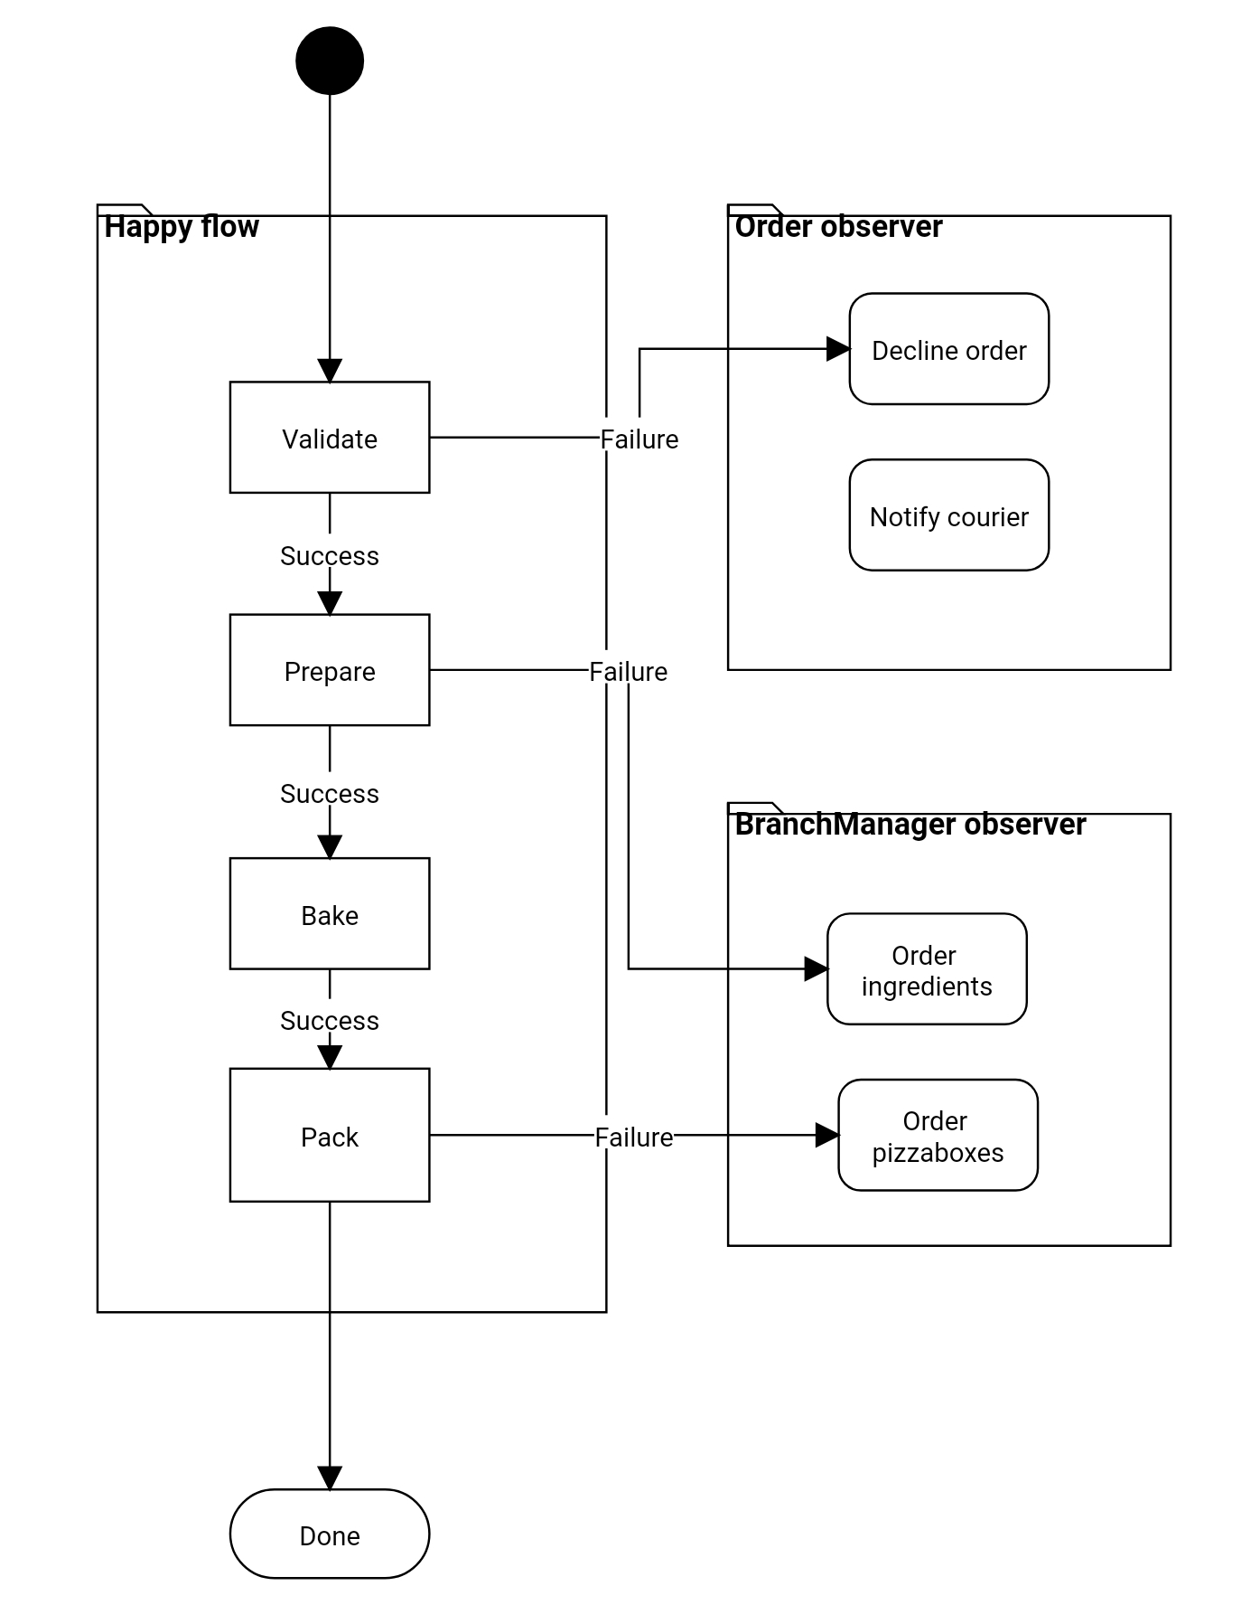
Use case:
Create Pizza from Order

Slide 23
Demo.4
Asking for trouble
Notes:
bat create_pizza_example.rb
ruby create_pizza_example.rb

Slide 24
Demo.5
Happy flow
Notes:
Remove exit point
bat create_pizza_example.rb
ruby create_pizza_example.rb

Slide 25
Dry-Transaction: Observer pattern
The Observer Pattern defines a 1-to-many dependency between objects so that when object changes a state,
all of its dependents are notified and updated automatically. [3]

Slide 26
Recap
Dry-Task: easy concurrent processes
Dry-Service: preconditions & result-container
Dry-Transaction: compose and handle errors
:step - for services
:tee - for tasks

Slide 27
How we benefited?
leaner models
leaner controllers
reusable services
SOLID architecture
building block for domain-services

Slide 28
[1] Dry-gems - https://dry-rb.org/gems/
[2] Railway oriented programming: https://fsharpforfunandprofit.com/posts/recipe-part2/
[3] "Event streams in action", https://www.manning.com/books/event-streams-in-action
[4] "Head First Design Patterns", page.86, https://play.google.com/store/books/details?id=NXIrAQAAQBAJ
"What is Dry-rb", examples for dry-events: https://www.rubyguides.com/2019/01/what-is-dry-rb/
"Concurrent Ruby with Tasks" - https://blog.drewolson.org/concurrent-ruby-with-tasks
[5] "Designing Services with dry-rb" https://medium.com/adhawk-engineering/designing-services-with-dry-rb-fe850f8dd4b7
Links

