Slide 1
ENEL420 Demonstration
Tim Hadler
Emily Tideswell

Slide 2
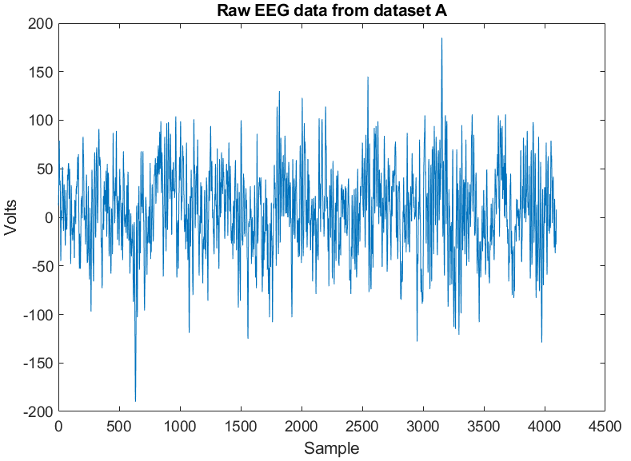
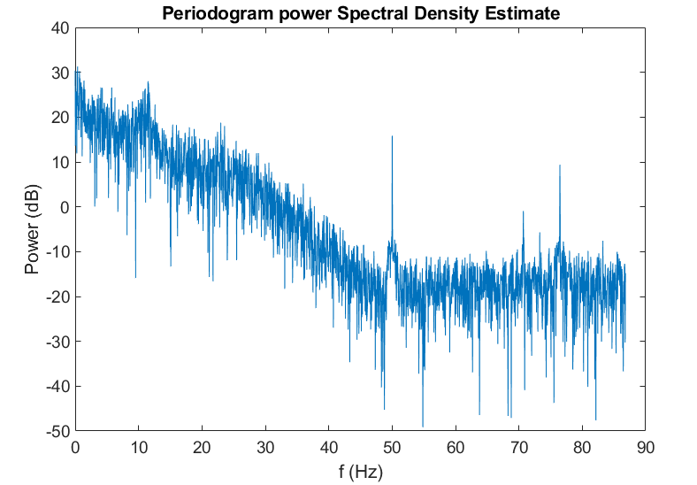
Periodogram method

Slide 3
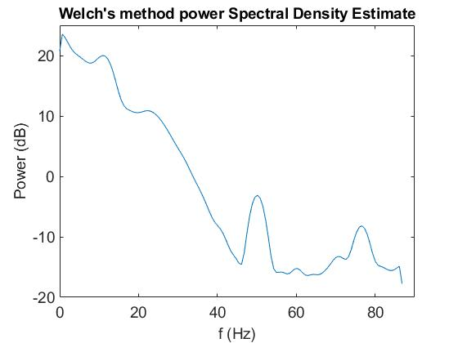
Welchs method

Slide 4
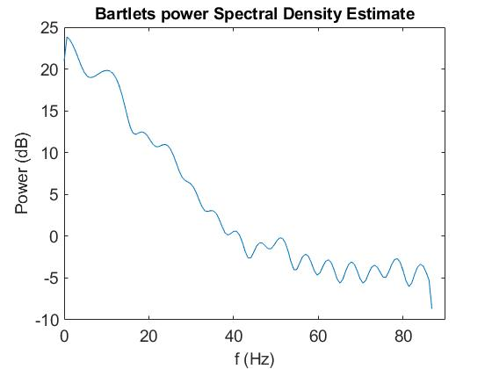
Bartlett’s method

Slide 5
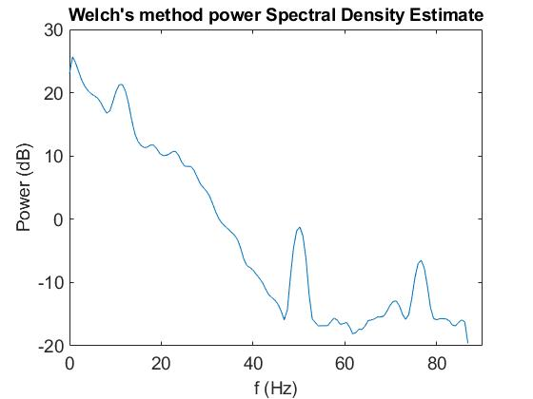
Welchs method
Effect of window sizes
Window = 64
Window = 100

Slide 6
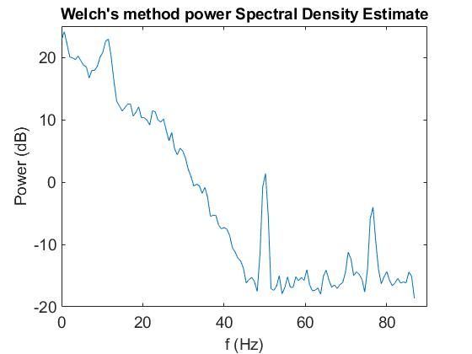
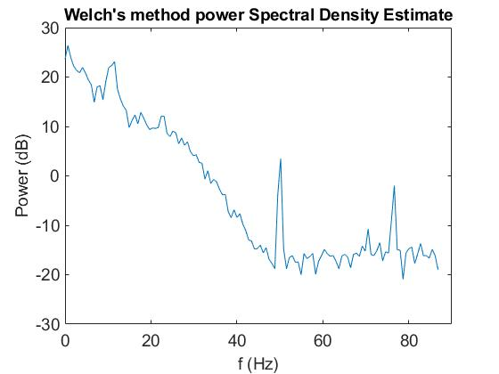
Welchs method
Effect of window sizes
Window = 200
Window = 400

Slide 7
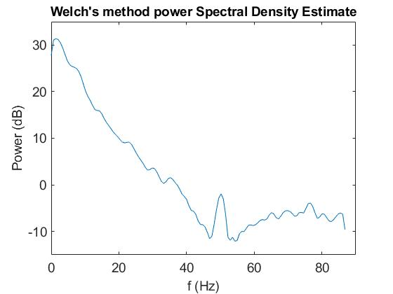
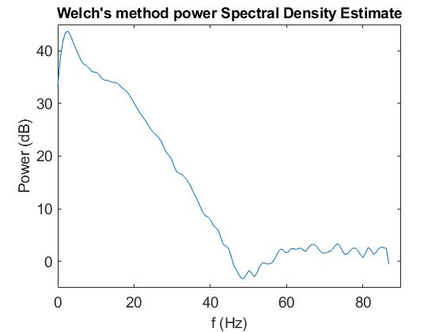
Welchs method
Data set A
Data set D
Data set E

