Slide 1
Prof. Dr. Rebonato
Financial Derivatives
Midterm
Augustin Lemarquand, Bob Hunold, Melody Cohen, Kristina Mihaylova, Consantin Schmidt-Chiari, Tobias Rungg, Elliot jonsson Tim Hirndorf
Notes:
[Speaker 1 | 0:15]
Introduce the group and the topic.
One European call: S0 = K = 100, T = 1 year, σ = 20%, r = 3.94% (1-month T-bill), GBM, no dividends.
Hand over straight to the plan.

Slide 2
1
Plan of the Presentation
We value a 1-year at-the-money call (S₀ = K = 100, σ = 20%, r = 3.94%, the 1-month T-bill rate (06.10.2026)) on a non-dividend-paying stock that follows a GBM. In this presentation we:
1 Pricing
2 Replication
3 Greeks
Price the option with Black-Scholes, Monte Carlo and a binomial tree, and study convergence and uncertainty.
Replicate the option by delta hedging along 10,000 Monte Carlo paths, and explain the hedging error at expiry.
Estimate delta, gamma and vega with all methods, and explain why the methods differ.
Mention appendix and that the math is in there
Throughout
We show what the results depend on, and what they do not depend on. Black-Scholes is the benchmark.
EDHEC Business School | FIN 6999 Financial Derivatives | Mid-term project
2
Notes:
[Speaker 1 | 0:30]
One option, three questions: these are the three parts of the brief.
Pricing: Black-Scholes, Monte Carlo and a binomial tree, plus convergence and uncertainty.
Replication: delta hedge along MC paths and explain the hedging error.
Greeks: delta, gamma, vega with all three methods.
Black-Scholes is the benchmark for everything.
Running theme: what the results depend on, and what they do not depend on (the drift μ).

Slide 3
2
Pricing One Price, Three Engines
Remember that, given dS_{t} = μS_{t}dt + σS_{t}dz_{t}, no-arbitrage gives the PDE
∂C/∂t + rS ∂C/∂S + ½σ²S² ∂²C/∂S² − rC = 0 (1)
and, by Feynman-Kac, its solution is the discounted expectation
C = e^{−rT} E^{Q}[max(S_{T} − K, 0)]
S_{T} = S₀ exp[(r − ½σ²)T + σ√T ε] (2)
Black-Scholes solves (1) in closed form:
C = S₀N(h₁) − Ke^{−rT}N(h₂), h₁ = 0.297, h₂ = 0.097
Three engines, one number
Black-Scholes
solves (1) in closed form
Monte Carlo
computes (2) by sampling S_{T}
Binomial tree (CRR)
computes (2) by enumerating a lattice
Better formulas, looking like real formulas, add formula of d1 and d2
All three compute the same number, so they must agree. What differs is speed and the type of error.
EDHEC Business School | FIN 6999 Financial Derivatives | Mid-term project
3
Notes:
[Speaker 1 | 0:50]
"Remember" the lecture: Ito on C, choose Δ = ∂C/∂S so dz cancels, riskless portfolio earns r → PDE (1). μ drops out.
Feynman-Kac: the solution of (1) is the discounted risk-neutral expectation (2).
Black-Scholes solves (1) in closed form (h1 = 0.297, h2 = 0.097).
Monte Carlo samples S_T exactly from the lognormal, so no time-discretisation bias.
The tree enumerates outcomes on an up/down lattice.
KEY LINE: "All three compute the same number, so they must agree. What differs is speed and the type of error."

Slide 4
2
Pricing Results
Method | Settings | Call price | Error vs BS | Uncertainty
Black-Scholes | closed form | 9.8940 | – | none (exact)
Monte Carlo | 10⁸ paths | 9.8959 | +0.0020 | SE 0.0014
Binomial tree (CRR) | 10,000 steps | 9.8938 | −0.0002 | deterministic
Black-Scholes lies inside the Monte Carlo 95% confidence interval [9.8931, 9.8988].
The tree has the same error for the, so it respects put-call parity exactly: C − P = S₀ − Ke^{−rT} = 3.863.
Every engine lands within a quarter of a cent of the Black-Scholes price.
Also include visualization of price convergence
EDHEC Business School | FIN 6999 Financial Derivatives | Mid-term project
4
Notes:
[Speaker 1 | 0:40]
Walk the table: BS 9.8940 exact.
MC with 10^8 paths: 9.8959, +0.0020, SE 0.0014. BS lies inside the 95% CI.
Tree with 10,000 steps: 9.8938, −0.0002.
Parity (one line): the tree is linear in the payoff and prices the forward exactly, so call minus put has no error.
KEY LINE: "Every engine lands within a quarter of a cent."
→ Hand over to Speaker 2.

Slide 5
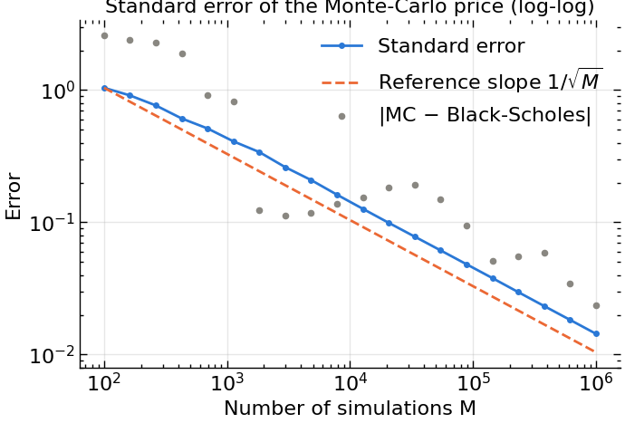
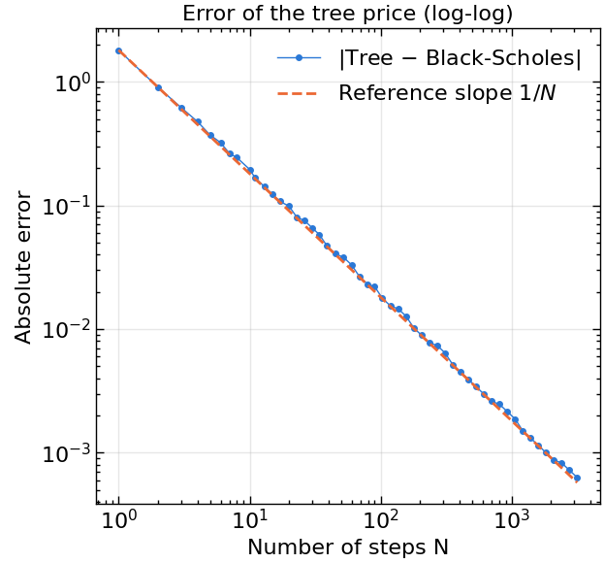
2
Pricing Convergence
Monte Carlo: error ∝ 1/sqrt(M)
Binomial tree: error ∝ 1/N
Variance of a mean of M i.i.d. payoffs is s²/M (CLT). SE 1.0 → 0.014 → 0.0014 at M = 10², 10⁶, 10⁸.
log S_{T} on the lattice tends to a Gaussian. The error zig-zags: K falls on or between nodes (odd/even N).
10× more effort gives 3.2× / 10× smaller error. The slope on the log-log plot is the order of convergence.
EDHEC Business School | FIN 6999 Financial Derivatives | Mid-term project
5
Notes:
[Speaker 2 | 1:15]
How to read the plots: log-log; error = c·N^(−k) gives a straight line with slope −k.
MC: SE = s/√M with s ≈ 14 (CLT). Halving the error needs 4× the paths. SE 1.0 / 0.014 / 0.0014 at 10^2 / 10^6 / 10^8. Grey dots = actual |MC − BS|, scattering around the SE line.
Tree: CRR matches mean and variance per step; binomial log S_T → Gaussian; error ∝ 1/N (1.8 / 0.02 / 0.002 / 0.0002 at N = 1 / 100 / 1,000 / 10,000).
Zig-zag: K = 100 falls on a node or between nodes depending on odd/even N.
10× effort: MC 3.2× smaller error, tree 10×.
But MC is the most flexible: path-dependent payoffs, many underlyings.
KEY LINE: "Same answer, very different speed. The slope is the order of convergence."

Slide 6
Pricing uncertainty
Error = bias + noise. Which error is the largest?
0.0014
0.0002
0.38
Monte Carlo standard error (10⁸ paths): statistical, random and unbiased. We report Ĉ ± 1.96 SE.
Tree bias (10,000 steps): deterministic, no confidence interval, size known from the order 1/N.
Price change from 1 vol point in σ (vega × 0.01): about 200× the MC standard error.
Die slide komplett ändern
Answer: none of the numerical ones. The real uncertainty is the volatility we put in: model error ≈ Vega × (σ_{true} − σ_{used}).
EDHEC Business School | FIN 6999 Financial Derivatives | Mid-term project
6
Notes:
[Speaker 2 | 0:50]
MC error is statistical: random, unbiased, so we give a confidence interval (Ĉ ± 1.96 SE).
Tree error is discretisation: deterministic bias, same settings give the same price, size known from the 1/N rate.
Ask the room: "Which error is the largest?" Pause.
Answer: neither. Vega = 38.17, so 1 vol point moves the price by 0.38, about 200× the MC standard error.
Also: every number assumes GBM with constant σ and r.
BRIDGE: "Our numerical errors are tiny. The real uncertainty is the volatility we put in, and that is what hedging is about."
→ Hand over to Speaker 3.

Slide 7
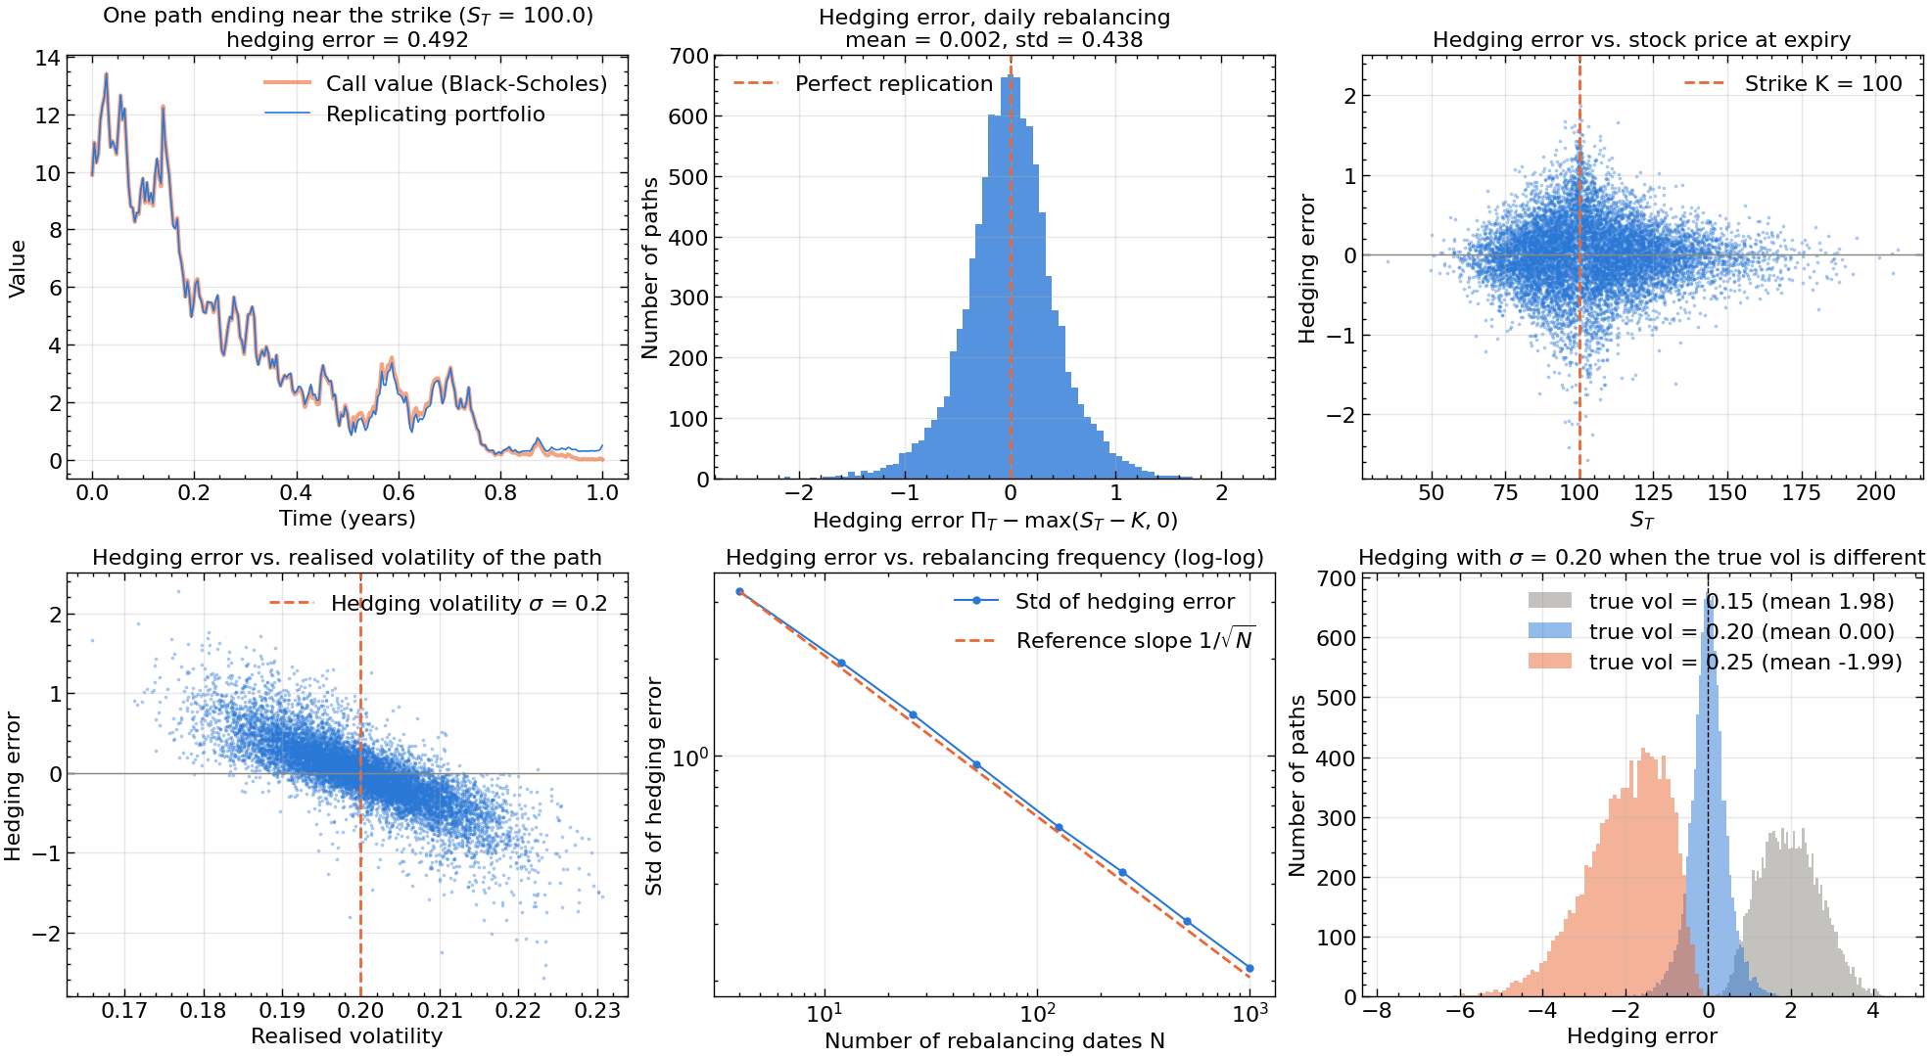
3
Replication set-up and results
Sell the call for C₀ = 9.894, buy Δ = N(h₁) shares, put the rest in the bank. Rebalance on fixed dates, self-financing. Paths use the real-world drift μ.
On each of 10,000 paths record the hedging error ε = Π_{T} − max(S_{T} − K, 0).
Dates N | Std ε | Mean ε
4 | 3.22 | 0.06
12 | 1.94 | 0.01
52 | 0.95 | 0.01
252 | 0.44 | 0.01
1,000 | 0.22 | 0.00
Reine Daten und 1 beispiel replication anzeigen
252 = daily: std 0.44, about 4.4% of the premium
On average the hedge works. Path by path it misses, and 4× more trading only halves the miss. Why?
EDHEC Business School | FIN 6999 Financial Derivatives | Mid-term project
7
Notes:
[Speaker 3 | 1:10]
Strategy: sell the call at 9.894, hold Δ = N(h1) ≈ 0.62 shares, rest in the bank; rebalance, self-financing.
Paths use the real-world drift μ, not r.
ε = portfolio minus payoff at expiry: positive = surplus, negative = shortfall.
Daily rebalancing: mean 0.002, std 0.44, about 4.4% of the premium.
Table: 4× more rebalancing only halves the std (slope −½ on the right plot).
KEY LINE: "On average the hedge works. Path by path it misses, and four times more trading only halves the miss. Why?"

Slide 8
3
Replication the hedging error
Proof: P&L of the hedged position over one step dt
Taylor / Ito: dC = Θdt + ΔdS + ½ΓdS²
The replicating portfolio earns ΔdS + r(C − ΔS)dt
The PDE (1) gives −Θ + r(C − ΔS) = ½σ²S²Γ
Therefore
dε = ½ΓS² [ σ²dt − (dS/S)² ] (3)
“variance we were paid for” minus “variance that was delivered”
What (3) tells us
E[(dS/S)²] = σ²dt, so the mean error is 0.
Each step adds noise of order dt; summed over N steps, std ∝ 1/√N.
μ does not appear in (3): the result does not depend on the drift.
Check against Derman-Kamal (1999): std(ε) ≈ √(π/4) σ Vega / √N = 6.77/√N
gives 3.38 / 1.95 / 0.94 / 0.43 / 0.21 for N = 4 / 12 / 52 / 252 / 1,000, against our simulated 3.22 / 1.94 / 0.95 / 0.44 / 0.22.
Bessere formeln und generell nochmal rüber
After delta hedging, what is left is a bet on volatility: gamma times implied minus realised variance.
EDHEC Business School | FIN 6999 Financial Derivatives | Mid-term project
8
Notes:
[Speaker 3 | 1:45] (longest slide, rehearse it)
Step 1: Ito/Taylor to second order.
Step 2: self-financing portfolio earns ΔdS plus interest on the cash.
Step 3: substitute the PDE: theta and gamma are tied together.
Step 4: equation (3) = variance we were paid for minus variance delivered.
Mean 0 because E[(dS/S)²] = σ²dt.
Std ∝ 1/√N: each step adds noise of order dt; N steps → variance N·dt² ∝ 1/N.
μ does not appear: drift does not matter.
As dt → 0, (dS)² → σ²S²dt and ε → 0: this is the Black-Scholes argument itself.
Derman-Kamal check: 6.77/√N matches our simulated std.
KEY LINE: "After delta hedging, what is left is a bet on volatility."

Slide 9
3
Replication what the error depends on
Equation (3) tells us everything:
Rebalancing frequency: std ∝ 1/√N. Quarterly hedging gives 3.2, about a third of the premium.
Where the path goes: ΓS² is largest near K close to expiry, so paths ending near the strike have the biggest errors.
The volatility that was delivered (we hedge with σ = 20%):
True vol | 10% | 15% | 20% | 25% | 30%
Mean ε | +3.90 | +1.97 | 0.01 | −1.98 | −3.97
Std ε | 1.05 | 0.73 | 0.44 | 1.00 | 1.92
Check: Vega × 5 vol points = 38.17 × 0.05 = 1.91.
Not the drift: mean ε ≈ 0 for μ = 0%, 5%, 10% and 20%.
Hedging with σ = 20%: wrong vol shifts the whole distribution, it does not just widen it.
Verstehen und dann nochmal gucken
Works with frequent trading, the right σ and no jumps. Fails with rare trading, the wrong σ, S near K close to expiry, transaction costs and jumps. Wrong volatility turns noise into a systematic loss.
EDHEC Business School | FIN 6999 Financial Derivatives | Mid-term project
9
Notes:
[Speaker 3 | 1:15]
Use (3) as a checklist.
Frequency: std ∝ 1/√N; quarterly gives 3.2, a third of the premium.
Where the path goes: ΓS² is largest near K close to expiry, so paths ending near the strike have the biggest errors.
Delivered vol: show the table and histograms. Real vol > 20% → systematic loss; < 20% → gain. About ±2 per 5 vol points; check Vega × 0.05 = 1.91.
Drift: mean ≈ 0 for μ = 0, 5, 10, 20%.
Works: frequent trading, right σ, no jumps. Fails: rare trading, wrong σ, S near K near expiry; in practice also transaction costs (trade-off with 1/√N), jumps, stochastic vol.
KEY LINE: "Wrong volatility turns noise into a systematic loss. The variance delivered is the BIG problem."
→ Hand over to Speaker 4.

Slide 10
4
Greeks results
Greek | Black-Scholes | MC (10⁶) | MC SE | Tree (N = 1,000)
Delta | 0.6168 | 0.6167 | 0.0006 | 0.6167
Gamma | 0.01909 | 0.01903 | 0.00011 | 0.01910
Vega | 38.17 | 38.19 | 0.08 | 38.16
The option is at the money. Why is delta 0.62 and not 0.5?
Answer:
h₁ = (r + ½σ²)√T / σ = 0.297 > 0.
The forward S₀e^{rT} ≈ 104 > K, and the lognormal is right-skewed.
Delta is a hedge ratio, not the probability of exercise: N(h₂) = 0.54.
Closed forms
Δ = N(h₁), Γ = φ(h₁) / (Sσ√T), Vega = Sφ(h₁)√T
The “magic cancellation” behind Δ = N(h₁) is Sφ(h₁) = Ke^{−rT}φ(h₂) (backup).
Vega is per 1.00 of volatility: per vol point (20% → 21%) the price moves by 0.38.
Formeln in appendix, das auch auf der slide sagen
All three methods agree to 3–4 digits; every MC estimate is within 0.5 standard errors of Black-Scholes.
EDHEC Business School | FIN 6999 Financial Derivatives | Mid-term project
10
Notes:
[Speaker 4 | 1:00]
All methods agree to 3–4 digits; MC within 0.5 SE of BS.
Delta 0.62: hedge ratio, hold 0.62 shares per call.
Gamma 0.019: delta change per 1 move in S; highest near the strike → hardest to hedge.
Vega 38.17 per 1.00 of vol = 0.38 per vol point.
Ask: "At the money, why is delta 0.62 and not 0.5?" Pause.
Answer: h1 = 0.297 > 0; forward 104 > K and the lognormal is right-skewed. Delta is not the exercise probability: N(h2) = 0.54.
If asked why Δ = N(h1): backup B2.

Slide 11
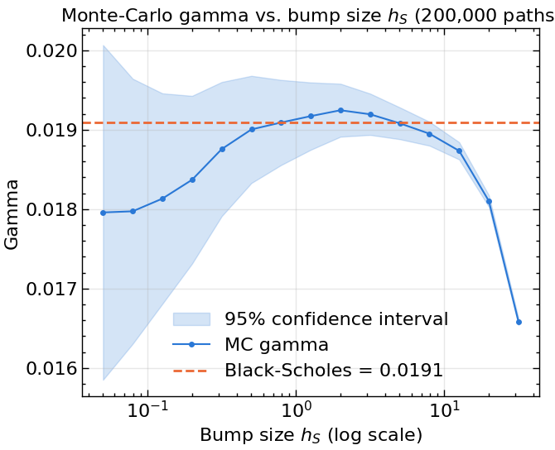
4
Greeks how each method gets them
Tree
Delta and gamma come for free from the first nodes: Δ = (C_{u} − C_{d}) / (Su − Sd), as in one-period replication.
Vega needs two extra trees (σ is not a dimension of the tree). Error ∝ 1/N.
Monte Carlo
Bump and reprice with the same random numbers:
Δ ≈ [C(S+h) − C(S−h)] / 2h
Γ ≈ [C(S+h) − 2C(S) + C(S−h)] / h²
Bias ∝ h², but Var(Γ) ∝ 1/h: only paths ending near K contribute. A bias-variance trade-off; we use h = 1.
Small h: unbiased but noisy. Large h: smooth but biased. Gamma has about 6× the relative error of delta.
Das sing rechts erstmal verstehen
The tree gets Greeks almost for free. Monte Carlo has to difference noisy numbers, and gamma suffers most.
EDHEC Business School | FIN 6999 Financial Derivatives | Mid-term project
11
Notes:
[Speaker 4 | 0:55]
Tree: delta and gamma for free from the first nodes, same as one-period replication. Vega needs two extra trees with σ bumped. Error ∝ 1/N.
MC: no derivative to read off, so bump and reprice with the same random numbers (common random numbers make the noise cancel).
Gamma trade-off: bias ∝ h², variance ∝ 1/h, since only paths ending near K contribute. Point to the plot; we use h = 1.
Gamma has about 6× the relative error of delta.
If asked: pathwise and likelihood-ratio estimators exist.
KEY LINE: "The tree gets Greeks almost for free. Monte Carlo has to difference noisy numbers, and gamma suffers most."

Slide 12
Conclusions
All three engines converge to 9.894. What matters is the volatility we put in and how often we hedge.
Pricing
Replication
Greeks
MC converges at order ½, the tree at order 1. The numerical error is small next to the error from the volatility input (vega).
The hedging error is ½ΓS² × (implied − realised variance). With the right σ it is zero on average and shrinks like 1/√N; with the wrong σ it is a systematic P&L of about Vega × vol error. It does not depend on μ.
All methods agree to 3–4 digits. Gamma and vega peak near the strike, and that is where hedging is hardest.
Visuell rüber gehen, rest passt pi mal daumen
Questions?
12
Notes:
[Speaker 4 | 0:40]
Read the headline statement.
Pricing: one line, convergence orders ½ and 1; numerical error small next to vega.
Replication: hedging error = ½ΓS² × (implied − realised variance); zero mean with the right σ, systematic with the wrong one; not the drift.
Greeks: gamma and vega peak near the strike, where hedging is hardest.
Close: "Thank you. Questions?"

Slide 13
Appendix
Backup slides for Q&A: hedging-error check, Δ = N(h₁), numerical details
Appendix komplett nochmal überarbeiten und viel mathematischen hintergund reinhauen
13
Notes:
Q&A only. Do not present; jump here when a question needs it.

Slide 14
B
Appendix replication and Greeks
B1 Discrete-hedging error vs. Derman-Kamal
B2 Why Δ = N(h₁)
Dates N | Simulated std | 6.77 / √N
4 | 3.22 | 3.38
12 | 1.94 | 1.95
52 | 0.95 | 0.94
252 | 0.44 | 0.43
1,000 | 0.22 | 0.21
Proof:
∂C/∂S = N(h₁) + Sφ(h₁) ∂h₁/∂S − Ke^{−rT}φ(h₂) ∂h₂/∂S
h₂ = h₁ − σ√T, so ∂h₁/∂S = ∂h₂/∂S
φ(h₂) / φ(h₁) = exp((h₁² − h₂²) / 2) = Se^{rT} / K
So Sφ(h₁) = Ke^{−rT}φ(h₂): the extra terms mercifully cancel, and Δ = N(h₁).
Derman-Kamal (1999): std(ε) ≈ √(π/4) σ Vega / √N. The simulation matches to within 5%.
EDHEC Business School | FIN 6999 Financial Derivatives | Mid-term project
14
Notes:
Q&A only.
B1: use if asked whether the hedging std is plausible. Derman-Kamal 6.77/√N vs our simulation.
B2: use if asked why Δ = N(h1). The extra terms cancel because Sφ(h1) = Ke^(−rT)φ(h2).

Slide 15
B
Appendix numerical details
B3 Monte Carlo standard error
B4 CRR tree
The estimator is a mean of M i.i.d. discounted payoffs X_{i}:
Var(mean) = s²/M, with s ≈ 14, so SE = s/√M.
CLT: 95% CI = Ĉ ± 1.96 SE.
Halving the error needs 4× the paths.
S_{T} is sampled exactly from the lognormal, so there is no time-discretisation bias.
u = e^{σ√Δt}, d = 1/u, p = (e^{rΔt} − d) / (u − d)
These match the mean and variance of the GBM over each step.
By the CLT, the binomial log S_{T} tends to a Gaussian: error O(1/N).
The odd/even oscillation comes from the strike sitting on or between nodes at expiry.
EDHEC Business School | FIN 6999 Financial Derivatives | Mid-term project
15
Notes:
Q&A only.
B3: MC standard error and confidence interval (s ≈ 14, CLT, exact lognormal sampling).
B4: CRR parameters, why they match mean and variance, and the odd/even oscillation.

