Slide 1
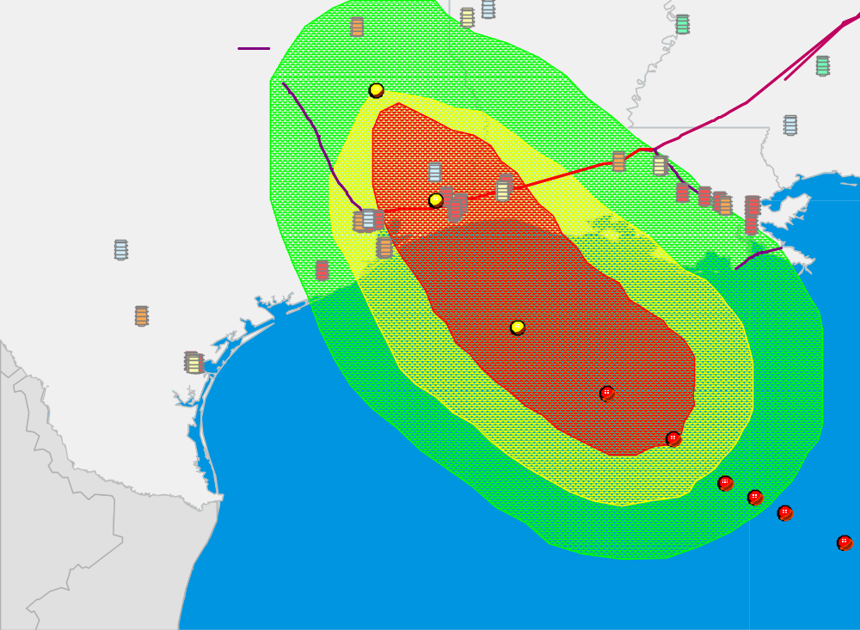
Hurricane Rita’s Projected Path – 1100 Sep. 23
Port Arthur
Refining Center
Lake Charles
Refining Center
Houston/Texas City/Galveston
Refining Center
Corpus Christi
Refining Center

