Slide 1
NLPCHEf
By Emilia, Tim and Sergio

Slide 2
Contents
Our project
Datasets
GPT-2 model
Custom model
Results
Conclusion

Slide 3
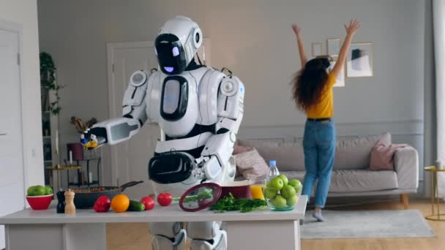
OUR project
What to cook?
Recipe generator
NLP

Slide 4
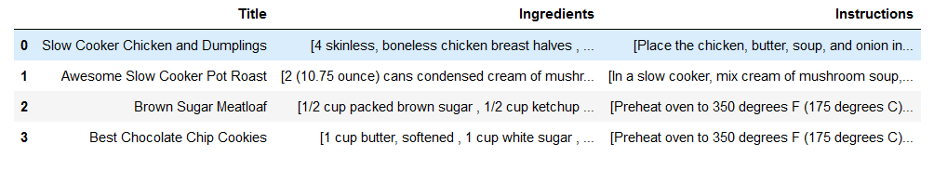
Datasets
Websites with recipes
Foodnetwork.com, Epicurious.com, Allrecipes.com
Preprocessing

Slide 5
GPT-2 model
General-purpose learner
A transformer model
Not perfect for the task at hand

Slide 6
Custom model
Input: specific ingredients
Output: a recipe
Training the model
Hyperparameter tuning
Perfect for task at hand

Slide 7
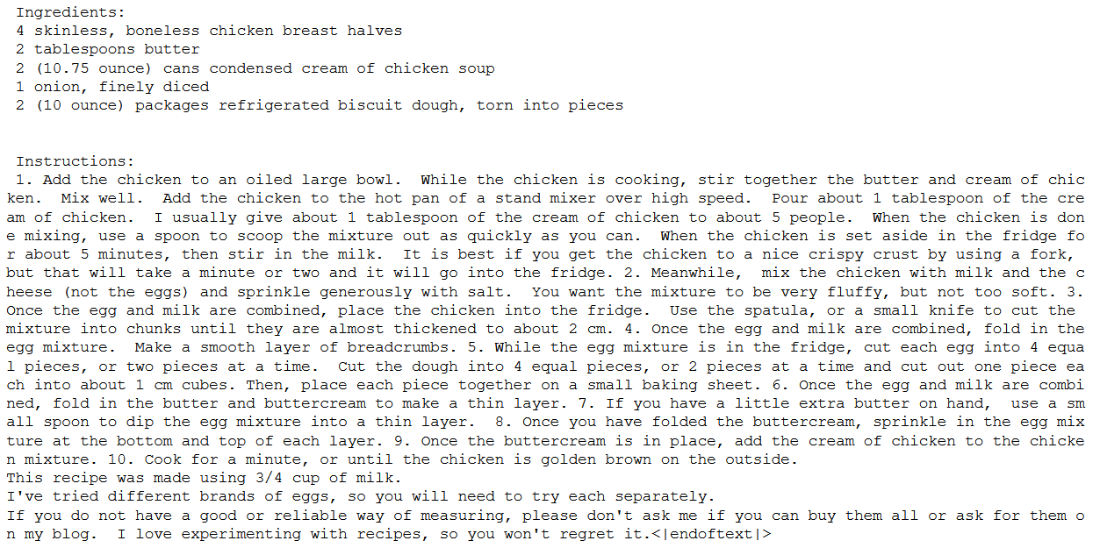
Results
Example of GPT-2 model generated recipe:

Slide 8
Results
Results of the custom model
How to know if the model is performing well

Slide 9

Conclusion
The GPT-model versus our custom model
Could it create cookbooks?

