Slide 1
NLPCHEf
By Emilia, Tim and Sergio

Slide 2
Contents
Our project
Datasets
GPT-2 model
Custom model
Results
Conclusion

Slide 3
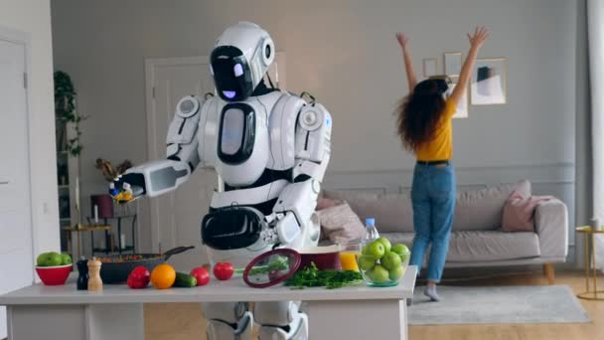
OUR project
What to cook?
Recipe generator
NLP

Slide 4
GPT-2 model
General-purpose learner
A transformer model
Not perfect for the task at hand

Slide 5
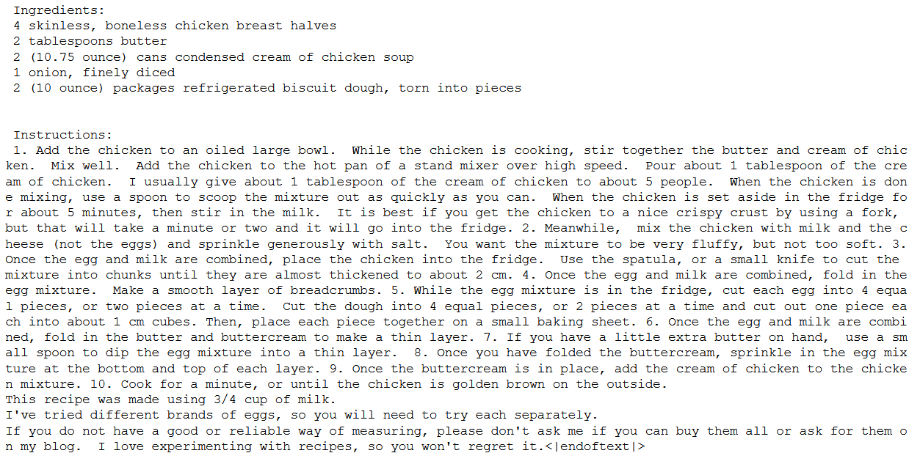
Results
Example of GPT-2 model generated recipe:

Slide 6
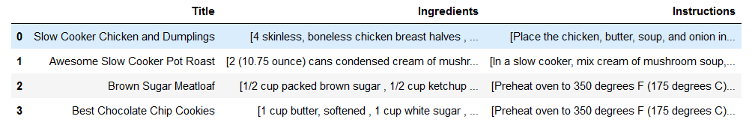
Custom model
Input: specific ingredients
Output: a recipe
Data Processing
Training the model
Perfect for task at hand
Datasets
Foodnetwork.com, Epicurious.com, Allrecipes.com

Slide 7
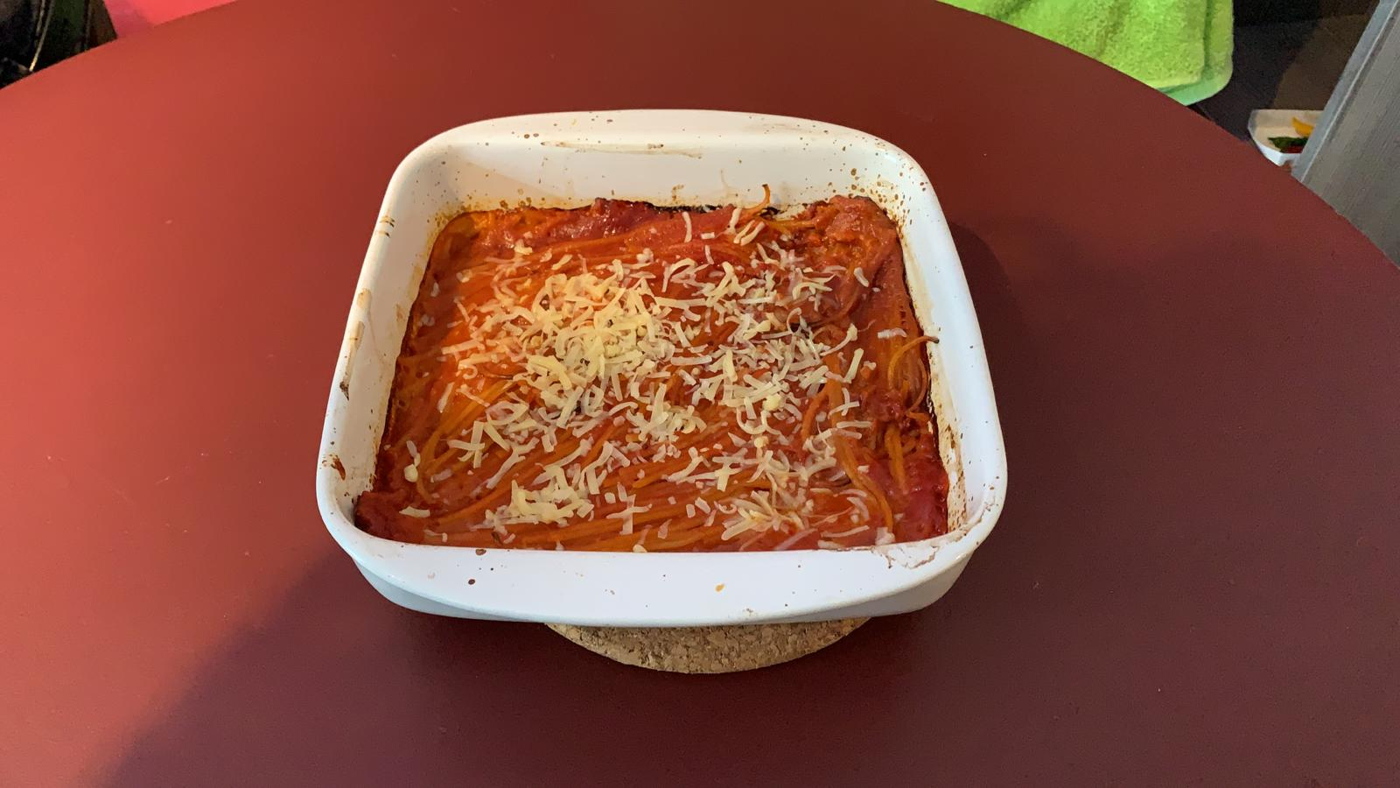
And I tried it!
Boiling Spaghetti in the oven
It was good!

Slide 8
Results
NLPChef Recipe:
Input | Output
Ingredients: 1/4 cup oil 6 medium onions, chopped 4 bell peppers, chopped 3 carrots, chopped 1 cup string beans, broken into pieces 3/4 cup peas 6 tomatoes, chopped 1/2 teaspoon black pepper 1 teaspoon dried thyme 4 cups medium grain brown rice, cooked (cold) 1/2 cup tomato paste | Instructions: Cut 2 large onions, in half lengthwise and place them on a baking sheet. Cover with a plastic baking sheet. Let sit 30 minutes. Set aside. In a bowl, toss in the onion mixture. Add the rice and cook gently. Remove from heat, and then place rice on a lightly oiled baking sheet. Bake at 425 degrees for 10 minutes, or until the top is golden brown. Remove from heat, and then place on serving platter. To serve, garnish the cooked rice with chopped parsley and chopped coriander. You can serve this appetizer on it's own or with other rice. Enjoy! Print Author: Baked Rice
GPT-2 Recipe:
NLPChef Recipe:
Input | Output
Bake 5 eggs. Add them to the tomatoes. Boil the pasta. | Bake 5 eggs. Add them to the tomatoes. Boil the pasta. Cover for 6 and set out on a large plate and serve as your usual dessert – or, to reheats! – the sauce may work, it's more complex on me. Try a bit too long a way for your tastes or to try the flavours at any level: if you think a bite looks a little boring try just going with your nose, which has your heart so set up you will find that

Slide 9
Results
GPT-Recipe vs Custom Recipe
Transformer model
Top-K Sampling
Temperature

Slide 10

Conclusion
The GPT-model versus our custom model
Could it create cookbooks?

