Slide 1
HP Hackathon 2015
EA 360
Universal task oriented knowledge context
Stephen Theby, Tim Huff & Gilbert Guerrero
2 Sep 2015

Slide 2

EA 360 Summary
Idea : universal task oriented knowledge context;
Audience: all employees
Value: $86,500 per minute ($1.73 FBR¹ @ 50,000 employees² @ 96 minutes per day³)
Self correcting; employees maintain knowledge artifacts via request mechanism routed to responsibility queues; missing knowledge explicitly evident in greyed out 360 icons.
1 Fully Burdened Rate
2 Assumes that all employees of HPI are knowledge workers who could benefit from this assistance approach
3 Assumes 20% of 8 hour day is spent searching for mechanisms to do assigned work, e.g. guidelines, standards, completed work examples, tools, subject matter experts (SMEs), similar problem solutions, special interest group and forum discussions. It also includes procedures on how to acquire suggested tools.

Slide 3
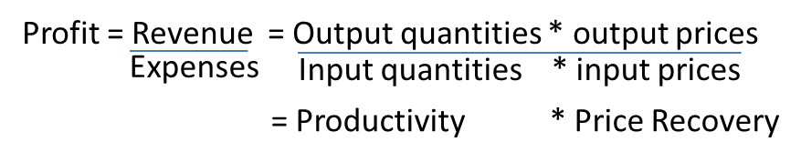
Productivity and Profitability
Let our sales team slide this ratio to get the sale
We need to concentrate on this ratio across all processes
Profitability drives all enterprises but especially startups
Profit ratio = Revenue/Expense
Revenue = Output quantities * Output prices
Expense = Input quantities * Input prices
Ratio
(1=breakeven)
We can make a profit two ways:
High price recovery
High productivity
When HP has high productivity it can continue to lower prices and still remain profitable and competitive.
How do we detect productivity leaks and what are our productivity improvement strategies?

Slide 4
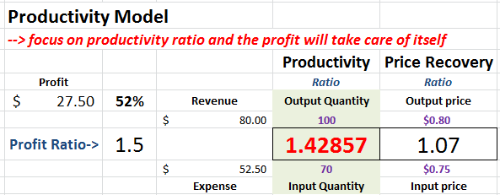
Productivity Strategies & Improvement Discovery
Output Up
Work Smarter
=
Input Same
Output Same
Reduce Costs
=
Input Down
How do we detect potential problem areas? We search for the following signals … Leaks
Unnecessary iteration (rework)
High manual effort
Lack of explicit procedures
High ambiguity in one or more tasks
Lack of completion criteria
High people coordination
High person to person communication
High complexity
Low reuse of known information (360º)
Inability to recognize operational patterns
Embedding of rules into procedure
Lack of tool usage
Output Up
Work Effectively
=
Input Down
Output Up
Manage Growth
=
Input up by lessor amount
Pare Down
Output Down
=
Input down more

Slide 5











Development Studios & Task Mechanisms
Example 1
Example 2
LightSwitch [Visual studio] / Model Driven (.Net & Azure)
Outsystems / Model Driven (.Net or Java)
Better
Idea !
3 EA wiki entry points:
General discovery
SIG directed discovery
Task specific discovery [context menu click & < 3 sec 360⁰ support view]
Studio⁴
Dev Studio³
T360 API
Studio
T360 API¹
Dev Studio
Studio
Architects/Area
Task Expert Blogs
Task Guidelines
Task Related Standards
Task Related Studio
Task Template
Task Tools
Task Training
Task Worked Example
Studio
Studio
Studio
ReST²
360^{0 by Task (one click)}
Mechanism
Best (easy button⁵)
Highest potential productivity increase
Studio
Example 3
Studio
Repository
( Cassandra⁶ )
T360 API
Studio
Example 4
Studio
Dev Studio
Dev Studio
Studio
T360 API
Website
Studio
Studio
Studio
Studio
Ralley, AgileCraft, Agile Mgr
IronSpeed / Model Driven (.Net)
1 Task 360 (T360) 360⁰ Resource Request by task API (task ID)
2 Representational State Transfer (stateless)
3 Development Portal (Visual Studio, Eclipse, 3rd party …)
4 Business Capability Delivery Studios (see HP fabric portal)
5 All three mechanism views are needed; the rating indicates value relative to value stream/task forward acceleration & cadence.
6 Unstructured data storage of our choice, e.g. Cassandra, Mongo, Autonomy depending on business strategy, functionality , cost/licensing
Discovery by SIG
Discovery by Role
Good - specific
Good - general
Issued: 28 Jun 2015
Revised: 9 Jul 2015
Architect: HPI EA, Stephen Theby

Slide 6
HP Fabric – Engineering Portal / Studios
Engineering Portal | Description
Development Studio | Intelligent CTO¹ tool to build/assemble applications with hot links to all other studios and resources
Service Studio | Tool to discover, build and manage services (simple to workflow as a service) by contract (assertions²)
Integration Studio | Tool to define integration usage patterns & connections to data and service resources
Business Rule Studio | Tool to define/manage application business rules
Business Events Studio | Tool to define/manage application business events
Security Studio | Tool to create and maintain application security resources
Archive Studio | Tool to create and maintain application archive resources
Deployment Studio | Tool to create and maintain application deployment packages
Traffic Studio | Tool to instrument and enable end to end message traffic monitoring, alerting and analysis
Backup/Recover Studio | Tool to configure application backup and recovery using services
Migration Studio | Tool to migrate an application to a new environment using a maintained impact signature by tools above
Decommission Studio | Tool to decommission an application, service or interface using a maintained impact signature by tools above
Studios best support a model driven development approach with a tiger team per studio that helps implement solution components to de-risk delivery cadence
1 Configure To Order using requirement characteristics, e.g. functional and non-functional artifact questionnaire; this tool is the starting point for all application construction with launch pads to IDEs of the developers choice, e.g. Eclipse and Visual Studio. Alternately its framework is pluggable into those IDEs for one uniform experience.
2 Assertions are business rules that constrain the values or relationship(s) of the object being operated on, e.g. they guard the object from invalid states.

Slide 7
Demo & Back matter
Thank you !!!

Slide 8
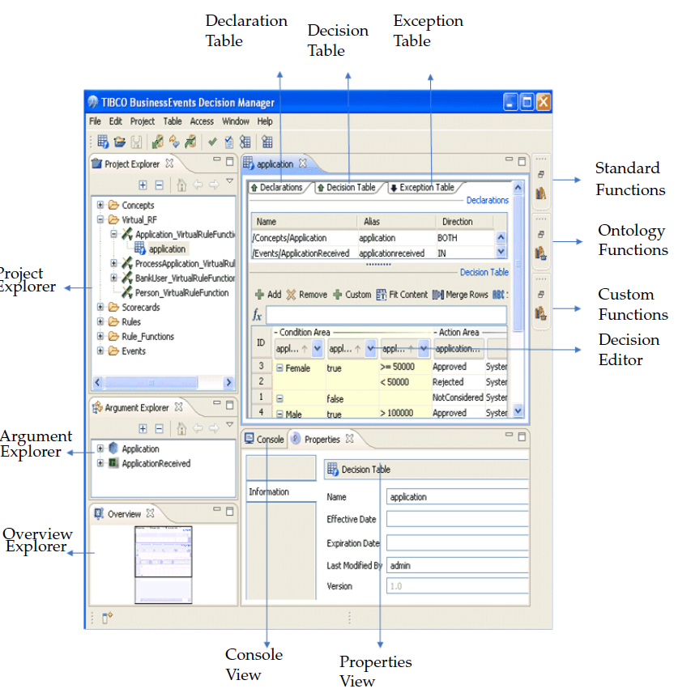
Rule Manager Entry (TIBCO rule administrator as example)
Used to enter & test business rules in local environment and then promote to production.
Declaration tables: declaring rule inputs and outputs
Decision tables: business rules/policies
Exception Tables: conditions & actions to handle exceptions

Slide 9
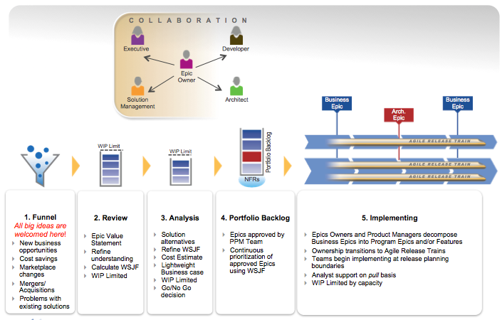
API/Service
Exposed as
Workflow
Value Stream
Implemented as
HP Behavior
Event
triggers
Story (Response)
Elaborated by
Use Case
Scaled Agile Methodology
Object
Governed by
Realized by
Interacts with
UX
Verified by
Is Responsible for
governs
Test Case (acceptance criteria)
Business Rule
Feature
Error Message
Crosses
Funded & Implemented by
Solution Big Picture
Constrained By
NFR
ART
ART
ART
Packages into
Weighted Shortest Job FIrst

Slide 10
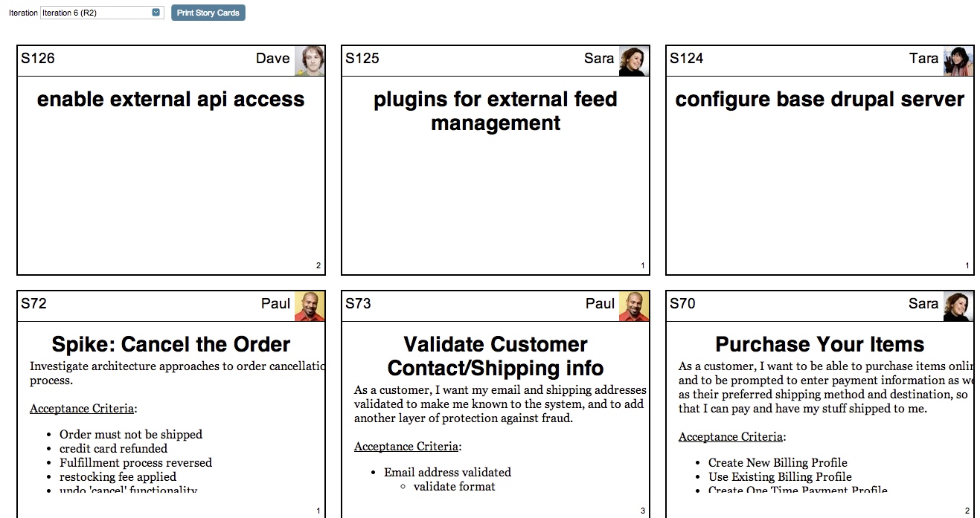
Story capture
Each card contains the following data:
Story FormattedID
Story owner and profile picture
Story name
Story description
Story estimate
Business Epic → Portfolio backlog
Story management & implementation
SCRUM
Extreme Programming (XP)

Slide 11
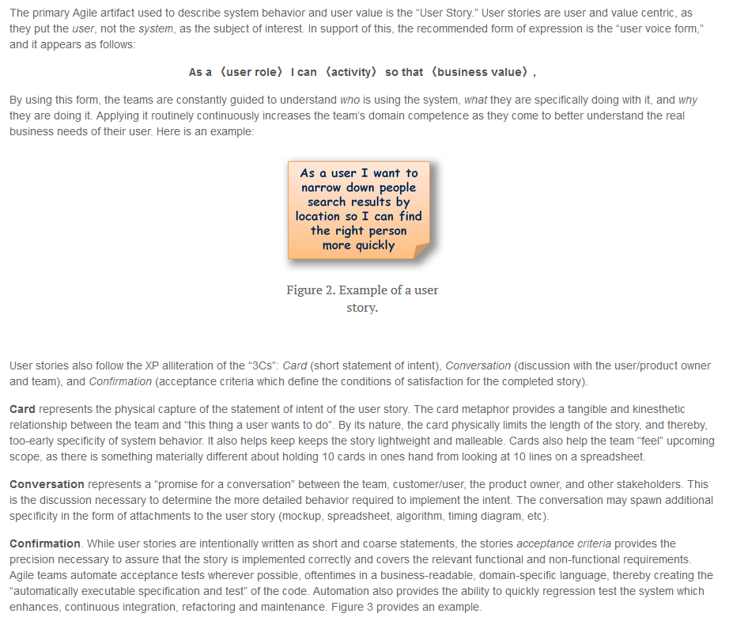
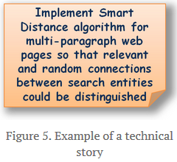
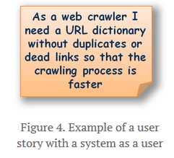
User Story – Standards example

Slide 12
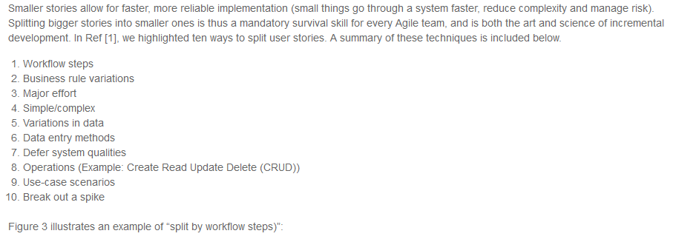
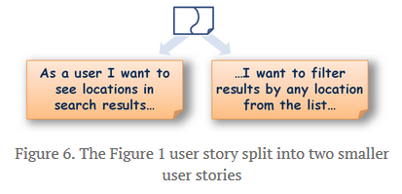
Splitting Stories - Guidelines

Slide 13
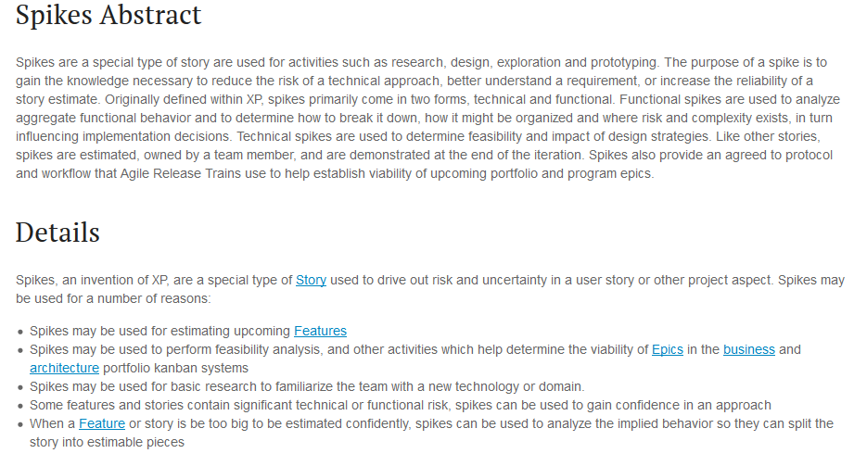
Spikes - Guidelines

Slide 14
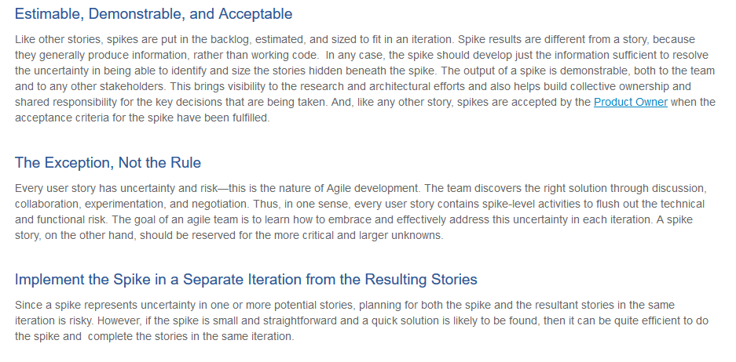
Spike Guidelines con’t

Slide 15
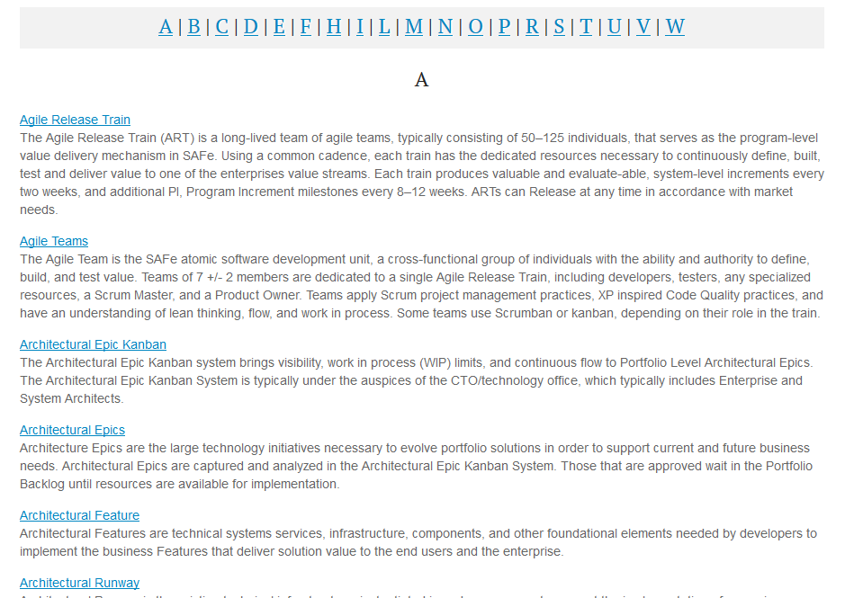
Glossary

Slide 16
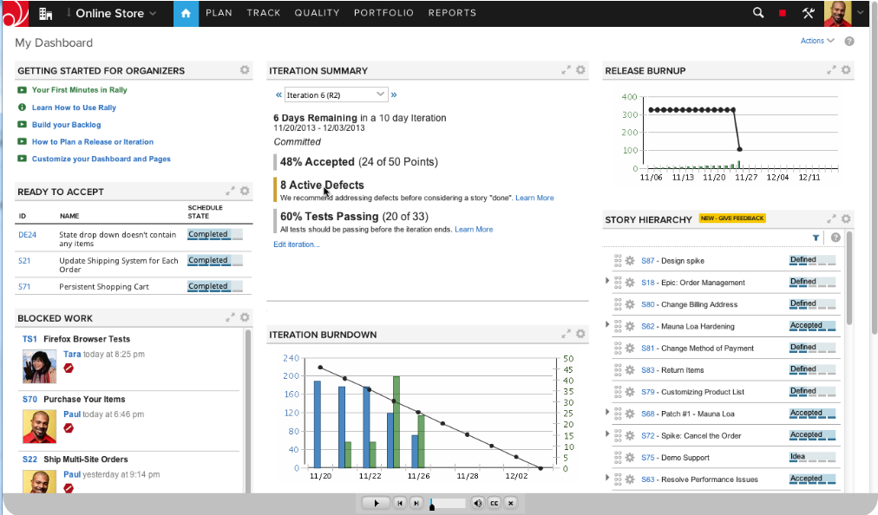
Agile Statusing

