Slide 1
SOLID
By Timi ‘Timigod’ Ajiboye

Slide 2


Slide 3
No, really.

Slide 4
S-O-L-I-D helps describe the 5 basic principles of object-oriented design

Slide 5
S
single responsibility principle
A class should have only one reason to change

Slide 6
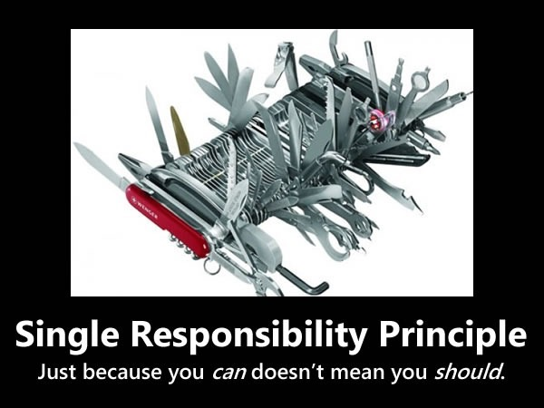

Slide 7
O
open-closed principle
Software entities (classes, functions, modules, etc) should be open for extension, but closed for modification

Slide 8
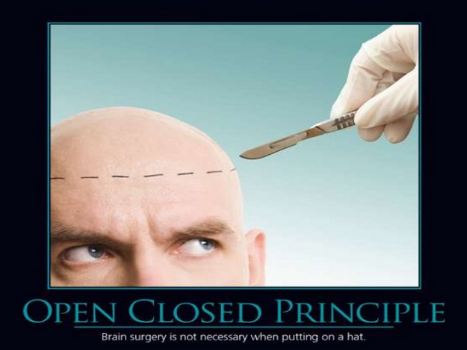

Slide 9
L
liskov substitution principle
Objects in a program should be replaceable with instances of their subtypes without altering the correctness of that program

Slide 10
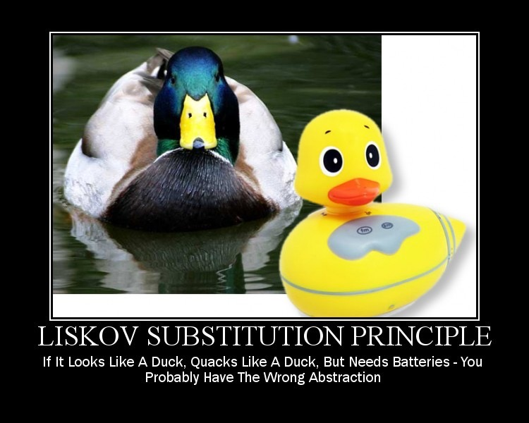

Slide 11
I
interface segregation principle
Many client-specific interfaces are better than one general purpose interface

Slide 12
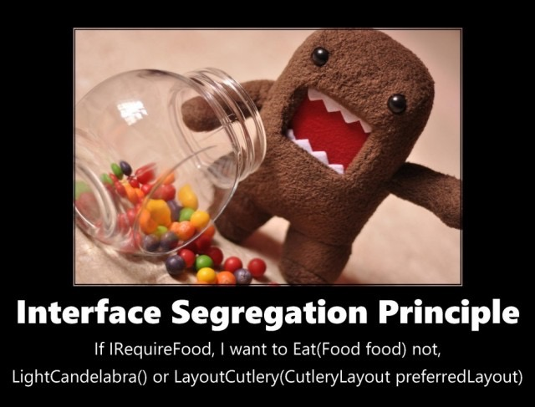

Slide 13
D
dependency inversion principle
1. High-level modules should not depend on low-level modules. Both should depend on abstractions.
2. Abstractions should not depend on details. Details should depend on abstractions.

Slide 14
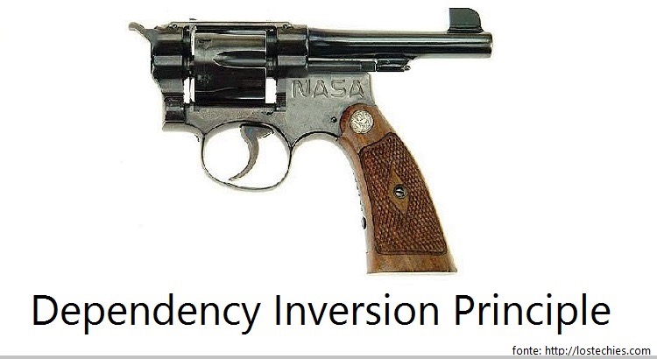

Slide 15
Clean code tips
Use literal names for variables and functions
Keep functions as concise as possible
Make it as readable (in English) as possible
Comment with caution

Slide 16


the end
(now’s the time to clap)

