Slide 1
Twits in Congress:
A Study of Social Media Adoption in US Congress by Session
Jason Smith, Michael Zhou, Tim Brown
UC Davis Data Analytics Bootcamp, 2022-23

Slide 2
Topic Overview/Relevance
Exploring Twitter Usage rates by Members of US Congress over time
Specifically investigate if a Machine Learning Model can be created to accurately predict how Twitter, or other Social Media Platforms, will be used in later stages based on early usage data.
Additionally, explore potential trends in contributing factors to a Congressperson’s Twitter adoption based on demographics, such as age and Congressional District location
Evaluate relationship between Social Media usage and Congressional Careers
Why The House of Representatives specifically
Twitter is a multimedia platform
Can be applied to non-Twitter alternatives
This analytical process, and machine learning model, could also potentially be used to evaluate what platforms a representative would most want to adopt
Twitter and Facebook alternatives, especially ones tied to extreme political beliefs, will likely become more widespread and diverse. How can politicians best reach their ‘followers’?
Notes:
Jason

Slide 3
Our Data
Sources:
List of Congress Representatives: Congress.Gov
List of Known Twitter Handles: Pressgallery.House.Gov
State Abbreviations: FAA.Gov
Twitter Handles: Twitter.com
Specific points of interest:
Congressperson Demographic information (Age, Gender, Political Party, State & District)
Congress Session in which Representatives created their Twitter Account
Twitter Account Information (Twitter Handle, Date profile created, age when handle created)
Notes:
Jason

Slide 4

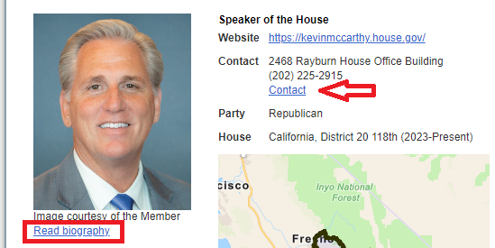

Data Wrangling - the easy one
Issues with getting the data together:
Demographics (Date of Birth, Gender, Twitter Handle, etc)
Using the current Speaker of the House - Kevin McCarthy (R - CA 20th) bio URL (https://www.congress.gov/member/kevin-mccarthy/M001165) the following is available
Political Party, Gender (using picture)
Date of Birth (found using the link inside
Clicking inside the “Read Biography” link will provide the below information
Using the link “Contact” provides the personalized web page for the Member where the Twitter page is found.
Notes:
Jason

Slide 5
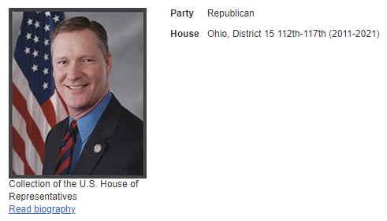
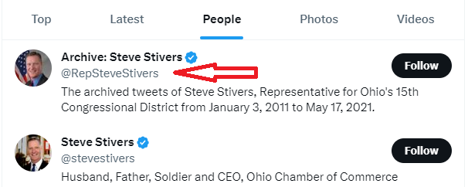

Data Wrangling - when everything went wrong
Using another member from the list Steve Stivers (R - OH 15) (https://www.congress.gov/member/steve-stivers/S001187)
Political Party, Gender (using picture), Date of Birth, Contact Page missing, Twitter unknown
This user does not have a “Contact” page so the information has to be searched using the Twitter.Com site.
Using the People tab, two (and more) accounts are found. The picture for the Archived account matches the Congressional Site
Clicking inside the “Read Biography” link will provide the Date of Birth
Notes:
Jason

Slide 6
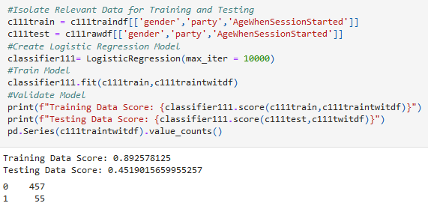
Machine Learning
Scikit-learn
Supervised ML
Logistic Regression
Training Data: Previous sessions
Testing Data: “Current” session
Notes:
Michael

Slide 7




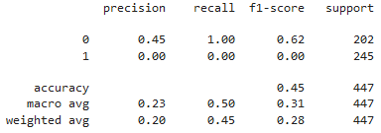
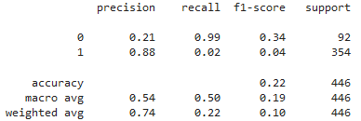




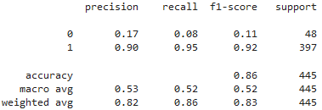
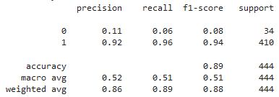
Conclusions/Results: Machine Learning
Session 111
Session 112
Session 113
Session 114
Notes:
Michael

Slide 8




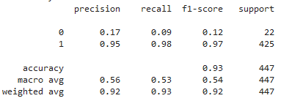
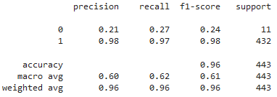




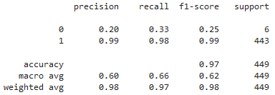
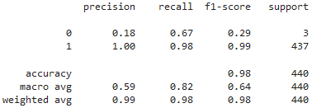
Conclusions/Results: Machine Learning
Session 115
Session 116
Session 117
Session 118
Notes:
Michael

Slide 9
Conclusions/Results: Machine Learning
Can a Machine Learning Model be created that can accurately predict the latter years of Twitter usage (approximately 2012-2020), after being trained with the prior years?
Can this model be improved?
Standardizing ages to reduce variance
More demographic features
Changing clustering for training data
Other platforms, along with their demographics (Ex: Parler, TikTok, Twitch)
Notes:
Michael

Slide 10
Visualizations
Dashboard Demonstration

Slide 11
Conclusions/Results: Visualizations
Most useful conclusion from Visualizations: Primary growth period of Congressional Twitter Usage, 2007-2015
Demographic breakdowns seem to match general party demographics
Adoption rates in later sessions seem to be determined by number of net new representatives in each party

Slide 12
Questions?

