Slide 1

THE TWO-PHASE LEARNING LOOP PROTOCOL
A Framework for AI Quality Assurance and Continuous Improvement
From 94/100 to 98/100: The Protocol in Action

Slide 2

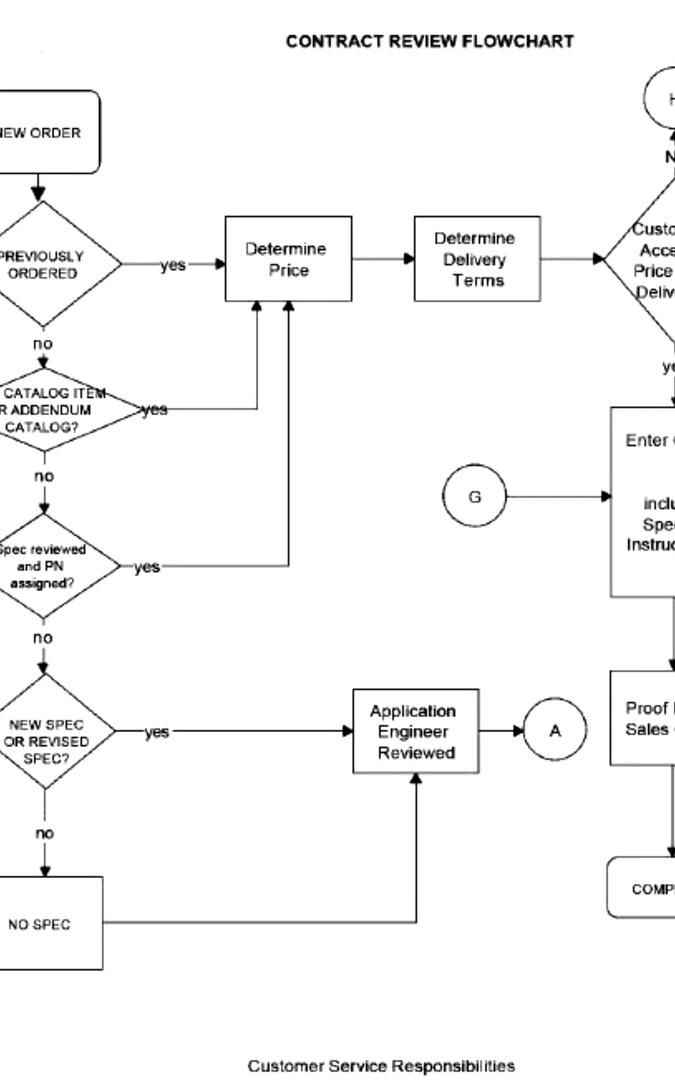
The Core Problem
AI outputs often lack consistent quality control and a structured path for measurable improvement, leading to unpredictable results.
Inconsistent Quality
No Self-Evaluation
Outputs vary significantly across tasks without a standard baseline.
Lack of a mandatory mechanism to check work before delivery.
Untracked Improvement
"Good Enough" Ambiguity
No data on whether iterations are actually adding value.
Difficulty determining when an output is ready to ship.
02

Slide 3

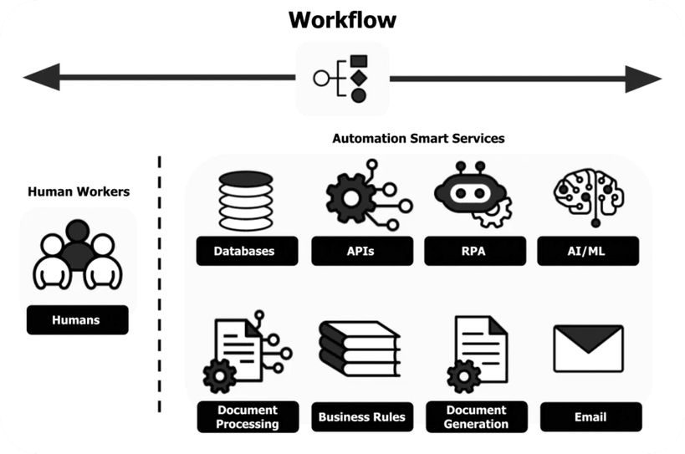
Two-Phase Architecture
The protocol operates in two distinct, sequential phases to ensure both baseline quality and continuous improvement.
MANDATORY
PHASE 1: BASELINE QUALITY GATE
Acts as a mandatory quality check. Ensures every major deliverable meets an 80/100 threshold before delivery.
OPTIONAL / USER-TRIGGERED
PHASE 2: ITERATIVE IMPROVEMENT
Activated on user request. Provides a structured framework for aggressive enhancement with measured KPIs.
03

Slide 4
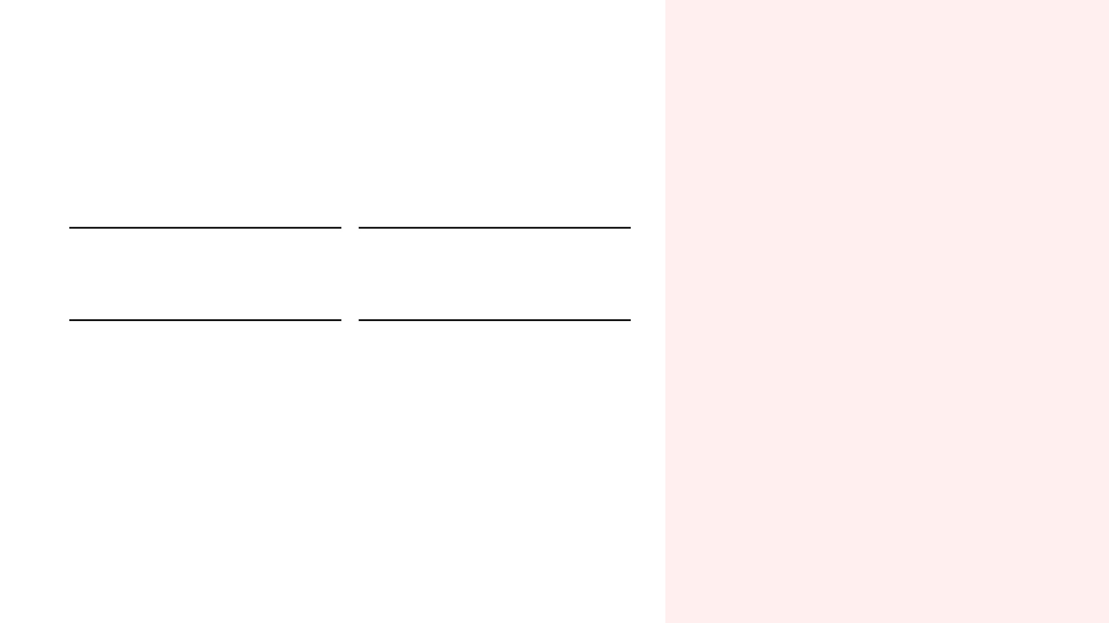
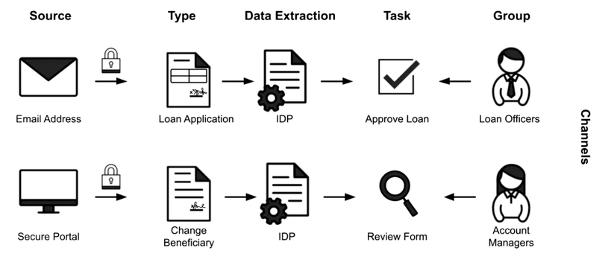
Phase 1: Baseline Quality Gate
THE 4-QUESTION PROCESS
01
02
SCORE
THE GAP
Rate quality 1-100.
Identify what's missing.
03
04
THE FIX
ACTION
Define actions to close gaps.
If < 80, fix. If ≥ 80, deliver.
THE 5 SCORING DIMENSIONS (20 PTS EACH)
Completeness
Clarity
Accuracy
Depth
Actionability
04

Slide 5

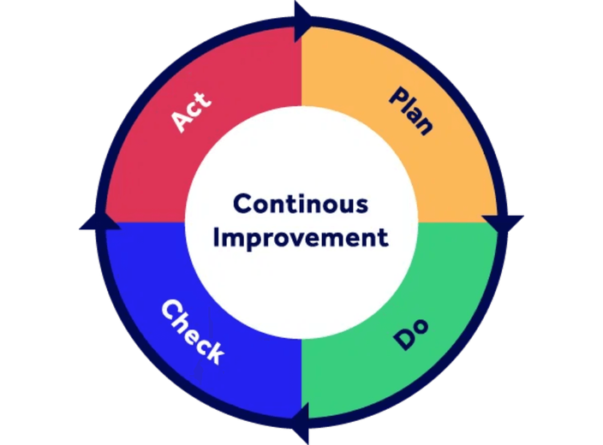
Phase 2: Iterative Engine
AGGRESSIVE ENHANCEMENT WITH MEASURED KPIS
01
Baseline Assessment
Score on 4 dimensions (Clarity, Completeness, Impact, Elegance) and identify top 3 weaknesses.
02
Iteration Execution
Make aggressive, meaningful changes. Don't be timid—fix the core issues.
DECISION FRAMEWORK
Continue
>10% Gain
03
Improvement KPIs
One More
5-10% Gain
Measure Absolute Gain, % Improvement, and check for Diminishing Returns.
Ship It
<5% Gain
05

Slide 6

CASE STUDY
We applied the protocol to its own documentation.
Demonstrating recursive improvement by running the Two-Phase Learning Loop on the protocol itself.
PHASE 1 RESULT
THE DECISION
94/100
Identified 3 Gaps: Missing installation guide, fragmented safety rules.
Action Taken: Triggered Phase 2 to pursue perfection.
Exceptional Score
06

Slide 7

V1 BASELINE ASSESSMENT
The V1 document scored 91/100 in Phase 2, passing the baseline but revealing three specific areas for improvement.
PHASE 2 BASELINE SCORE
TOP 3 WEAKNESSES
91
01
Missing Installation Guide
No explicit instructions for other AIs on how to install the protocol.
02
Fragmented Safety Rules
OUT OF 100
Critical warnings were scattered across sections rather than consolidated.
Clarity
95
Completeness
85
03
No Abstract
Impact
90
Elegance
92
Lacked a high-level summary for immediate orientation.
07

Slide 8

V2 Iteration: Changes Made
Three targeted improvements were implemented to directly address weaknesses from the baseline assessment.
01
02
03
Quick Start & Installation Guide
Consolidated Rules & Safety
Purpose Statement
Merged key operational rules and safety notes into a single reference.
Added a one-sentence purpose at the document start for immediate orientation.
Added concise, platform-specific install steps for easy adoption.
RESULT
All three weaknesses were fully addressed.
08

Slide 9

V2 POST-ITERATION ASSESSMENT
The V2 document achieved a 98/100 score with a 7.7% improvement, validating the effectiveness of the iteration.
FINAL SCORE
IMPROVEMENT KPIS
98
+7
+7.7%
NO
ABSOLUTE GAIN
IMPROVEMENT
DIMINISHING RETURNS
OUT OF 100
DIMENSION BREAKDOWN
Clarity
100 (+5)
Completeness
98 (+13)
Impact
98 (+8)
Elegance
97 (+5)
09

Slide 10

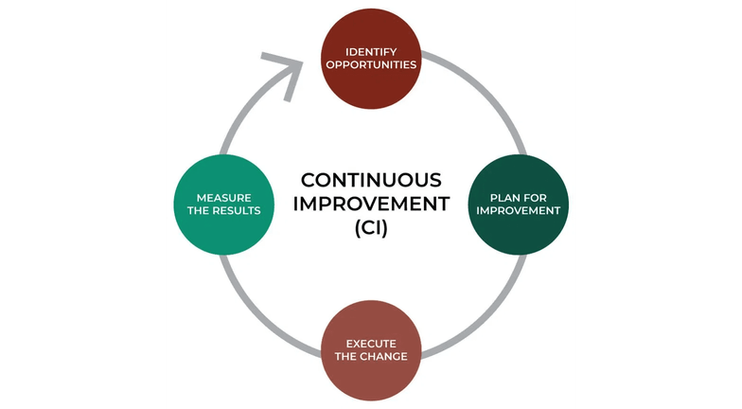
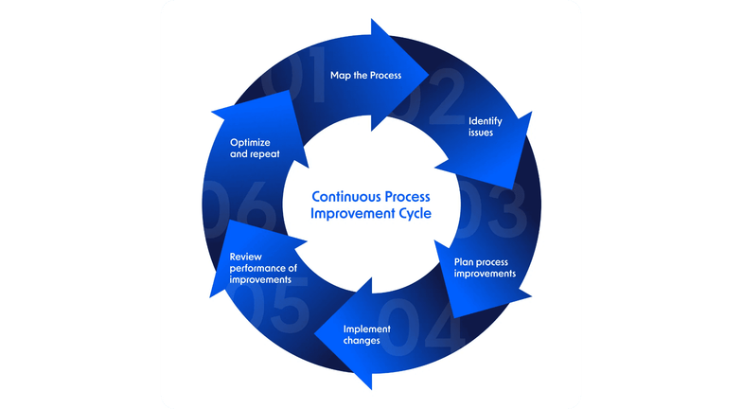
Improvement Summary
VERSION
CLAR
COMP
IMP
ELEG
TOTAL
Δ CHANGE
REC
V1 (Base)
95
85
90
92
91
—
—
V2 (Final)
100
98
98
97
98
+7.7%
🔴 SHIP IT
FINAL VERDICT
A single iteration delivered a 7.7% improvement, reaching the 98/100 threshold. Further iterations would yield diminishing returns.
10

Slide 11
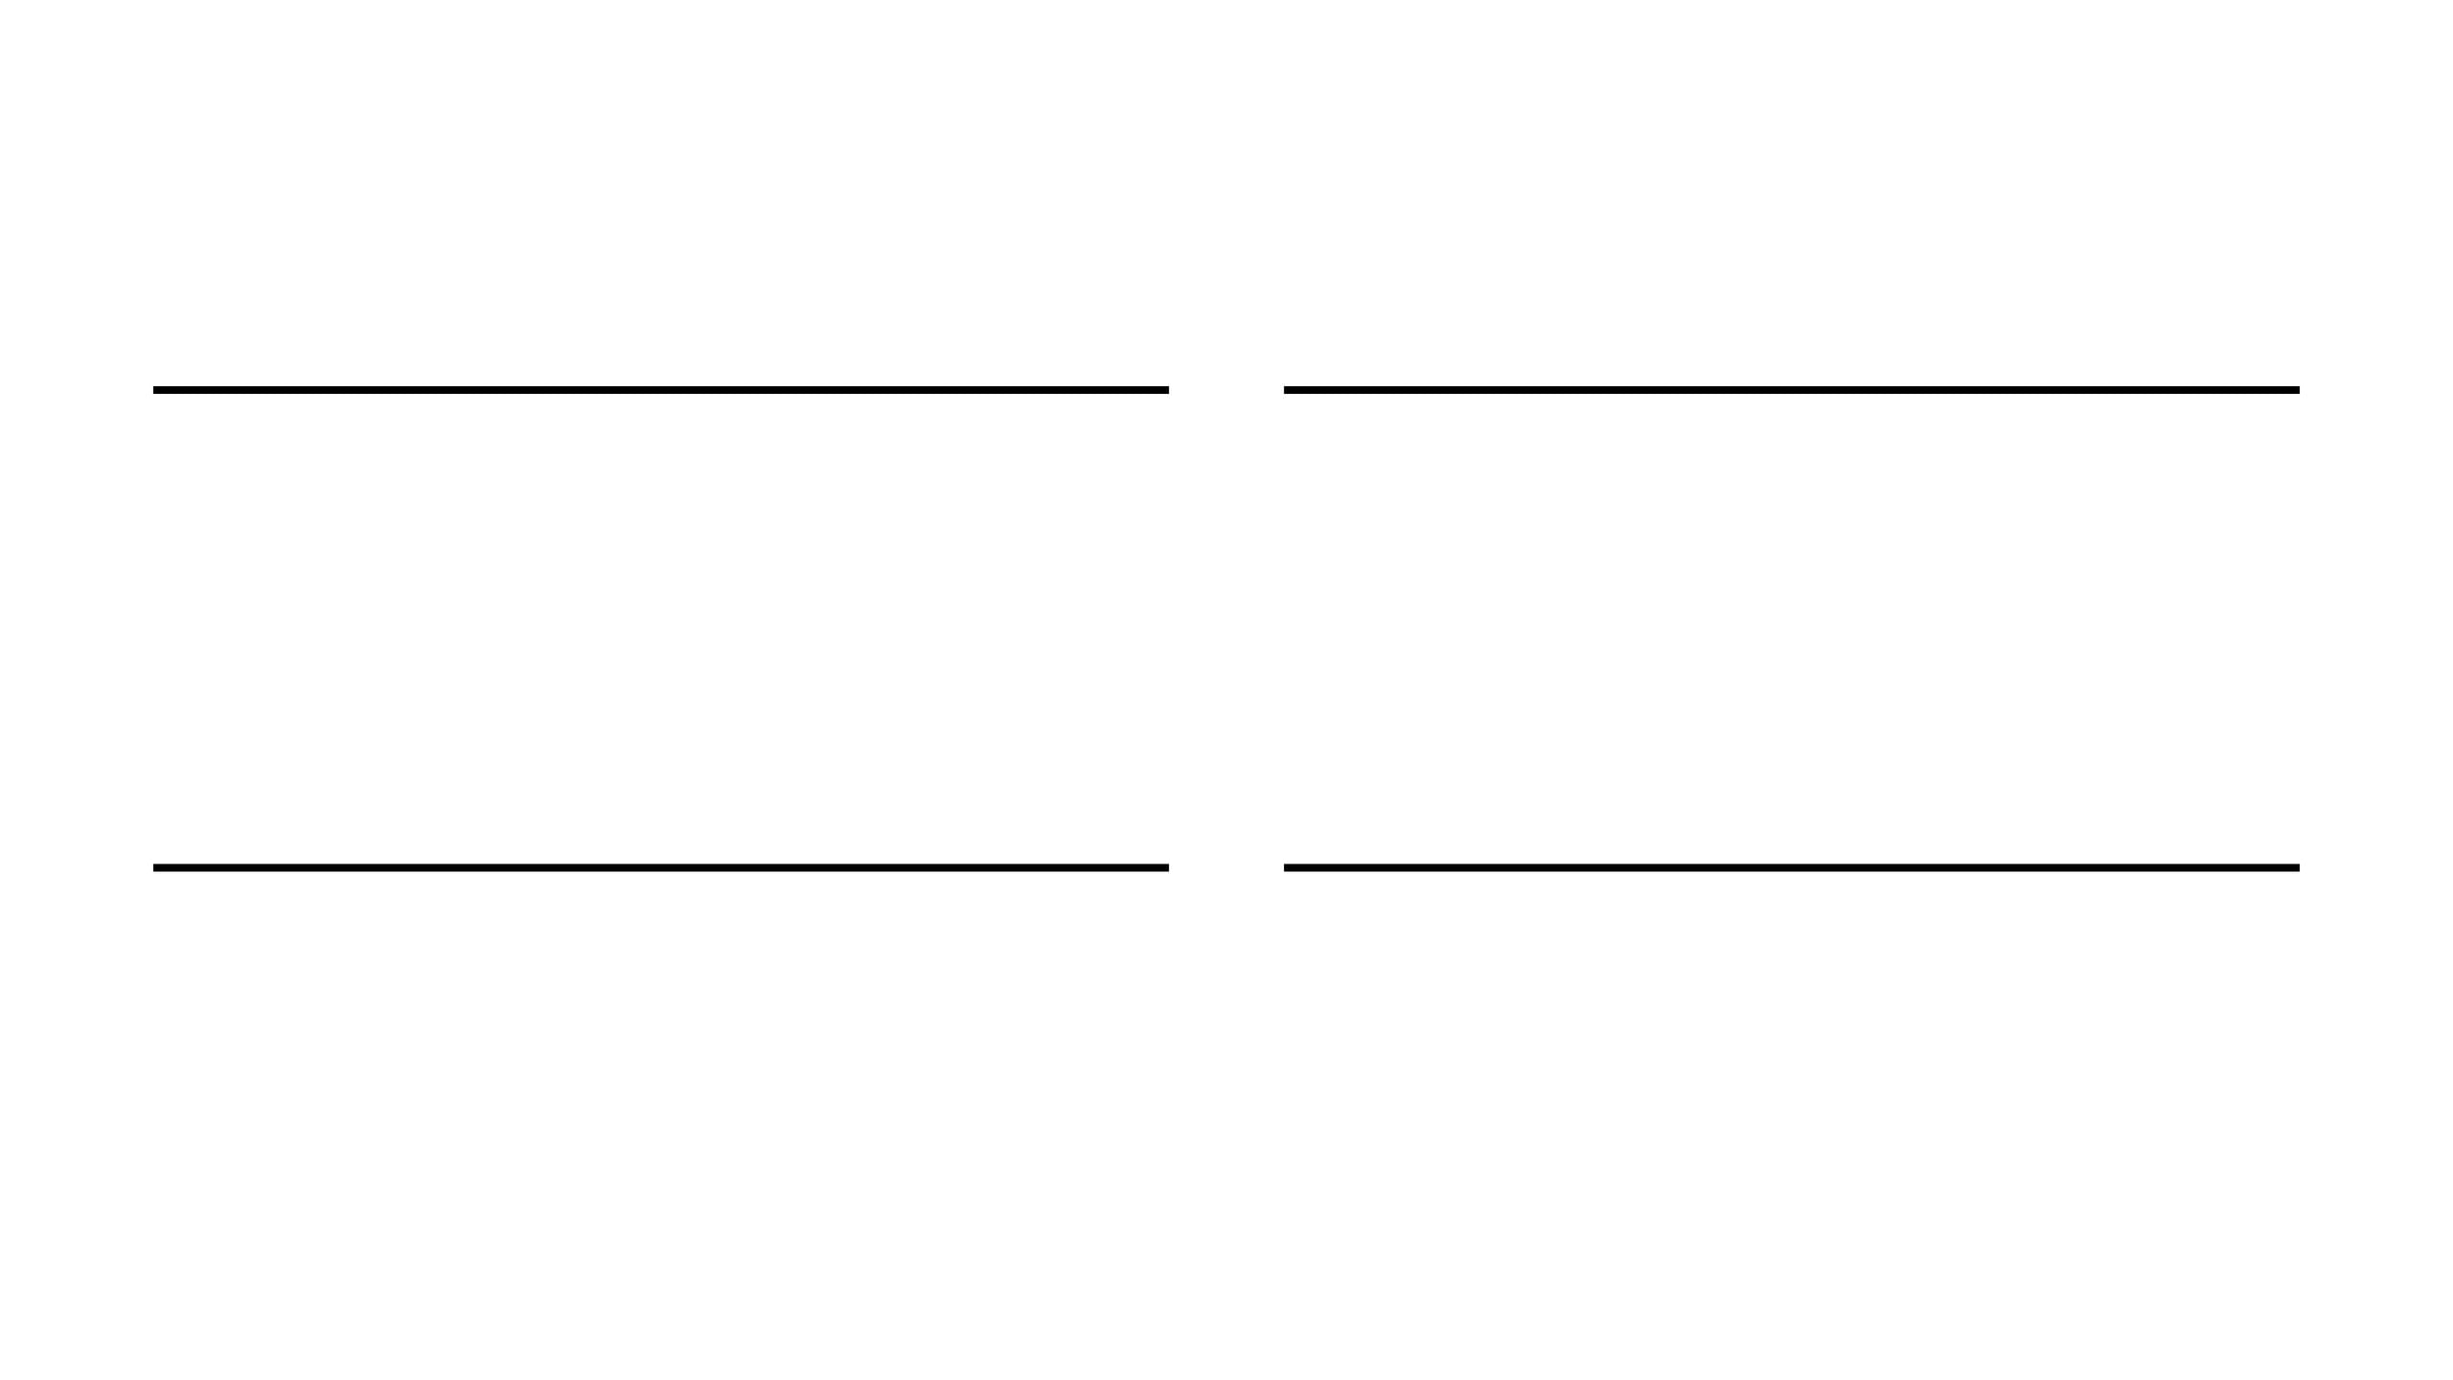




Key Takeaways
MANDATORY QUALITY
MEASURABLE GROWTH
Phase 1 acts as a strict gate. No major deliverable is shipped unless it meets the 80/100 threshold.
Phase 2 eliminates guesswork. Every iteration is scored with KPIs to track absolute and percentage gains.
SMART STOPPING
SELF-APPLICABLE
The protocol flags diminishing returns (< 5%), preventing endless cycles of low-value polishing.
The protocol is recursive. It successfully improved its own documentation by 7.7% in a single loop.
11

Slide 12
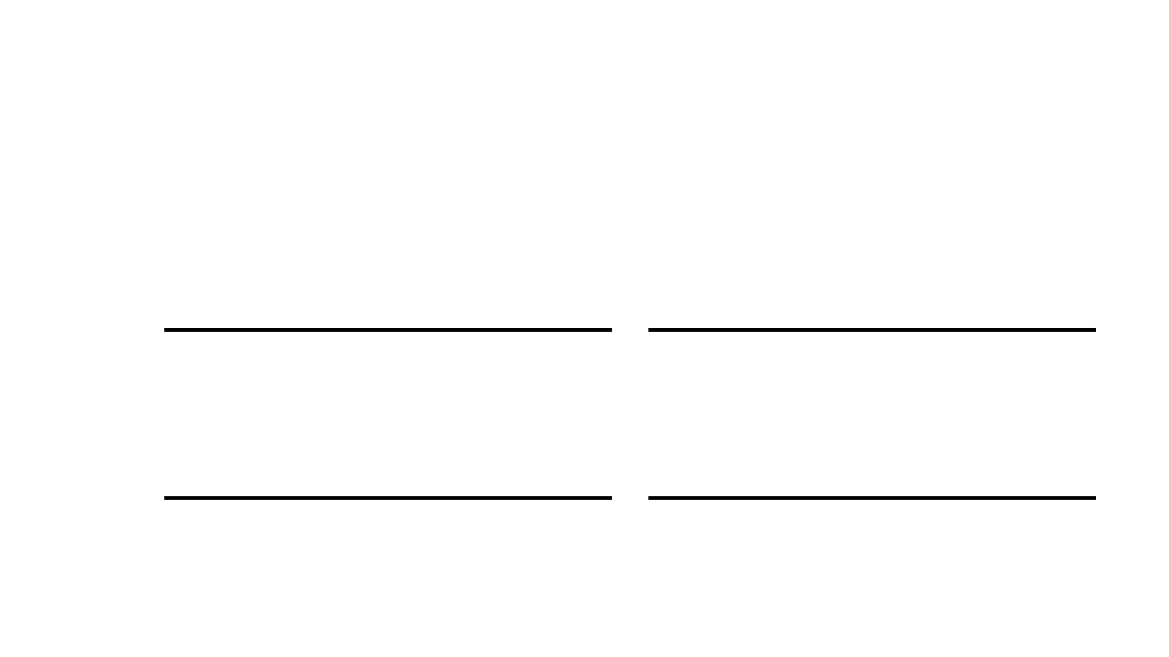
CALL TO ACTION
Systematize Excellence.
Install the Two-Phase Learning Loop Protocol to ensure consistent, high-quality AI outputs.
01
02
Download
Install
Get the V2 protocol document (PDF or Markdown).
Paste into your AI's system prompt or custom instructions.
03
04
Apply Phase 1
Trigger Phase 2
Make the quality gate mandatory for all major deliverables.
Activate the iterative engine when you need to pursue perfection.

