Slide 1

BIG MAMA'S GENIUS VILLAGE
FOR EVERY SEASON OF LIFE
🌱
🚀
🏡
🌄
🌳
Youth
Emerging Adults
Family Builders
Empty Nesters
Elders
Guidance, safety, protection
Finances, wellbeing, children
Connection, mentoring, trust
Respect, wisdom, joy
Truth, money, independence
BM04.5
BM04.1
BM04.3
BM04.4
BM04.2
No matter your age or stage, the Village gives you safety, clarity, and JOY.

Slide 2
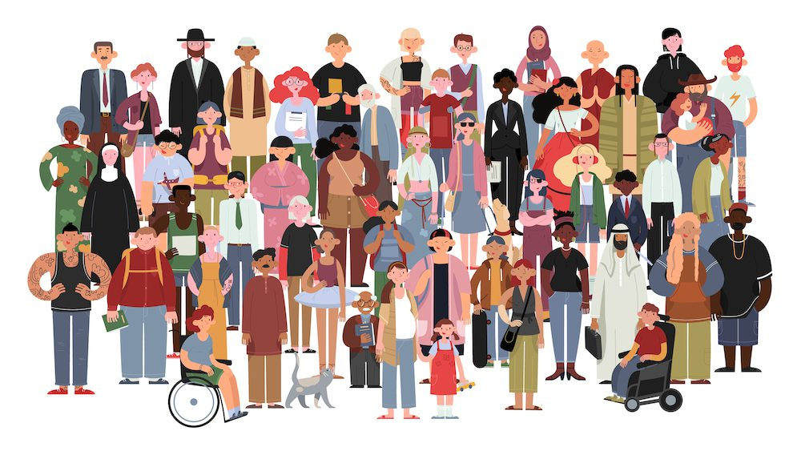
THEY'RE STEALING YOUR LIFE
YOUR EVERY CLICK: SOLD
YOUR EVERY DOLLAR: TRACKED
YOUR EVERY EMOTION: MANIPULATED
YOUR TRUST: SHATTERED
♥
Youth
Adults
Families
Elders
BIG TECH IS WATCHING

Slide 3





BIG MAMA FLIPS THE SCRIPT
REAL-TIME PROTECTION
Your digital bodyguard for every generation
Youth
Adults
Elders
JOY COACHING
Your emotional compass through every life stage
Growing
Family
Golden
•
BULLSHIT DETECTOR
VILLAGE POWER
Your truth filter from first click to golden years
Learning
Working
Retired
COLLECTIVE POWER
Your village strength across all ages
Together
Forever
TOGETHER, WE'RE UNSTOPPABLE

Slide 4


FOR MEN: CONTROL. TRUTH. POWER.
BULLSHIT DETECTOR
Cut through the noise at any age
BM10
Youth
Adults
Elders
BANKING WATCHDOG
Protect your wealth from first job to retirement
BM11
•
Starting
Building
Preserving
CONTROL
PASSWORD & SPOOF GUARD
Secure your identity across generations
BM12
Digital
Mobile
Secure
TRUTH
POWER
MENTORSHIP
Learn from the best, be the best for others
BM31
Learning
Leading
Guiding
PROXIMITY GENIUS
Connect with your tribe, whatever your stage
YOUTH
YOUNG
ADULT
MATURE
ELDER
BM30
Community
Support
Connection
REAL MEN PROTECT WHAT MATTERS

Slide 5



FOR WOMEN: SAFETY. TRUST. SUPPORT.
SAFETY FIRST
Always watching, always protecting at every age
BM02
Youth
Adult
Elder
EMOTIONAL MOOD RING
Your inner balance through all seasons of life
BM03
Growing
Family
Golden
•
VILLAGE CHAT
Positive connections for women of all generations
SAFETY
BM21
Support
Community
Connection
BANKING WATCHDOG
Protect your family from young children to aging parents
BM11
TRUST
SUPPORT
Children
Household
Future
•
BULLSHIT DETECTOR
See through deception at any stage
BM10
Learning
Working
Retired
SEASON OF LIFE
Wisdom for your unique journey
YOUTH
YOUNG
ADULT
MATURE
ELDER
BM04
Spring
Summer
Autumn
Winter
STRONG WOMEN BUILD STRONGER COMMUNITIES

Slide 6

THE VILLAGE GIVES BACK
10% PROFITS RETURNED
Your share, annually - for villagers of all ages
BM41.1
Youth
Adults
Elders
VILLAGE COUNCIL
Your voice, your choice - wisdom from every generation
BM41.2
Fair
Democratic
Empowering
•
VILLAGE
SPONSOR-A-NEIGHBOR
Your kindness, multiplied - connecting youth and elders
BM41.3
Caring
Connecting
Sustaining
COLLECTIVE STRENGTH
YOUTH
YOUNG
ADULT
MATURE
ELDER
Your power, amplified - when all ages stand together
Protection
Unity
Empowerment
WHAT GOES AROUND, COMES AROUND

Slide 7

WHY NOW? BECAUSE EVERY SECOND COUNTS
BIG DATA STEALS FROM YOU DAILY
No matter your age
Youth
Adults
Elders
BIG MAMA PUTS YOUR DATA TO WORK FOR YOU
For every generation
Protect
Empower
Connect
YOUTH
YOUNG
ADULT
MATURE
ELDER
PROTECTION
COACHING
JOY
JOIN THE VILLAGE. TAKE BACK YOUR DATA. TAKE BACK YOUR LIFE. NOW.
DIVIDENDS
COMMUNITY

Slide 8
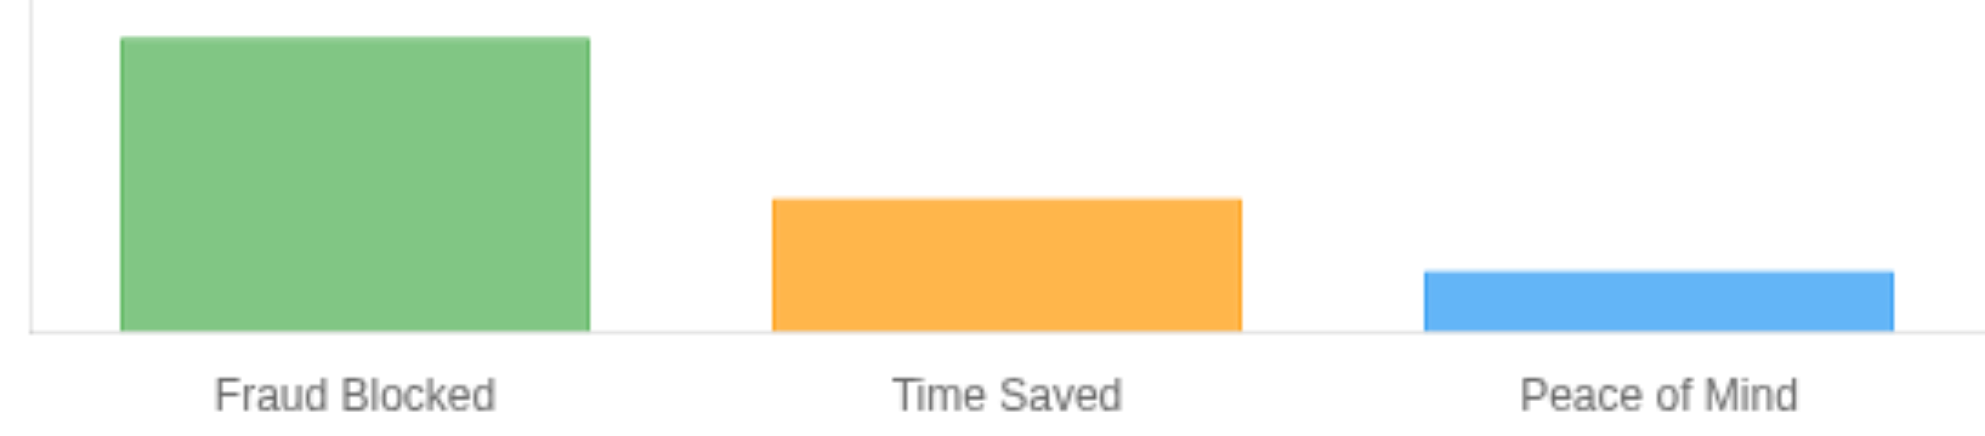

JOIN THE VILLAGE. NO BULLSHIT.
NEW
$9.95/month
Big Mama's Savings KPI
$237
That's it. No hidden fees. No games.
Full protection for your entire family, no matter their age
10% of profits returned to villagers annually
Your choice of FIVE ironclad guarantees
Our best guess. You tell us if we're right.
$100 Security Guarantee
JOY or Your Money Back
Scan to join the Village
No-Hassle Cancel
Fraud-Free Promise
Risk-free for 90 days
Double-JOY Guarantee — Try with a friend
JOIN THE VILLAGE NOW
TRUST ISN'T GIVEN. IT'S EARNED. IN THE VILLAGE.

