Slide 1
Values Card
What do you believe in? What guides your choices?

Slide 2
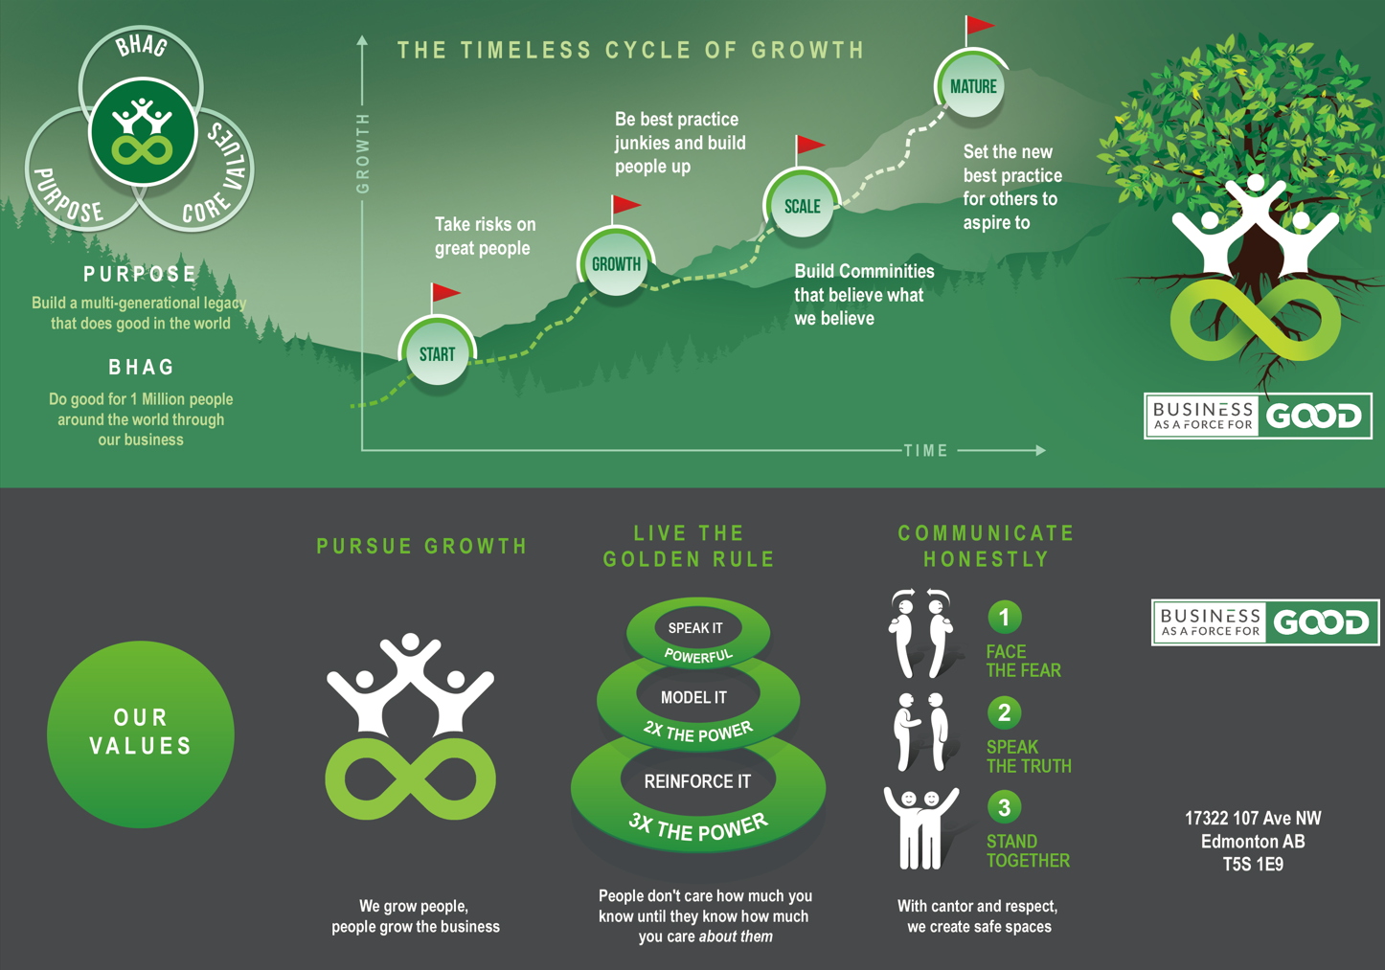

Slide 3
Portfolio Structure 2025

Slide 4
1874490 Alberta ltd. (Hold Co for the Trust shares)
Business as a Force for Good Inc.
24 Hour Mortgage (not operating, license only)
Pawn Princess Solutions Inc.
NextUse Business Solutions Inc. (50%)
Love Train Cannabis Inc. (Not operating, to be dissolved) (was 2627413 Alberta Ltd)
A Trust as a Force for Good (Trustees)
CosignSimple Inc. (not active)
2294955 Alberta Ltd. Lady Loans Canada (not active)
Maven / MoneyUp
Cashco Venue Inc. (active)
CashCo Financial Inc (active)
Lady Loans Ltd (52% owned by trustee SL) (not active)
JL Legacy Ltd. (Real Estate and Lending)
Freedom Cannabis Inc. (active)
Cashco Consumer TermLoans Inc. (inactive)
Settlement Lenders of Canada (1090747 Alberta Inc.) (inactive)
Settlement Lenders Inc. (inactive)
2624476 Alberta Ltd. - Seba Property (HoldCo)
Seba Hub Inc. / Kokanee / Village Vows
Viridis Cannabis (active)
2627411 Alberta Ltd (Bzam Building Hold Co)
2644323 Alberta Ltd. (Cannabis HoldCo under JL)
10s and 20s Cannabis Inc. (Retail)
Cashco Group of Companies Inc.
Herb 'n' Hetty Inc. (not active, 75% BAAFFG 25% Jesse)
2745660 ALBERTA LTD. (not in use yet – New)
2624476 Alberta Ltd. Seba Property incl Kokanee
CTS
2626664 Alberta Ltd. (Cannabis Hold Co)
HoldCo for PoW

Slide 5
Western Canada Trust
The North American Foundation (not active, legal status unsure)
1496120 Alberta Ltd. (Hold Co)
CashCo PW Inc. (Hold Co)
Image in Delaware Inc. (Hold Co. $0)
CashCo ADM Inc. (Hold Co)
1378310 Alberta Ltd (Hold Co)
2137259 Alberta Ltd (Kelowna Dev Property)

Slide 6
2025 Portfolio Review

Slide 7
What does A Trust as a Force for Good do and invest in?
Real Estate – Property Management - $3.4M
Real Estate – Property Development - $10.5M
Lending & Financial Services - $20M
Cannabis - $23M
Food Manufacturing and Brand Development (eliminated in 2025)

Slide 8
Real Estate – Property Management
Real Estate – Owned - $6.4M (tax value)
(-$3.5M leverage used to buy Ogen)
Loans & Mortgages - $500k

Slide 9
2. Real Estate – Property Development
Seba Hub & RV Projects:
$5M Kokanee (Purchase Price)
$1M+ School and Grounds with permitting (approx. purchase/invested value)
$1M Wedding Lodge (Held Personally) (Purchase Price) under lease to Seba Hub
$3.5M Next Use – Ogen (purchase price, leveraged JL property)

Slide 10
3. Lending & Financial Services
$5M approx. market value of IP (including FSL & DE) and loans out net of loans - CashCo
$13.5M loans to CashCo from associated portfolio companies
$1M loan value – Venue
$500k loan and asset values – Pawn Princess

Slide 11
4. Cannabis
$23M ($17M purchase price from CCAA + $6M DIP) Freedom Cannabis

Slide 12
5. Food Manufacturing and Brand Development
(sold in 2025)
Food Manufacturing and Brand Development
Loan Balance on sale: $6.2MM Loan (principal only)
Sale Price: $1.85MM
Net Loss: $4.35MM

