Slide 1


Code Like A BOSCH
VISUMAGINATION

Slide 2
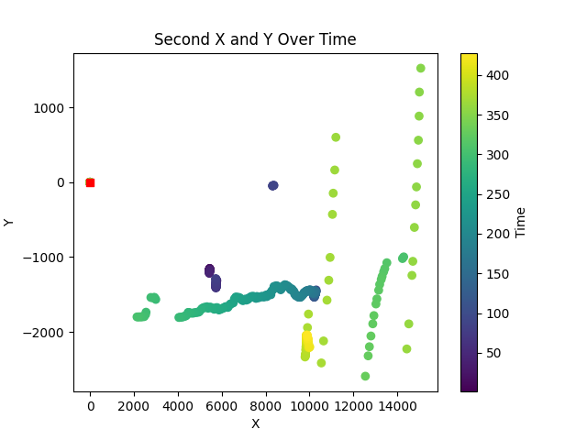
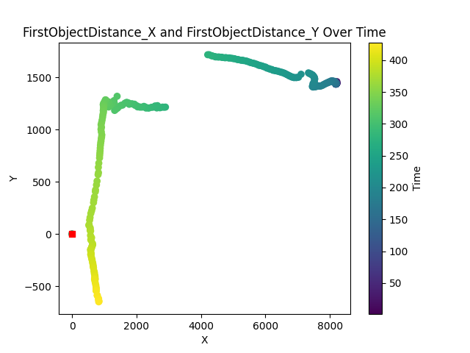

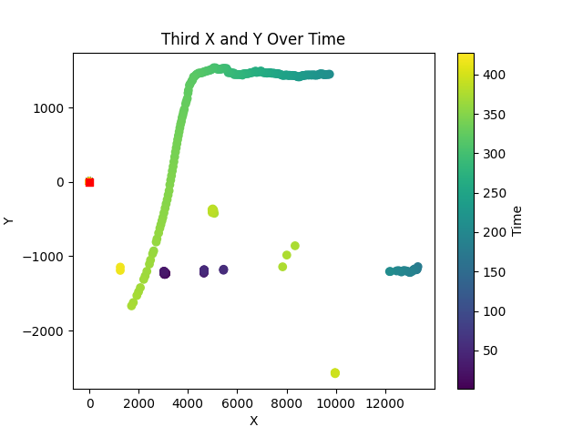
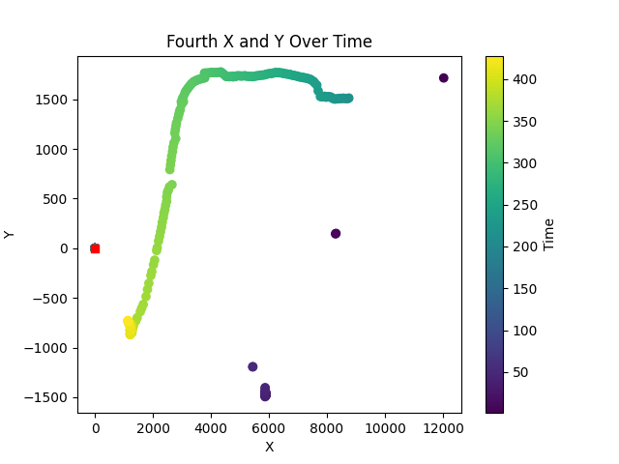
Visualization

Slide 3
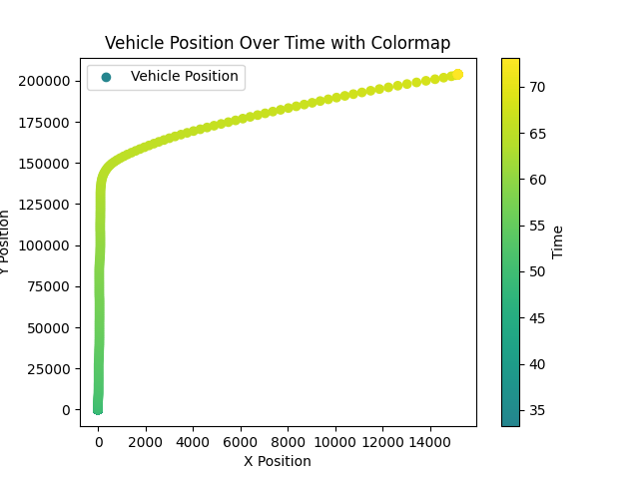

Slide 5

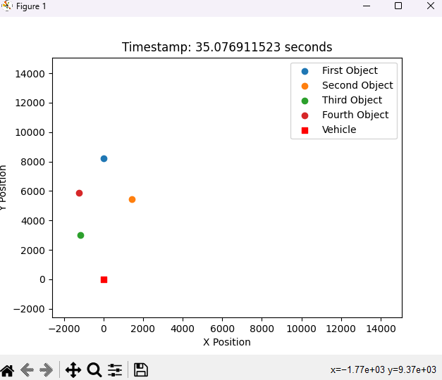
At first glance we visualized the the raw data, just to see at least what happens.
That way we found out the correct target and then we filtered out the unnecessary targets.
Then, it was clear which scenario happened in our scene.
First Part

Slide 6

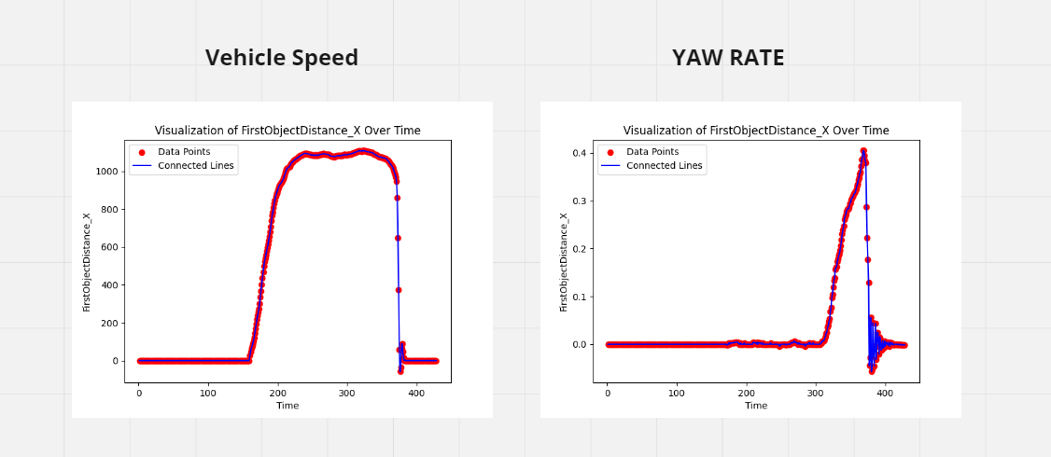
We used the vechile speed and the Yaw rate to consider the correct scenario:
At first glance we visualized the the raw data, just to see at least what happens.
That way we found out the correct target and then we filtered out the unnecessary targets.
Then, it was clear which scenario happened in our scene.

Slide 7
We used the vechile speed and the Yaw rate to consider the correct scenario:

Slide 8
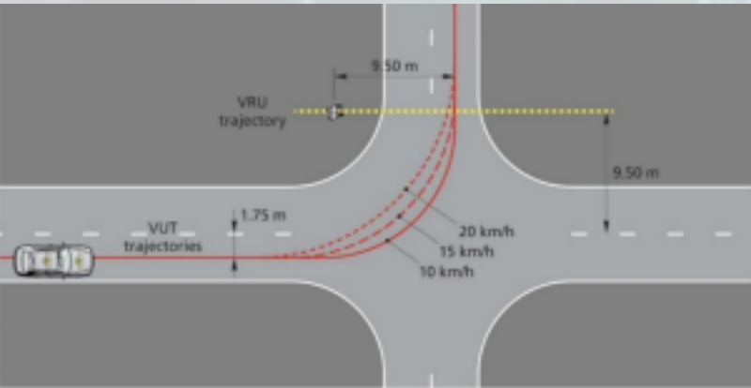
Based on the first part, we conclude that the second scenario had happened (CPTA – Car to Pedestrian Turn Adult).
We used the vechile speed and the Yaw rate to consider the correct scenario:
Second Part

Slide 9
Based on the first part, we conclude that the second scenario had happened (CPTA – Car to Pedestrian Turn Adult).

Slide 10
In our opinion, the best solution would be to use the headlights and the horn at the same time while braking.
We also calculated the brake distance.
At first glance we visualized the the raw data, just to see at least what happens.
That way we found out the correct target and then we filtered out the unnecessary targets.
Then, it was clear which scenario happened in our scene.
Third Part

Slide 11
In our opinion, the best solution would be to use the headlights and the horn at the same time while braking.
We also calculated the brake distance.

Slide 12
In our opinion, the best solution would be to use the headlights and the horn at the same time while braking.
We also calculated the brake distance.
At first glance we visualized the the raw data, just to see at least what happens.
That way we found out the correct target and then we filtered out the unnecessary targets.
Then, it was clear which scenario happened in our scene.
Thank You for your attention!

