Slide 1
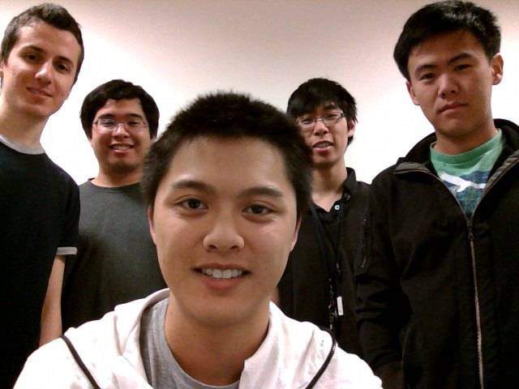
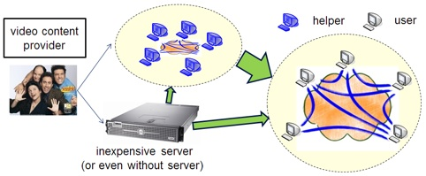
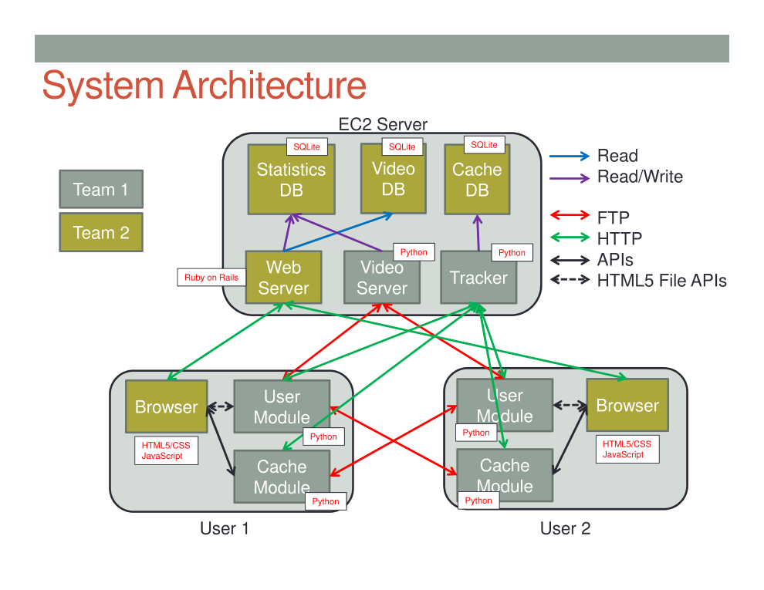
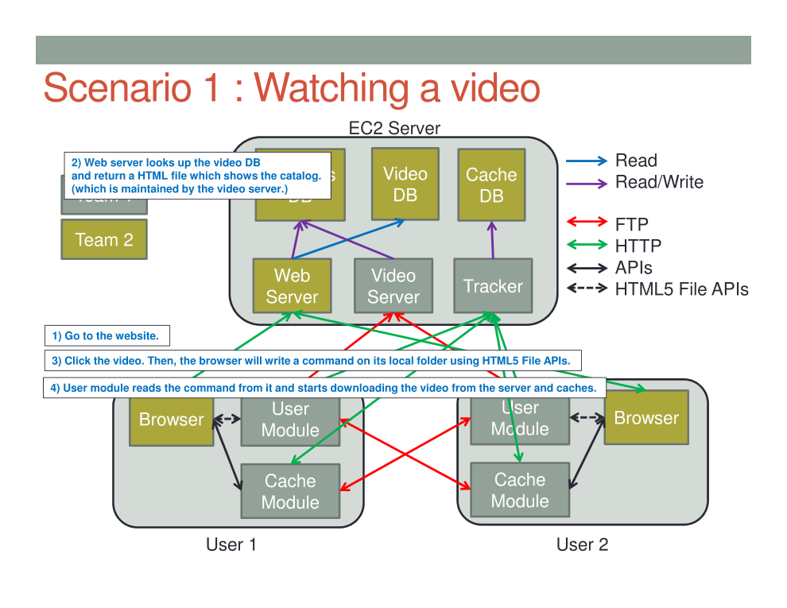
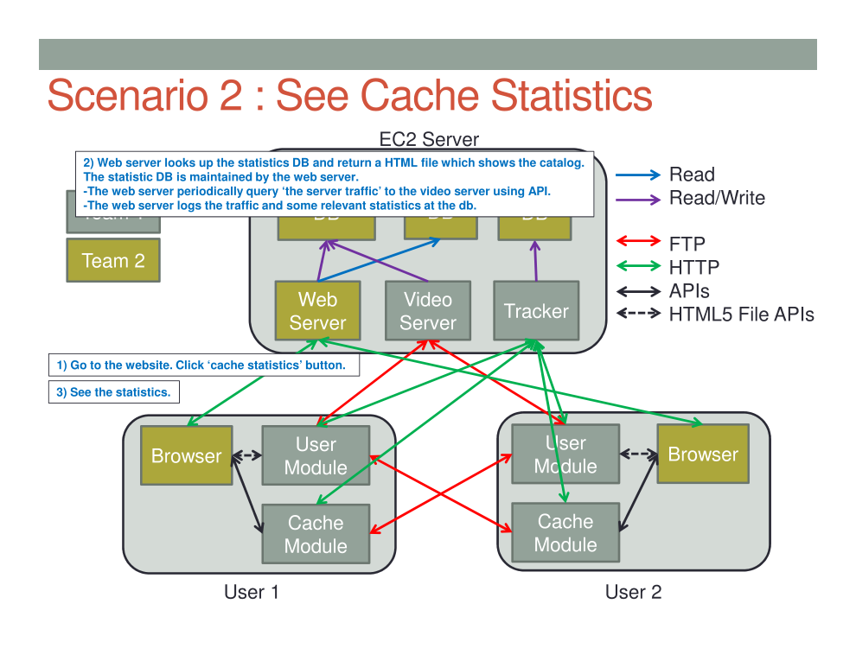
FreeEdu
“Free Online Education for Free!”
Group 33
Brandon Luong
Hamed Fallaha
Kelvin Chen
Raymond Lee
Timothy Ko
The Problem
Online education is no longer 100% free.
In order to maintain their websites, online education websites must find ways to pay for their webhosting.
The Solution
Since it is expensive to host videos, the BASICS group developed an algorithm using client computers to emulate a CDN(Content Delivery Network).
This would minimize the load and thus cost on the central server hosting the videos.
Features
Cache statistics
Donor Users(Users who donate their resources such as disk space and bandwidth).
Students can watch videos from many different courses.
Challenges: Attracting attention and getting a large userbase.
Encourage enough people to donate resources.
Working as part of a larger team.
Making sure the application is actually scalable with enough users.
Looking to the FUTURE
Online education has massive potential to change the way we learn new subjects. However, the costs of maintaining large video databases proves challenging in creating a truly free online education platform. A new scalable distribution system could prove to be flexible enough to drive cost down and spread availability.
Screenshot Preview

