Slide 1
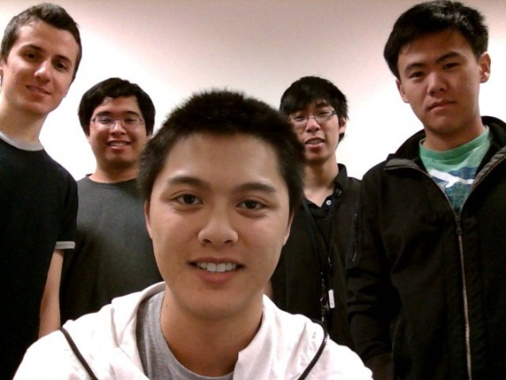
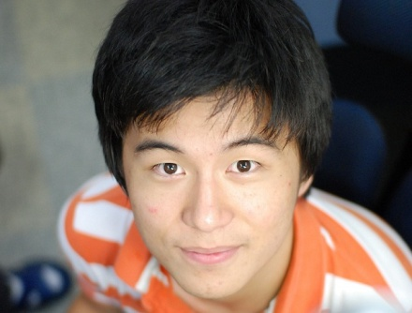


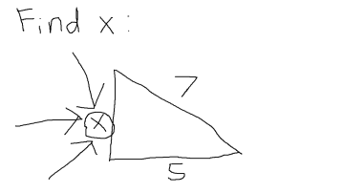

FreeEdu
“Free online education web service, for free!”
Building a massively scalable and fully distributed content distribution system for video-on-demand based on “caching” resources
Implement "donation" software that empowers anyone who is willing to participate in donating their resources (bandwidth, hard-disk, compute power)
Website created as an implementation of the concept in the form of a real world application, as a free online education video distribution service.
Group 33 members:
Left to right: Hamed Fallaha, Raymond Lee, Timothy Ko, Brandon Luong, Kelvin Chen
Client: BASiCS Group @ UC Berkeley
Project leader: Kangwook Lee

