Slide 1
Intro to Graph Neural Nets
Timothée Lacroix

Slide 2
Outline
Motivation
Graph Neural Nets
Implementation

Slide 3

Motivation : Graph classification
B
A
?
B
A
Train
Test

Slide 4
Motivation : Graph classification
B
A
These graphs could be :
Molecules
User Neighborhoods
Local electric networks
B
A

Slide 5
Motivation : Node classification
A
B
B
A
B
B
A
B
A
?
?
A
?
A
?
A
B
Train
Test

Slide 6
Motivation : Link prediction
train
test
How ?
Predict u_{i} , v_{i} for each node
Score of edge i → j is <u_{i} ,v_{j}>
Goal :
Recommandation
Denoising

Slide 7
Outline
Motivation
Graph Neural Nets
Implementation

Slide 8
Graph Neural Nets
Start with initial node features
Aggregate :
Combine :
Readout :
K repetitions (depth)
optional

Slide 9
Graph Neural Nets
Sets

Slide 10
Graph Neural Nets
Functions over sets
(ie permutation invariant)

Slide 11
Graph Neural Nets
Functions over sets
(ie permutation invariant)
→ Invariant to Isomorphism

Slide 12
Invariance to Graph Isomorphism
3
2
1
4

Slide 13
Invariance to Graph Isomorphism
3
3
2
1
1
2
4
4

Slide 14
Invariance to Graph Isomorphism
3
4
2
1
1
2
4
3
Same underlying graphs should have same output !

Slide 15
Graph Convolutional Networks
Start with initial node features ,
Let be the adjacency matrix and
Aggregate & Combine :

Slide 16
Graph Convolutional Networks

Slide 17
Graph Convolutional Networks

Slide 18
Graph Convolutional Networks

Slide 19
Graph Convolutional Networks

Slide 20
Graph Convolutional Networks

Slide 21
Graph Convolutional Networks
K = 0

Slide 22
Graph Convolutional Networks
K = 1

Slide 23
Graph Convolutional Networks
K = 2

Slide 24
Graph Convolutional Networks
K=3

Slide 25
Outline
Motivation
Graph Neural Nets
Implementation

Slide 26
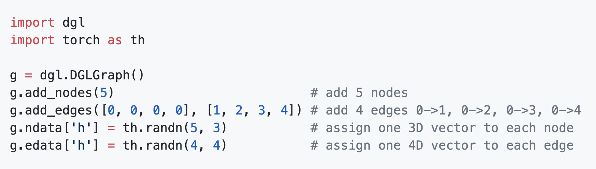
Implementation with Deep Graph Library

Slide 27
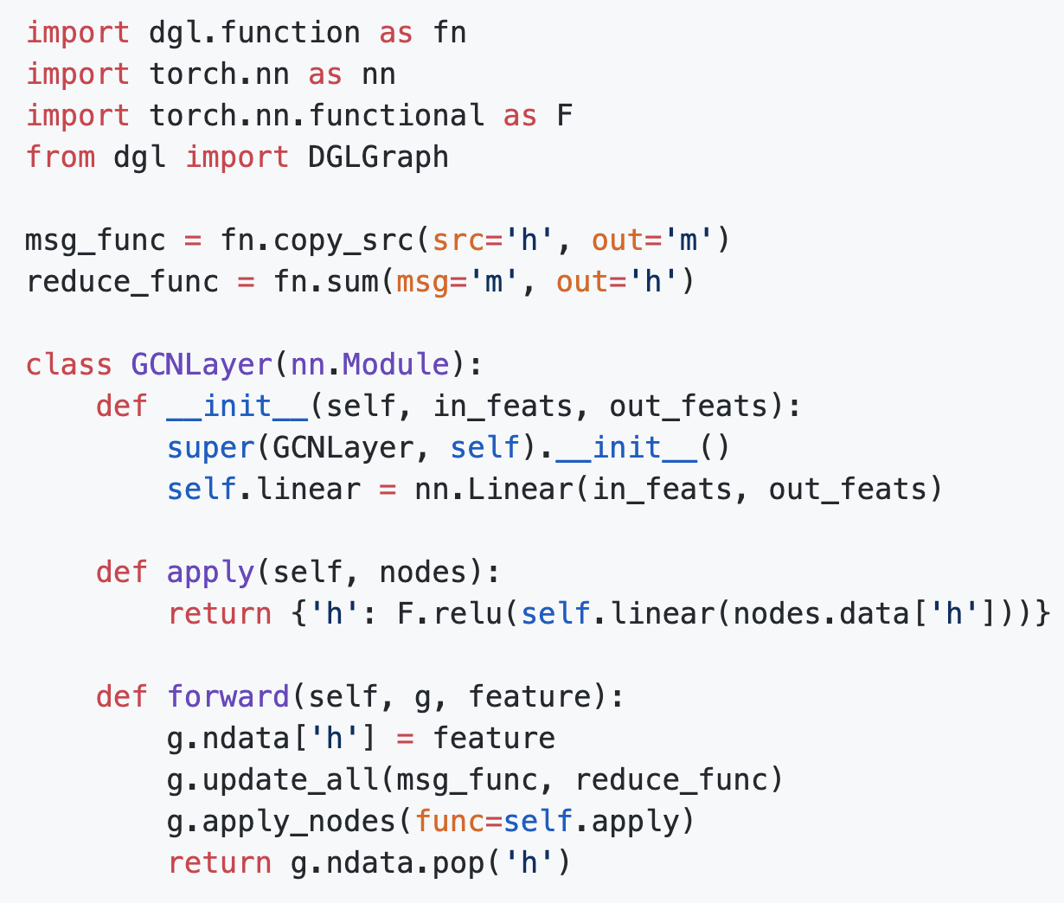
Implementation with Deep Graph Library
Set node features

Slide 28
Implementation with Deep Graph Library
Sum neighboring features

Slide 29
Implementation with Deep Graph Library
Transform

Slide 30
Difficulties for big graphs
Problems :
Forward pass is O(|E|) which can be too large
Predicting label for one node requires computation over entire graph
Solutions ?
Sample the neighborhoods to make forward pass O(|V|) (graphSAGE)
Use previous activations (Stochastic Training of GCN with Variance Reduction)

Slide 31
Conclusion
Graph Neural Nets are a broad class of solutions to graph-structured problems
Not necessarily hard to implement with libraries like DGL
Can be made faster if necessary to handle very large graphs

Slide 32
Intro to the Practical Session

Slide 33
Outline
Set-up
Baseline
Encoder
Decoder

Slide 34
Neural Relational Inference - Setup
Goal:
Observe speed and position of K particles for B timesteps
Predict speed and position for the remaining T timesteps
How ?
Predict particle-particle interaction matrix with fully connected GNN
Condition an RNN decoder with this interaction matrix for prediction
Why ?
Can seem like a complex system to implement
Actually not that hard

Slide 35
Neural Relational Inference - Baseline
hidden
LSTM
LSTM
LSTM
LSTM
LSTM
LSTM
LSTM
LSTM
LSTM
LSTM
LSTM
LSTM
LSTM
input
H
dimensions
D
dimensions
MLP
(Seq2Seq)
B timesteps -- Burn In

Slide 36
Neural Relational Inference - Encoder
MLP

Slide 37
Neural Relational Inference - Encoder
MLP

Slide 38
Neural Relational Inference - Encoder
Aggregate

Slide 39
Neural Relational Inference - Encoder

Slide 40
Neural Relational Inference - Encoder
Linear layer
Softmax
P(i→j)

Slide 41
Neural Relational Inference - Decoder
P(I → J)
aggregate
hidden
All pairs
MLP
*
input
output
GRU
hidden
hidden

Slide 42
Neural Relational Inference - Model
Ground truth
output
decoder
decoder
B timesteps -- Burn In

Slide 43
Neural Relational Inference - Model
Loss = H( ) – LL( , )
Ground truth
output

Slide 44
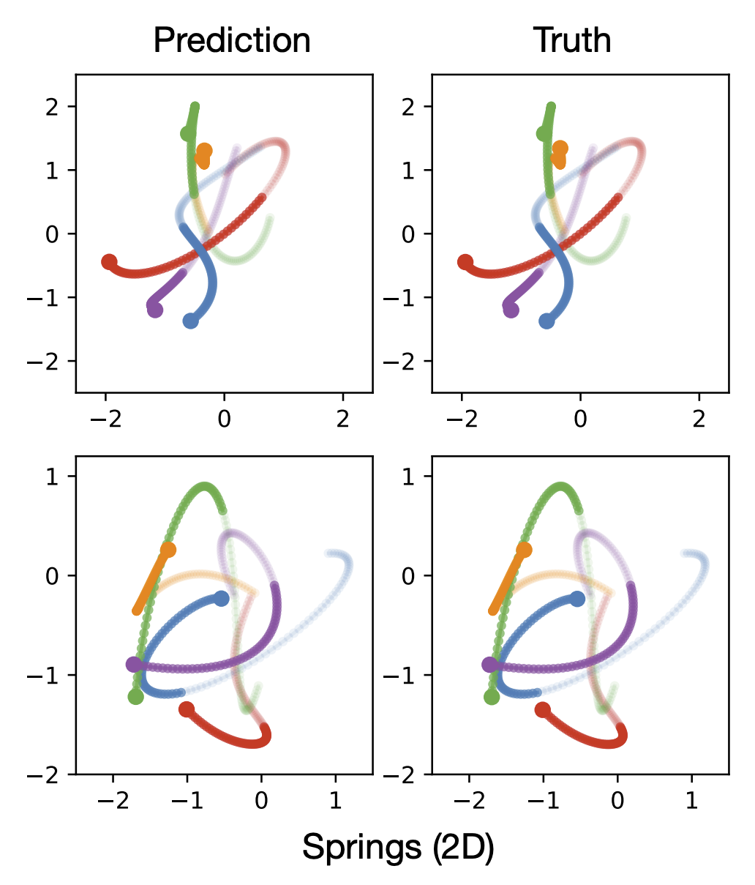
And in the end …

