Slide 1
12.1 Overview of the .NET Framework
- A component is an encapsulation of software
that can stand by itself and be used by other
components
- .NET Framework is a collection of technologies
for the development and deployment of .NET
software systems
- .NET languages from Microsoft:
VB .NET, C++/CLI, JScript .NET, C#, F#
- There are now a large number of other .NET
languages, including COBOL, Fortran, Perl,
Python, and Ruby
- Advantage of multi-language systems:
- Can use old components
- Easy transition to .NET
- Disadvantage of multi-language systems:
- Maintenance is difficult
- .NET is still almost exclusively used on Windows

Slide 2
12.1 Overview of the .NET Framework
(continued)
- The .NET Common Language Runtime (CLR)
- JIT compilation (for each .NET language)
- Garbage collection – can be forced
- Exception handling , type checking,
debugging
- Common Language Infrastructure (CLI)
- Common Type System (CTS)
- Minimum type set for .NET
- All .NET languages must support them
- e.g., Int32, which corresponds to int in C#
- All CTS types are derived from System.object
- Two categories of data types: value and
reference

Slide 3
12.1 Overview of the .NET Framework
(continued)
- Common Language System (CLS)
- Minimum language constructs and rules
- Framework Class Libraries (FCL)
- > 4000 classes
- Aim of CLI and CLR: interoperability
- A component in any .NET language can:
- Use any class in the FCL
- Call the methods of any other .NET language
class
- Subclass any class from any .NET language

Slide 4
12.2 Introduction to C#
- C# heritage:
- From Java:
- Single inheritance
- Interfaces
- Garbage collection
- No global types or variables
- Level of coercion
- From C++:
- Pointers
- Operator overloading
- Preprocessor
- structs, enums, …
- From Delphi and VB:
- Properties
- From J# (actually, J++):
- Delegates

Slide 5
12.2 Introduction to C# (continued)
- C# heritage (continued):
- New Features:
- Indexes
- Attributes
- Events
- Primitive Types and Expressions
- Similar to Java, except C# has unsigned integers
and a 16-byte decimal type
- Math class provides methods for Abs, Cos, Sqrt,
and Pow
- Data Structures
- Similar to Java and C++: class library support for
Array, ArrayList, String, Queue, Stack, and
Hashtable
- An enumeration type, similar to that of C++,
except no coercions to or from other types
- Regular expressions for string pattern matching

Slide 6
12.2 Introduction to C# (continued)
- Control Statements
- Like Java, except:
The foreach statement has different syntax
foreach (int myInt in myIntArray) { … }
3. The switch has a static semantics rule that
requires each selectable segment to end in an
unconditional transfer (either break or goto)
case 0:
Zeros++;
goto case 1;
case 1:
...
break;
case ...
- Classes, Methods, and Structures
- Like Java, except:
1. Parameters can be passed by value (default),
passed by reference, or passed by result
- Pass by reference - ref
- Pass by result - out

Slide 7
12.2 Introduction to C# (continued)
2. A method that can be overriden must be marked
virtual
A method that overrides must be marked
override
A method that has the same protocol as an
inherited method but is NOT to override it is
marked new
3. A C# struct is a lightweight class
- Supports constructors and can implement
interfaces
- Does not support inheritance or subclasses
- Is allocated from the stack
- Partial Classes
- A class definition can appear in two or more
files – put together by the compiler
- Two uses:
- To make large class definitions more
manageable
- When a tool (like Visual Studio) creates part
of a class definition and the developer
creates another part

Slide 8
12.2 Introduction to C# (continued)
- Exception Handling
- All exception classes are descendants of
Exception
- Two subclasses, SystemException and
ApplicationException
- Common system exceptions are
IndexOutOfRangeException and
ArithmeticException
- Output, etc.
System.Response.Write(
″<h1> Today’s Report </h1>″);
- For outputting the values of variables:
string msg = string.Format(
″The answer is: {0} <br />″, answer);
System.Response.Write(msg);
- The using statement
using System;
- Namespaces
namespace myStuff {
…
}

Slide 9
12.3 Introduction to ASP.NET
- The Basics of ASP.NET
- Based on ASP, but revolutionarily different
- ASP documents could have embedded scripts in
either Jscript or VB – both purely interpreted
- Disadvantages:
1. Inefficient
2. Mixing script and markup is confusing
3. Scripting languages are unreliable
- ASP.NET differs from JSP in two ways:
1. Several different non-scripting .NET
languages can be used (VB, J#, C#)
2. All ASP.NET code is compiled
- Code can be embedded in ASP.NET documents,
or can be separate in a code-behind file
- Base class is System.Web.UI.Page, unless there
is a code-behind class (then it is the base)

Slide 10
12.3 Introduction to ASP.NET (continued)
- ASP.NET documents
- Can include:
1. XHTML markup
2. Directives – appear in <%@ … %> blocks
3. Render blocks <% … %>
- No method definitions
- Put into a function in the document class
4. Declaration blocks
- Script elements - method definitions
5. Server-side comments <%-- … --%>
- The only directive covered here is Page
- The only necessary attribute is Language
→ SHOW timeLeft.aspx
- Code-behind Files
- The Page directive must specify the code-behind
file in a Inherits attribute

Slide 11
12.3 Introduction to ASP.NET (continued)
<%@ Page language = ″C#″ Inherits= ″timeLeft2″
Src = ″timeLeft2.aspx.cs″ %>
→ SHOW timeLeft2.aspx and timeLeft2.aspx.cs
- The using directives are in the code-behind file,
but not in the ASP.NET document because the
class made from the ASP.NET document is a
subclass of the code-behind class
12.4 ASP.NET Controls
- Two collections of server controls:
HTML controls and Web controls
- Because HTML controls are rarely used, we will
not discuss them
- Web Controls
- Two categories:
1. Those that correspond to the HTML controls
2. Special controls for data validation and data
binding

Slide 12
12.4 ASP.NET Controls (continued)
- Four subclasses of ListControl:
- DropDownList and ListBox – converted to HTML
select elements
- CheckBoxList and RadioButtonList – converted
to HTML table elements
- Some commonly used special Web controls –
converted to combinations of HTML elements
- Xml – allows the inclusion of XSL
transformations
- Panel – allows collections of elements to be
handled together (placement, etc.)
- AdRotator – Easy way to have different content
appear on different requests
- Validator controls – later
- Web controls must include the runat attribute, set
to ″server″
- The tag names of Web controls must be prefixed
with asp
<asp:textbox id = ″phone″ runat = ″server″ />

Slide 13
12.4 ASP.NET Controls (continued)
- All Web controls are converted to objects in the
document class
- An ASP.NET document with a form has two
purposes:
1. Describe the form to be displayed by the
browser
2. Process the form when its data is submitted
- Each of these has its own kind of request –
initial and postback
- Code in the document can determine which kind of
request it is by testing the IsPostBack property of
the Page class
- The values of controls can be accessed through
the Value property of the associated object
- Example – Gets user name and presents a greeting
→ SHOW hello.aspx (before postback)

Slide 14
12.4 ASP.NET Controls (continued)
- Document classes implicitly maintain form data
state between postbacks in the ViewState hidden
element of the form
- The life cycle of hello.aspx:
Client requests
a document
Compile document
and call constructor
Initialize control
state with ViewState
Set control state
with the form data
Save control state
in ViewState
Execute instance and
return results to client
Delete class and its
instance from server
Client leaves
site
Client interacts
with the form
Client causes a
postback

Slide 15
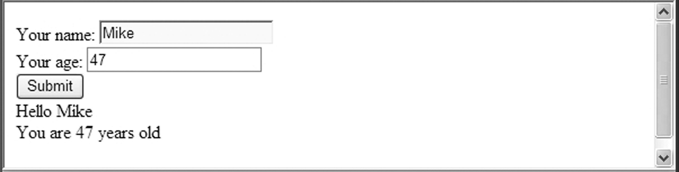
12.4 ASP.NET Controls (continued)
- ViewState is user-accessible, so it can be used to
store state information other than form data
ViewState[″myName″] = ″Freddie″;
SHOW hello.aspx (after the form has been filled
and the document has been compiled)
- Changes:
1. The ViewState control
2. The document has an internal name
3. The render block has been replaced by its
output
- Display of hello.aspx after filling and clicking
Submit

Slide 16
12.4 ASP.NET Controls (continued)
- Postbacks are initiated when:
1. User clicks the Submit button
2. Any button (except maybe a checkbox) is clicked
3. A checkbox is clicked or a select item is
selected, if its AutoPostBack property is set to
″true″
- Visual Studio and Visual Web Developer (free) – IDEs
for both Web and non-Web applications
- Allows development and testing of Web apps
without using an external Web server
- Includes an integrated debugger for .NET
languages

Slide 17
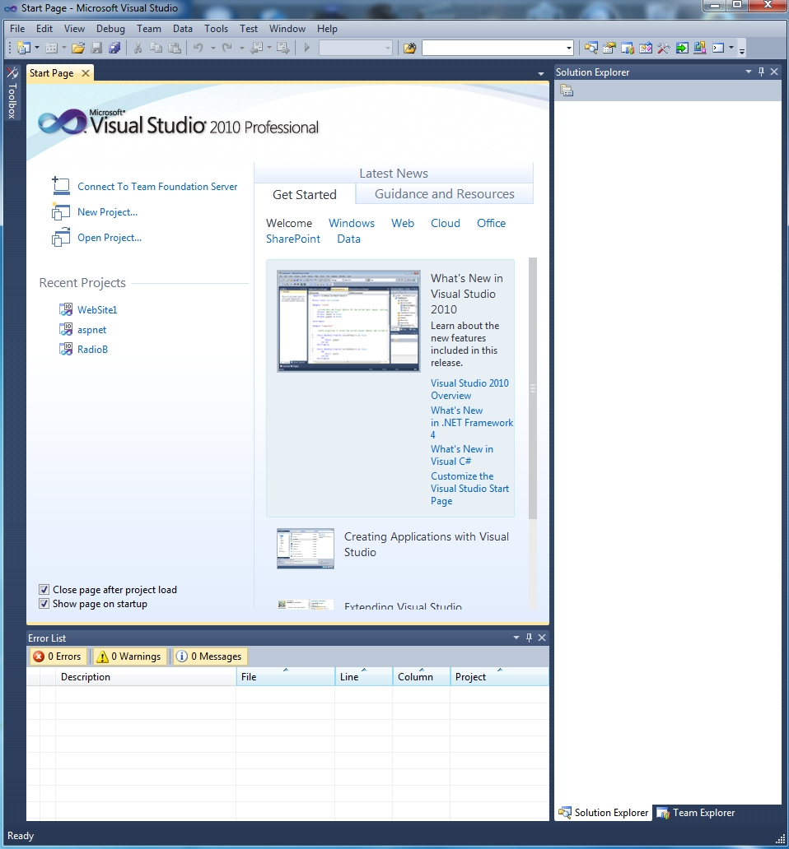
12.4 ASP.NET Controls (continued)
Start Page:

Slide 18
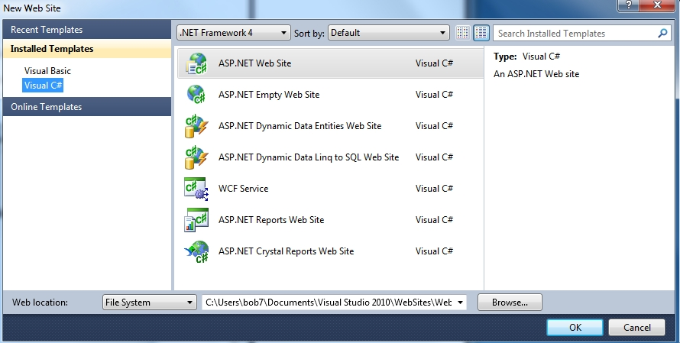
12.4 ASP.NET Controls (continued)
- The Start Page has two tabs, Toolbox and Solution
Explorer
- An Example (rebuild hello using VS)
1. Select File/New/Web Site, which opens:
2. Select ASP.NET Empty Web Site
3. Enter C:\whatever\helloVS for location (HTTP)
4. Click OK

Slide 19
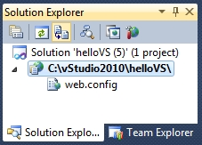
12.4 ASP.NET Controls (continued)
5. Right click the second line in the Solution Explorer
6. Select Add New Item, select Web Form, and click
Add
- This produces the following skeletal document,
Default.aspx:
<%@ Page Language="C#" AutoEventWireup="true"
CodeFile=Default.aspx.cs" Inherits="_Default" %>
<!DOCTYPE html PUBLIC
"-//W3C//DTD XHTML 1.0 Transitional//EN"
"http://www.w3.org/TR/xhtml1/DTD/
xhtml1-transitional.dtd">
<html xmlns="http://www.w3.org/1999/xhtml" >
<head runat="server">
<title></title>
</head>
<body>
<form id="form1" runat="server">
<div>
</div>
</form>
</body>
</html>

Slide 20
12.4 ASP.NET Controls (continued)
6. Change the name of the .aspx document to
helloVS.aspx (by right-clicking the original name,
Default.aspx)
7. Click Split at the bottom of the workspace
8. Expose the Toolbox (select View/Toolbox)
9. Drag two text boxes and a button to the design
window and set their IDs to name, age, and
Submit
10. Set the Text attribute of the button to ″Submit″
11. Insert the response markup and code from
hello.aspx
<!-- helloVS.aspx
A simple example of an ASP.NET document with controls,
built with VS. It uses textboxes to get the name and
age of the client, which are then displayed.
-->
<%@ Page Language="C#" AutoEventWireup="true"
CodeFile="helloVS.aspx.cs" Inherits="_Default" %>
<!DOCTYPE html PUBLIC
"-//W3C//DTD XHTML 1.0 Transitional//EN"
"http://www.w3.org/TR/xhtml1/DTD/
xhtml1-transitional.dtd">
<html xmlns="http://www.w3.org/1999/xhtml">
<head runat="server">
<title> helloVS </title>
</head>

Slide 21
12.4 ASP.NET Controls (continued)
<body>
<form id="form1" runat="server">
<p>
Your name:
<asp:TextBox ID="name" runat="server">
</asp:TextBox>
<br />
Your age:
<asp:TextBox ID="age" runat="server">
</asp:TextBox>
<br />
<asp:Button ID=“submit" runat="server"
Text="Submit" />
<br />
<% if (IsPostBack)
{ %>
Hello <%= name.Text%> <br />
You are <%= age.Text%> years old <br />
<% } %>
</p>
</form>
</body>
</html>
- To test it, click the Debug menu and select
Start without Debugging

Slide 22
12.4 ASP.NET Controls (continued)
- ASP.NET Events
- There are two levels of events – page-level events
and control events
- Page-Level Events
- Four page-level events are implicitly raised by
the Page class during the process of processing
a request
Load, Unload, PreRender, and Init
- There are two ways to write and register handlers
for page-level events
1. Write handlers with preassigned names and
a specific protocol – implicitly registered when
the document class is created
public void Page_Init(System.EventArgs e)
{ … }
- Called auto event wireup

Slide 23
12.4 ASP.NET Controls (continued)
- Page-Level Events (continued)
2. Overload virtual methods and manually
register them – not covered here
- Control Events
- Many events are handled on the server, although
they are raised on the client
- Control events are either postback or
non-postback
- All events on Button and Menu are postback
- CheckBox, TextBox, and RadioButton are non-
postback controls
- Event handlers for controls are registered on
attributes of the control element attributes
TextBox uses OnTextChanged
Button uses OnClick
CheckBox and RadioButton use
OnCheckedChanged
CheckBoxList and RadioButtonList use
SelectedIndexChanged

Slide 24
12.4 ASP.NET Controls (continued)
- Control Events (continued)
- Handler protocol:
- Return type is void
- Two parameters: an object type and the event
object, whose type is System.EventArgs
protected void TextboxHandler(object src,
System.EventArgs e) {
...
}
- Registration:
<asp:TextBox ID = "Name"
OnTextChanged = "TextBoxHandler"
runat = "server" />

Slide 25
12.4 ASP.NET Controls (continued)
- Controls can be created by either markup or by
programming code
- For example,
<asp.Button ID = "helpButton" Text = "help"
OnClick = "OnClickHandler"
runat = "server" />
Or
protected Button helpButton = new Button();
helpButton.Text = ″help″;
helpButton.id = ″helpButton″;
helpButton.OnClick = ″OnClickHandler″;
helpButton.runat = ″server″;
- There are two problems with using code:
1. It required more typing
2. Placement of the control in the document is
cumbersome

Slide 26
12.4 ASP.NET Controls (continued)
- Can use a placeholder
<asp:PlaceHolder id = ″buttonPlace″
runat = ″server″ />
buttonPlace.Controls.Add(helpButton);
- Although creating elements is easier with
markup, modifying them is a good use of code
- Response output from controls
- Can’t use Response.Write, because the output
goes to the beginning of the buffer, rather than
close to the controls

Slide 27
12.4 ASP.NET Controls (continued)
- Alternative control output:
- Create a label element where you want the
output to appear
- Set the content of the label by assigning to
its Text property
- Use string.Format for output with text and
values
<asp:Label ID = ″output″
runat = ″server″ />
<% string msg = string.Format{
″The result is {0} <br />″, result);
output.Text = msg; %>
- List Controls
- Common characteristics:
- Items in the lists are modeled with ListItem
objects
- The collection of items of a list control are
modeled with the Item object

Slide 28
12.4 ASP.NET Controls (continued)
- List Controls - Common characteristics (continued)
- ListItem objects can be defined with the Add
method
- The SelectedIndex and SelectedItem properties of
a control reference the index and value of the
selected item with the lowest index
- All list controls can raise SelectedIndexChanged
- Example – create a text box, a drop-down list,
and a button, using a code-behind
file to fill the items in the list
→ SHOW controls.aspx
- Fetch the VS-furnished code-behind file by clicking
its name in the Solution Explorer (you must click
on the triangle in front of the .aspx file’s name)

Slide 29
12.4 ASP.NET Controls (continued)
using System;
using System.Collections;
using System.Configuration;
using System.Data;
using System.Linq;
using System.Web;
using System.Web.Security;
using System.Web.UI;
using System.Web.UI.HtmlControls;
using System.Web.UI.WebControls;
using System.Web.UI.WebControls.WebParts;
using System.Xml.Linq;
namespace controls {
public partial class _Default : System.Web.UI.Page {
protected void Page_Load(object sender,
EventArgs e) { }
}
}
- Delete the usings except System, System.Web,
System.Web.UI, and System.Web.UI.WebControls
- Use the Page_Load handler (on non-postback calls)
to fill the list, using the Add method, as in:
mySelect.Items.Add(new ListItem(″red″));
- Add a handler for the itemSelected event to
display the chosen color
- Also, the handler to confirm the user’s choice
→ SHOW controls.aspx.cs

Slide 30
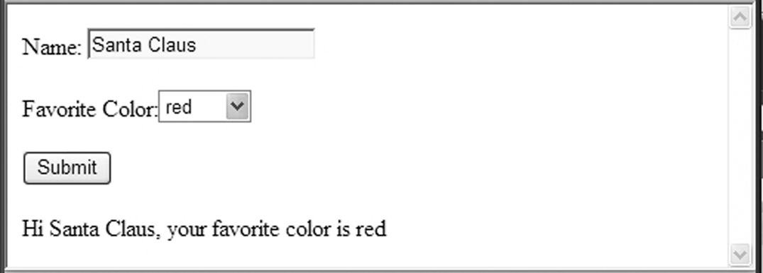
12.4 ASP.NET Controls (continued)
- Validation Controls
- RequiredFieldValidator
- CompareValidator
- RangeValidator
- RegularExpressionValidator
- CustomValidator
- ValidationSummary
- Validation controls are placed just after the
controls whose values they are to validate
- Use the ControlToValidate attribute to specify
the control to be validated
- Use the ErrorMessage attribute to specify the
error message
→ SHOW validate.aspx

Slide 31
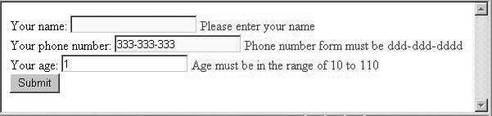
12.4 ASP.NET Controls (continued)
- Custom Validation controls
- CustomValidator control
- Example:
<asp:CustomValidator runat = "server"
id = "CustomValidator1"
ControlToValidate = "name"
ValidateEmptyText = “false"
Display = "Static"
ErrorMessage = "The text entered is not valid"
ClientValidationFunction = "clientValidator"
OnServerValidate = "ServerValidator">
</asp:CustomValidator>

Slide 32


12.4 ASP.NET Controls (continued)
- An Example
- A form asks the user to input an even number
- A custom validator control is used to determine
whether the input number is even and produce a
message
→ SHOW customValid.aspx & customValid.aspx.cs
- For an odd number:
- For an even number:

Slide 33
12.4 ASP.NET Controls (continued)
- Master Documents
- Create a master document whose content
is common to several other documents, called
content documents
- Implicitly merge each content document into the
master document before presentation when the
content document is requested
- Example: Master document gives a company’s
standard header – no active controls and no code
- To create a master document with VS:
1. Create a new Web site
2. Right-click the project in the Solution Explorer
3. Select Add New Item from the menu
4. Click Master Page from the list of template
buttons
5. Change the name to airad.master & click Add

Slide 34
12.4 ASP.NET Controls (continued)
- The skeletal document produced by VS:
<%@ Master Language="C#" AutoEventWireup="true"
CodeFile="airad.master.cs" Inherits="airad" %>
<!DOCTYPE html PUBLIC
"-//W3C//DTD XHTML 1.0 Transitional//EN"
"http://www.w3.org/TR/xhtml1/DTD/
xhtml1-transitional.dtd">
<html xmlns="http://www.w3.org/1999/xhtml">
<head runat="server">
<title>Untitled Page</title>
<asp:ContentPlaceHolder id="head" runat="server">
</asp:ContentPlaceHolder>
</head>
<body>
<form id="form1" runat="server">
<div>
<asp:ContentPlaceHolder id="ContentPlaceHolder1"
runat="server">
</asp:ContentPlaceHolder>
</div>
</form>
</body>
</html>
6. Add the content and styles for the application
→ SHOW airad.master

Slide 35
12.4 ASP.NET Controls (continued)
- Content documents must begin with a Page
directive with the masterpagefile attribute
- The whole content document must be an
asp:content element, which includes the
contentplaceholderID attribute set to
"TopPageContent"
- The URL of the merged file is the name of the
content document
- To create the content document:
1. Right-click the project in the Solution Explorer
2. Select Add New Item
3. Select Web Form and change its name to
airadContent.aspx
4. Select Select Master Page and click Add
5. Select the master page airad.master and click
OK

Slide 36
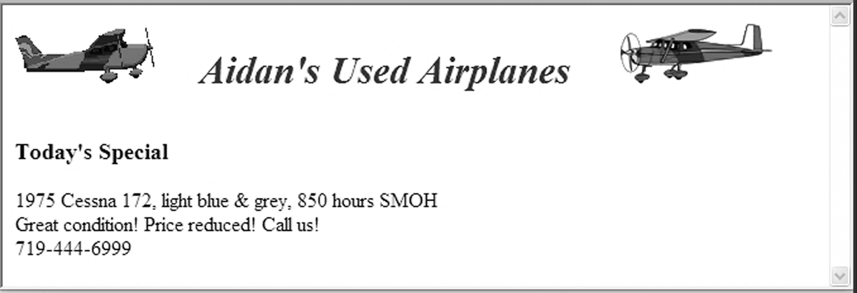
12.4 ASP.NET Controls (continued)
- The skeletal document produced:
<%@ Page Language="C#" MasterPageFile="~/airad.master"
AutoEventWireup="true"
CodeFile="airadContent.aspx.cs"
Inherits="airadContent"
Title="Untitled Page" %>
<asp:Content ID="Content1"
ContentPlaceHolderID="head"
Runat="Server">
</asp:Content>
<asp:Content ID="Content2"
ContentPlaceHolderID="TopPageContent"
Runat="Server">
</asp:Content>
6. Add a div element with a special ad in second
Content element
7. Delete first Content element
→ SHOW airadContent.aspx

Slide 37
12.5 ASP.NET AJAX
- Ajax can be included an ASP.NET document without
the developer writing any JavaScript, if VS is used
- VS Toolbox for Ajax – Ajax Extensions
- Ajax server controls add script to documents that
is run on the client
- Other server control processing is done on the
server
- We cover only two server controls, ScriptManager
and UpdatePanel
- Every document that uses ASP.NET AJAX must
include a ScriptManager control
<asp:ScriptManager id = "whatever"
runat = "server" />
- UpdatePanel defines the area of a document that
can be updated with Ajax – its content

Slide 38
12.5 ASP.NET AJAX (continued)
<asp:UpdatePanel runat = "server"
id = "whatever" />
<ContentTemplate>
(whatever is to be Ajax-updateable)
</ContentTemplate>
</asp:UpdatePanel>
- Example – the old zip-code problem
1. Select File/New Web Site and ASP.NET Web Site
2. Drag a ScriptManager element to just after the
form tag
3. Add a TextBox for the zip code with id, columns,
and runat attributes
4. Add the AutoPostBack attribute in the zip code
TextBox set to "true"
5. Add an OnTextChanged attribute to the zip code
text box set to the name of the C# handler (in the
code-behind file)

Slide 39
12.5 ASP.NET AJAX (continued)
7. Drag an UpdatePanel element to just after the zip
code text box
8. Type in a ContentTemplate control inside the
UpdatePanel
9. Drag text boxes for the city and state inside the
ContentTemplate element
10. Drag in two labels to be used as placeholders for
time stamps, one for initial rendering (id is
Label1) and one for each Ajax update (id is
Label2). The Label1 element goes just before the
“name” text box; the Label2 element goes just
after the “state” text box
- Label form:
<asp:Label id = "whatever" runat = "server" >
</asp:Label>
→ SHOW CityState.aspx
- Note: The registered handler is named
Zip_OnTextChanged

Slide 40
12.5 ASP.NET AJAX (continued)
- The code-behind file
1. Select File/Open/File and CityState.aspx.cs
2. Add the handler method for the zip code text box,
with the HashTable object with cities and zip codes
- The value of the zip code text box is accessible
through zip.Text
- The time stamp for the Ajax updates is created
with:
Label2.Text =
"(Refreshed at " + DateTime.Now.ToString() +
")";
- The other time stamp is added to the Page_Load
method, but executed only on a non-postback
call
→ SHOW CityState.aspx.cs

Slide 41
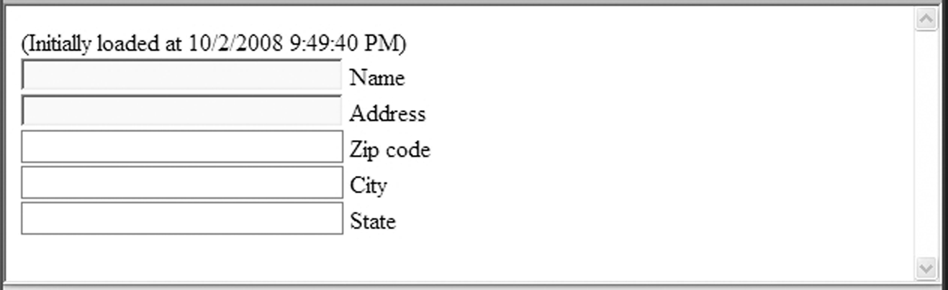
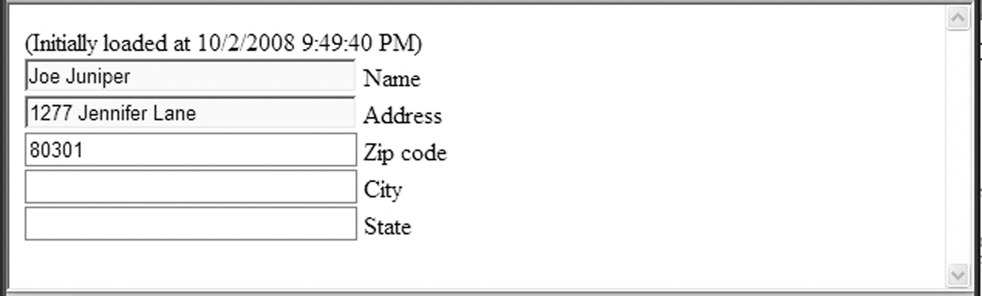
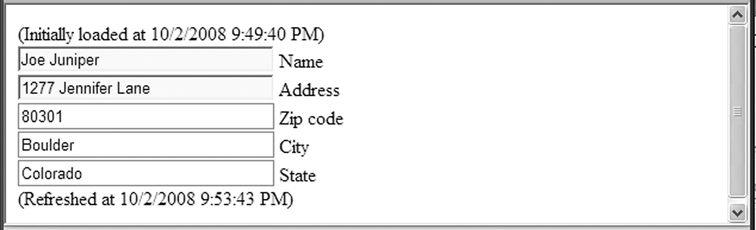
12.5 ASP.NET AJAX (continued)
- The initial screen:
- After entering name, address and zip code:
After moving the cursor out of the zip code text box:

Slide 42
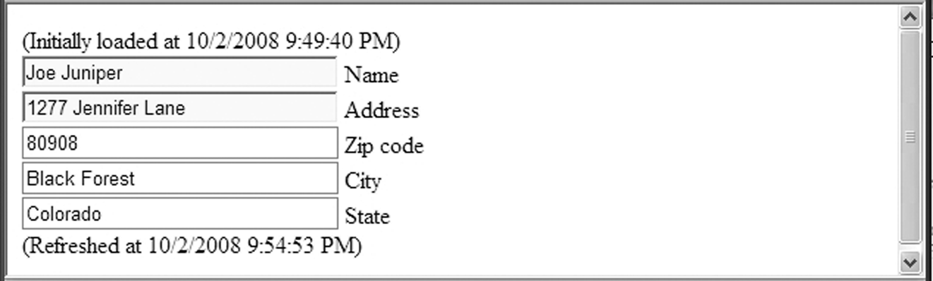
12.5 ASP.NET AJAX (continued)
- After entering a new zip code and moving the
cursor out of the zip code text box:

Slide 43
12.6 Web Services
- Introduced in Chapter 7 – XML
- A Web service is a collection of one or more
related methods that can be called by remote
systems using standard protocols on the Web
- VS provides two approaches to building and
advertising Web services:
- Traditional – since 2002 – we’ll cover this one
- Windows Communication Foundation (WCF)
- since 2006 (not restricted to the Web)
- In .NET, a Web service is a special kind of class
defined in a document that is all code except the
first line, which is a directive, such as:
<%@ WebService Language = "C#“
CodeBehind = " … "
Class = "MyWebService1.Service1" %>
- To build a Web Service in VS:
1. Select File/New Web Site/ASP.NET Web Service
2. Choose File System for location and enter
C:\vStudio\PaymentService for the name and
C# for the language and click OK

Slide 44
12.6 Web Services (continued)
3. Right-click on the .asmx file in the Solution
Explorer and select Rename to change the name
to PaymentService. Also for the .cs file
Also change the name of the code-behind file and
the inherited class of PaymentService.asmx to
reflect the new names of the code-behind file.
The .asmx and .cs files are now:
<%@ WebService Language="C#"
CodeBehind="~/App_Code/PaymentService.cs"
Class="PaymentService" %>
using System;
using System.Linq;
using System.Web;
using System.Web.Services;
using System.Web.Services.Protocols;
using System.Xml.Linq;
[WebService(Namespace = "http://tempuri.org/")]
[WebServiceBinding(ConformsTo =
WsiProfiles.BasicProfile1_1)]
// To allow this Web Service to be called from script,
// using ASP.NET AJAX, uncomment the following line:
// [System.Web.Script.Services.ScriptService]
public class Service : System.Web.Services.WebService {
Public Service () {
//Uncomment the next line if using designed components
//InitializeComponent();
}
[WebMethod]
public string HelloWorld() {
return "Hello World";
}
}

Slide 45
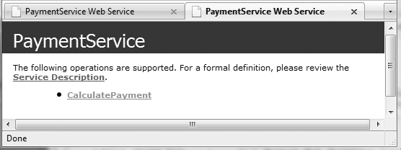
12.6 Web Services (continued)
4. Modify PaymentService.cs to add the calculation:
- Delete all using statements except for System
and System.Web.Services.
- Rename the class PaymentService and delete the
constructor
- Replace the HelloWorld method with:
public double CalculatePayment(double loanAmt,
double intRate, int months)
{
double monthRate, payment;
monthRate = intRate / 12.0d;
payment = (monthRate * loanAmt) /
(1.0d - Math.Pow(1.0d + monthRate, -months));
return payment;
}
SHOW PaymentService.cs
- To test the service, select Debug/Start Without
Debugging, to get:

Slide 46
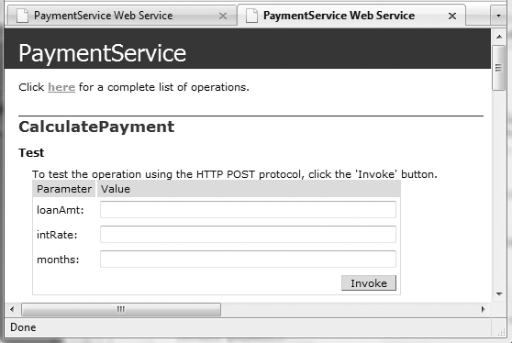
12.6 Web Services (continued)
- Click the CalculatePayment link, to get:
If we enter three numbers 100000.0, 0.05, and 120
and click Invoke, we get the result, in XML:

Slide 47
12.6 Web Services (continued)
- Consuming a Web Service
- We create a client Web application to use the
PaymentService service
1. Select File/Add New Web Site/ASP.NET Web Site,
while the PaymentService project is open, and
name it PaymentUser
2. Modify Default.aspx
- Rename it PaymentUser.aspx
- Replacing _Default with PaymentUser in its
Page directive
- Add text boxes to collect the input
parameters and a button to call the service
- Add a Label element as a placeholder for the
return value from the service
→ SHOW PaymentUser.aspx
- Now we must modify the code-behind file
(PaymentUser.aspx.cs)
1. Delete all using statements except System and
System.Web.UI and add using localhost

Slide 48
12.6 Web Services (continued)
2. Rename the partial class PaymentUser and
rename the Page_Load method buttonClick
3. Add a statement to instantiate the proxy class
PaymentService Proxy = new PaymentService();
4. The return value must be inserted into a string
and set to the Text attribute of the Label
element in the PaymentUser.aspx document
5. In the actual call to the proxy, the form
values must be converted to numerics, using
Convert.ToDouble and Convert.ToInt32
// PaymentUser.aspx.cs
// The code-behind file for the PaymentUser.aspx
// document. Defines the event handler that creates the
// proxy, and calls it to produce the results.
using System;
using System.Web.UI;
using localhost;
public partial class PaymentUser : System.Web.UI.Page {
protected void buttonClick(object sender,
EventArgs e) {
PaymentService proxy = new PaymentService();
Result.Text = String.Format(
"<br />Payment is: {0:C}“,proxy.CalculatePayment(
Convert.ToDouble(Loan.Text),
Convert.ToDouble(Interest.Text),
Convert.ToInt32(Months.Text)));
}
}

Slide 49
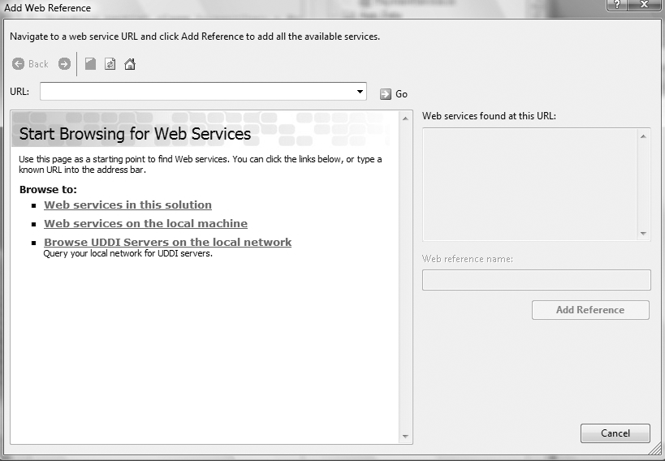
12.6 Web Services (continued)
- The final step of building the Web service
consumer is to create a Web reference in the client
1. Right-click on the PaymentUser entry in the
Solution Explorer and select Add Web Reference

Slide 50
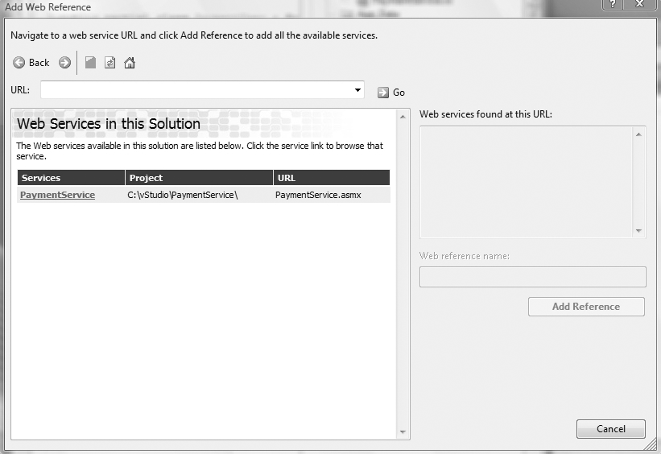
12.6 Web Services (continued)
2. Select Web Services in this Solution, which
produces:

Slide 51
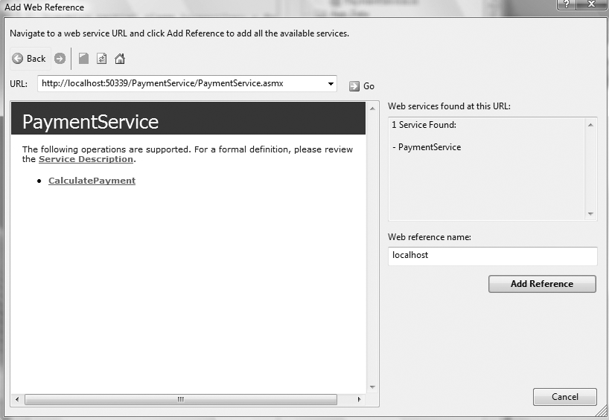
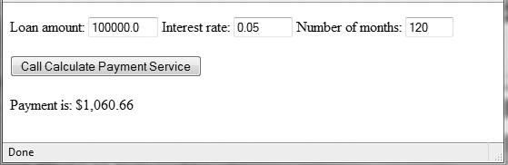
12.6 Web Services (continued)
- Select PaymentService, which produces:
- Click Add Reference (the new reference
will appear in the Solution Explorer)
- Right-click PaymentUser.aspx and selecting View
in Browser

Slide 52
12.6 Web Services (continued)
- Advertising Web Services
- There are two ways used with .NET to make Web
services available to clients:
1. With a Web services discovery document
2. With a Web services directory written in UDDI
- UDDI is supported by the .NET UDDI SDK

