Slide 1
15.1 Overview of Rails
- Rails is a development framework for Web-based
applications
- Based on MVC architecture for applications
- MVC cleanly separates applications into three
parts:
- Model – the data and any restraints on it
- View – prepares and presents results to the
user
- Controller – controls the application
- One characterizing part of Rails is its approach
to connecting object-oriented software with a
relational database – ORM
- Maps tables to classes, rows to objects, and
columns to fields of the objects

Slide 2
15.1 Overview of Rails (continued)
- View documents are HTML documents that may
include Ruby code
- A Rails application is a program that provides a
response when a client browser connects to a
Rails-driven Web site
- Rails can be used with Ajax
- Two fundamental principles that guided the
development of Rails:
1. DRY
2. Convention over configuration
- Rails does not use a GUI
- Rails is included in versions 1.8.7 or later of Ruby
- We use SQLite 3, so it must be downloaded and
installed (http://www.sqlite.org)

Slide 3
15.2 Document Requests
- After creating a subdirectory for our Rails
applications, examples, in the Ruby bin directory,
we create our first application in that subdirectory
named greet
>rails new greet
- This creates the framework for the new
application
- The created app subdirectory has four
subdirectories, models, views, controllers, and
helpers
- Rails provides the generate script, which is used to
create part of the controller for the application, as
well as a subdirectory of the views directory for
the view documents of the application
- generate needs three parameters
- controller
- a name for the controller
- a name for an action method in the controller
(which is also the name of the view markup file)
>rails generate controller say hello

Slide 4
15.2 Document Requests (continued)
- Static Documents (continued)
- There are now two files with empty classes in the
controller directory, say_controller.rb:
application.rb has ApplicationController
say_controller.rb has SayController
class SayController < ApplicationController
def hello
end
end
- The SayController class produces, at least
indirectly, responses to requests
- The URL of our Rails application is
http://localhost:3000/say/hello
- The Rails-generated view document:
<h1> say#hello</h1>
<p>Find me in app/views/say/hello.html.erb</p>

Slide 5

15.2 Document Requests (continued)
- Static Documents (continued)
<!DOCTYPE html>
<!-- hello.html.erb - the template for the
greet application
-->
<html lang = "en">
<head>
<title> greet </title>
<meta charset = "utf-8" />
</head>
<body>
<h1> Hello from Rails </h1>
</body>
</html>
- To test the application, a Web server must be
started – we use webrick (included with Rails)
>rails server webrick

Slide 6
15.2 Document Requests (continued)
- Static Documents (continued)
- Response activities:
1. Instantiate SayController class
2. Call the hello action method
3. Search the views/say directory for hello.html.erb
4. Process hello.html.erb with Erb
5. Return the resulting hello.html.erb to the
requesting browser

Slide 7
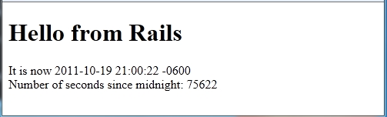
15.2 Document Requests (continued)
- Dynamic Documents
- Dynamic documents can be built with Rails by
embedding Ruby code in the template document
- An example: display a greeting and the current
date and time and the number of seconds since
midnight
- Ruby code is embedded in a document by
placing it between <% and %>
- To insert the result of evaluating the code into
the document, use <%=
- The Time class has a method, now, that returns
the current day of the week, month, day of the
month, time, time zone, and year, as a string
It is now <%= t = Time.now %>
Number of seconds since midnight:
<%= t.hour * 3600 + t.min * 60 + t.sec %>

Slide 8
15.2 Document Requests (continued)
- Dynamic Documents (continued)
- It would be better to put the code in the controller
def hello
@t = Time.now
@tsec = @t.hour * 3600 + @t.min * 60 + @t.sec
end
- Now the Ruby code in the template is:
It is now <%= @t %> <br />
Number of seconds since midnight: <%= @tsec %>

Slide 9
15.3 Rails Applications with Databases
- Use a simple database with just one table
- The application will be named cars
- The application will present a welcome document
to the user, including the number of cars in the
database and a form to get the beginning and
ending years and a body style for the desired car
- Creating the application
- In the subdirectory of our examples:
>rails new cars
- Build the model, migration script, database table,
and maintenance controller for the database
>rails generate scaffold corvette
body_style:string miles:float year:integer
- corvette is the name of the model
(by convention the name of the table is the
plural form of the name of the model)

Slide 10
15.3 Rails Applications with Databases
(continued)
- The migration class file built by this in
cars/db/migrate is:
class CreateCorvettes < ActiveRecord::Migration
def change
create_table :corvettes do |t|
t.string :body_style
t.float :miles
t.integer :year
t.timestamps
end
end
end
- We do not have a database—only the description
(a migration class) of a database
- To create the database, use rake:
>rake db:migrate
- This causes the execution of the change method
(in C:/Ruby192/bin/examples/cars)
== CreateCorvettes: migrating==============
-- create_table(:corvettes)
-> 0.0020s
== CreateCorvettes: migrated (0.0020s) ====

Slide 11
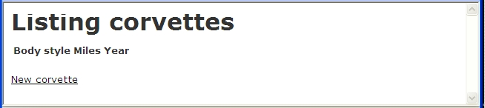
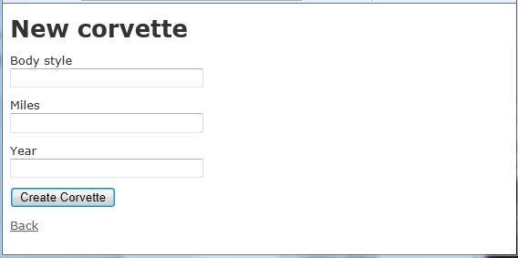
15.3 Rails Applications with Databases
(continued)
- The controller for the application is named
corvettes, so we can see the application at
http://localhost:3000/corvettes
- Rails built the basic table maintenance operations,
create, read, update, and delete (CRUD)
- If we click New corvette, we get:

Slide 12
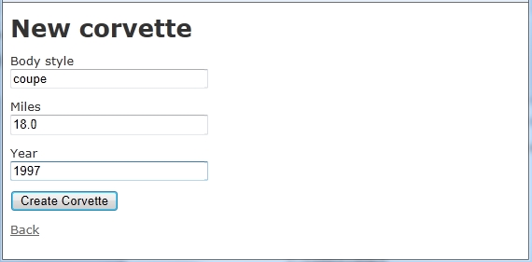
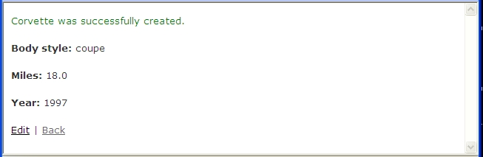
15.3 Rails Applications with Databases
(continued)
- If we fill out the form, as in:
- Now we click Create, which produces:

Slide 13
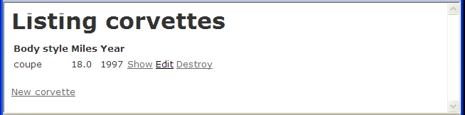
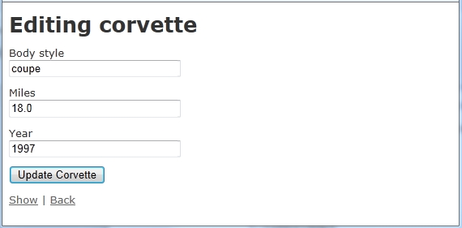
15.3 Rails Applications with Databases
(continued)
- Now if we click Back, we get:
- If we click Edit, we get:

Slide 14
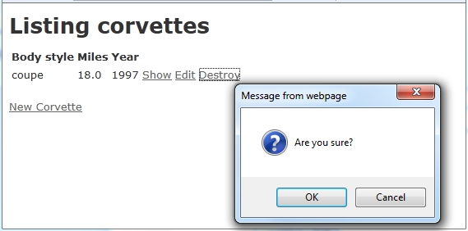
15.3 Rails Applications with Databases
(continued)
- If we click Destroy, we get:
- The model file, which is in cars/models, has the
empty class:
class Corvette < ActiveRecord::Base
end
- We can easily add some validation to this class by
calling validates; the last parameter specifies the
kind of validation
validates :body_style, :miles, :year
:presence => true

Slide 15
15.3 Rails Applications with Databases
(continued)
validates :year, numericality => {
:greater_than => 1952,
:less_than_or_equal_to => Time.now.year}
- The model class is now:
class Corvette < ActiveRecord::Base
validates :body_style, :miles,:year,
presence => true
validates :year, numericality => {
:greater_than => 1952,
:less_than_or_equal_to => Time.now.year}
end
- The controller built by Rails, named
CorvetteController, provides the action methods:
index – creates a list of rows of the table
show – creates the data for one row
new – creates a new row object
edit – handles editing a row
create – handles row creation
update – handles updating a row
delete – handles row deletion

Slide 16
15.3 Rails Applications with Databases
(continued)
- There are four documents in the views directory,
index.html.erb, new.html.erb, show.html.erb,
and edit.html.erb; here is index.html.erb:
<h1>Listing corvettes</h1>
<table>
<tr>
<th>Body style</th>
<th>Miles</th>
<th>Year</th>
<th></th>
<th></th>
<th></th>
</tr>
<% @corvettes.each do |corvette| %>
<tr>
<td><%= corvette.body_style %></td>
<td><%= corvette.miles %></td>
<td><%= corvette.year %></td>
<td><%= link_to 'Show', corvette %></td>
<td><%= link_to 'Edit', edit_corvette_path(corvette)
%></td>
<td><%= link_to 'Destroy', corvette, confirm:
'Are you sure?', method: :delete %></td>
</tr>
<% end %>
</table>
<br />
<%= link_to 'New corvette', new_corvette_path %>

Slide 17
15.3 Rails Applications with Databases
(continued)
- Notice that index.html.erb is only the content of
the body element
- The rest of the document comes from a layout
document, which is stored in the layout
subdirectory of views – built by scaffold
<!DOCTYPE html>
<html>
<head>
<title>Cars</title>
<%= stylesheet_link_tag ″application″ %>
<%= javascript_include_tag ″application″ %>
<%= csrf_meta_tags %>
</head>
<body>
<%= yield %>
</body>
</html>
- yield is the place the template file belongs
- The style sheet was furnished by scaffold
- Any JavaScript files are stored in
public/javascripts

Slide 18
15.3 Rails Applications with Databases
(continued)
- The new.html.erb and _form.html.erb documents:
(new and edit both use _form.html.erb)
<h1> New corvette </h1>
<%= render 'form' %> <!– Renders _form.html.erb -->
<%= link_to 'Back', corvettes_path %>
<%= form_for(@corvette) do |f| %>
<% if @corvette.errors.any? %>
<div id="error_explanation">
<h2><%= pluralize(@corvette.errors.count,
"error") %>
prohibited this corvette from being saved:</h2>
<ul>
<% @corvette.errors.full_messages.each do |msg|%>
<li><%= msg %></li>
<% end %>
</ul>
</div>
<% end %>
<div class="field">
<%= f.label :body_style %><br />
<%= f.text_field :body_style %>
</div>
<div class="field">
<%= f.label :miles %><br />
<%= f.text_field :miles %>
</div>
<div class="field">
<%= f.label :year %><br />
<%= f.number_field :year %>
</div>
<div class="actions">
<%= f.submit %>
</div>
<% end %>

Slide 19
15.3 Rails Applications with Databases
(continued)
- The show.html.erb document is:
<p id = ″notice″> <%= notice %> </p>
<p>
<b>Body style:</b>
<%= @corvette.body_style %>
</p>
<p>
<b>Miles:</b>
<%= @corvette.miles %>
</p>
<p>
<b>Year:</b>
<%= @corvette.year %>
</p>
<%= link_to 'Edit',
edit_corvette_path(@corvette) %> |
<%= link_to 'Back', corvettes_path %>
- The edit.html.erb document is:
<h1>Editing corvette</h1>
<%= render ′form′ %>
<%= link_to 'Show', @corvette %> |
<%= link_to 'Back', corvettes_path %>

Slide 20
15.3 Rails Applications with Databases
(continued)
- Now we must build the actual application
- Build a second controller for the required
processes
>rails generate controller main welcome
# main_controller.rb - for the cars application
class MainController < ApplicationController
# welcome method – fetches values for the
# initial view
def welcome
@num_cars = Corvette.count
end
end
- The count method of the table classes returns
the number of rows in the table

Slide 21
15.3 Rails Applications with Databases
(continued)
- To implement the searches of the table, use where
- The where method searches a table for a
specific row or rows
mycar = Corvette.where(:body_style => "convertible")
The RecordNotFound exception is thrown if
where is asked to do something it cannot do
- The qualifiers first, last, or all can be attached to
the call to where (first is the default)
- Multiple conditions can be specified:
sixty_five_conv = Corvette.where([
:year = 1965,:body_style = 'convertible’]).all
- To use find with non-literal conditions, a
different parameter form is needed
my_year_conv = Corvette.where([
"year = ? and body_style = 'convertible’",
@year]).all

Slide 22
15.3 Rails Applications with Databases
(continued)
- Next, design the welcome template, which
has two tasks:
1. Display text boxes to get the model years
and body style of interest from the user
2. Display the number of cars furnished by the
welcome action method in the controller
<!– welcome.html.erb – initial view for the
cars application -->
<!– The initial information -->
<p>
<h1> Aidan’s Used Car Lot </h1>
<h2> Welcome to our home document </h2>
We currently have <%= @num_cars %> used
Corvettes listed <br /> To request information
on available cars, please fill out <br /> the
following form and submit it
</p>
<!– The form to collect input from the user
about their interests -->
<form action = "result" method = "post">
From year: <input type = "text" size = "4"
name = "year1" />
To year: <input type = "text" size = "4"
name = "year2" />
Body style: <input type = "text" size = "12"
name = "body" /> <br />
<input type = "submit" value = "Submit" />
<input type = "reset" value = "Reset" />
</form>

Slide 23
15.3 Rails Applications with Databases
(continued)
- Next, design the result action method, which
is named result in the welcome template form
- Task: get form data and use find to compute the
required output data for the result template
- The form data is made available by Rails through a
hash-like object params
- params can be indexed by either keys or symbols
If phone is the name of a control, we can use:
@phone = params[:phone]
- The result method of the main controller is:
# result method - fetches values for the result
# template
def result
@year1 = params[:year1].to_i
@year2 = params[:year2].to_i
@body = params[:body]
@selected_cars = Corvette.where(
["year >= ? and year <= ?
and body_style = ?",
@year1, @year2, @body]).all
end

Slide 24
15.3 Rails Applications with Databases
(continued)
- Last step: build the result template document
- Put the information about cars from
@selected_cars in a table
<!-- Display what the user asked for -->
<p> Cars from <%= @year1 %> to
<%= @year2 %>
with the <%= @body %> body style </p>
<!-- Display the results in a table -->
<table border = "border">
<tr>
<th> Body Style </th>
<th> Miles </th>
<th> Year </th>
</tr>
<!-- Put the cars of @selected_cars in table-->
<% @selected_cars.each do |car|
<tr>
<td> <%= car.body_style %> </td>
<td> <%= car.miles %> </td>
<td> <%= car.year %> </td>
</tr>
<% end %> <!-- end of do loop -->
</table>

Slide 25
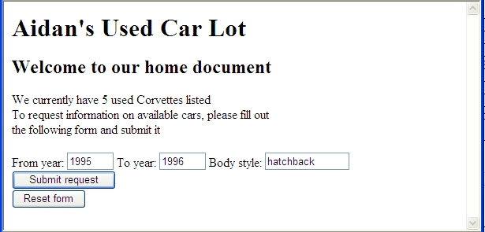
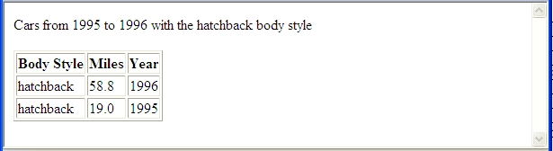
15.3 Rails Applications with Databases
(continued)
- A filled out request:
- The result document:

Slide 26
15.3 Rails Applications with Databases
(continued)
- Modifying a database
- Rails was designed for agile development, so it
makes it easy to change to new versions of
databases, and also to revert back to earlier
versions
- The name of the initial version of the migration for
the corvettes table was
20111016030420_create_corvettes.rb
(it is in db/migrate)
- To change a database table, a new migration file
is created and rake is used to update the table
- To illustrate a change, we add a state column to
the corvettes table
- To create the new migration file:
>rails generate migration
AddStateToCorvette state:string
- Produces the response:
invoke active_record
create db/migrate/
20111016030420_add_state_to_corvette.rb

Slide 27
15.3 Rails Applications with Databases
(continued)
- Modifying a database (continued)
- The resulting migration class, named
20111016030420_add_state_to_corvette.rb:
class AddStateToCorvette <
ActiveRecord::Migration
def change
add_column :corvettes, :state, :string
end
end
- Now use rake to apply the migration to the table:
>rake db:migrate
- Rails response:
(in c:\Ruby192\bin\examples\cars)
== AddStateToCorvette: migrating ============
-- add_column(:corvettes, :state, :string)
-> 0.0010s
== AddStateToCorvette: migrated (0.0010s) ===

Slide 28
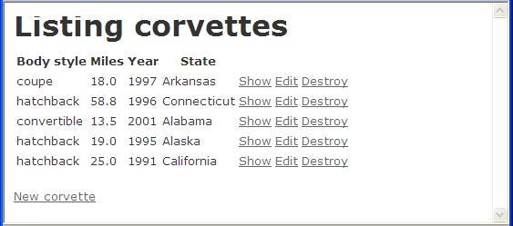
15.3 Rails Applications with Databases
(continued)
- Modifying a database (continued)
- Now the display of corvettes is:
- To go back to the last migration form:
>rake db:rollback
- To go back to a specific migration:
>rake db:migrate VERSION=20091016120032
- Layouts
- Rails provided one for the corvettes controller
- We could build one for the main controller
- Include the DOCTYPE, some headings, and a
footer for a copyright

Slide 29
15.3 Rails Applications with Databases
(continued)
<!DOCTYPE html>
<!-- main.htm.erb – a layout for the main
controller of cars
-->
<html lang="en">
<head>
<title> Main </title>
<meta charset = "utf-8" />
</head>
<body>
<h1> Aidan's Used Car Lot </h1>
<h2> Welcome to our home document </h2>
<%= yield %>
<hr/>
<p> Copyright 2012, AUCL, Inc. </p>
</body>
</html>
- We could also add a stylesheet for the templates of
main
- Could be used for both the actual template file
and the layout
/* mainstyles.css - a style sheet for
the main controller */
h1 {font-style: italic; color: blue;}
h2 {color: blue;}
.labels {font-style: italic; color: red;}
- Stored in cars/app/assets/stylesheets

Slide 30
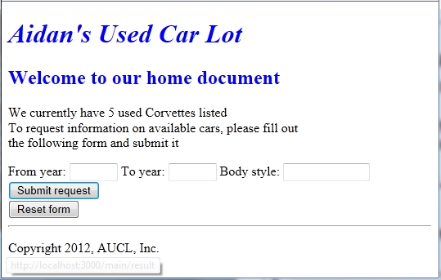
15.3 Rails Applications with
Databases (continued)
- To reference the stylesheet in the layout, add the
following to the head of the layout document
<%= stylesheet_link_tag "mainstyles" %>
- Now the welcome template appears as:

