Slide 1
3.1 Introduction
- The CSS1 specification was developed in 1996
- CSS2 was released in 1998
- CSS2.1 reflects browser implementations
- CSS3 is partially finished and parts are
implemented in current browsers
- CSSs provide the means to control and
change presentation of HTML documents
- CSS is not technically HTML, but can be
embedded in HTML documents
- A style sheet is a syntactic mechanism for
specifying style information
- Style sheets allow you to impose a standard
style on a whole document, or even a whole
collection of documents
- Style is specified for a tag by the values of its
properties

Slide 2
3.2 Levels of Style Sheets
- There are three levels of style sheets
1. Inline - specified for a specific occurrence of a
tag and apply only to that tag
- This is fine-grain style, which defeats the
purpose of style sheets - uniform style
2. Document-level style sheets - apply to the
whole document in which they appear
3. External style sheets - can be applied to any
number of documents
- When more than one style sheet applies to a
specific tag in a document, the lowest level style
sheet has precedence
- In a sense, the browser searches for a style
property spec, starting with inline, until it finds
one (or there isn’t one)

Slide 3
3.2 Levels of Style Sheets (continued)
- Inline style sheets appear in the tag itself
- Document-level style sheets appear in the head of
the document
- External style sheets are in separate files,
potentially on any server on the Internet
- A <link> tag is used to specify that the browser
is to fetch and use an external style sheet file
<link rel = "stylesheet" type = "text/css"
href = "http://www.wherever.org/termpaper.css">
</link>
- External style sheets can be validated
http://jigsaw.w3.org/css-validator/

Slide 4
3.3 Style Specification Formats
- Format depends on the level of the style sheet
- Inline:
- Style sheet appears as the value of the style
attribute
- General form:
style = "property_1: value_1;
property_2: value_2;
…
property_n: value_n"
- Document-level:
- Style sheet appears as a list of rules that are the
content of a <style> tag
- The <style> tag must include the type attribute,
set to "text/css"

Slide 5
3.3 Style Specification Formats (continued)
- General form:
<style type = "text/css">
rule list
</style>
- Form of the rules:
selector {list of property/values}
- Each property/value pair has the form:
property: value
- Pairs are separated by semicolons, just as in
the value of a <style> tag
- Comments in the rule list must have a different
form - use C comments (/*…*/)
- External style sheets
- Form is a list of style rules, as in the content of
a <style> tag for document-level style sheets

Slide 6
3.4 Selector Forms
1. Simple Selector Forms
- The selector is a tag name or a list of tag names,
separated by commas
- Examples:
h1, h3
p
- Contextual selectors
ol ol li
2. Class Selectors
- Used to allow different occurrences of the same
tag to use different style specifications
- A style class has a name, which is attached to a
tag name
- For example,
p.narrow {property/value list}
p.wide {property/value list}

Slide 7
3.4 Selector Forms (continued)
2. Class Selectors (continued)
- The class you want on a particular occurrence of
a tag is specified with the class attribute of the tag
- For example,
<p class = "narrow">
...
</p>
...
<p class = "wide">
...
</p>
3. Generic Selectors
- A generic class can be defined if you want a
style to apply to more than one kind of tag
- A generic class must be named, and the name
must begin with a period

Slide 8
3.4 Selector Forms (continued)
3. Generic Selectors (continued)
- Example,
.sale { … }
- Use it as if it were a normal style class
<h1 class = "sale"> Weekend Sale </h1>
...
<p class = "sale"> … </p>
4. id Selectors
- An id selector allows the application of a style to
one specific element
- General form:
#specific-id {property-value list}
- Example:
#section14 {...}

Slide 9
3.4 Selector Forms (continued)
5. Contextual Selectors
- Descendant Selectors
ul ol – applies to ol when it is in a ul element
- Child Selectors
ul > ol – applies to ol when it is a child of a ul
element
p > h1 > em – applies to em when it is the child of
an h1 element that is the child of a p element
6. Universal Selectors
* {color: red;}
- Applies to all elements in the document

Slide 10
3.4 Selector Forms (continued)
7. Pseudo Classes
- Pseudo classes are styles that apply when
something happens, rather than because the
target element simply exists
- Names begin with colons
- hover classes apply when the mouse cursor is
over the element
- focus classes apply when an element has focus
- link classes apply when a link has not been
selected
- visited classes apply when a link previously has
been selected

Slide 11
3.5 Property Value Forms
- There are 60 different properties in 7 categories:
- Fonts
- Lists
- Alignment of text
- Margins
- Colors
- Backgrounds
- Borders
- Property Value Forms
- Keywords - left, small, …
- Not case sensitive
- Length - numbers, maybe with decimal points
- Units:
px - pixels
in - inches
cm - centimeters
mm - millimeters
pt - points
pc - picas (12 points)
em - height of the letter ‘m’
ex - height of the letter ‘x’

Slide 12
3.5 Property Value Forms (continued)
- Percentage - just a number followed
immediately by a percent sign
- URL values
- url(protocol://server/pathname)
- Colors
- Color name
- rgb(n1, n2, n3)
- Numbers can be decimal or percentages
- Hex form: #XXXXXX
3.6 Font Properties
- font-family
- Value is a list of font names - browser uses
the first in the list it has
- font-family: Arial, Helvetica, Futura
- Generic fonts: serif, sans-serif, cursive,
fantasy, and monospace (defined in CSS)
- Browser has a specific font for each
- If a font name has more than one word, it
should be single-quoted

Slide 13
3.6 Font Properties (continued)
- font-size
- Possible values: a length number or a name,
such as smaller, xx-large, etc.
- Points or picas do not display the same
- Percentages and em are the best
- Font variants
- Default is normal, but can be set to small-caps
- font-style
- italic, oblique (useless), normal
- font-weight - degrees of boldness
- bolder, lighter, bold, normal
- Could specify as a multiple of 100 (100 – 900)
- font (shorthand)
- For specifying a list of font properties
font: bolder 14pt Arial Helvetica
- Order must be: style, weight, size, name(s)

Slide 14
3.6 Font Properties (continued)
→ SHOW fonts.html and display
→ SHOW fonts2.html and styles.css and display
- The text-decoration property
- line-through, overline, underline, none
→ SHOW decoration.html & display
- letter-spacing – value is any length property
value
- Text Spacing
- letter-spacing property – the amount of space
between the letters in words – tracking
Possible values: normal or any length value
- Positive length values increase spacing
- Negative length values decrease spacing
- word-spacing property – the amount of space
between words
Possible values – like those of letter-spacing
- line-height property – space between lines –
leading
Possible values – a number, which is the number
of times the font size, or a percentage
→ SHOW text_space.html and display

Slide 15
3.7 List properties
- list-style-type
- Unordered lists
- Bullet can be a disc (default), a square, or a
circle
- Set it on either the <ul> or <li> tag
- On <ul>, it applies to all items in the list
<h3> Some Common Single-Engine Aircraft </h3>
<ul style = "list-style-type: square">
<li> Cessna Skyhawk </li>
<li> Beechcraft Bonanza </li>
<li> Piper Cherokee </li>
</ul>
- On <li>, list-style-type applies to just that
item
<h3> Some Common Single-Engine Aircraft </h3>
<ul>
<li style = "list-style-type: disc">
Cessna Skyhawk </li>
<li style = "list-style-type: square">
Beechcraft Bonanza </li>
<li style = "list-style-type: circle">
Piper Cherokee </li>
</ul>

Slide 16
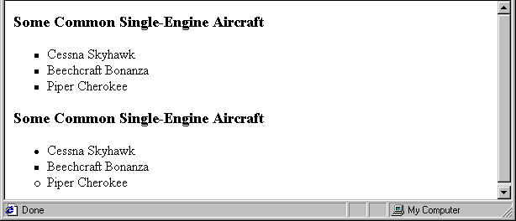
3.7 List properties (continued)
- Could use an image for the bullets in an
unordered list
- Example:
<li style = "list-style-image:
url(bird.jpg)">

Slide 17
3.7 List properties (continued)
- On ordered lists - list-style-type can be used
to change the sequence values
Property value Sequence type First four
decimal Arabic numerals 1, 2, 3, 4
upper-alpha Uc letters A, B, C, D
lower-alpha Lc letters a, b, c, d
upper-roman Uc Roman I, II, III, IV
lower-roman Lc Roman i, ii, iii, iv
→ SHOW sequence_types.html and display
- CSS2 has more, like lower-greek, and hebrew,
and armenian

Slide 18
3.8 Alignment of Text
- The text-indent property allows indentation
- Takes either a length or a % value
- The text-align property has the possible
values, left (the default), center, right, or
justify
- Sometimes we want text to flow around
another element - the float property
- The float property has the possible values,
left, right, and none (the default)
- If we have an element we want on the right,
with text flowing on its left, we use the
default text-align value (left) for the text and
the right value for float on the element we
want on the right

Slide 19
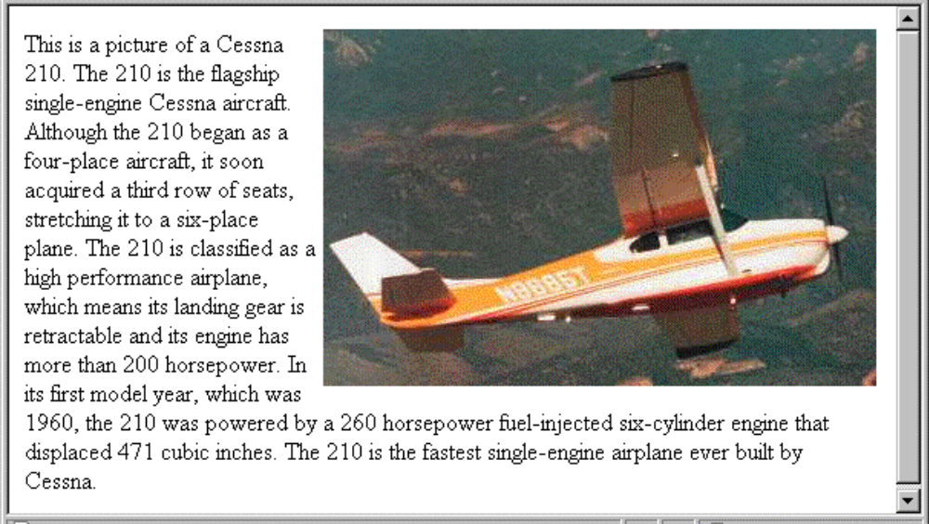
3.8 Alignment of Text (continued)
<img src = "c210.jpg"
style = "float: right" />
-- Some text with the default alignment - left

Slide 20
3.9 Colors
- There are three color collections
1. There is a set of 17 colors that are guaranteed
to be displayable by all graphical browsers on
all color monitors
2. There are 147 named colors – see Appx. B
3. There is a much larger set, the Web Palette
- 216 colors
- Use hex color values of 00, 33, 66, 99, CC,
and FF

Slide 21
3.8 Colors (continued)
- The color property specifies the foreground
color of elements
<style type = "text/css" >
th.red {color: red}
th.orange {color: orange}
</style>
…
<table>
<tr>
<th class = "red"> Apple </th>
<th class = "orange"> Orange </th>
<th class = "orange"> Screwdriver </th>
</tr>
</table>
- The background-color property specifies the
background color of elements
SHOW back_color.html and display

Slide 22
3.10 The Box Model
- Borders – every element has a border-style
property
- Controls whether the element has a border and
if so, the style of the border
- border-style values: none, dotted, dashed,
and double
- border-width – thin, medium (default), thick,
or a length value in pixels
- Border width can be specified for any of the
four borders (e.g., border-top-width)
- border-color – any color
- Border color can be specified for any of the
four borders (e.g., border-top-color)
- Table borders and table cell borders
- To get cell borders:
td, th {border: thin solid black}
- To get table borders:
table {border: thin solid black}
→ SHOW borders.html and display

Slide 23
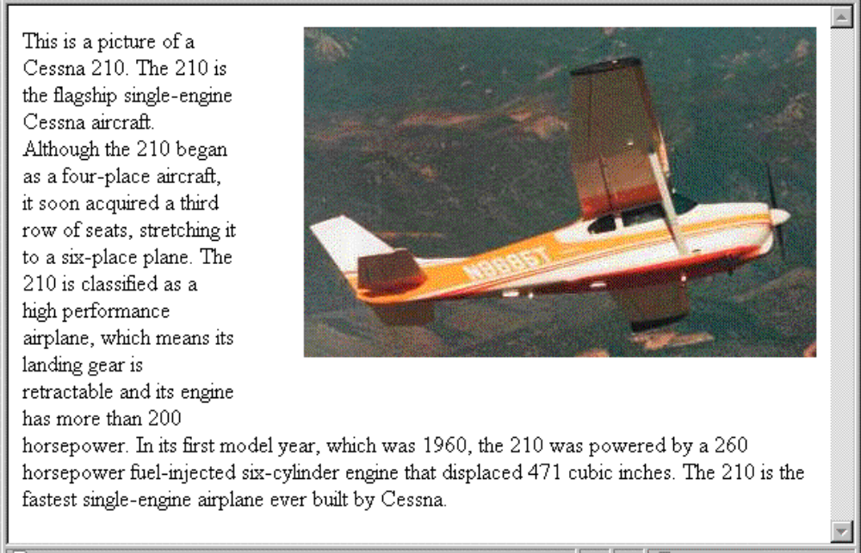
3.10 The Box Model (continued)
- Margin – the space between the border of an
element and its neighbor element
- The margins around an element can be set with
margin-left, etc. - just assign them a length
value
<img src = "c210.jpg " style = "float: right;
margin-left: 0.35in;
margin-bottom: 0.35in" />

Slide 24
3.10 The Box Model (continued)
- Padding – the distance between the content of an
element and its border
- Controlled by padding, padding-left, etc.
→ SHOW marpads.html and display
3.11 Background Images
- The background-image property
→ SHOW back_image.html and display
- Repetition can be controlled
- background-repeat property
- Possible values: repeat (default), no-repeat,
repeat-x, or repeat-y
- background-position property
- Possible values: top, center, bottom, left,
or right

Slide 25
3.12 The <span> and <div> tags
- One problem with the font properties is that
they apply to whole elements, which are
often too large
- Solution: a new tag to define an element in the
content of a larger element - <span>
- The default meaning of <span> is to leave the
content as it is
<p>
Now is the <span> best time </span> ever!
</p>
- Use <span> to apply a document style sheet to
its content
<style type = "text/css">
.bigred {font-size: 24pt;
font-family: Ariel; color: red}
</style>
...
<p>
Now is the
<span class = "bigred">
best time </span> ever!
</p>

Slide 26
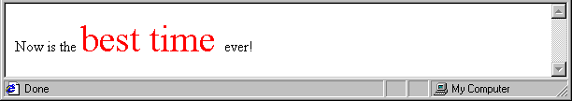
3.12 The <span> and <div> tags (continued)
- The <span> tag is similar to other HTML tags,
they can be nested and they have id and class
attributes
- Another tag that is useful for style specifications:
<div>
- Used to create document sections (or divisions)
for which style can be specified

Slide 27
3.13 Conflict Resolution
- A conflict occurs when there are two or more
values for the same property on the same
element
- Sources of conflict:
1. Conflicting values between levels of style
sheets
2. Within one style sheet
3. Inheritance can cause conflicts
4. Property values can come from style sheets
written by the document author, the browser
user, and the browser defaults
- Resolution mechanisms:
1. Precedence rules for the different levels of
style sheets
2. Source of the property value
3. The specificity of the selector used to set the
property value
4. Property value specifications can be marked
to indicate their weight (importance)

Slide 28
3.12 Conflict Resolution (continued)
- Weight is assigned to a property value by
attaching !important to the value
- Conflict resolution is a multistage process,
called the cascade:
1. Gather all of the style specs from the different
levels of style sheets
2. All available specs, from all sources, are sorted
by origin and weight, using the following rules,
which are given in precedence order:
a. Important declarations with user origin
b. Important declarations with author origin
c. Normal declarations with author origin
d. Normal declarations with user origin
e. Any declarations with browser (or other user
agent) origin

Slide 29
3.12 Conflict Resolution (continued)
3. If any conflicts remain, sort them by
specificity:
a. id selectors
b. Class and pseudo-class selectors
c. Contextual selectors
d. Universal selectors
4. If there are still conflicts, resolve them by
precedence to the most recently seen
specification

