Slide 1
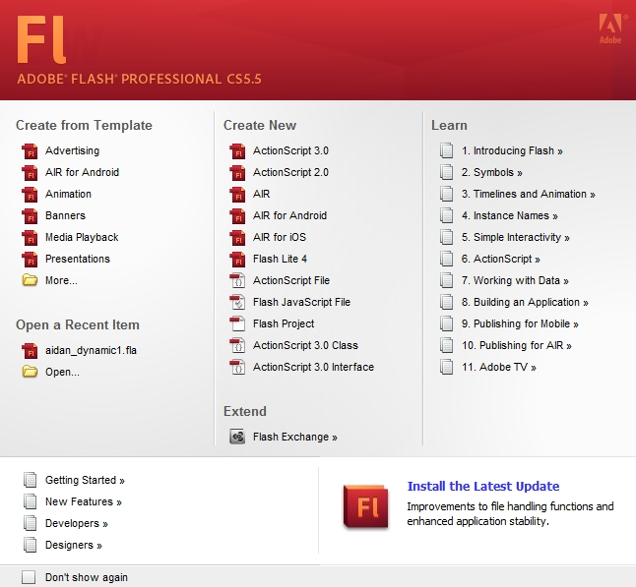
8.1 Origins and Uses of Flash
- mid-1990s – FutureSplash Animator
- 1996 – Macromedia bought it and renamed it Flash
- 2005 – Adobe bought Macromedia
- Current version: Flash CS5.5
- Now – Flash is the leading technology for
graphics, animation, and video on the Web
- Flash is supported by two systems:
1. The Flash player
2. The Flash authoring environment
8.2 The Flash Authoring Environment

Slide 2
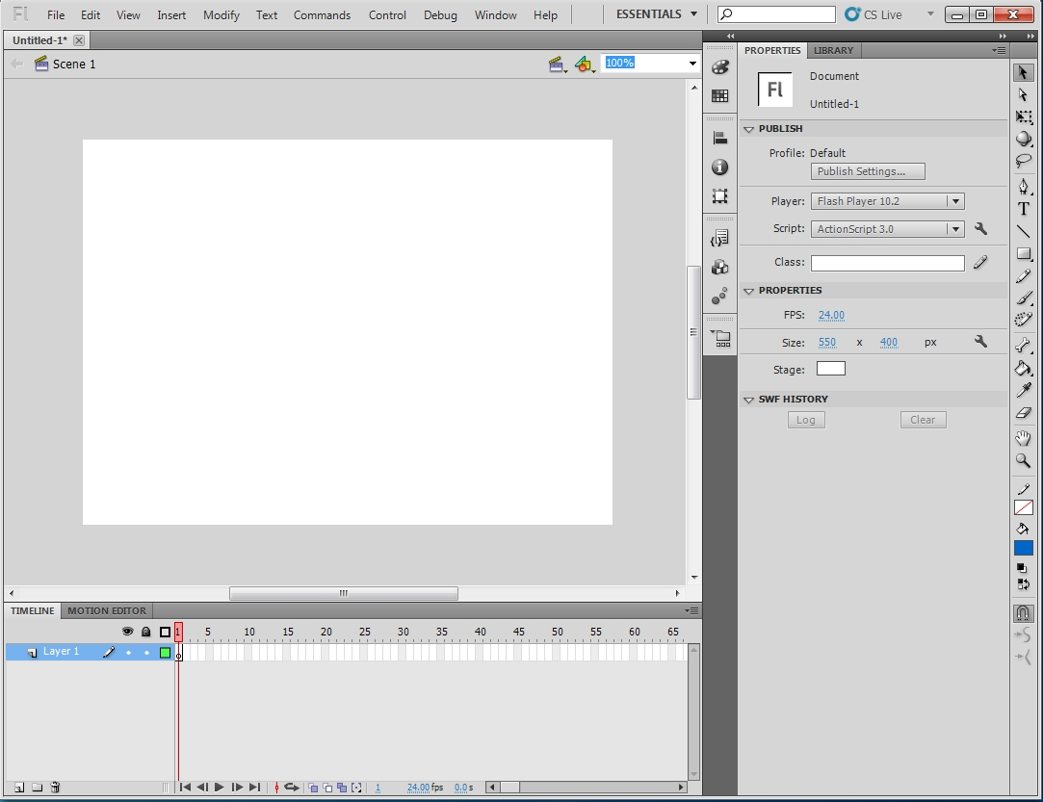
8.2 The Flash Authoring Environment
(continued)
- Three kinds of files:
Movies - .swf
Documents - .fla
Files with ActionScript - .as
- Selecting Create New opens the workspace

Slide 3
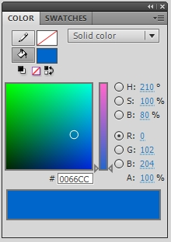
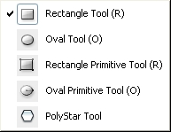
8.2 The Flash Authoring Environment
(continued)
- The tools panel:
- The COLOR panel:
- Drawing Tools
- Predefined Figures - Rectangles Tool

Slide 4
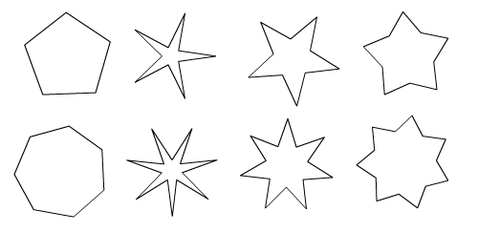
8.2 The Flash Authoring Environment
(continued)
- To draw a rectangle:
- Select stroke style, stroke color, and fill color
- Place cursor on the stage, hold down left button
and drag
- Drawing an oval is just like drawing a rectangle
- Polystar Tool
- Use Options button of the properties panel to
choose between a polygon or a star
- The number of points is then chosen
- For stars, the point size can be chosen

Slide 5

8.2 The Flash Authoring Environment
(continued)
- Modifying a drawn figure:
- The Select tool:
- A single click on a stroke selects that stroke
- A double click on a stroke selects the whole
stroke
- A single click inside the figure selects the fill
- A double click inside the figure selects the
whole figure
- Strokes can be bent by dragging them

Slide 6
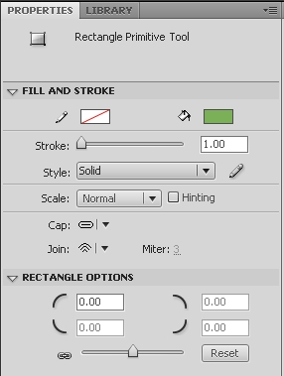
8.2 The Flash Authoring Environment
(continued)
- Primitive Rectangles and Ovals
- Difference: non-primitive figures are
disconnected from their master templates
- Effects:
1. Disconnected figures can be modified
2. The master template parameters of a
disconnected figure cannot be modified
- These parameters control the radius of
the corners

Slide 7
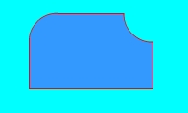
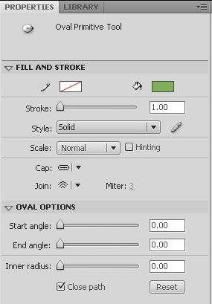
8.2 The Flash Authoring Environment
(continued)
- Positive values round the corner in the
usual way
- Negative values round the corner to the
inside
- Primitive Ovals- Start angle, End angle, and Inner
Radius

Slide 8


8.2 The Flash Authoring Environment
(continued)
- When a figure is placed on the stage, a black dot
appears in the first frame of the time line – it is
now a populated frame
- The first frame is a keyframe by default

Slide 9
8.2 The Flash Authoring Environment
(continued)
- Lines – drawn with the Line Tool
- Freehand drawing – Pencil Tool, Pen Tool, and
Brush Tool
- Pencil Tool – When it is selected, two small icons
appear at the bottom of the tools panel
- The right icon is a squiggly line – click it and
three labeled icons, Straighten, Smooth, and
Ink (the default)
- Text (we discuss classic text only)
- Selecting the Text Tool and clicking the left
mouse button places a narrow box on the stage
(similar to that for PowerPoint)
- As text is typed in the box, it stretches in width
- Each corner of the box can be dragged to
lengthen the box – when it is lengthened, it
switches to wrap mode and the upper right
corner changes from a small circle to a small
square
- If the upper right corner is double-clicked,
the box reverts to its original size

Slide 10
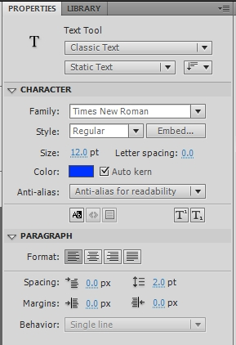
8.2 The Flash Authoring Environment
(continued)
- Text (continued)
- The properties panel for text:
- The most commonly used part is the upper
menu (Static Text)
- Other options are Dynamic and Input

Slide 11
8.2 The Flash Authoring Environment
(continued)
- Flash supports both bitmap and vector figures
- Vector figures can be created and modified
- Bitmap figures are imported and cannot be
modified
- Libraries and Symbols
- Every Flash document has a library, which stores
the things that could be part of the movie
- Graphic figures can be stored as symbols
- Symbols in the library can be dragged to the
stage
- Library contents are shown in the Library panel
- Figures created on the stage are vector graphic
figures
- Can be converted to symbols and placed in the
library with Modify/Convert to Symbol
- This opens a dialog box
- Usually rename the symbol and select a type

Slide 12
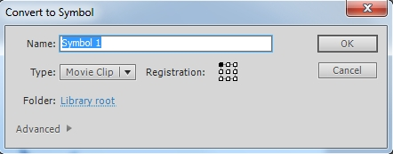
8.2 The Flash Authoring Environment
(continued)
- Libraries and Symbols (continued)
8.4 An example – Static Graphics
- A banner for an ad for used airplanes
- Because it is static, it occupies a single frame
- Also, we’ll use a single layer
- Steps:
1. Open a new Flash document and resize the
stage to 700 by 350 pixels
2. Create the text box with the company’s name
and slogan

Slide 13
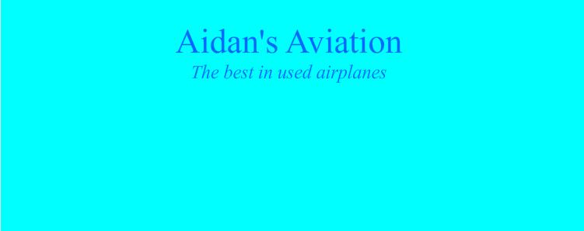
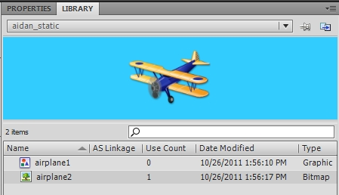
8.4 An example – Static Graphics
(continued)
3. Add two small airplane figures
- Select File/Import and browse for the figure
- For bitmap graphic figures, import to the
stage, which also puts it in the library
- For vector graphic figures (including WMF),
import to the library and drag an instance
to the stage

Slide 14
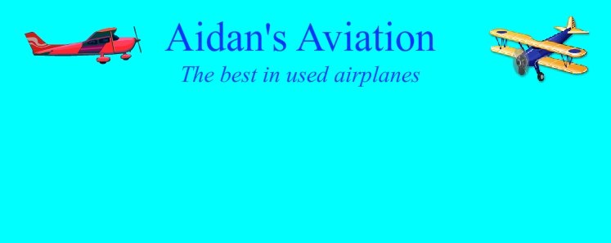
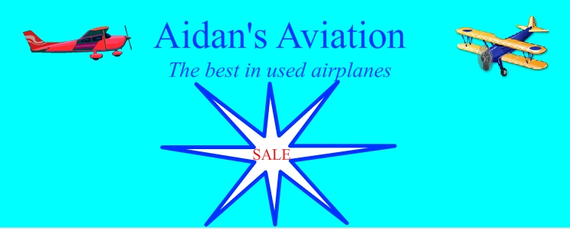
8.4 An example –Static Graphics
(continued)
Step 4. Add a star with the word “Sale” inside
- Draw an 8-point star and stretch the four side
points
- Convert it to a symbol
- Use the Text Tool to put “Sale” inside the star

Slide 15
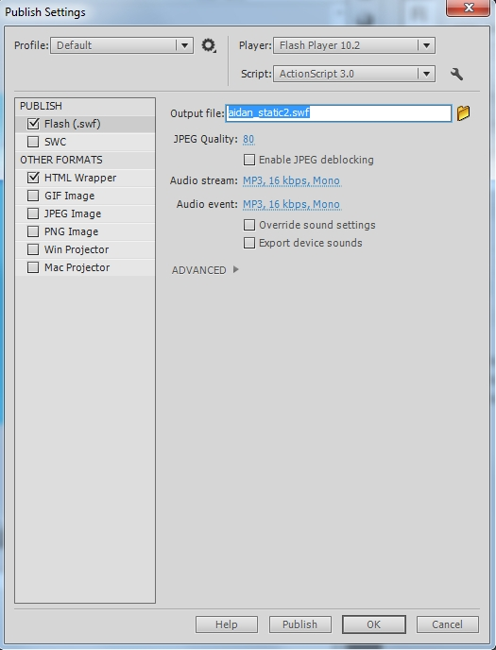
8.4 An example –Static Graphics
(continued)
Step 5. Test the movie with Control/Test Movie
Step 6. Publish the movie
- Select File/Publish/Settings

Slide 16
8.4 An example –Static Graphics
(continued)
- Can publish the movie as an SWF file and insert
it into an HTML document
- The HTML file produced by Flash uses UNIX
eolns, so on Windows it is hard to read or
edit
- We added the following to the HTML document:
<style type = "text/css">
p.special {text-indent: "2.5in";
font-family: 'Times New Roman';
font-size: 24pt;
font-style: italic; color: "red";
text-decoration: "underline";}
p.list {text-indent: "1in";
font-family: 'Times New Roman';
font-size: 16pt; color: "blue";}
</style>

Slide 17
8.4 An example –Static Graphics
(continued)
<!-- Content added to the Flash-produced file
for the aidan_static3 movie -->
<p></p><p></p>
<p class = "special">
Specials of the Week
</p>
<p></p>
<p class = "list">
1960 Cessna 210
<span style = "position: absolute; left: 3in">
$49,000 </span>
</p>
<p class = "list">
2. 1977 Piper Commanche
<span style = "position: absolute; left: 3in">
$72,000 </span>
</p>
<p class = "list">
3. 1980 Cessna 182RG
<span style = "position: absolute; left: 3in">
$81,000 </span>
</p>

Slide 18

8.4 An example –Static Graphics
(continued)
8.5 An Example – Animation and Sound
- Introduction to Animation
- Same approach as a film movie
- Create a sequence of pictures with small changes
and view them in rapid succession

Slide 19
8.5 An Example – Animation and Sound
(continued)
- Introduction to Animation (continued)
- Developer builds a few of the frames
- Flash builds the rest, using either classic tweening
or motion tweening – we’ll only do classic tweening
- Different assets of most movies occupy their own
layers, some static and some animated
- An example – moving a figure with classic tweening
- Simple animation – just move a figure across the
stage
1. Create a new Flash document (aidan_dynamic1)
and resize the stage to 700 by 400 pixels
2. Change the name of the initial layer to name
3. Select frame 1 and create the text for the
company’s name and slogan; lock the layer
4. Create a new layer with Insert/Timeline/Layer
and name it animation1
(layers are displayed bottom first)

Slide 20
8.5 An Example – Animation and Sound
(continued)
- Layers can be dragged with the cursor
5. Import a vector graphic figure of an airplane to
the library
6. Select frame 1 of the animation1 layer and drag
an instance of the figure onto the stage – place
it in the upper left corner
7. Convert the figure to a symbol with Modify/
Convert to Symbol – select type Movie clip and
name the figure airplane
8. Create a new keyframe in frame 100 by right-
clicking in frame 100 of the animation1 layer
and selecting Insert Keyframe from the menu
that appears
9. With frame 100 and the animation1 layer
selected, drag the airplane figure from the
upper left corner to the upper right corner
10. Select frame 50 of the animation1 layer and
then select Insert/Classic Tween
- This creates the in between frames
- Indicated with a long arrow from frame 1
to 100 and the purple color

Slide 21
8.5 An Example – Animation and Sound
(continued)
11. The text in the movie must be copied into frames
2 to 100
Click frame 100 in the name layer and select
Insert/Timeline/Frame
12. Test the movie (aidan_dynamic1)
- More Animation
- Add the star with “SALE” in it and make it grow and
shrink as the airplane moves across the stage
Steps:
1. Add a new layer to aidan_dynamic1 and name it
animation2 (Insert/Timeline/Layer or click Insert
Layer (bottom left of the layers panel)
2. Select frame1 and the new layer and create a
12-point star with dark blue stroke and white fill
and stretch the points on left and right
3. Convert the star to a symbol named star and set
its type to Movie clip
4. Put the text in the star in red bold 18 pt (in the
name layer)

Slide 22

8.5 An Example – Animation and Sound
(continued)
5. Create two new keyframes in animation2, one in 50
and one in 100 (Insert/Timeline/Keyframe)
6. Select frame 50 and the animation2 layer and the
star. Select the Free Transform Tool – this puts a
rectangle with black squares on the corners
around the star. Drag a corner square with Shift
held down to make the star smaller.
7. Select frame 25 in the animation2 layer and select
Insert/Classic Tween.
Repeat in frame 75.
(Symbols cannot be shape tweened)
8. Test the movie

Slide 23
8.5 An Example – Animation and Sound
(continued)
→ SHOW aidan_dynamic1
- Shape animation
- Only vector figures can be shape tweened
- Example - red circle to blue square to green
triangle
Steps:
1. Create a new movie named shape_morph and
rename the initial layer morph
2. Draw a circle in frame 1 with a dark red stroke
and a light red fill
3. Create a blank keyframe in 50 by right clicking
frame 50 and selecting Insert Blank Keyframe
from the menu that appears
4. Draw in frame 50 a square with dark blue stroke
and light blue fill
5. Select frame 25 and select Insert/Shape Tween

Slide 24
8.5 An Example – Animation and Sound
(continued)
6. Create a blank keyframe in frame 100
7. Draw in frame 100 a triangle with dark green
stroke and light green fill.
8. Select frame 75 and select Insert/Shape Tween
9. To align the figures on the stage: Click Edit
Multiple Frames button (this places square
brackets on the timeline). Drag the right bracket
to frame 100; drag the left bracket to frame 1.
Click Control-A to select all elements.
Select Modify/Align and Vertical Center from the
resulting menu. Then do the same with
Horizontal Center
10. Turn off the Edit Multiple Frames
11. Test the movie
→ SHOW shape_morph

Slide 25
8.5 An Example – Animation and Sound
(continued)
- Frame Rates
- Animation can be made smoother by placing the
assets farther apart on the timeline
- More frames means a larger file means slower
download
- The frame rate is the speed at which the frames are
displayed
- Too fast creates blur
- Too slow creates jerky motion
- Film frame rate is 24fps; the Flash default rate is 12
- If the frame rate is high and the Internet connection
is slow, the movie cannot be displayed properly

Slide 26
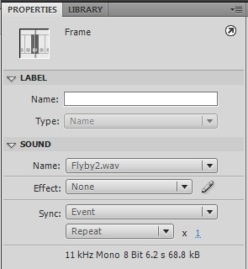
8.5 An Example – Animation and Sound
(continued)
- Sound
- Sound clips can be added to Flash movies
- As an example, we’ll add a sound clip to
aidan_dynamic1 and name it aidan_dynamic2
- Add a new layer and name it sound
- Download a sound clip to the library and edit it
- Properties panel for a sound clip:

Slide 27
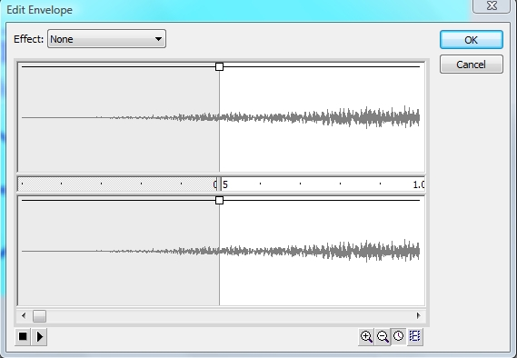
8.5 An Example – Animation and Sound
(continued)
- Click the edit button (the pencil icon) to get:
- Either the left end, right end, or both ends can
be removed by sliding the small rectangle at the
center left or right
- We shortened the sound clip to better match
the length of the movie
- The waveform of the clip is shown in the
timeline

Slide 28
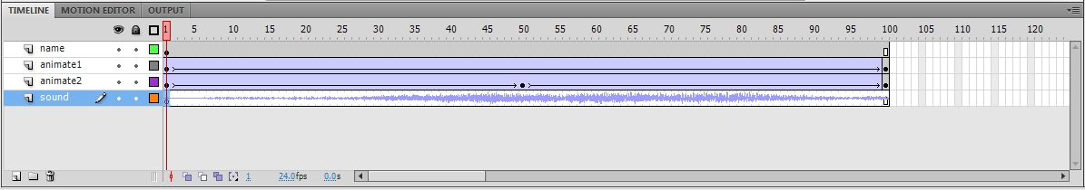
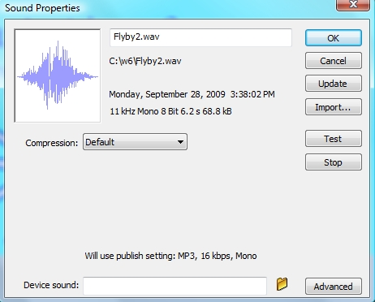
8.5 An Example – Animation and Sound
(continued)
- Sound clips can be compressed
- Select the library entry for the sound clip
- Click the third icon from the left at the bottom of
the library panel (button is named Properties)

Slide 29
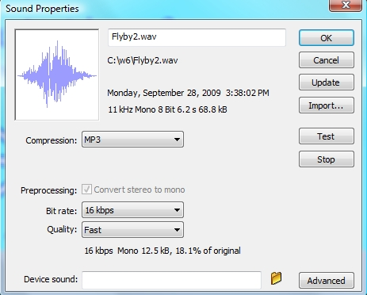
8.5 An Example – Animation and Sound
(continued)
- Select MP3 in the Compression menu
- Adjust the Bit rate – set it to the slowest bit rate
that results in acceptable sound
- Set Quality to Best
→ SHOW aidan_dynamic2

Slide 30
8.5 User Interactions
- Flash documents can be designed to allow users to
control the content of the movies
- Control is provided through graphical components
- ActionScript is used to program the control
- Actions
- ActionScript can reside in an external file or be
associated with frames
- User interactions raise events and the event
handlers implement the movie controls
- Event handlers are registered with
addEventListener
- Player control methods:
nextFrame()
gotoAndPlay(frame number)
play()
stop()
- Actions are added to a new layer, often named
actions

Slide 31
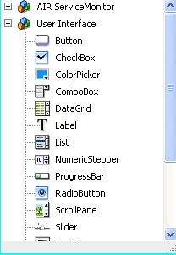
8.5 User Interactions (continued)
- ActionScript is written in a window that appears
when Window/Actions is selected
- Script Assist helps one create ActionScript
- Usual components are prebuilt
- An Example
- Use an airplane ad with a title and an animated
airplane (aidan_dynamic1), add start and stop
buttons for the animation
- Add two new layers, buttons and actions
- Create the two buttons from the window opened
by selecting Window/Components/User Interface

Slide 32
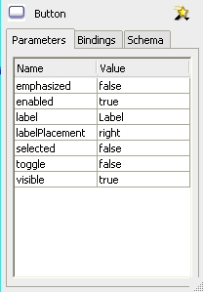
8.5 User Interactions (continued)
- Change the labels of the buttons by selecting the
button and selecting
Window/Component Inspector
- Then type the new label in Value
- Next, give instance names to the buttons
(stopButton and startButton) in their property
panels

Slide 33
8.5 User Interactions (continued)
- Code is placed in the Window/Actions window
- The code for our project:
- In frame 1 enter the handler
function handleClick(bEvent: MouseEvent) {
if (bEvent.target == stopButton)
stop();
if (bEvent.target == startButton)
play();
}
- Finally, add the code to register the handler:
stopbutton.addEventListener(
MouseEvent.CLICK, handleClick);
startbutton. addEventListener(
MouseEvent.CLICK, handleClick);
→ SHOW interact

