Slide 1
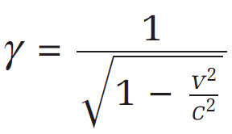

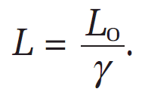



� Relativistic Speeds:
0 Gamma is used simply for saving time and physicists been lazy

Slide 2

� EX2:
0 A spacecraft passes Earth at a speed of 2.00x10⁸m/s. If observers on Earth measure the length of the spacecraft to be 554m, how long would it be according to its passengers?

Slide 3
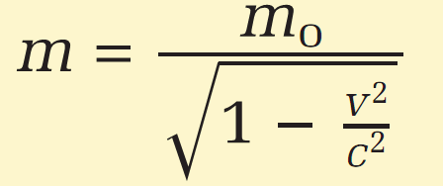
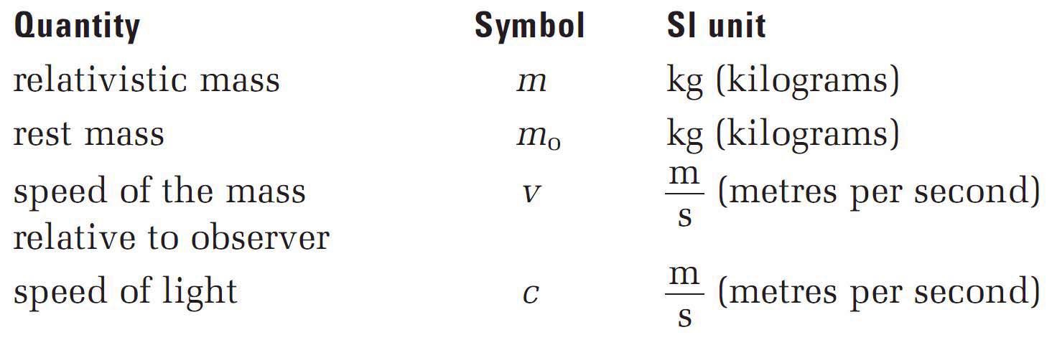

� Relativistic Mass

Slide 4

� EX3:
0 An electron has a rest mass of 9.11x10⁻³¹kg. In a detector, it behaves as if it has a mass of 12.55x10⁻³¹kg. How fast is that electron moving relative to the detector?

Slide 5
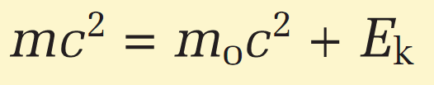
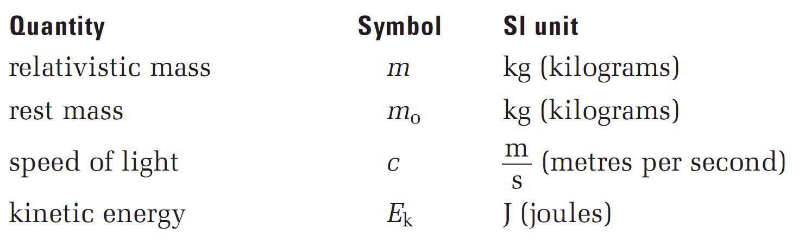

� Total Energy

Slide 6
� EX4
0 A rocket car with a mass of 2.00x10³kg is accelerated to 1.00x10⁸m/s. Calculate its kinetic energy
Using the classical or general equation for kinetic energy
Using the relativistic equation for kinetic energy

