Slide 1
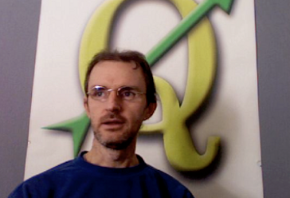
GeoDjango
Tim Sutton
tim@linfiniti.com
Linfiniti Consulting CC.
http://linfiniti.com

Slide 2








Django Architecture
Client Browser
Middleware
Template Tags
<app>/
templatetags/*.py
Template
<app>
/templates/*.html
Form
<app>/forms.py
Model
<app>/models.py
http://protocol
Apache
+
mod_python
Middleware
Controller
urls.py
View
<app>/views.py

