Slide 1


A little dive into the Vector Tiles Ecosystem (with QGIS)

Slide 2

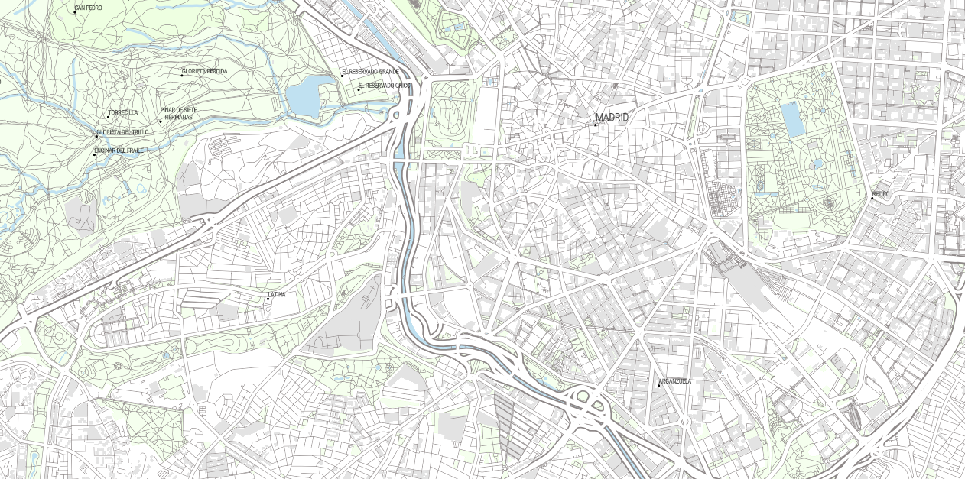
Overview

Slide 3
Overview
Some history and background
Structure of vector tiles
Using tiles in QGIS
Styling tiles
Hosting your own

Slide 4
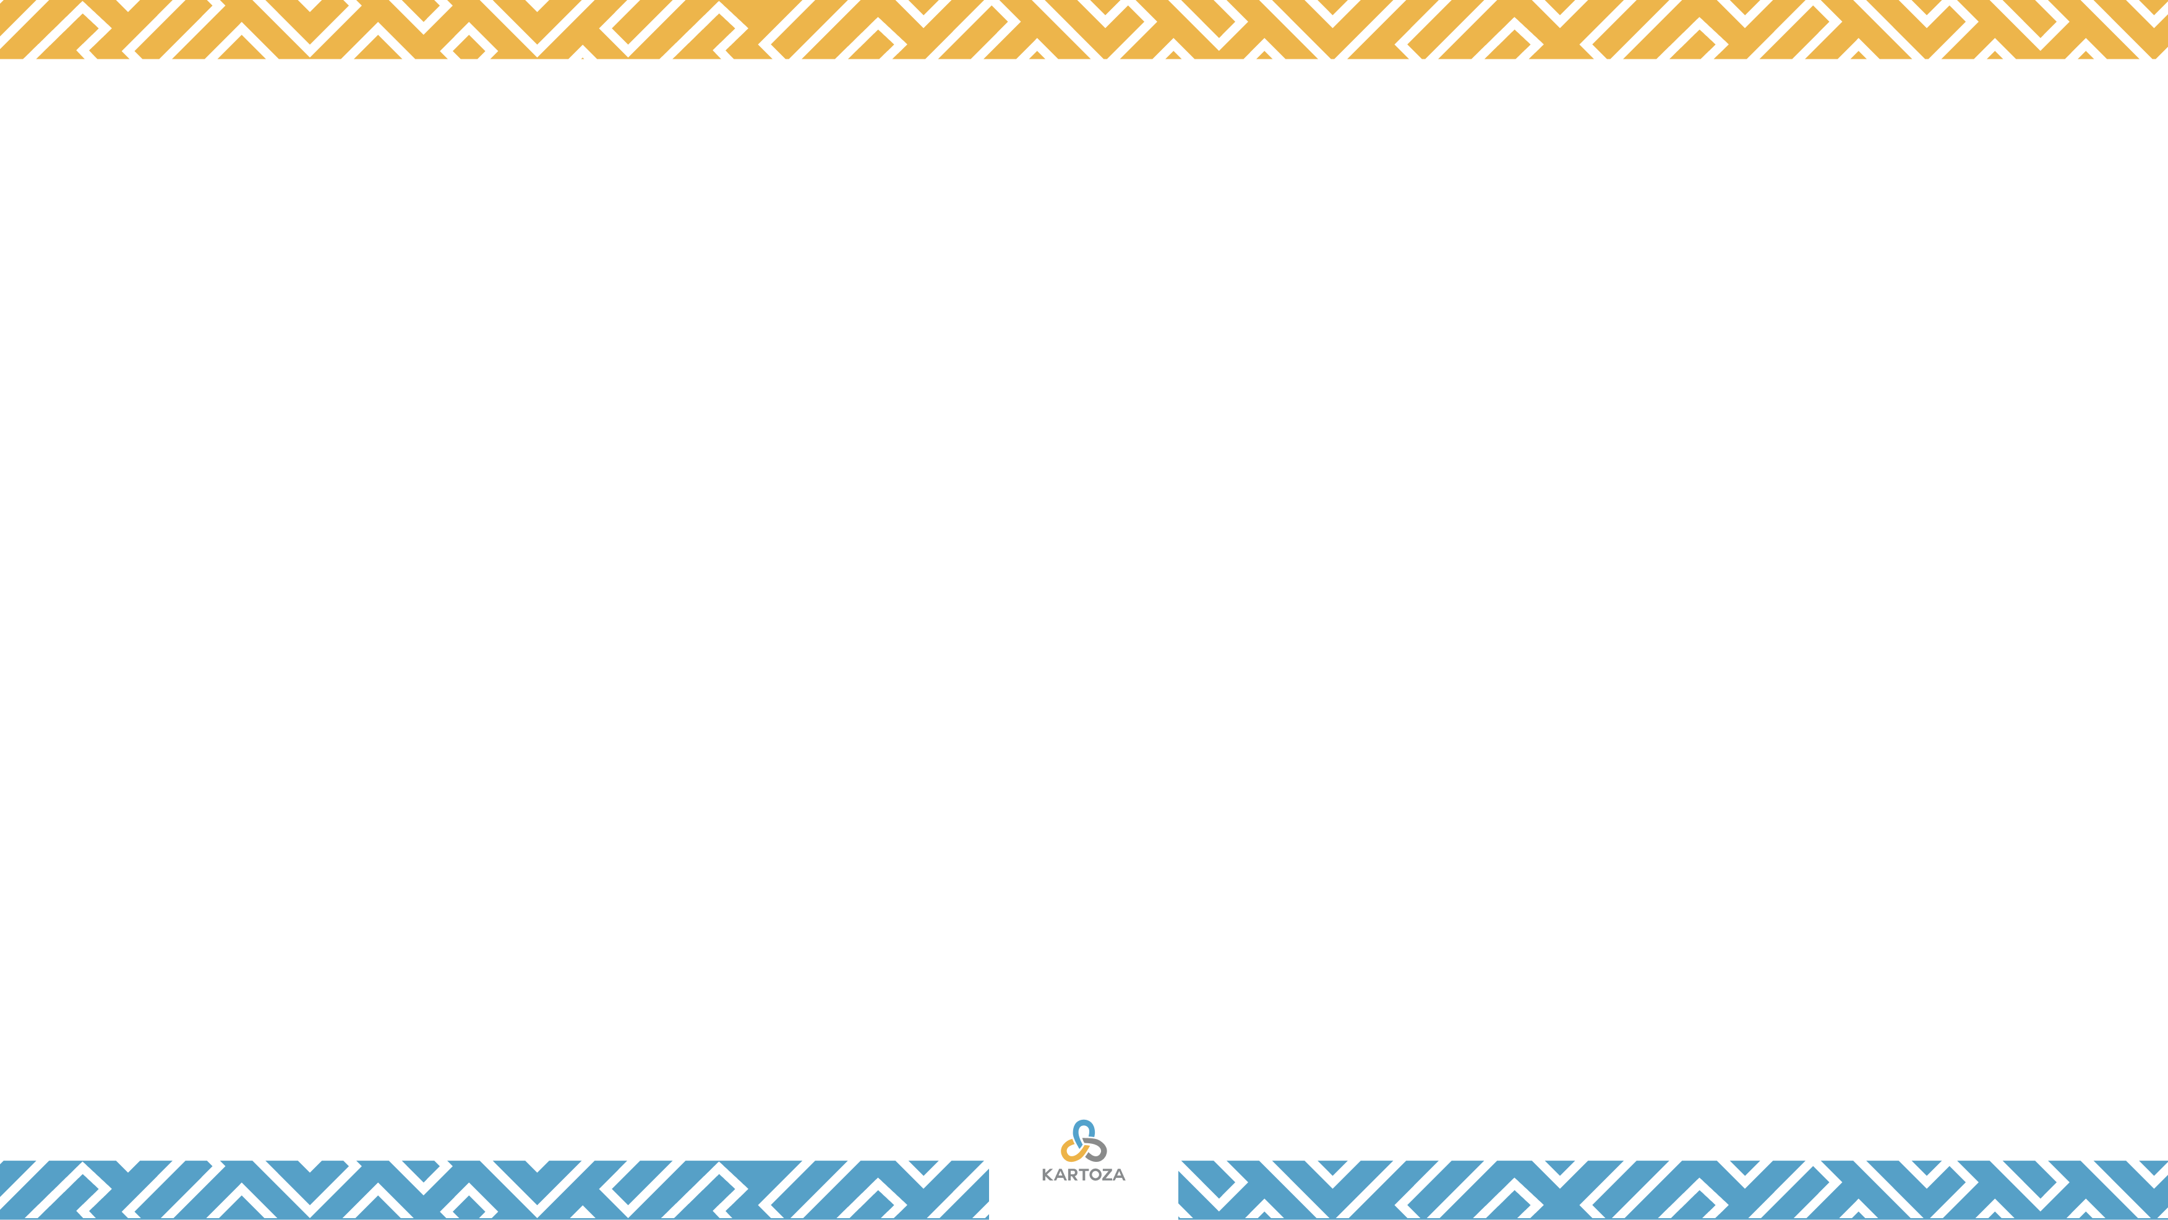
Tile Structure - organisation
2
2
There is a long history of the use of vector tile schemes in GIS. A very early GIS (circa 1966), the Canada Geographic Information System (CGIS), used a vector tile storage scheme that allowed limited resource computers to efficiently access and process vector map data.[4] CGIS used the term "frame" instead of vector tiles.
1
2
2
https://en.wikipedia.org/wiki/Vector_tiles

Slide 5
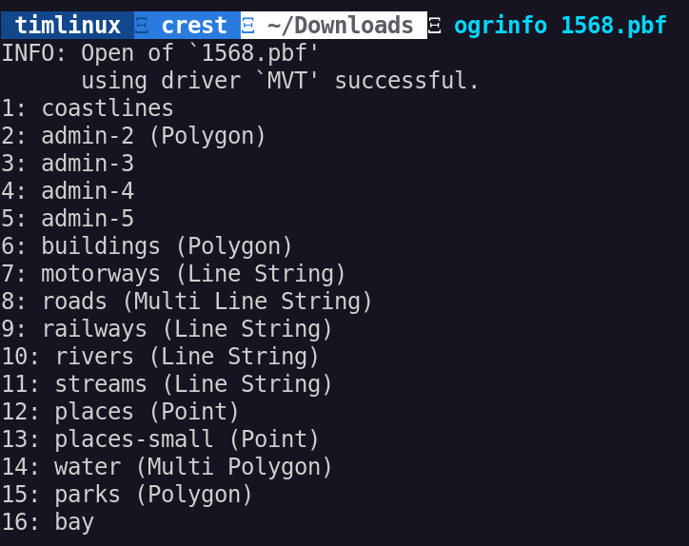
Vector Tile Contents
A collection of layers
Different geometry types
Attributes
Clipped to tile boundary

Slide 6
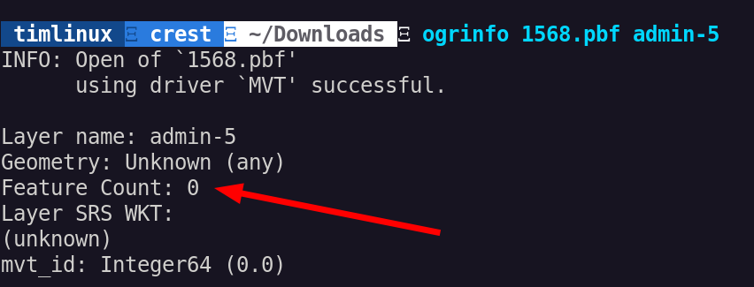
Vector Tile Contents (continued..)

Slide 7
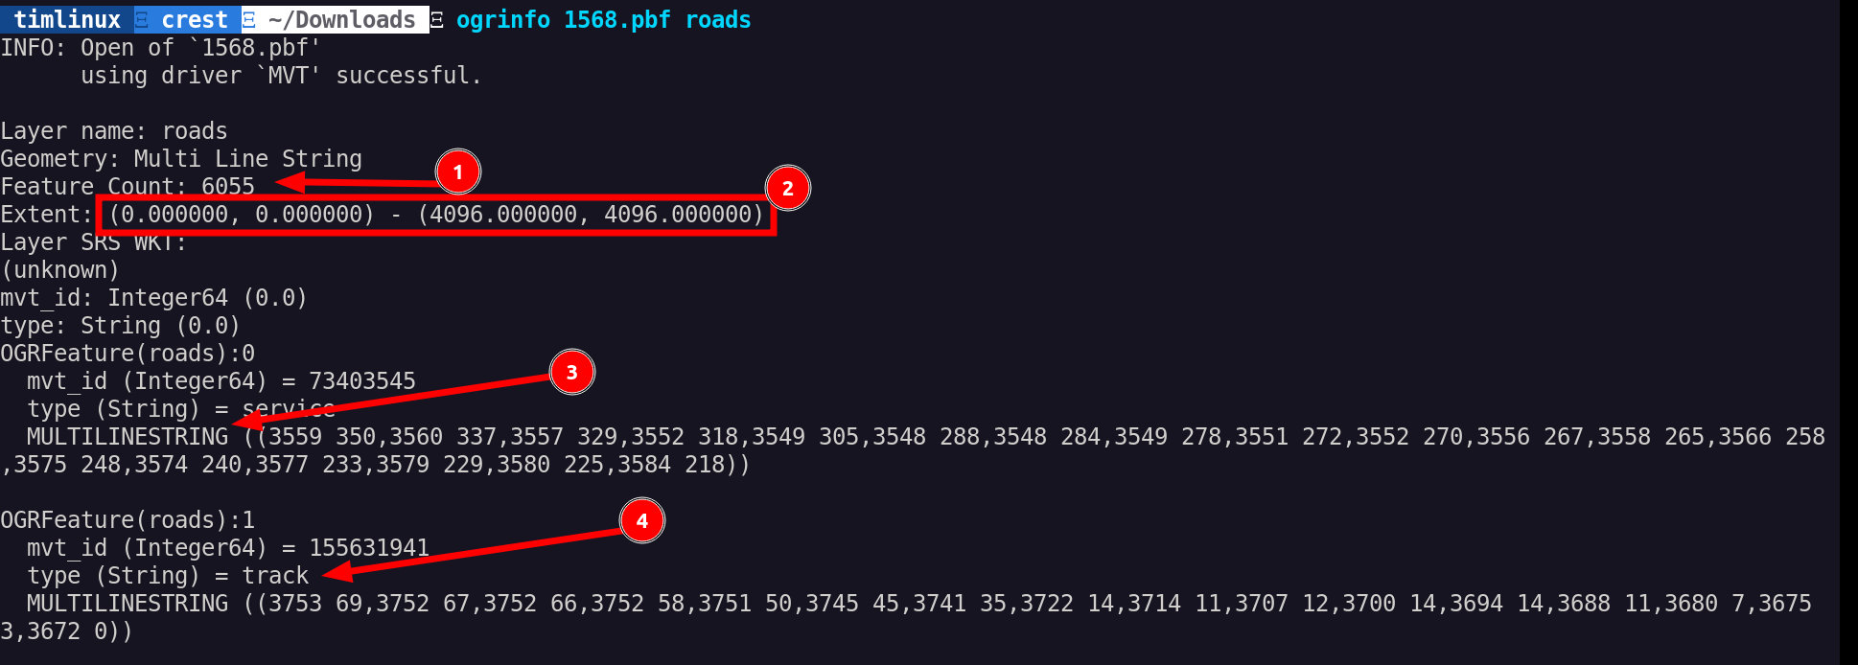
Vector Tile Contents (continued..)

Slide 8
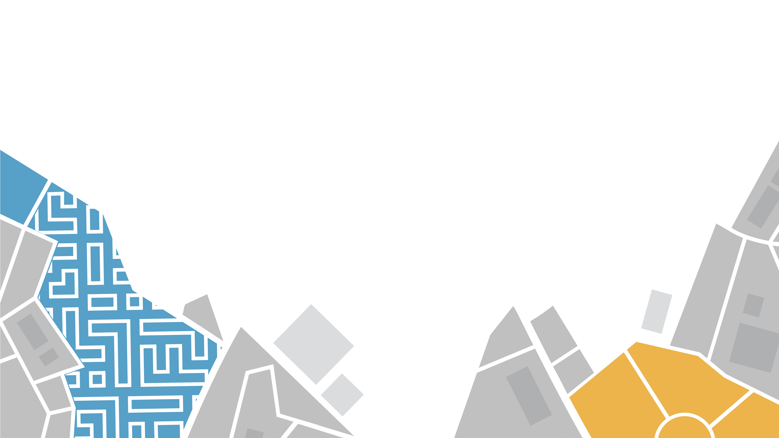

NATIVE SUPPORT IN QGIS

Slide 9
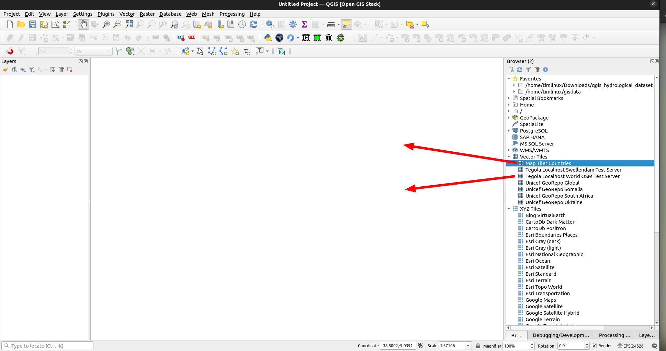

Slide 10
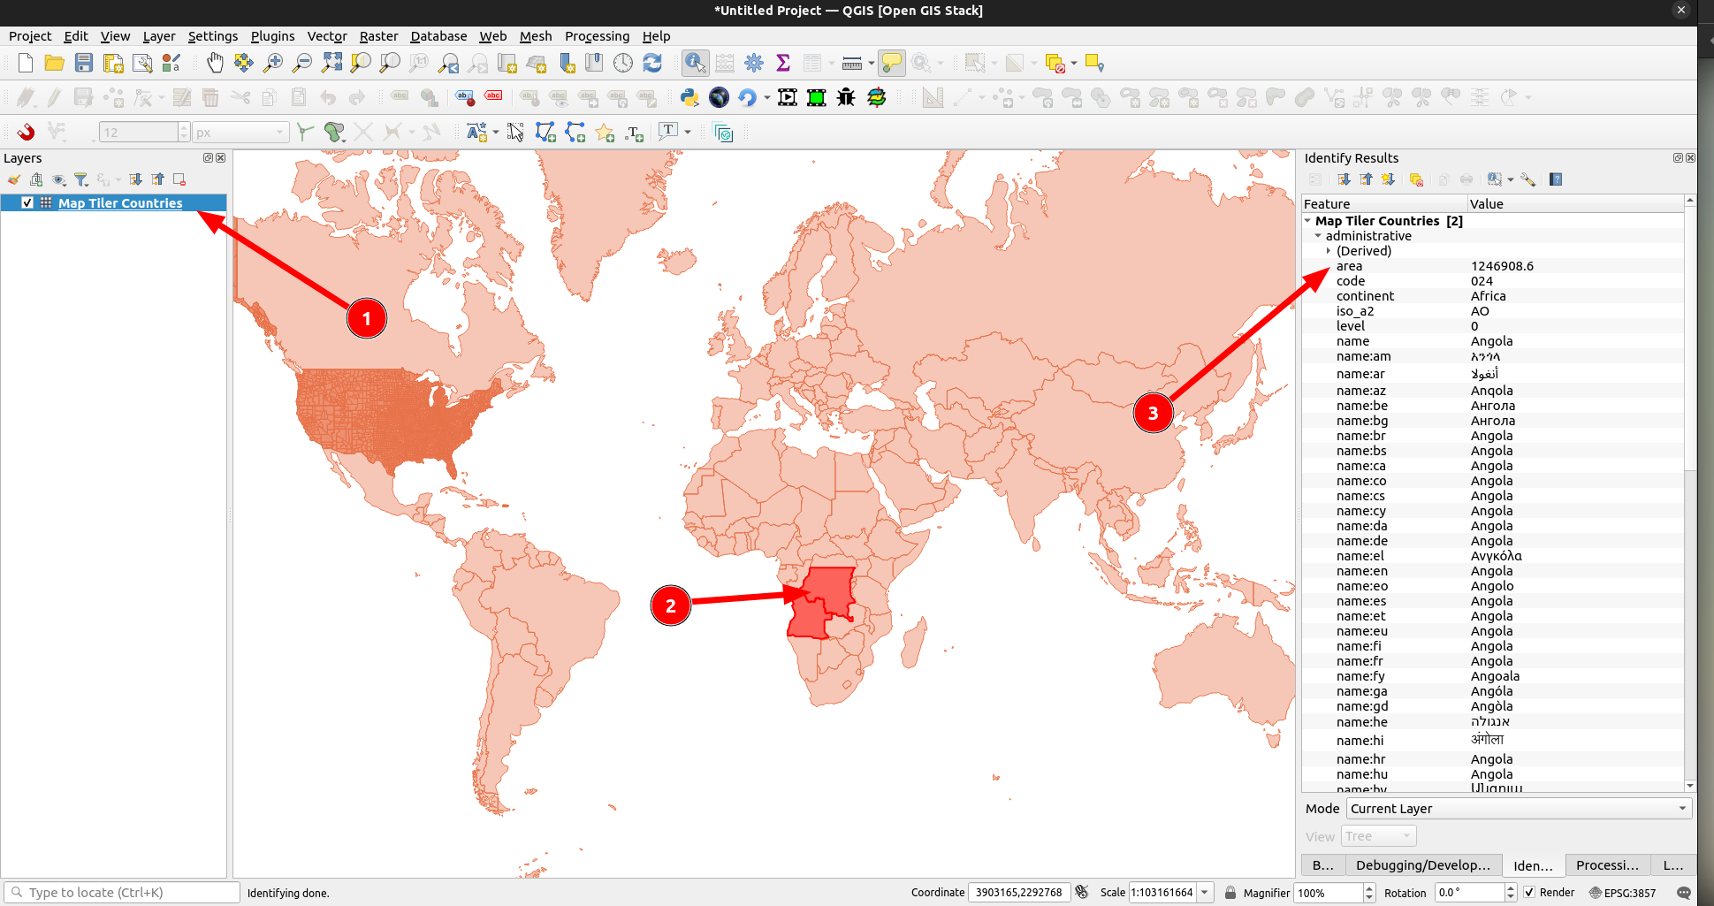

Slide 11
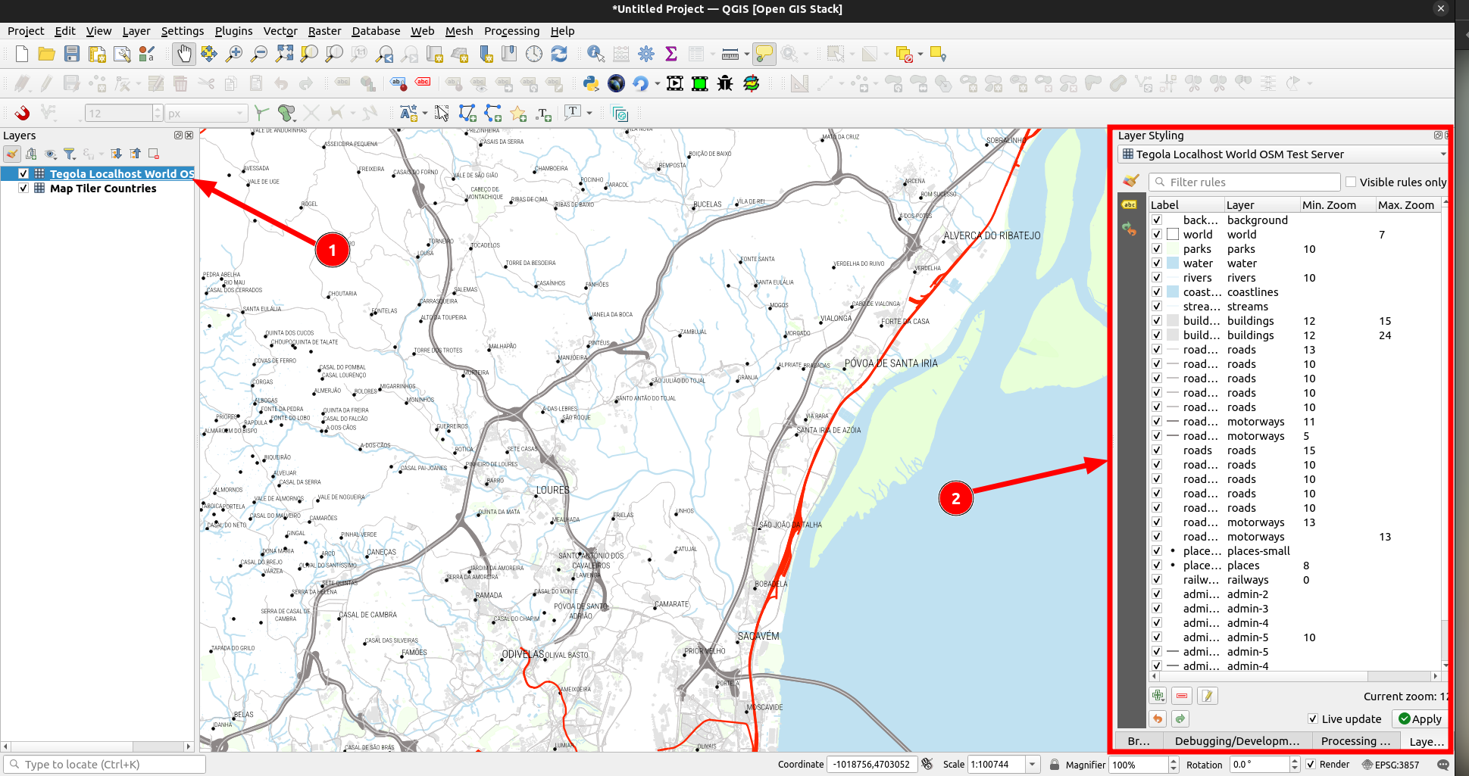

Slide 12

STYLING
Option 1: Style in QGIS
Option 2: Web Vector Tile Style Editor

Slide 13
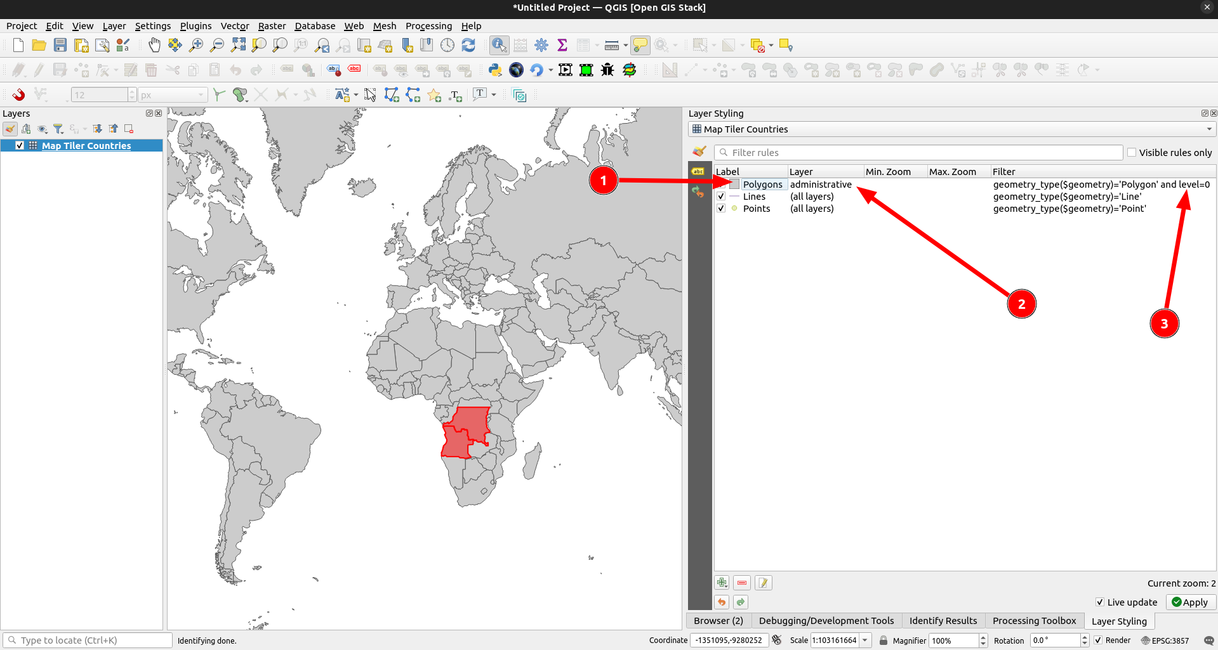
SLIDE TITLE
0

Slide 14
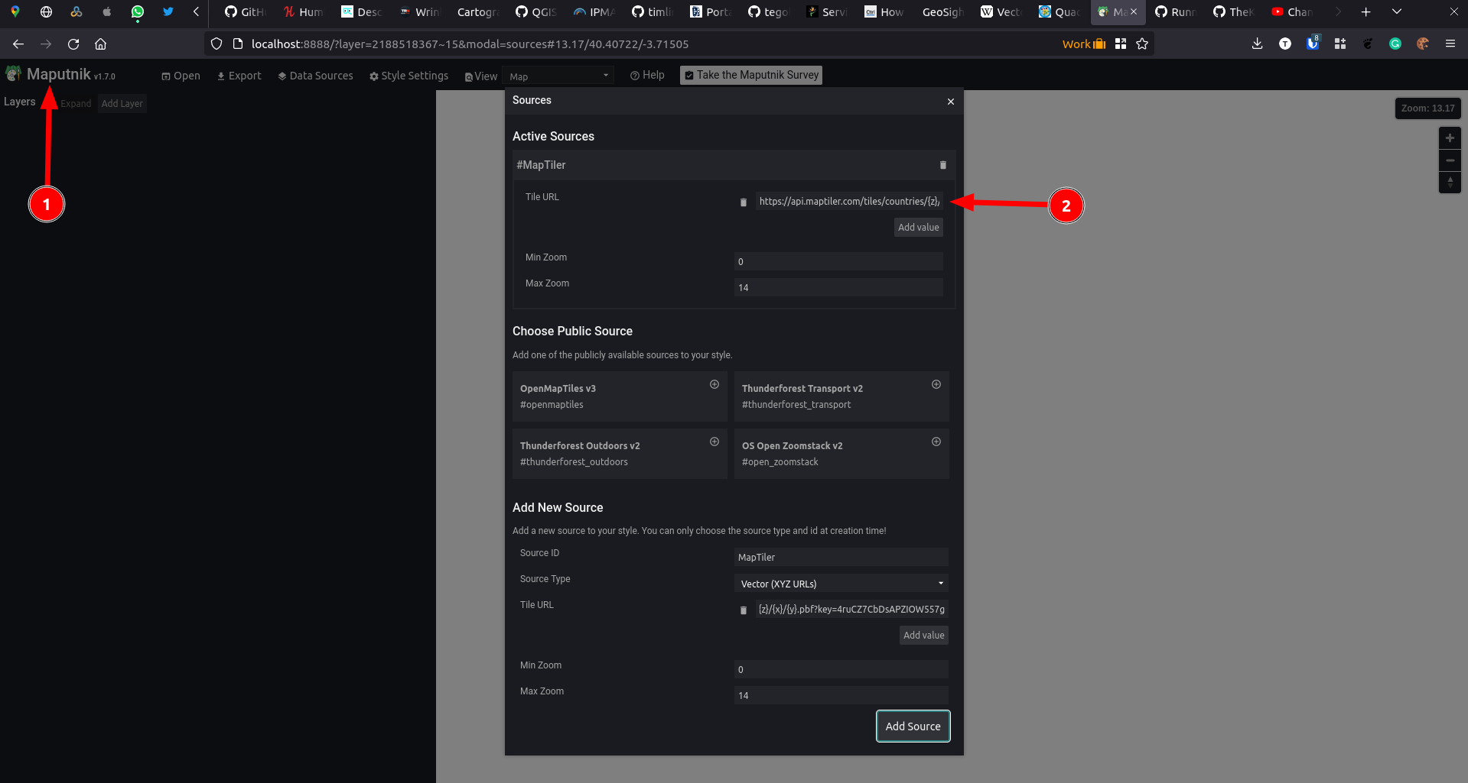

Slide 15
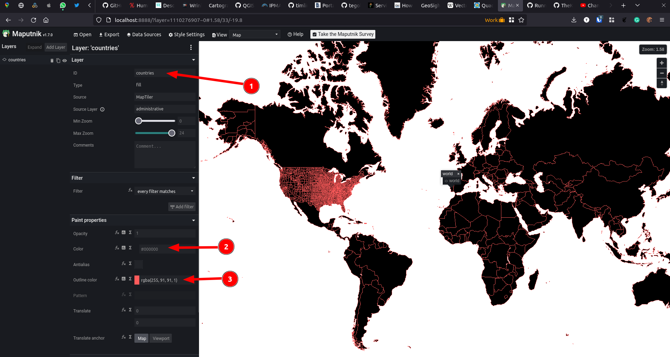

Slide 16
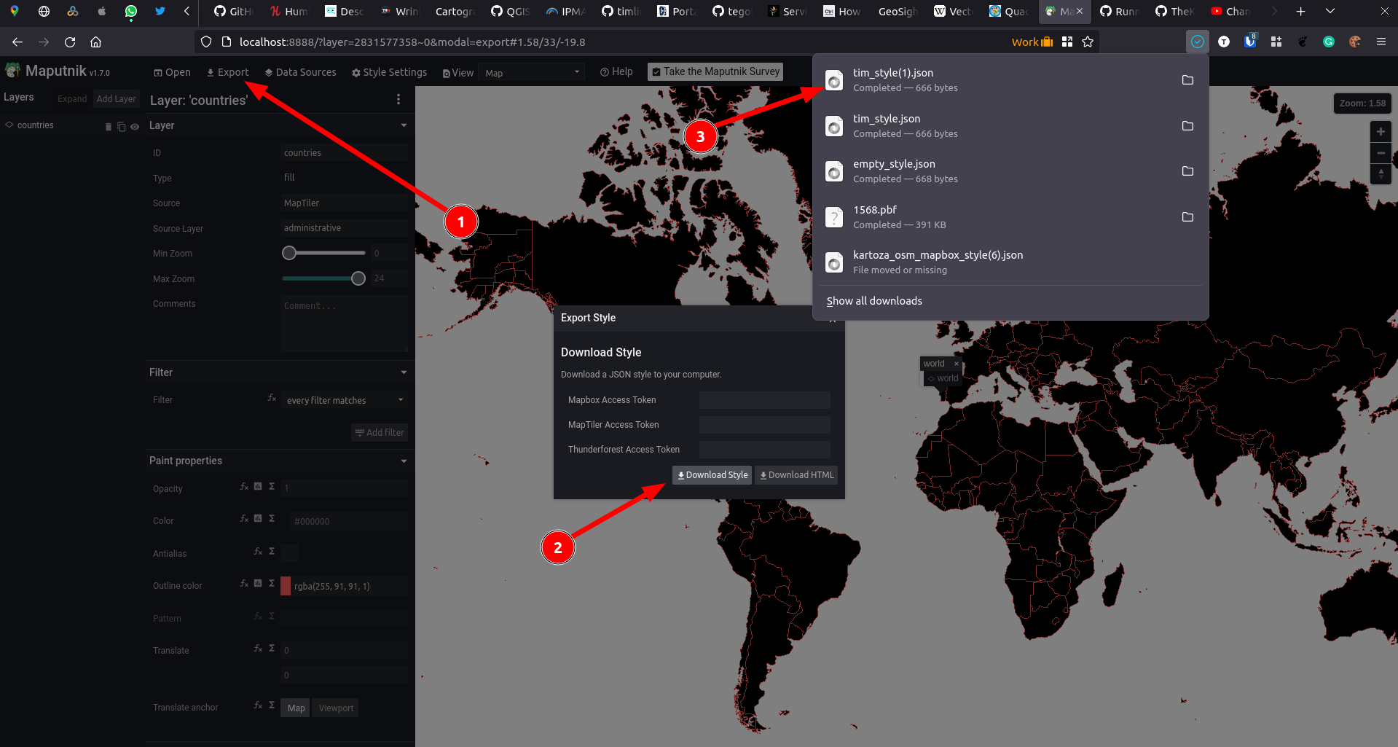

Slide 18
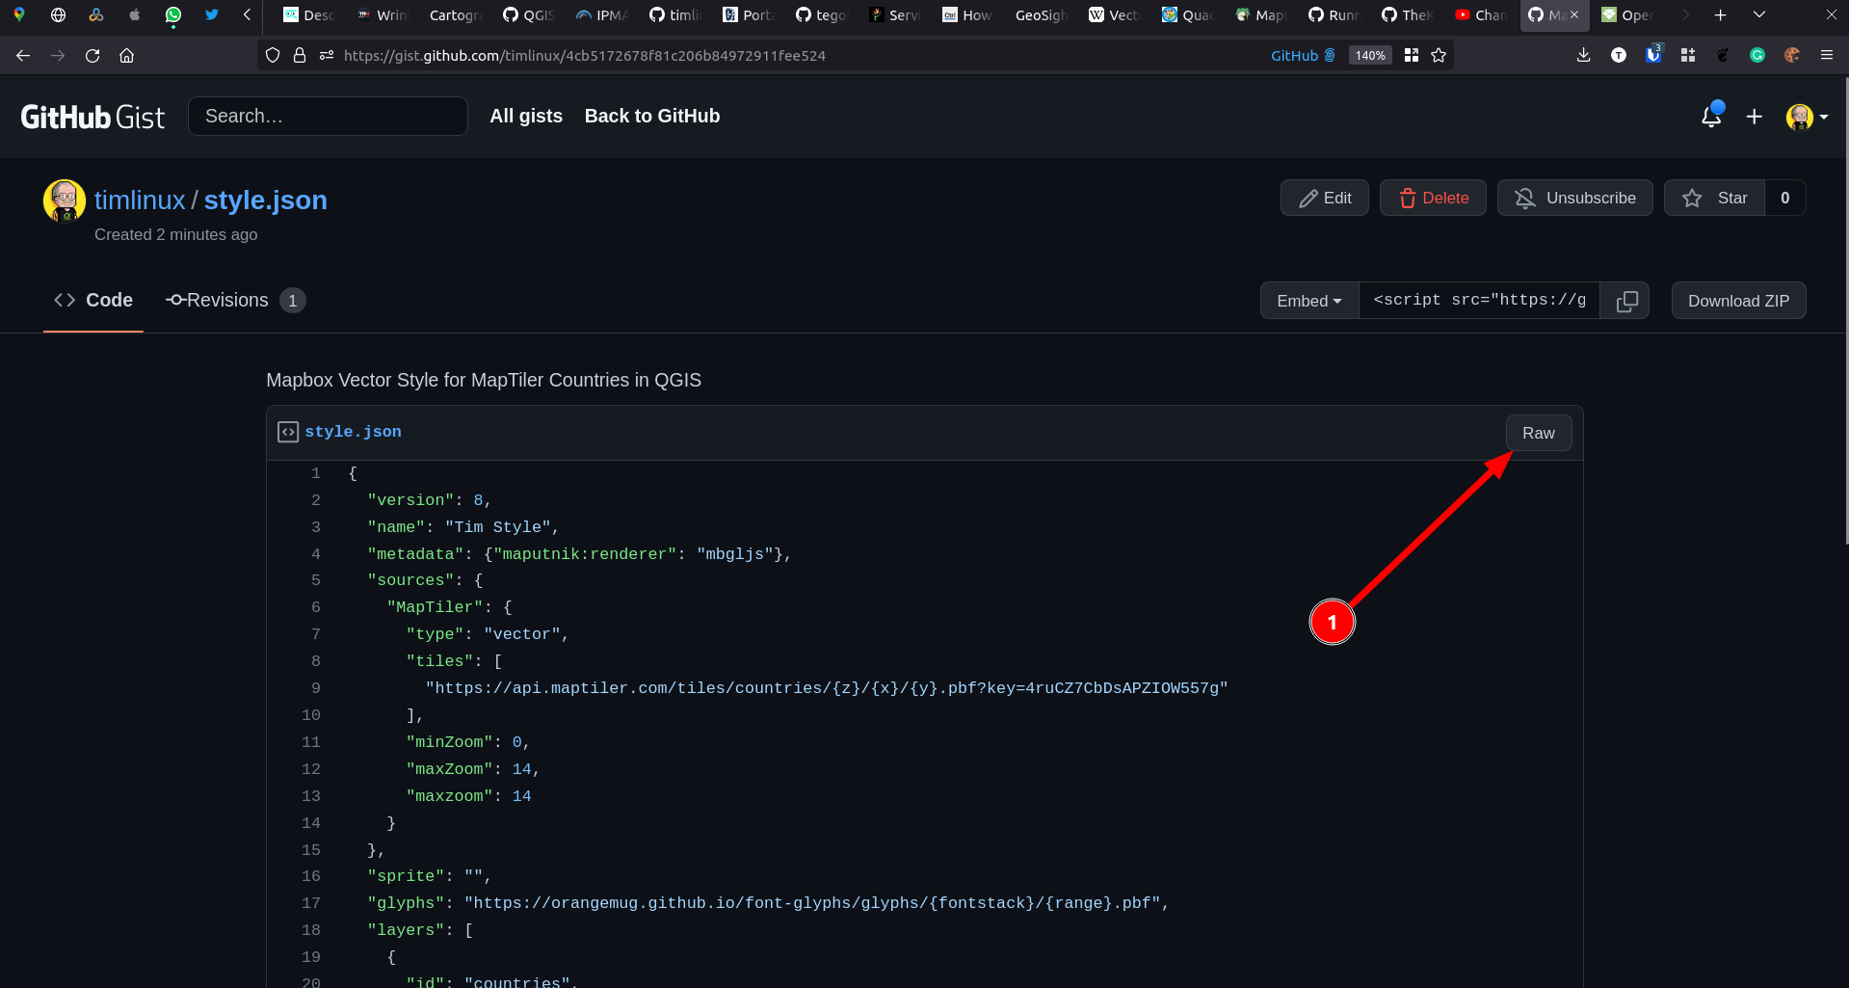
https://gist.github.com/timlinux/4cb5172678f81c206b84972911fee524

Slide 19
https://gist.githubusercontent.com/timlinux/4cb5172678f81c206b84972911fee524/raw/5a25d7412356b62c7a97dada7d3e0e5e2f487b86/style.json

Slide 20
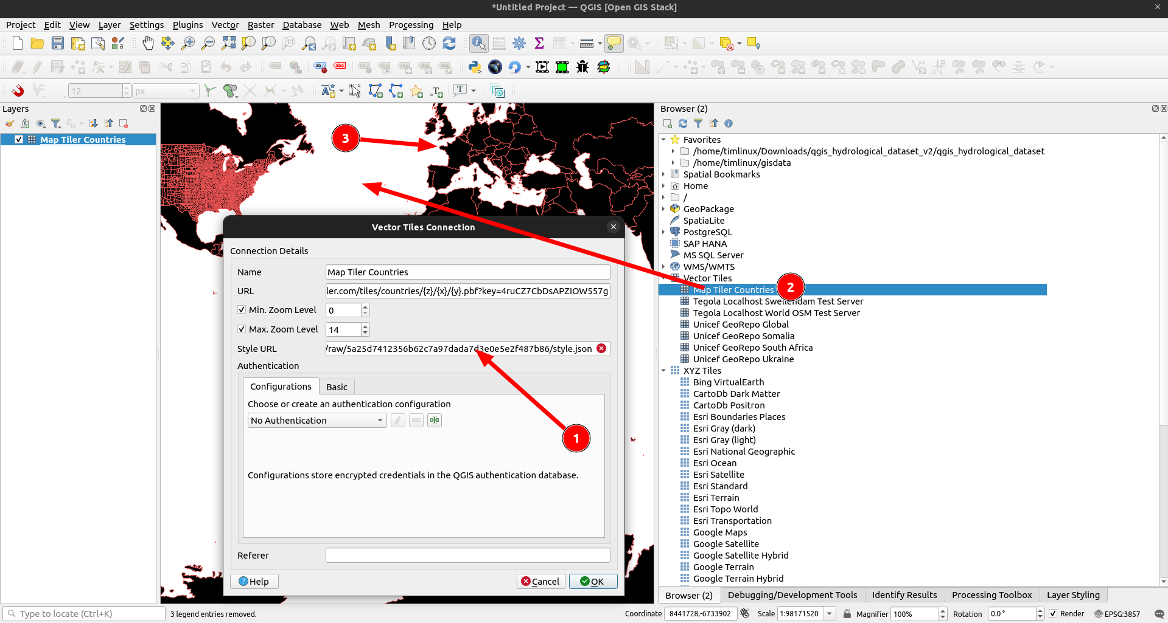

Slide 21
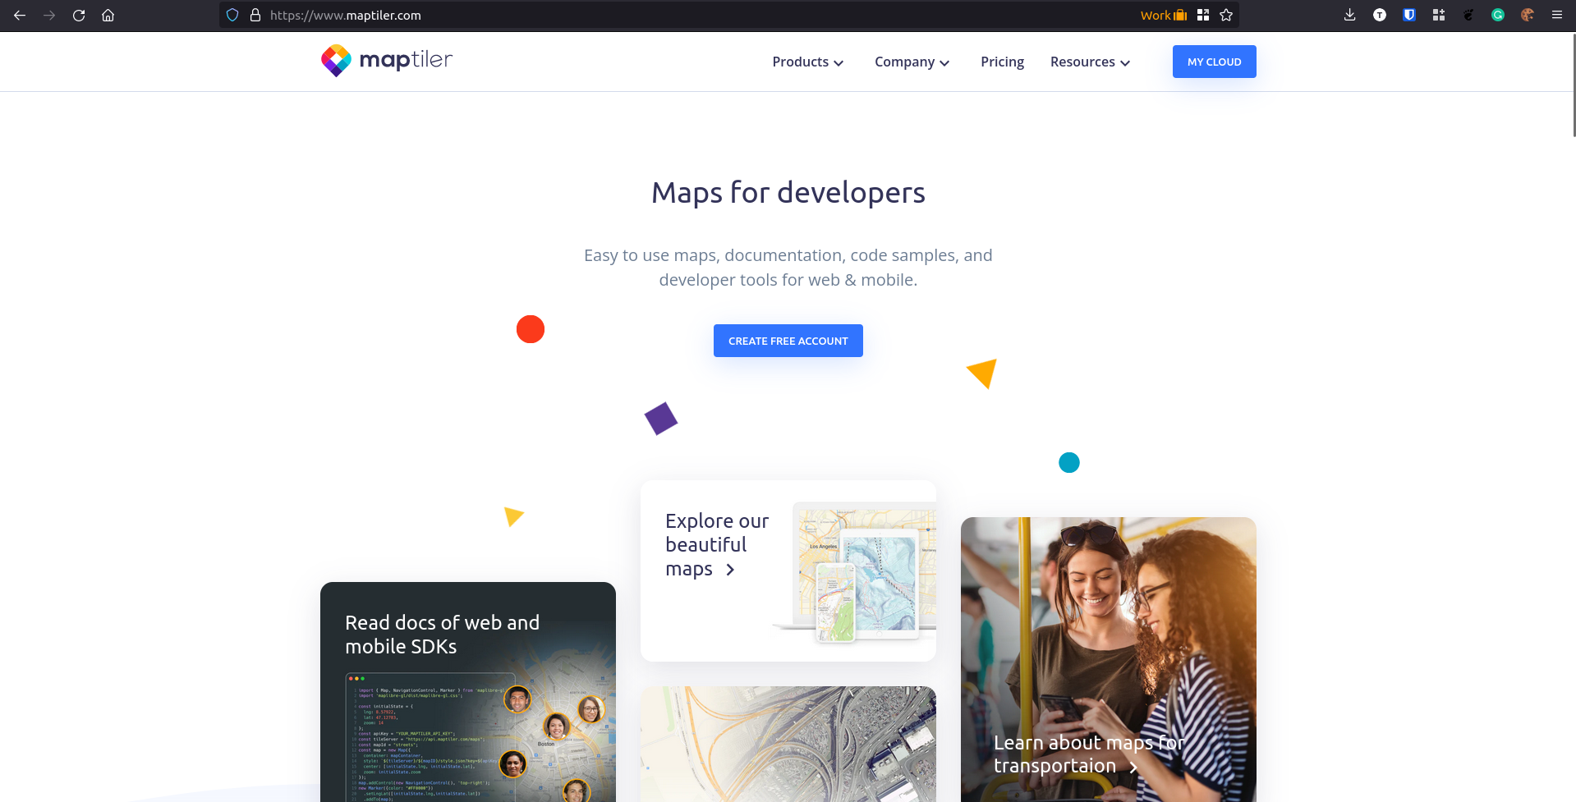

Slide 22
Hosting your own OSM tiles
https://github.com/timlinux/kartoza-world-osm-tegola-map

