Slide 1
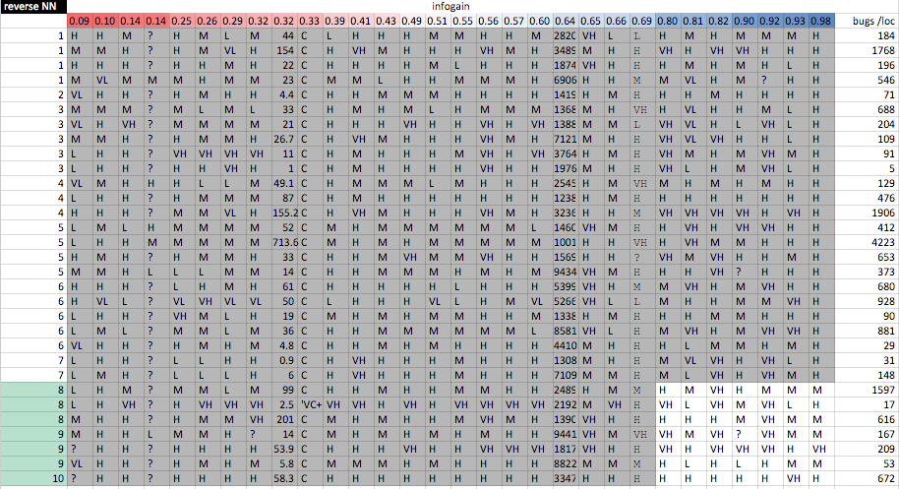
900 cells (total)
64 cells (in corner)
900-64/900 = 93% data that need not be shared; 100% privacy
Six laws of trusted sharing: (4) only share the corners; (5) mutate corners before sharing; (6) never mutate more than half way to nearest neighbor in the corners

Slide 2
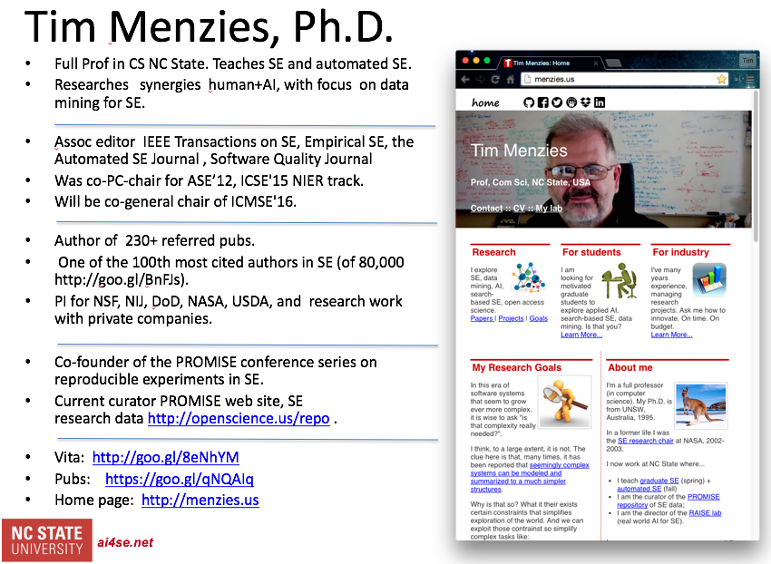
Laws of trusted data sharing
pass around a cache between data owners, in random order
Each owner adds justthe data not already in the cache
Before passing, privitize using Laws 4,5,6
Only share the corners.
Mutate corners before sharing.
Never mutate more than half way to nearest neighbor in the corners.
For more information:
Menzies et al. IEEE Transactions Soft Eng, 2013
https://goo.gl/H7CXOv
Menzies et al.
Int. Conf. on Software Eng, 2015 https://goo.gl/31jDUu

