Slide 1

Three Laws of Trusted Data Sharing: (Building a Better Business Case for Data Sharing)
Tim Menzies (prof, cs)
tim.menzies@gmail.com
August 6, 2015

Slide 2

Discussions about sharing
Too much fear
Not enough about benefits
Can we learn more from sharing that hoarding ?
Yes (results from SE)
Three laws of trusted data sharing:
For SE quality prediction..
Better models from shared privatized data that from all raw data
Q: does this work for other kinds of data?
A: don’t know… yet

Slide 3
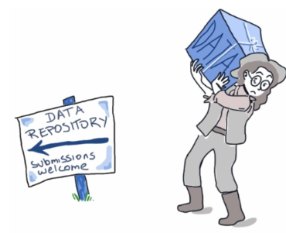
Why We Care…
Sebastian Elbaum et al. 2014 Sharing industrial datasets with the research community is extremely valuable, but also extremely challenging as it needs to balance the usefulness of the dataset with the industry’s concerns for privacy and competition.
S. Elbaum, A. Mclaughlin, and J. Penix, “The google dataset of testing results,” june 2014. [Online].
Available: https://code.google.com/p/google-shared-dataset-of-test-suite-results

Slide 4


Cost of privacy
- Privacy Goals (conflicting)
protect confidentiality of software defect data with privacy preserving techniques...
while data remains useful
- Not trivial
With standard anonymization methods
as privacy increases...
data becomes less useful
Privacy
Usefulness
J. Brickell and V. Shmatikov, “The cost of privacy: destruction of data-mining utility in anonymized data publishing,” in Proceeding of the 14th ACM SIGKDD international conference on Knowledge discovery and data mining, ser. KDD ’08.
M. Grechanik, C. Csallner, C. Fu, and Q. Xie, “Is data privacy always good for software testing?” in Proceedings of the 2010 IEEE 21st International Symposium on Software Reliability Engineering, ser. ISSRE ’10.
4

Slide 5

Building a business case for data sharing
Q1: What do you lose by not sharing?
Compare conclusions seen with via sharing or via hoarding?
Q2: Does anonymization protect us?
Using standard privatization algorithms:
Can we violate privacy on data from Smart Cities, Community health, Biometrics
Q3: Are we protecting data too much
Using standard privatization algorithms:
How worse off are our models?
Q4: Do costs of sharing out-weight benefits?
Apply our novel “3 laws of data sharing” and see what what can be learned?
Check of learned models not very useful, interesting
Funded by NC Data Science and Analytics Initiative
Joint project with Prof. Bojan Cukic, UNC Charlotte
Applying the following to data from
The smart cities initiative
Community health care data
Biometrics data

Slide 6
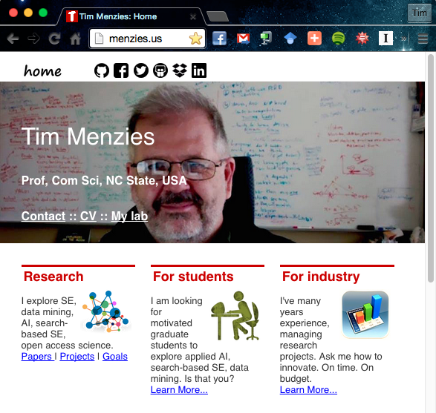
About me: http://menzies.us
Funding: $7 million
NASA, DoD, National Science Foundation, National Archives, etc
Some STTR work
Ph.D/masters students: dozens
Papers: 200+
Teaching:
Grad SE + automated SE
Service:
Editorial boards: TSE, EMSE, ASE
Conference org: ICSME’16, ASE,
Many program committees

Slide 7
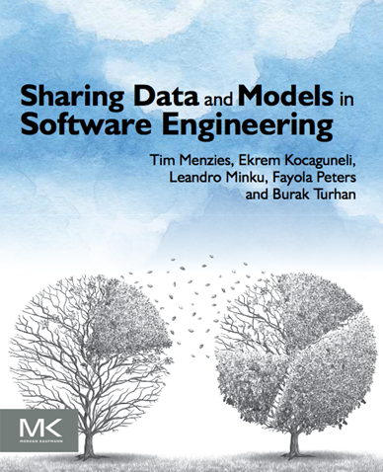
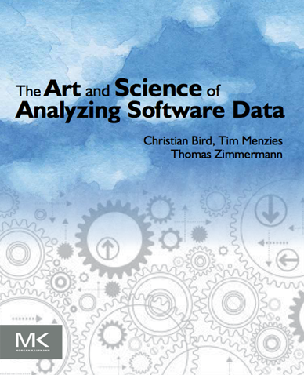
Recent books

Slide 8
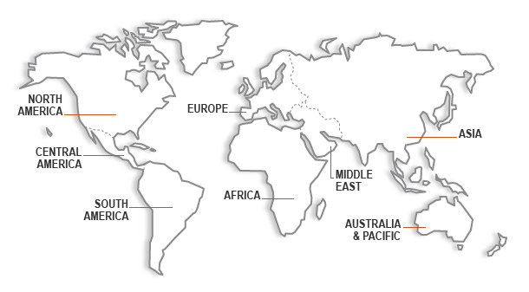

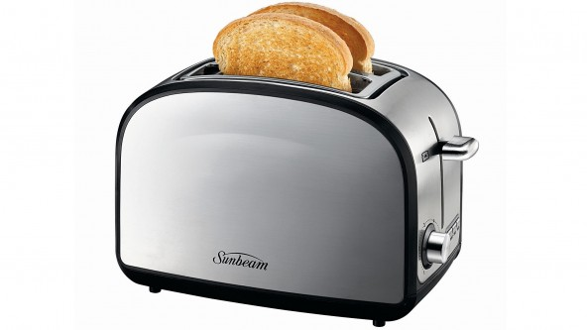
Sharing data, Turkey to Texas: Toasters to rocket ships

Slide 9
Sharing data Turkey to Texas: Toasters to rocket ships
Q: Does this work for other kinds of data? E.g. anonymized privatized data?
A: Perhaps

Slide 10
Everyone else’s research question
Why does
software fail?

Slide 11
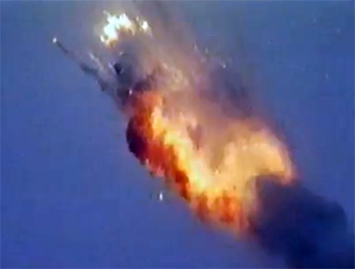
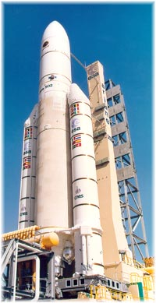
Sure, software sometimes fails (at may do so at the worst time)
E.g. software floating point bug, Ariane 5, 1996
Cost of vehicle: $500 million
Development cost: $7 billion
Loss of income due to loss of client confidence: unknown

Slide 12
Everyone else’s research question
Why does
software fail?

Slide 13
My research question
Why does
software fail?
Ever work?

Slide 14
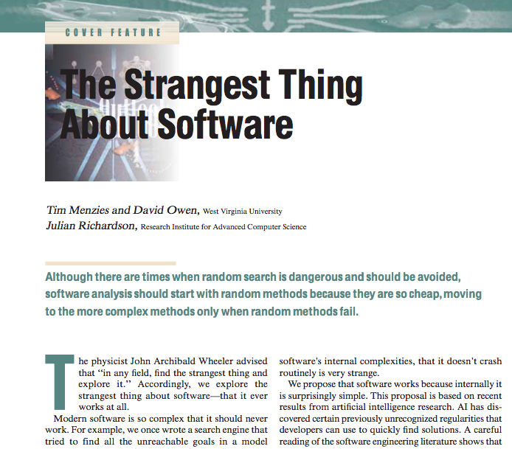
According to the maths, software is too complex to understand
IEEE Computer, Jan 2007, p54- 60
10²⁴ stars in the sky
N^{V} states in software
Consider 100 if statements
Then N=2, V=100 and N^{V}=2¹⁰⁰
a million times more than 10²⁴
The space inside our software
is bigger than stars in the sky.
http://menzies.us/pdf/07strange.pdf

Slide 15
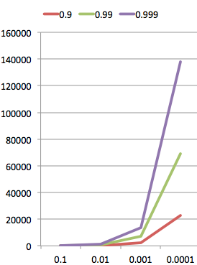
Complex things
should not work
C= odds bug found
C = 1 – (1-p)^{N} so
N = log(1-C)/log(1-p)
N =#tests
required
P= Probability of bug

Slide 16
Yet (often) they do
Complex things
should not work
C= odds bug found
C = 1 – (1-p)^{N} so
N = log(1-C)/log(1-p)
Examples:
Open source software
The internet
Electrical power grids
Pace makers
International air traffic control systems
Operating systems
Etc
etc
N =#tests
required
P= Probability of bug

Slide 17

Sure, software sometimes fails (at may do so at the worst time)
E.g. software floating point bug, Ariane 5, 1996
Cost of vehicle: $500 million
Development cost: $7 billion
Loss of income due to loss of client confidence: unknown
But puzzle is this:
These errors should be much more frequent
So where is all that missing behavior?

Slide 18
When reasoning about complex things, you don’t have to look at very much
Narrows: Amarel 1960s
Prototypes: Chen 1975
Frames: Minsky, 1975
Min environments: DeKleer, 1986
Saturation: Horgan & Mathur: 1980
Homogenous propagation: Michael: 1981
Master variables: Crawford & Baker, 1995
Clumps, Druzdel, 1997
Feature subset section, Kohavi, 1997,
Back doors, Williams, 2002
Active learning: many people (2000+)

Slide 19
Specifically, for “transfer learning” (migrating conclusions from one project to another)
Target domain: software quality prediction
Q: How to transfer ?
A: Ignore most of the data
relevancy filtering: Turhan ESEj’09; Peters TSE’13
variance filtering: Kocaguneli TSE’12,TSE’13
performance similarities: He ESEM’13

Slide 20
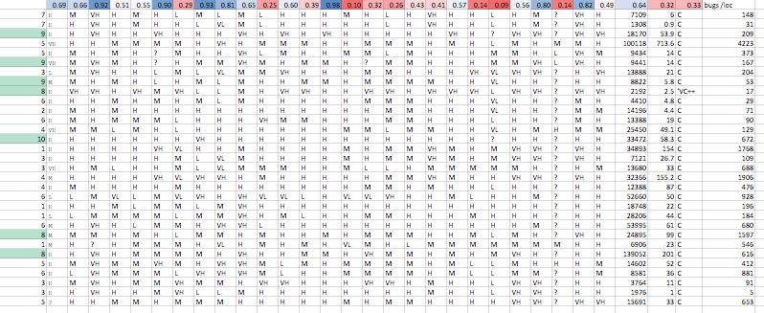
Ignoring data = privacy?
How well each
column predicts
For defects
Centrality
count
Defects per KLOC
Static code features
(e.g. LOC per class, coupling, etc)

Slide 21
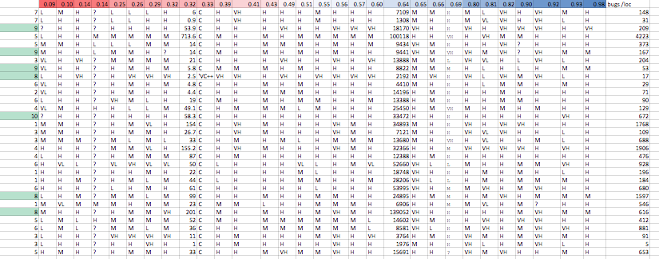
Sort by column “worth”
How well each
column predicts
For defects
Centrality
count
Defects per KLOC
Static code features
(e.g. LOC per class, coupling, etc)

Slide 22
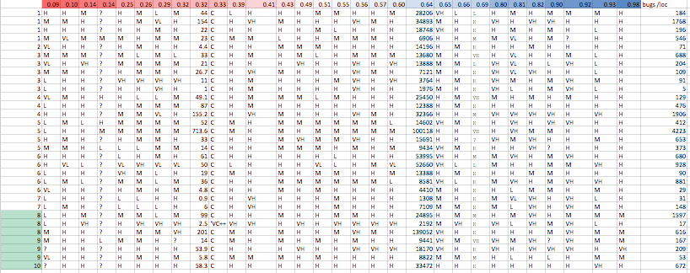
Sort by row “centrality”
How well each
column predicts
For defects
Centrality
count
Defects per KLOC
Static code features
(e.g. LOC per class, coupling, etc)

Slide 23
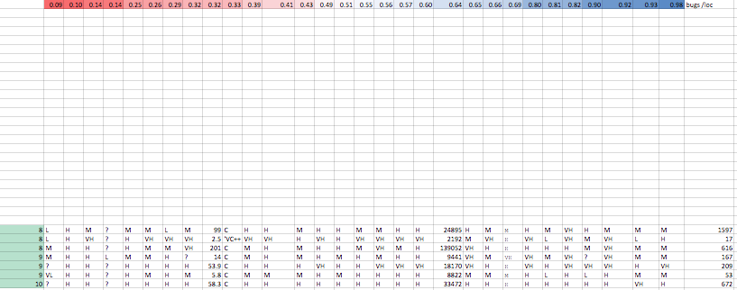
Prune the dull rows
How well each
column predicts
For defects
Centrality
count
Defects per KLOC
Static code features
(e.g. LOC per class, coupling, etc)

Slide 24
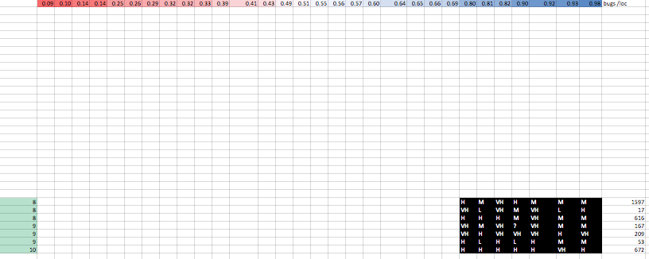
Prune the dull columns
How well each
column predicts
For defects
Centrality
count
Defects per KLOC
Static code features
(e.g. LOC per class, coupling, etc)

Slide 25
Data “corners” 49/900 = 5.4% of the data
How well each
column predicts
For defects
Centrality
count
Defects per KLOC
Static code features
(e.g. LOC per class, coupling, etc)

Slide 26
Too much pruning?
For SE quality data no
Vasil 213:
Quality by extrapolating between the rows of the corners
Just as good as using all the data
The “corners” are the nub, the essence
Without any superfluous detail removed

Slide 27
Three law of data sharing
First Law: don’t share everything; just the “corners”.

Slide 28
Three law of data sharing
First Law: don’t share everything; just the “corners”.
Second Law: anonymize the data in the “corners”.

Slide 29
Three law of data sharing
First Law: don’t share everything; just the “corners”.
Second Law: anonymize the data in the “corners”.
All data
Just the corners

Slide 30
Three law of data sharing
First Law: don’t share everything; just the “corners”.
Second Law: anonymize the data in the “corners”.
All data
Just the corners
Mutate data to some
random nearby location

Slide 31
Three law of data sharing
First Law: don’t share everything; just the “corners”.
Second Law: anonymize the data in the “corners”.
Third Law: never mutate across “decision boundary”.

Slide 32
Three law of data sharing
First Law: don’t share everything; just the “corners”.
Second Law: anonymize the data in the “corners”.
Third Law: never mutate across “decision boundary”.

Slide 33
Three law of data sharing
First Law: don’t share everything; just the “corners”.
Second Law: anonymize the data in the “corners”.
Third Law: never mutate across “decision boundary”.

Slide 34
Three law of data sharing
First Law: don’t share everything; just the “corners”.
Second Law: anonymize the data in the “corners”.
Third Law: never mutate across “decision boundary”.

Slide 35
Three law of data sharing
First Law: don’t share everything; just the “corners”.
Second Law: anonymize the data in the “corners”.
Third Law: never mutate across “decision boundary”.

Slide 36
Three law of data sharing
First Law: don’t share everything; just the “corners”.
Second Law: anonymize the data in the “corners”.
Third Law: never mutate across “decision boundary”.

Slide 37
Better models from shared privatized data that from all raw data
Simulated 20 data owners sharing privatized data
“pass the parcel”
Data owners incrementally added their data to a parcel of shared data
but only data that was somehow outstandingly different to data already in the parcel
Data was privatized
using corners
before leaving each data owner)
Shared parcel :
just 5% of all data
Software quality predictors built from this 5%,
predictors performed better than predictors built from all that data.
Peters, F., Menzies, T., & Layman, L. (2015). LACE2: Better Privacy-Preserving Data Sharing for Cross Project Defect Prediction. In ICSE’15, Florence, Italy http://menzies.us/pdf/15lace2.pdf

Slide 38
Building a business case for data sharing
Q1: What do you lose by not sharing?
Compare conclusions seen with via sharing or via hoarding?
Q2: Does anonymization protect us?
Using standard privatization algorithms:
Can we violate privacy on data from Smart Cities, Community health, Biometrics
Q3: Are we protecting data too much
Using standard privatization algorithms:
How worse off are our models?
Q4: Do costs of sharing out-weight benefits?
Apply our novel “3 laws of data sharing” and see what what can be learned?
Check of learned models not very useful, interesting
Funded by NC Data Science and Analytics Initiative
Joint project with Prof. Bojan Cukic, UNC Charlotte
Applying the following to data from
The smart cities initiative
Community health care data
Biometrics data

Slide 39
Discussions about sharing
Too much fear
Not enough about benefits
Can we learn more from sharing that hoarding ?
Yes (results from SE)
Three laws of trusted data sharing:
For SE quality prediction..
Better models from shared privatized data that from all raw data
Q: does this work for other kinds of data?
A: don’t know… yet

Slide 40


