Slide 1
Actionable Analytics: why?
Tim Menzies, Ye Yang, you…
Lincoln, Nebraska, 2015

Slide 2
How we got here
2001
“Stop telling me what is. Tell me what to do.”
-- Gruff user, NASA, dismissing a decision tree
2007
Norman Fenton, PROMISE keynote
“Most metrics irrelevant to the industrial mix.”
2012
ICSE Goldfish bowl panel on predictive analytics.
“Enough mere prediction. Give us something we can use.”

Slide 3
The collapse of prediction?
Ye olde days
Requirements => analysis => number (2.71 years)
E.g. waterfall model
Now
From process-based to feature-based devoplment
Before
“we will craft this diamond with these capabilities”
Now
“we will explore N possible features, and will deliver M < N”
Recognition / exploring/ reaction to opportunity
Exact predictions are spurious
Need more coarse grain control (“ontime”, “aLittleLate”, “wayOverdue”)
E.g.. Predicting delays in software projects using networked classification
Choetkiertikul et al. ASE’15 (Thurs morning)

Slide 4
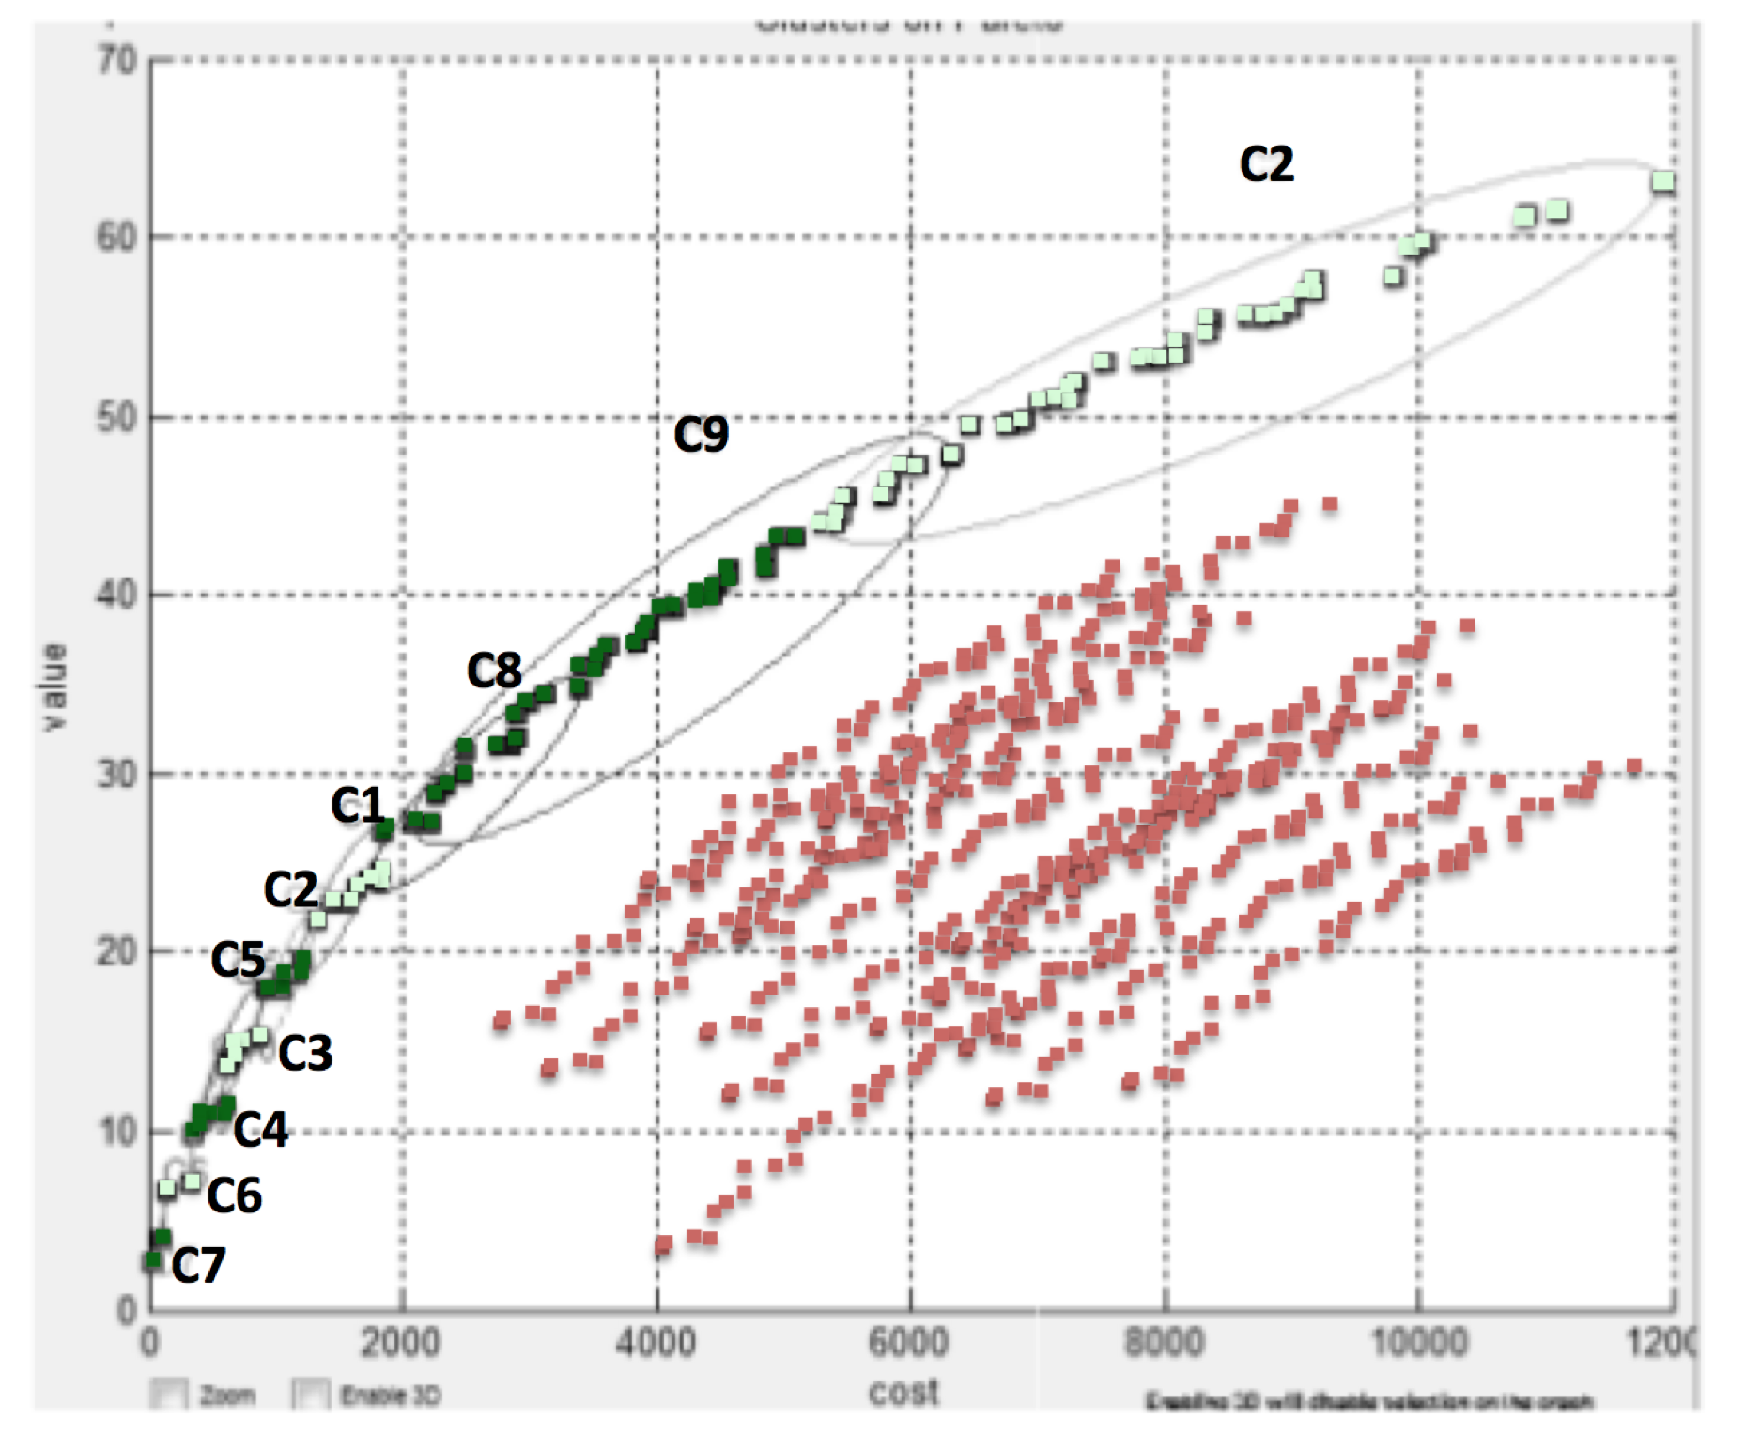
End of “the” prediction
Rather:
Predictions
PLural
Range of options
assessed via criteria
learned interactively with business users

Slide 5
Not “What Is”
So not your standard classifier
But “what could be”
Contrast set learners: Minwal, STUCCO, TAR234,
Deltas between classes
Option generation technolgoy
E.g. Bayes nets
Optimziers that return pareto frontiers

Slide 6
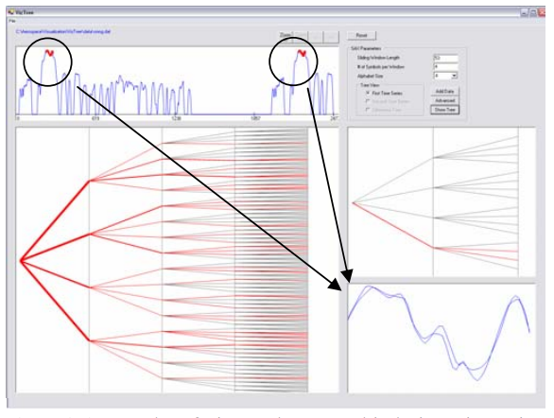
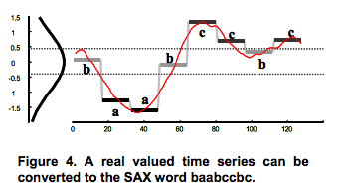
“What’s that?” (anomaly detection)
E,g, Keogh’s SAX representation
Monitors (e.g.) thousands of on-board rocket sensors

Slide 7
Not “What Is”
So not your standard classifier
But “what could be”
Contrast set learners: Minwal, STUCCO, TAR234,
Deltas between classes
Option generation technolgoy
E.g. Bayes nets
Optimziers that return pareto frontiers

Slide 8
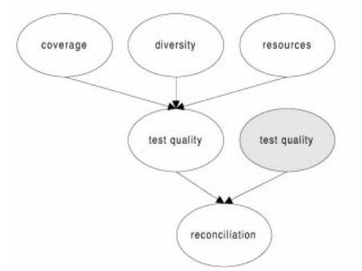
“What if”: e.g. Bayes nets
All links bi-directional
Tickle anything to see impact on anything else
E.g. Fenton et al., TSE, 2000, Misirli et al, TSE 2014

Slide 9
“What if” e.g. Pareto clustering
Range of options
assessed via criteria
learned interactively with business users

Slide 10
Not “What Is”
So not your standard classifier
But “what could be”
Contrast set learners: Minwal, STUCCO, TAR234,
Deltas between classes
Option generation technolgoy
E.g. Bayes nets
Optimziers that return pareto frontiers

Slide 11
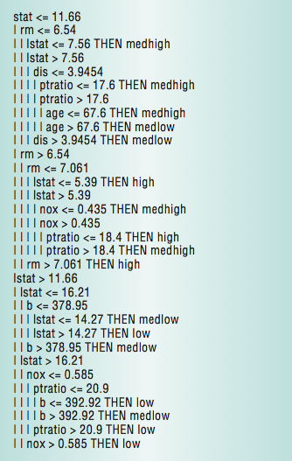
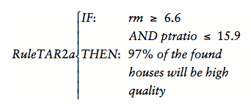
“What to do” (e.g. contrast set learning)
Not predictors for separate classes
But deltas between classes
Minwal, STUCCO, TAR2, TAR3

Slide 12
Not “What Is”
So not your standard classifier
But “what could be”
Contrast set learners: Minwal, STUCCO, TAR234,
Deltas between classes
Option generation technolgoy
E.g. Bayes nets
Optimziers that return pareto frontiers

