Slide 1
http://tiny.cc/se15
http://tiny.cc/se15

Slide 2
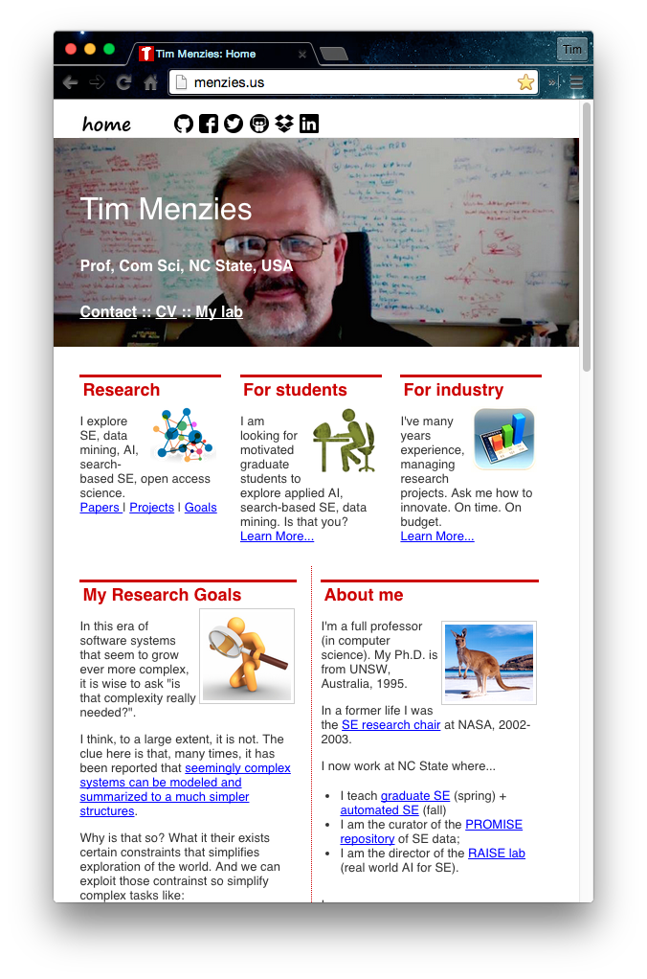
About the speaker http://tiny.cc/se15
Full Prof in CS NC State. Teaches SE and automated SE.
Researches synergies human+AI, with focus on data mining for SE.
Assoc editor IEEE Transactions on SE, Empirical SE, the Automated SE Journal , Software Quality Journal
Was co-PC-chair for ASE’12, ICSE'15 NIER track.
Will be co-general chair of ICMSE'16.
Author of 230+ referred pubs.
One of the 100th most cited authors in SE (of 80000 goo.gl/BnFJs).
PI for NSF, NIJ, DoD, NASA, USDA, and research with priv companies.
Co-founder of the PROMISE conference series on reproducible experiments in SE.
Current curator PROMISE web site, SE research data http://openscience.us/repo .
Vita: http://goo.gl/8eNhYM
Pubs: https://goo.gl/qNQAIq
Home page: http://menzies.us

