Slide 1

GALE: Geometric active learning for Search-Based software Engineering
(a “Journal First” paper for FSE’15)
Joseph Krall : LoadIQ
Tim Menzies : NC State
Misty Davies : NASA Ames
Sept 5, 2015

Slide 2
Today’s task
Simpler (shorter) decisions
From complex multi-objective models
Using less CPU

Slide 3
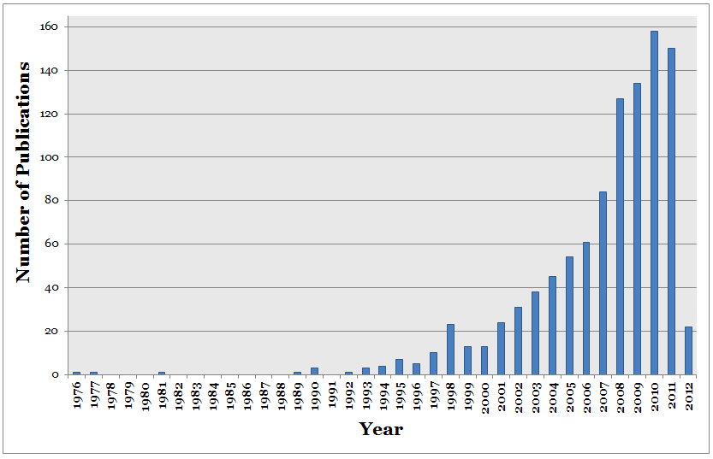
Search-based SE wants your CPUs
Because after “big data” comes “big models”
Collect all that data– and summarize it

Slide 4
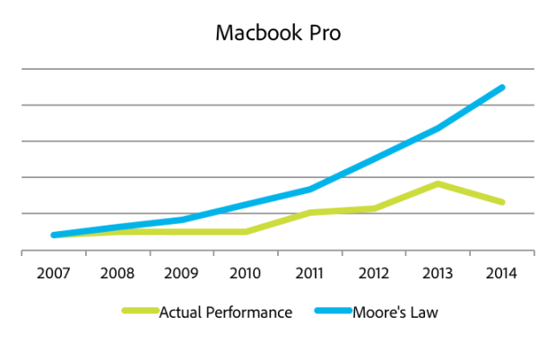
But we are running out of CPUs
Moore’s Law is Dead
No more exponential increase in CPU speeds
power and heat issues
Data centers consume 1.5% of globally electrical output
And growing
2013: 91 billion Kwatt hrs
2020: 139 billion Kwatt hrs

Slide 5

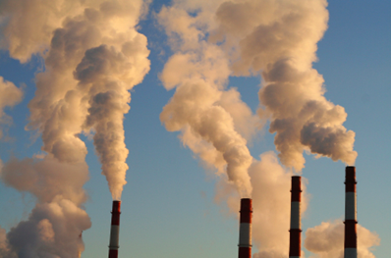
But we are running out of CPUs
More energy = pollution + cost
Making energy = making pollution
Cloud computation = heavily monetized
Everything costs: storage, uploads, downloads, CPU.
Google: 1% reduction in CPU saves $millions

Slide 6
Roadmap
Journal-first
GALE
strong force to push you around
Search-based SE
The future of SE
Why we explore with GALE
Geometric
Look before you leap
Faster hops over the space
Active learning:
Scoring examples costs X.
Minimize sum of X

Slide 7
Roadmap
Journal-first
GALE
strong force to push you around
Search-based SE
The future of SE
Why we explore with GALE
Geometric
Look before you leap
Faster hops over the space
Active learning:
Scoring examples costs X.
Minimize sum of X

Slide 8
Journal first: useful for jumping communities e.g. me, 12 years, 12 TSE articles, 8 journal first
2015 (to appear):
GALE: Geometric active learning for Search-Based software Engineering, Krall, Menzies, Davies
2013:
Learning Project Management Decisions: A Case Study with Case-Based Reasoning versus Data Farming, Menzies, Brady, Keung, Hihn, Steven Williams, El-Rawas, Green, Boehm
Balancing Privacy and Utility in Cross-Company Defect Prediction, Peters, Menzies, Gong, Zhang
Active Learning and Effort Estimation: Finding the Essential Content of Software Effort Estimation Data Kocaguneli, Menzies, Keung, Cok, Madachy
Local versus Global Lessons for Defect Prediction and Effort Estimation, Tim Menzies, Butcher, Cok, Marcus, Layman, Shull, Turhan, Zimmermann
2012:
On the Value of Ensemble Effort Estimation, Kocaguneli, Menzies, Keung
Exploiting the Essential Assumptions of Analogy-Based Effort Estimation, Kocaguneli, Menzies, Bener, Keung
2011:
Gas for Randomized Unit Testing, Andrews, Menzies, Felix Li
2007:
Problems with Precision: A Response to "Comments on 'Data Mining Static Code Attributes to Learn Defect Predictors’”, Menzies, Dekhtyar, Distefano, Greenwald
Data Mining Static Code Attributes to Learn Defect Predictors, Menzies, Greenwald, Frank
2006:
Best Practices for Effort Estimation, Menzies, Chen, Hihn, Lum
2003:
More Success & Failure Factors in Software Reuse, Menzies, Stefano

Slide 9
Roadmap
Journal-first
GALE
strong force to push you around
Search-based SE
The future of SE
Why we explore with GALE
Geometric
Look before you leap
Faster hops over the space
Active learning:
Scoring examples costs X.
Minimize sum of X

Slide 10
Roadmap
Journal-first
GALE
strong force to push you around
Search-based SE
The future of SE
Why we explore with GALE
Geometric
Look before you leap
Faster hops over space
Active learning:
Scoring examples costs X.
Minimize sum of X

Slide 11
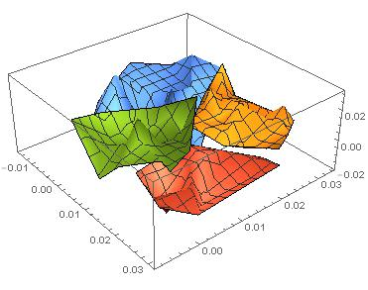
GALE force
Approximate the space
k=2 divisive clustering
Evaluate 2 distant points (X,Y) per cluster
If better(X,Y)
If size(cluster) > large
Cut in two
Recurse on better half
Else, push points towards X
e.g. orange points get pushed this way

Slide 12
Roadmap
Journal-first
GALE
strong force to push you around
Search-based SE
The future of SE
Why we explore with GALE
Geometric
Look before you leap
Faster hops over space
Active learning:
Scoring examples costs X.
Minimize sum of X

Slide 13
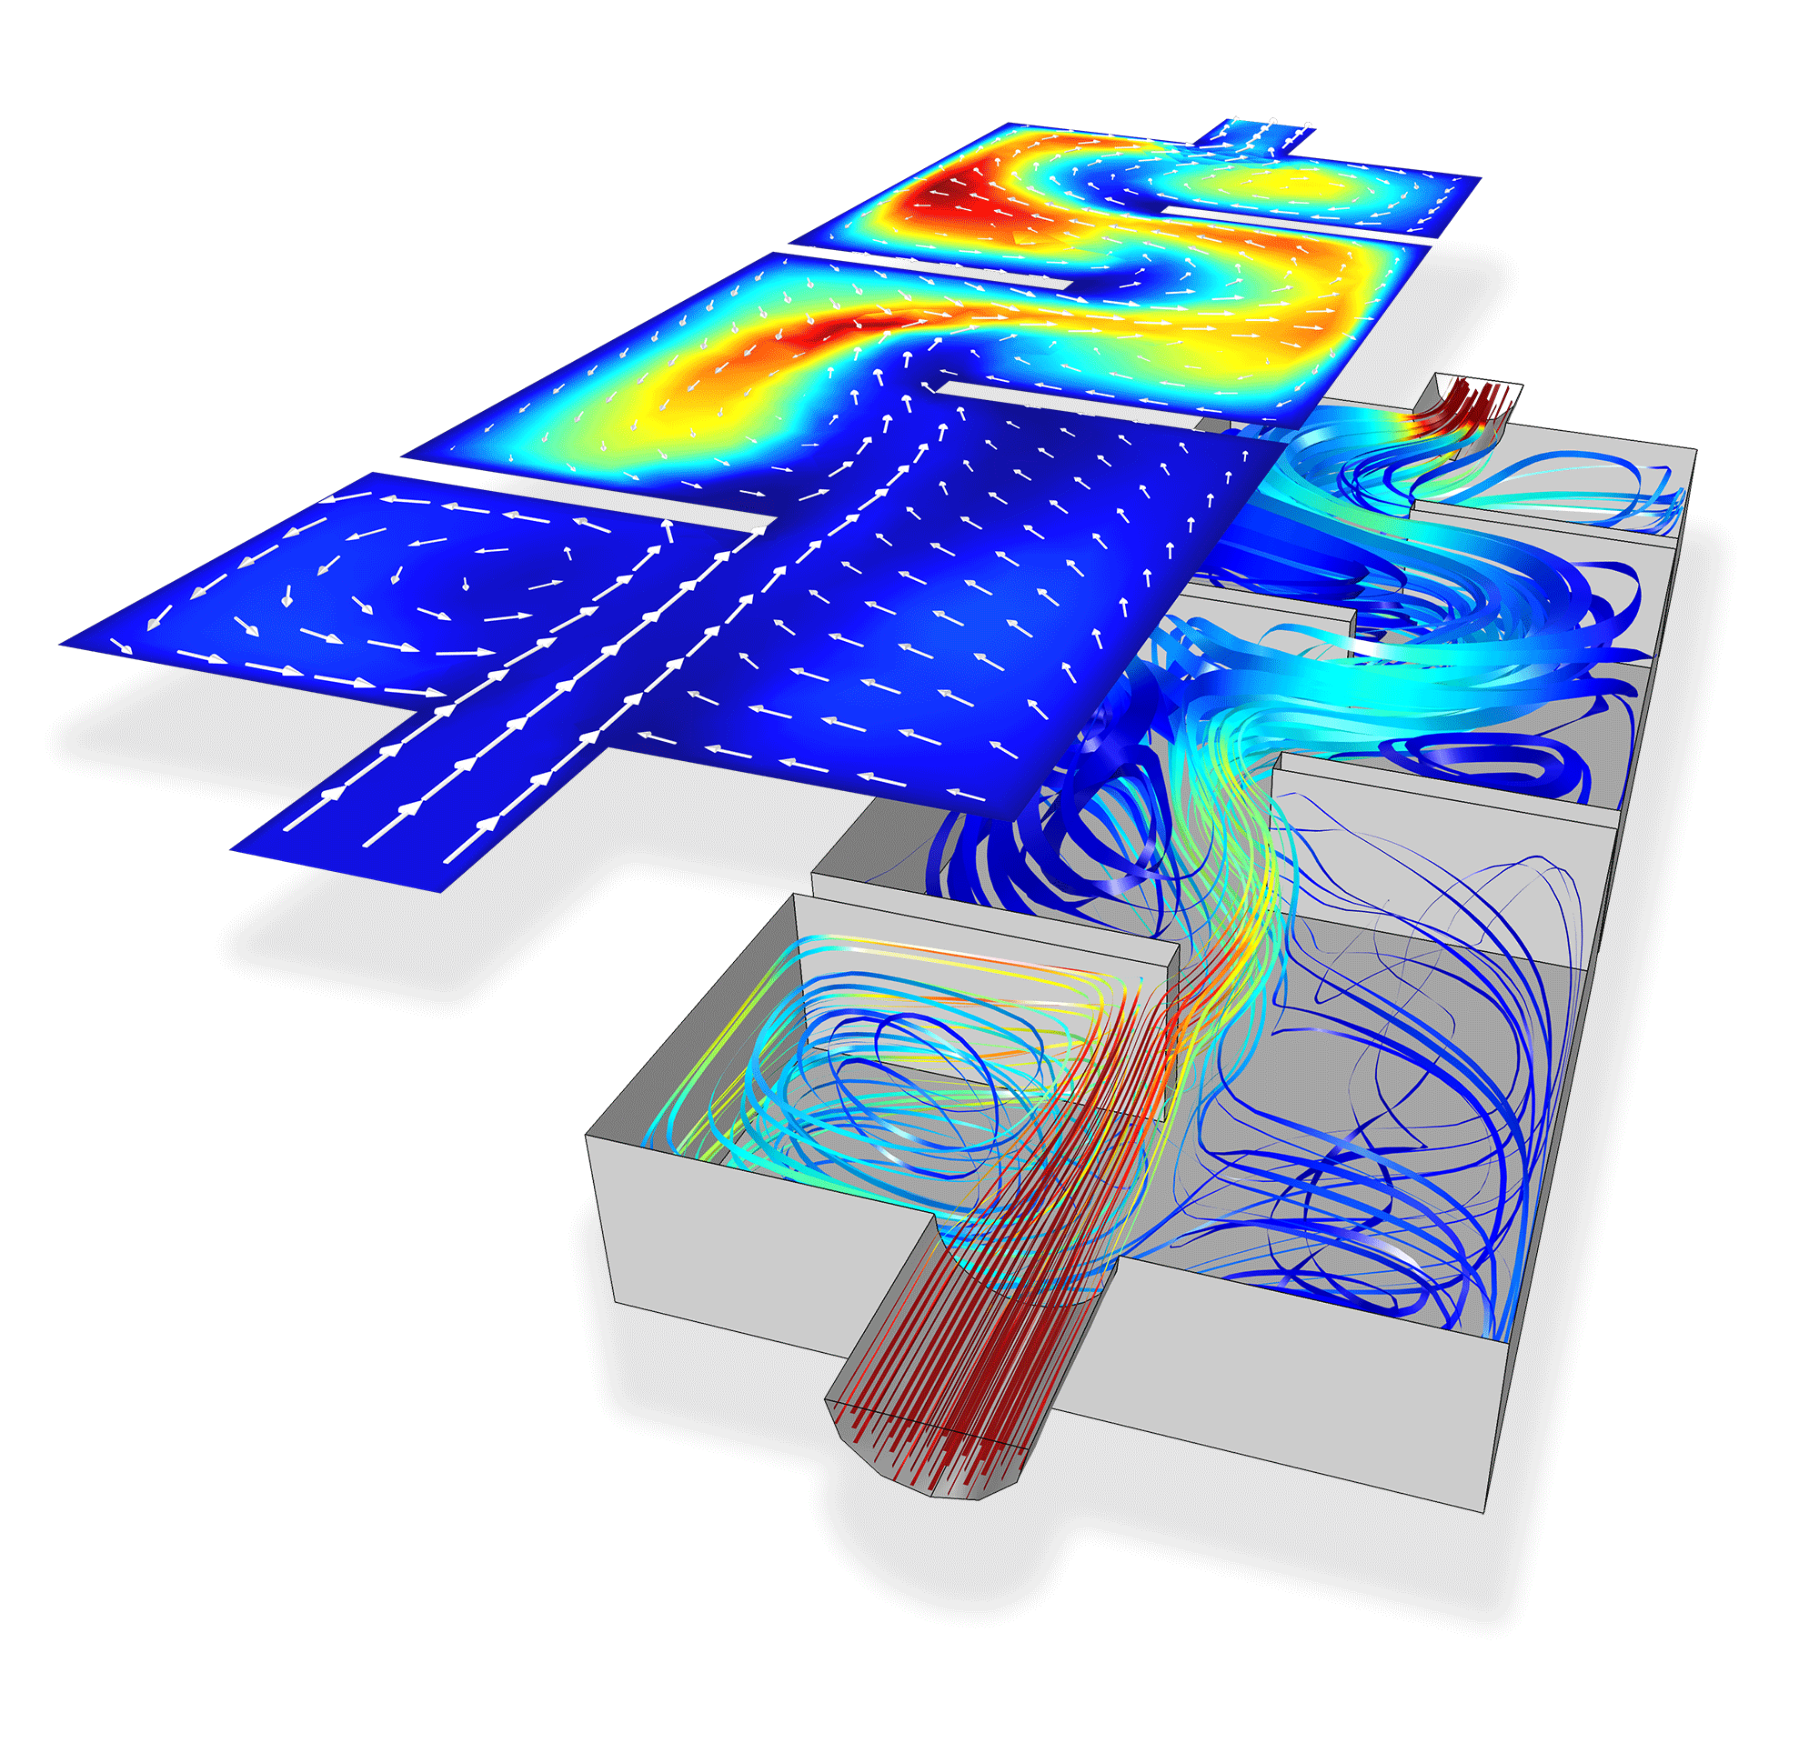
Models are everywhere
If you call an ambulance in London or New York,
those ambulances are controlled by emergency response models.
If you cross the border Arizona to Mexico,
A models determines if you are taken away for extra security measures.
If you default on your car loans,
A model determines when (or if) someone to repossess your car.
If the stock market crashes,
it might be that some model caused the crash.

Slide 14
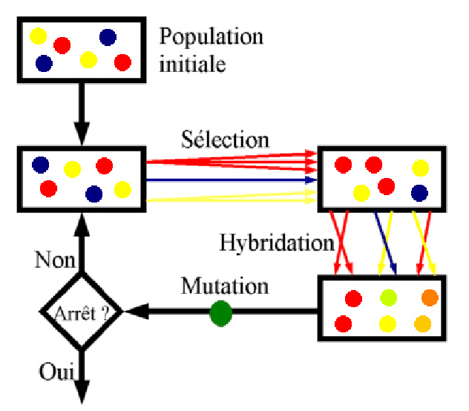
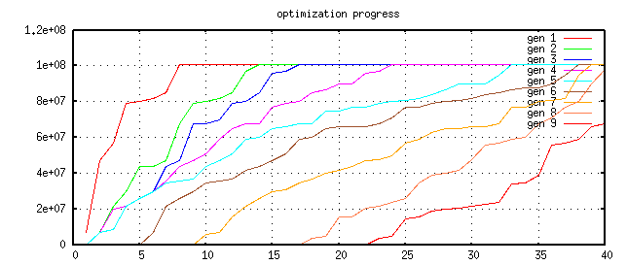
SBSE and evolutionary algorithms
Repeat till happy or exhausted
Selection (cull the herd)
Cross-over (the rude bit)
Mutation (stochastic jiggle)
Pareto frontier
-- better on some criteria, worse on none
Selection:
-- generation[i+1] comes from Pareto frontier of generation[i]
9
8
7
6
5
4
3
2
1

Slide 15

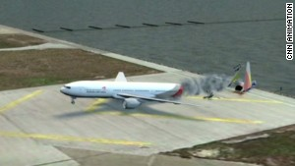
Organizations with CPU Limits
Cognitive models of the agents (both pilots and computers)
Late descent,
Unpredicted rerouting,
Different tailwind conditions
Goal: validate operations procedures (are they safe?)
NASA’s analysts want to explore 7000 scenarios.
With current tools (NSGA-II)
300 weeks to complete
Limited access to hardware
Queue of researchers wanting hardware access
Hardware pulled away if in-flight incidents for manned space missions
Asiana Airlines
Flight 214

Slide 16
Roadmap
Journal-first
GALE
strong force to push you around
Search-based SE
The future of SE
Why we explore with GALE
Geometric
Look before you leap
Faster hops over space
Active learning:
Scoring examples costs X.
Minimize sum of X

Slide 17
Roadmap
Journal-first
GALE
strong force to push you around
Search-based SE
The future of SE
Why we explore with GALE
Geometric
Look before you leap
Faster hops over space
Active learning:
Scoring examples costs X.
Minimize sum of X

Slide 18
GALE force
Approximate the space
k=2 divisive clustering
Evaluate 2 distant points (X,Y) per cluster
If better(X,Y)
If size(cluster) > large
Cut in two
Recurse on better half
Else, push points towards X
e.g. orange points get pushed this way

Slide 19
GALE force
Approximate the space
k=2 divisive clustering
Evaluate 2 distant points (X,Y) per cluster
If better(X,Y)
If size(cluster) > large
Cut in two
Recurse on better half
Else, push points towards X

Slide 20
GALE force
Approximate the space
k=2 divisive clustering
Evaluate 2 distant points (X,Y) per cluster
If better(X,Y)
If size(cluster) > large
Cut in two
Recurse on better half
Else, push points towards X
C= Candidate = <Decisions, Objectives>
P= Population = { C1, C2, C3….}
Recursive k=2 division of population of on dimension of large variability in decisions

Slide 21
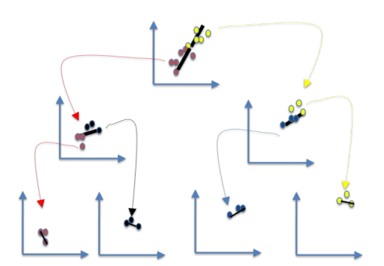
GALE force
Approximate the space
k=2 divisive clustering
Evaluate 2 distant points (X,Y) per cluster
If better(X,Y)
If size(cluster) > large
Cut in two
Recurse on better half
Else, push points towards X
C= Candidate = <Decisions, Objectives>
P= Population = { C1, C2, C3….}
Recursive k=2 division of population of on dimension of large variability in decisions

Slide 22
GALE force
Approximate the space
k=2 divisive clustering
Evaluate 2 distant points (X,Y) per cluster
If better(X,Y)
If size(cluster) > large
Cut in two
Recurse on better half
Else, push points towards X
C= Candidate = <Decisions, Objectives>
P= Population = { C1, C2, C3….}
Recursive k=2 division of population of on dimension of large variability in decisions
Splits found via the O(2N) FASTMAP heuristic

Slide 23
GALE force
Approximate the space
k=2 divisive clustering
Evaluate 2 distant points (X,Y) per cluster
If better(X,Y)
If size(cluster) > large
Cut in two
Recurse on better half
Else, push points towards X
Evaluations on N objectives for just the two distance points in each cluster
So, at max, 2log(N) evals

Slide 24
GALE force
Approximate the space
k=2 divisive clustering
Evaluate 2 distant points (X,Y) per cluster
If better(X,Y)
If size(cluster) > large
Cut in two
Recurse on better half
Else, push points towards X

Slide 25
GALE force
Approximate the space
k=2 divisive clustering
Evaluate 2 distant points (X,Y) per cluster
If better(X,Y)
If size(cluster) > large
Cut in two
Recurse on better half
Else, push points towards X
LARGE (greater than sqrt(N)(

Slide 26
GALE force
Approximate the space
k=2 divisive clustering
Evaluate 2 distant points (X,Y) per cluster
If better(X,Y)
If size(cluster) > large
Cut in two
Recurse on better half
Else, push points towards X

Slide 27
GALE force
Approximate the space
k=2 divisive clustering
Evaluate 2 distant points (X,Y) per cluster
If better(X,Y)
If size(cluster) > large
Cut in two
Recurse on better half
Else, push points towards X

Slide 28
Roadmap
Journal-first
GALE
strong force to push you around
Search-based SE
The future of SE
Why we explore with GALE
Geometric
Look before you leap
Faster hops over space
Active learning:
Scoring examples costs X.
Minimize sum of X

Slide 29
Sample models
Approximate the space
k=2 divisive clustering
Evaluate 2 distant points (X,Y) per cluster
If better(X,Y)
If size(cluster) > large
Cut in two
Recurse on better half
Else, push points towards X

Slide 30
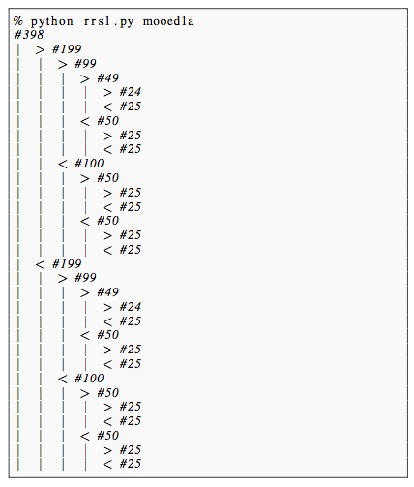
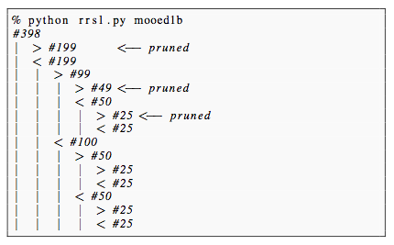
Recursively cluster data, find most distant points in leaf clusters
e.g. 398 cars
Maximize acceleration,
Maximize mpg
Find splits using FASTMAP O(n) [Faloutsos & Lin ’95]
At each level only check for dominance of two most extreme points
2log₂(N) evals, or less
Leaves = non-dominated examples (i.e. the Pareto frontier)
14 evaluations
of goals

Slide 31
Active learning and evolutionary computing
Repeat till happy or exhausted
Selection (cull the herd)
Cross-over (the rude bit)
Mutation (stochastic jiggle)
Naïve selection
• score every candidate Active learning • Score only the most informative candidates • e.g. just score most distant points in data
clusters

Slide 32
But why do we care?

Slide 33
Researech questions
RQ1:
Is GALE slow due to all that clustering
RQ!:
Is GALE effective:

Slide 34
Related work
Multi-objective optimization
MOEA/D : R random directions, uses N eval/gen
GALE: informed directions, log(N) evals/gen
Active learning:
In SE, have not see this applied before MOEA
Response surface methods
Parametric approximations of topology
Avoids slow evals of model
Use approximation instead
GALE:
no parametric assumptions
V.simple approximation
Local search
Some work in MOEA
None known (to us) in SE
? Needs more than log(N) evals

Slide 35
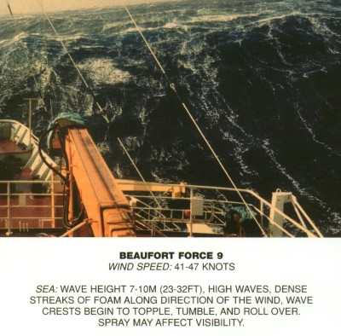
GALE : a strong wing

Slide 36
Optimization and evolutionary algorithms
Repeat till happy or exhausted
Selection (cull the herd)
Cross-over (the rude bit)
Mutation (stochastic jiggle)
Pareto frontier
-- better on some criteria, worse on none
Selection:
-- generation[i+1] comes from Pareto frontier of generation[i]
9
8
7
6
5
4
3
2
1

Slide 37
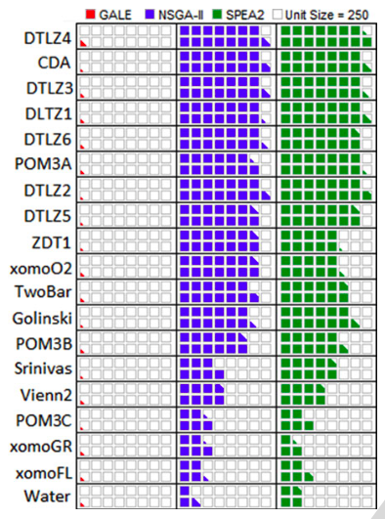
Evaluations per generation: GALE = O(log(N)); Others = O(N)
RQ1:
Is GALE slow ?
all that clustering
RQ2:
Is GALE effective?
evals 2 points per cluster

Slide 38
Search-based SE (SBSE)
﻿Many SE activities are like optimization problems [Harman,Jones’01].
Due to computational complexity, exact optimization methods can be impractical for large SBSE problems
So researchers and practitioners use metaheuristic search to find near optimal or good-enough solutions.
E.g. simulated annealing [Rosenbluth et al.’53]
E.g. genetic algorithms [Goldberg’79]
E.g. tabu search [Glover86]

Slide 39
WMC: GIT’s Work Models that Compute [Kim’11]
Cognitive models of the agents (both pilots and computers)
Late descent,
Unpredicted rerouting,
Different tailwind conditions
Goal: validate operations procedures (are they safe?)
NASA’s analysts want to explore 7000 scenarios.
With current tools (NSGA-II)
300 weeks to complete
Limited access to hardware
Queue of researchers wanting hardware access
Hardware pulled away if in-flight incidents for manned space missions
Asiana Airlines
Flight 214

