Slide 1

Lexisnexis, Ncstate opportunities
Tim Menzies
computer science,
june 2015

Slide 2
SeBIG LAB : SE for Big Data
Three year partnership
New lab to explore SE methods for big data apps.
Grow skill set of engineers:
Assess different approaches to Big Data
Validation of results

Slide 3
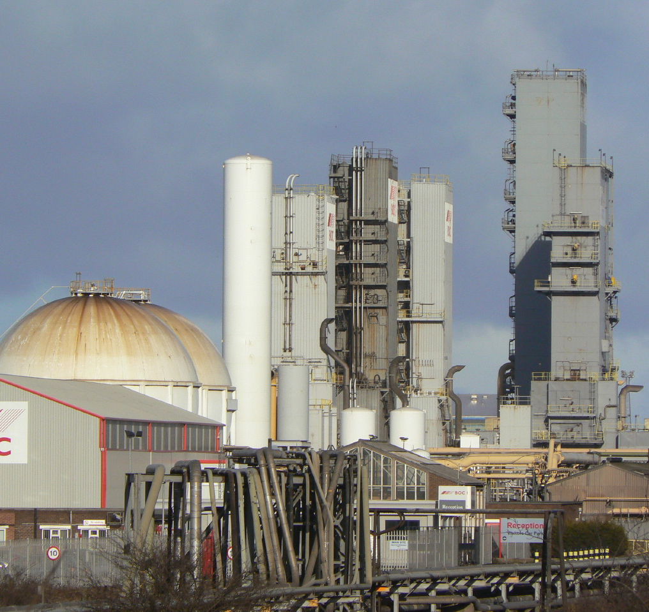
Lab processes vs Industrial processes
Lab processes
Make 10ml of oxygen?
Easy!
Make 100,000 liters per day?
That’s another matter

Slide 4
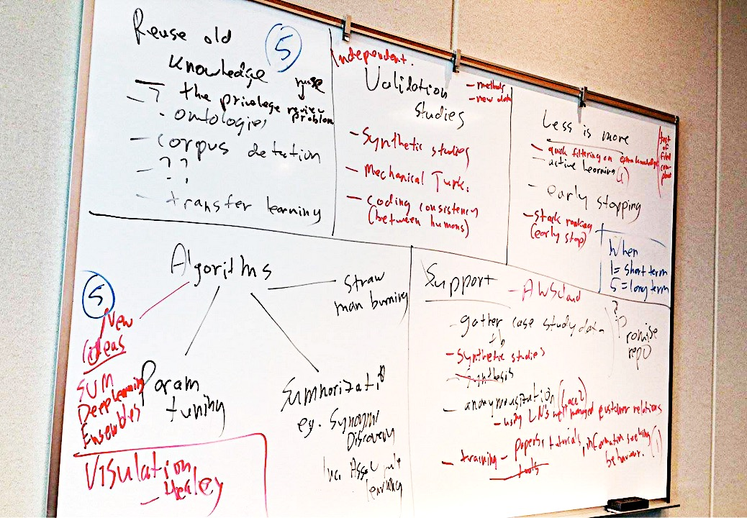
Industrial processes for data mining

Slide 5
Industrial processes for data mining
3
2
5
1
4

Slide 6
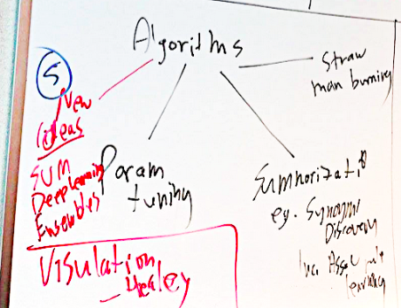
Exploring new algorithms
1
New ideas
SVM
Deep learning
Ensembles
etc
Visualizations
Parameter tuning
Synonym discovery
Incremental association rule learning

Slide 7
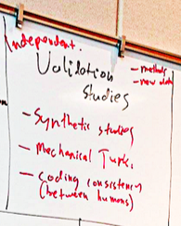
Validation studIes
2
Independent checks of industrial results
Optimizing validation:
? Mechanical Turk
Better support tools for coding new functionality
Better test suites for certifying new functionality

Slide 8
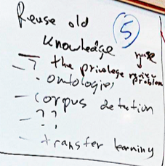
Can we make better use of Old knowledge?
3
Learning domain ontologies.
Corpus definition.
How to revise old knowledge?
The privileged review problem.
Transfer learning.

Slide 9
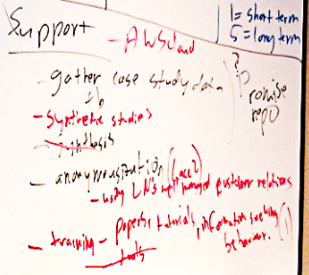
Support
4
Gather case study data
Synthetic studies
Annonymization of data
Training
Papers
Tutorials
Learning information seeking behavior

Slide 10
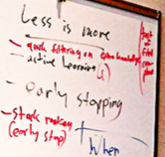
Less is more
5
Reasoning via fewer, most representative examples
Active learning
Early stopping
Stack ranking (early stop)

