Slide 1

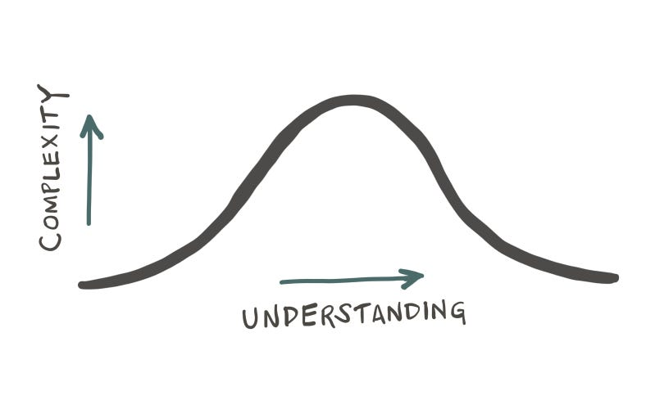
easier AI?
“as a system evolves, its complexity increases unless work is done to reduce it” — Lehman, 1980 [1]
if anyone can do it for $1 … can you do it for a cent?
timm@ieee.org
ssbse’26: july 6, 2026 code: pip install ezr data: http://tiny.cc/moot

Slide 2



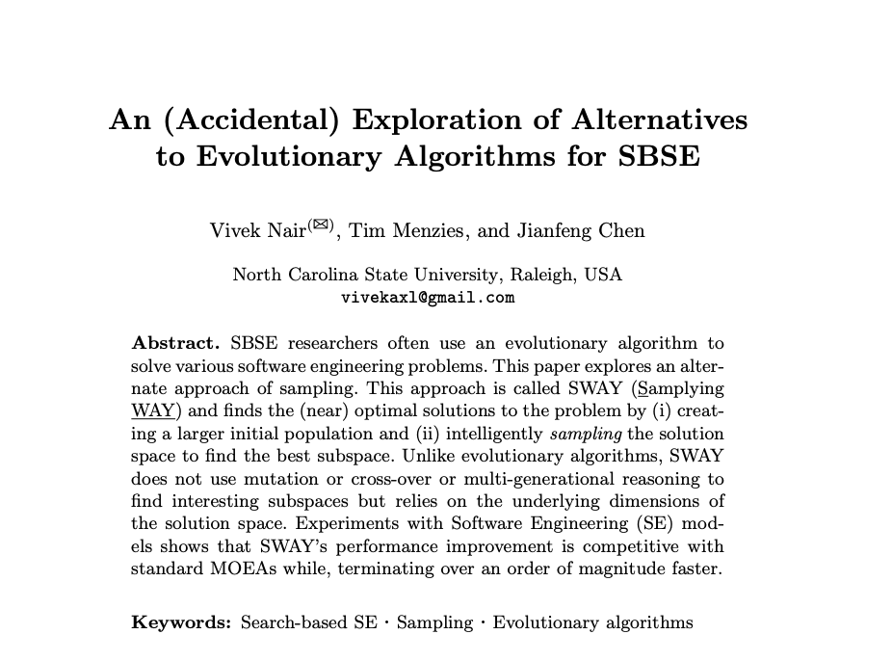
Ssbse’16
[2]
2019: Amritanshu Agrawal (Snap); Vivek Nair (Meta) Jianfeng Chen (Meta)
2025: Andre Lustosa (Redhat)
2027: Kishan Ganguly BINGO (FSE’26); Amirali Rayegon Explanation (JSS’26)
2028: Srinath Srinivasan, Neurosymbolic (arxiv)

Slide 3

why easier AI?
how to do easier AI?
why not more of easier AI?

Slide 4

An ASE’26 workshop
1 page abstract due July 20

Slide 5
why easier AI?
how to do easier AI?
why not more of easier AI?

Slide 6
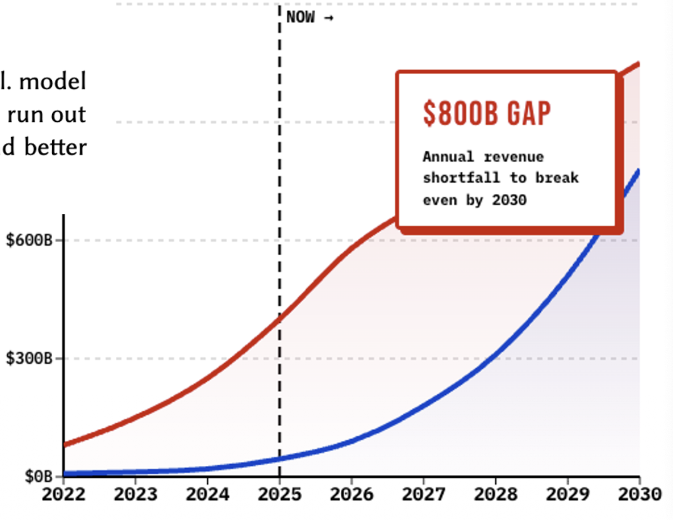
Q: why easier AI?
A: economics [3] [4]
Niklaus Wirth:
“Software gets slower faster than hardware gets faster”
Even if $/token falls, Jevons paradox: total token burn grows (*10, *100: 2023→2026)
Bain 2025 forecast:
$800B/yr revenue gap by 2030
2026 capex ~$725B; 2027 projected >$1T — gap widening
4
money is one worry … trust is another →

Slide 7
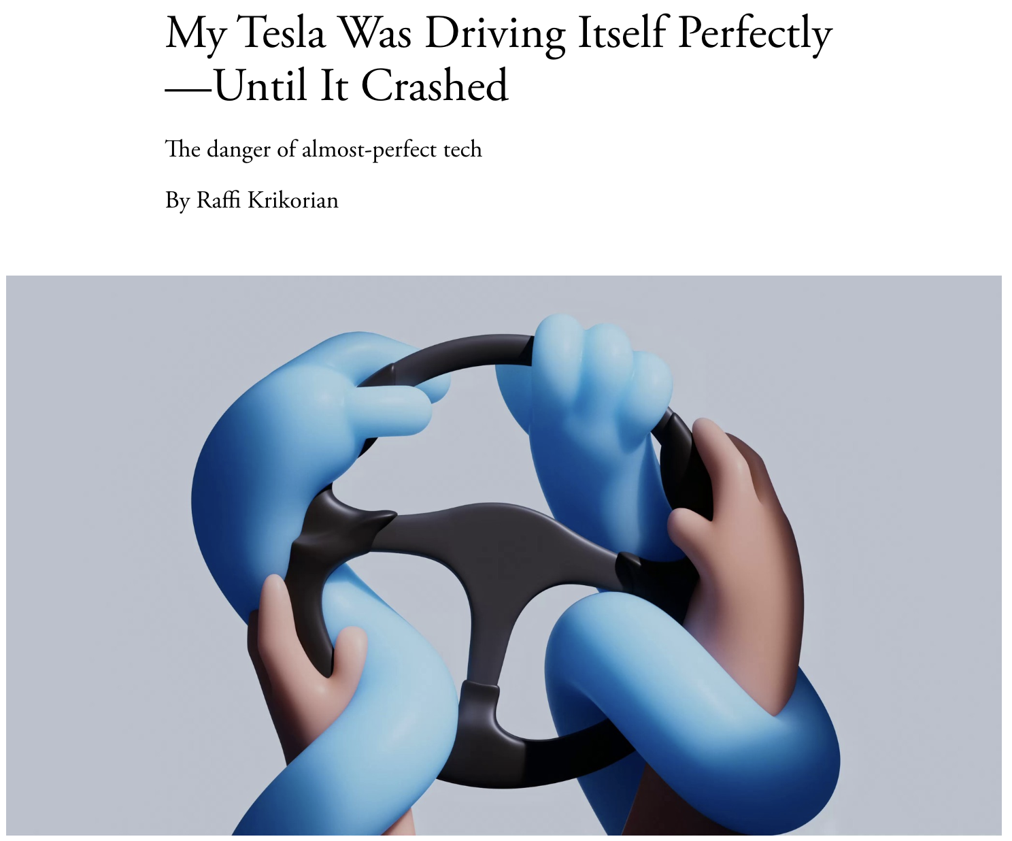
Q: why easier AI? A: easier to trust; easier to watch and understand
The Atlantic
March 17, 2026
5
and some domains have no choice →

Slide 8
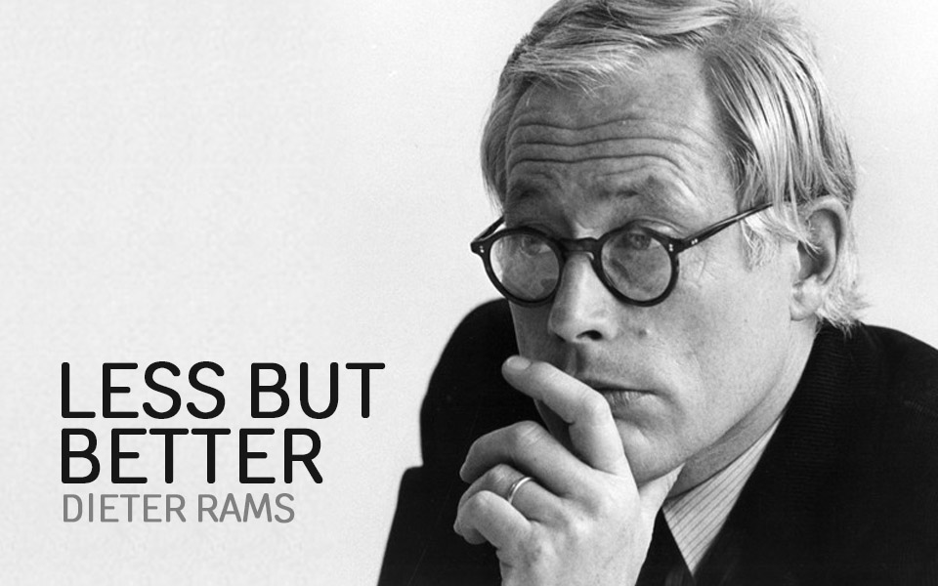
Q: why easier AI? A: cause some domains demand it [5]
Green AI
global south (countries without e.g. American-scale infrastructure)
resource-constraint teaching
community colleges,
K–12 CS,
MSIs,
thise using personal hardware
privacy-constrained industrial dev
defense,
regulated healthcare,
financial services,
law firms)
air-gapped settings;
edge or on-device inference
6
even SE itself says “less” →

Slide 9
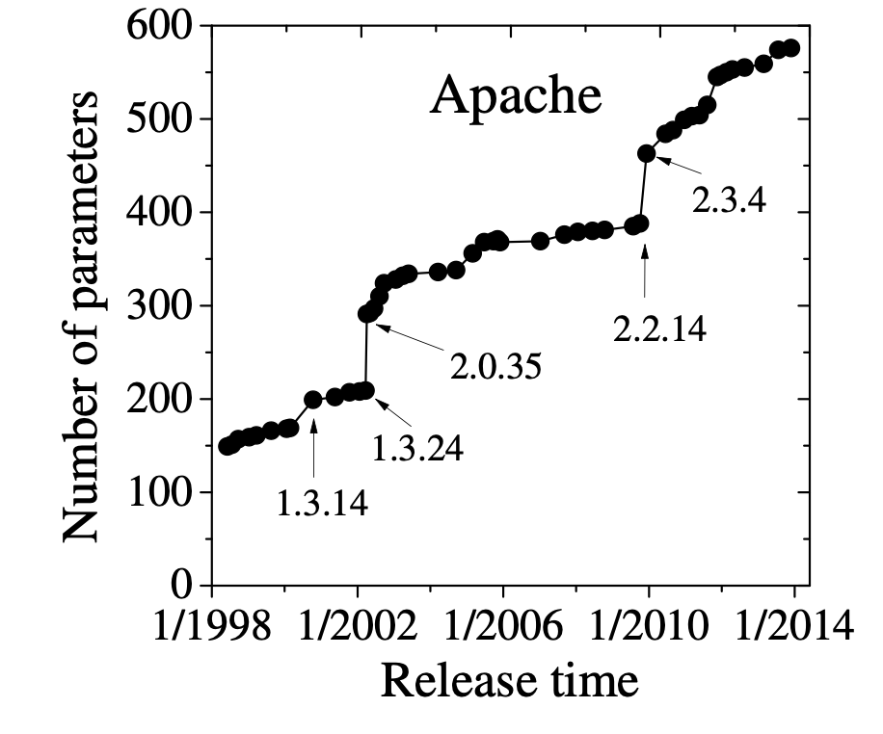
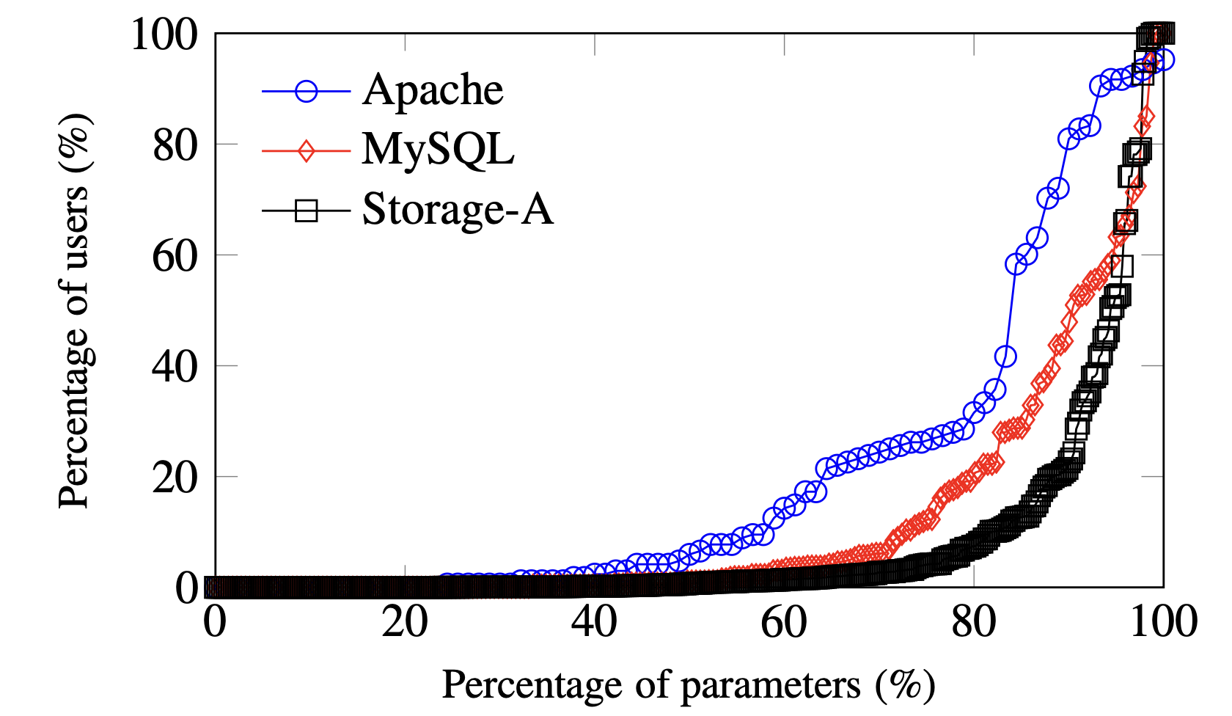
Q: why easier AI? A: software engineering
security:
modern software = assembly of pre-made parts (> 80%)
more reuse == more exposure
e.g. left-pad; MOVEit ($12B), Falcon ($5B), ByBit (1.4B) $24B (2025);
survivability: e.g. SQLite does not use Berkeley DB.
Now used on Mars
maintainability + reliability:
more loc = more to maintain, more to go wrong
waste: Most users cannot handle most options [6]
7
and the data for “big” is running out →

Slide 10
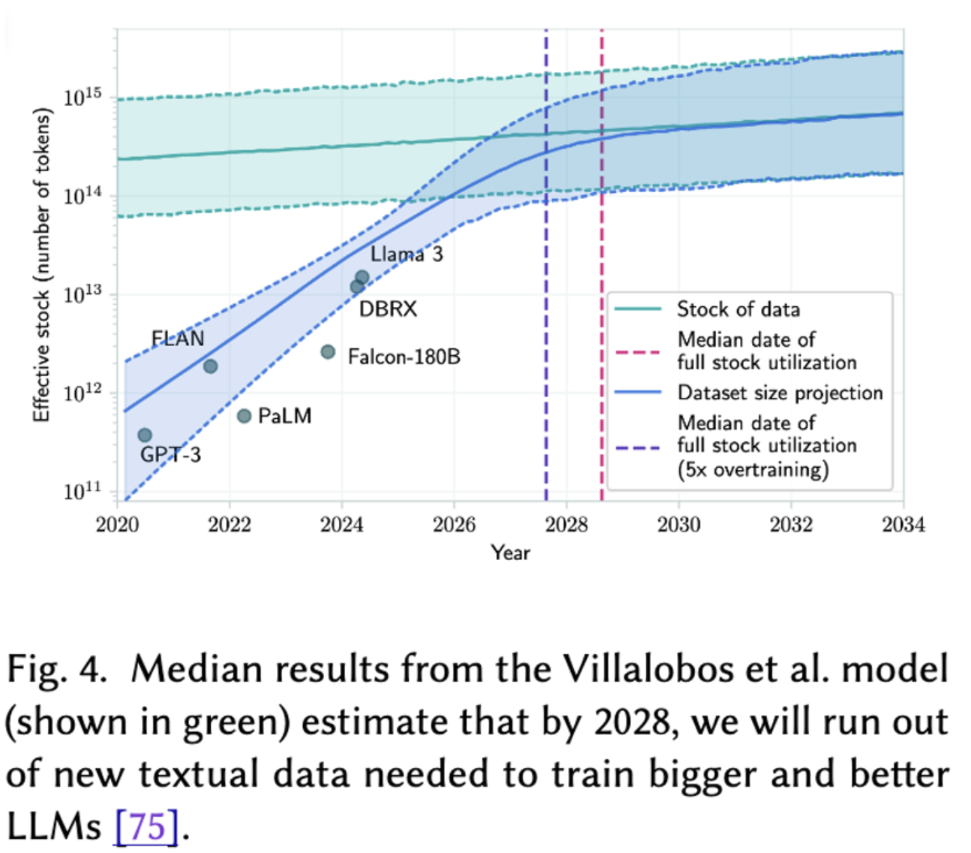
Q: why easier AI? A: cause “big AI” needs too much data [7,10]
8
besides, more was never always better →

Slide 11
Q: why easier AI? A: more AI not always better [8][9][10]
text mining predicting effort within agile projects,
(SVM and TFIDF) better predictions than deep learners
Runs 100 times faster
tree-based models (Random Forest, XGBoost)
consistently outperform deep neural networks on tabular datasets,
especially those with more than 10,000 rows
Etc [11-14]
9
so: how? →

Slide 12
why easier AI?
how to do easier AI?
why not more of easier AI?

Slide 13
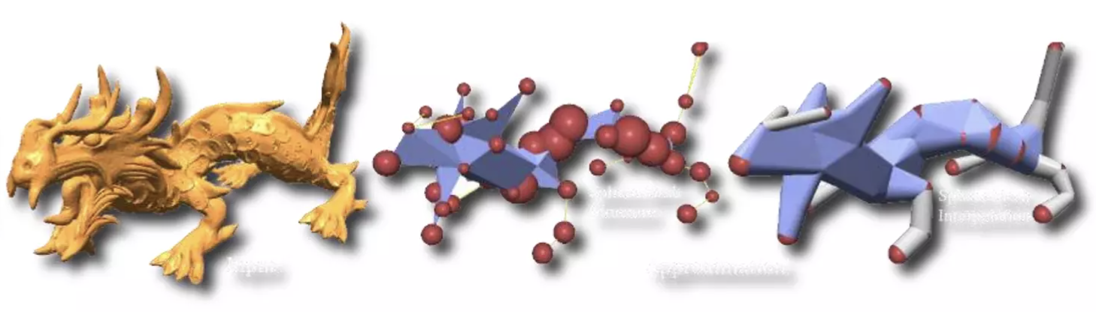
Q: how to do easier AI? A: so many ways [15-28]
1300: William of Ockham: “entities must not be multiplied beyond necessity"
1902, PCA: reduce data to a few principal components
1974, Prototypes: speed up k-NN by reducing rows to a few exemplars
2009, Active learning: only use most informative rows
2020s, Distillation: compress large LLM models with little performance loss
etc
11
of all these, focus on active learning →

Slide 14
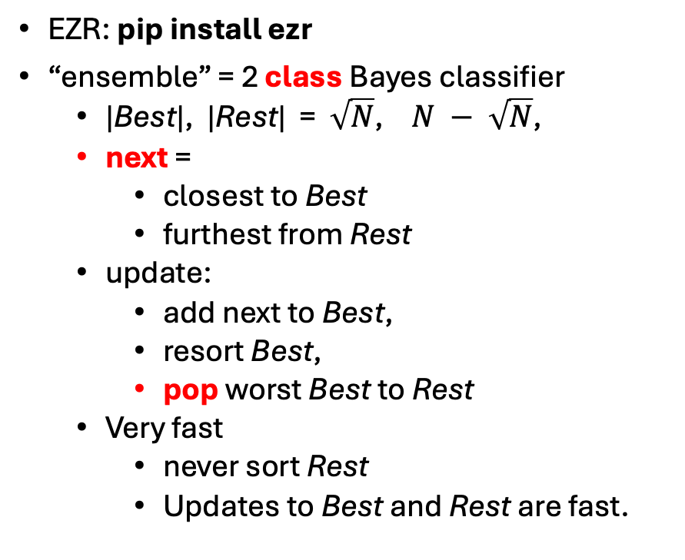
Q: how to do easier AI (with active learning) A: use current model to decide what’s next [29]
E.g. SMAC3
ensemble of decision trees
Seek unlabeled examples where
ensemble most disagrees (a.k.a. explore)
ensemble most agree (a.k.a. exploit)
adapt = Slowly shift explore to exploit
Cost of SMAC3:
when new data arrives
rebuilding the ensemble
EZR: pip install ezr
“ensemble” = 2 class Bayes classifier
|Best|, |Rest| = $\sqrt{N}$, $N − \sqrt{N}$,
next =
closest to Best
furthest from Rest
update:
add next to Best,
resort Best,
pop worst Best to Rest
Very fast
never sort Rest
Updates to Best and Rest are fast.
12
does it work? first: data →

Slide 15
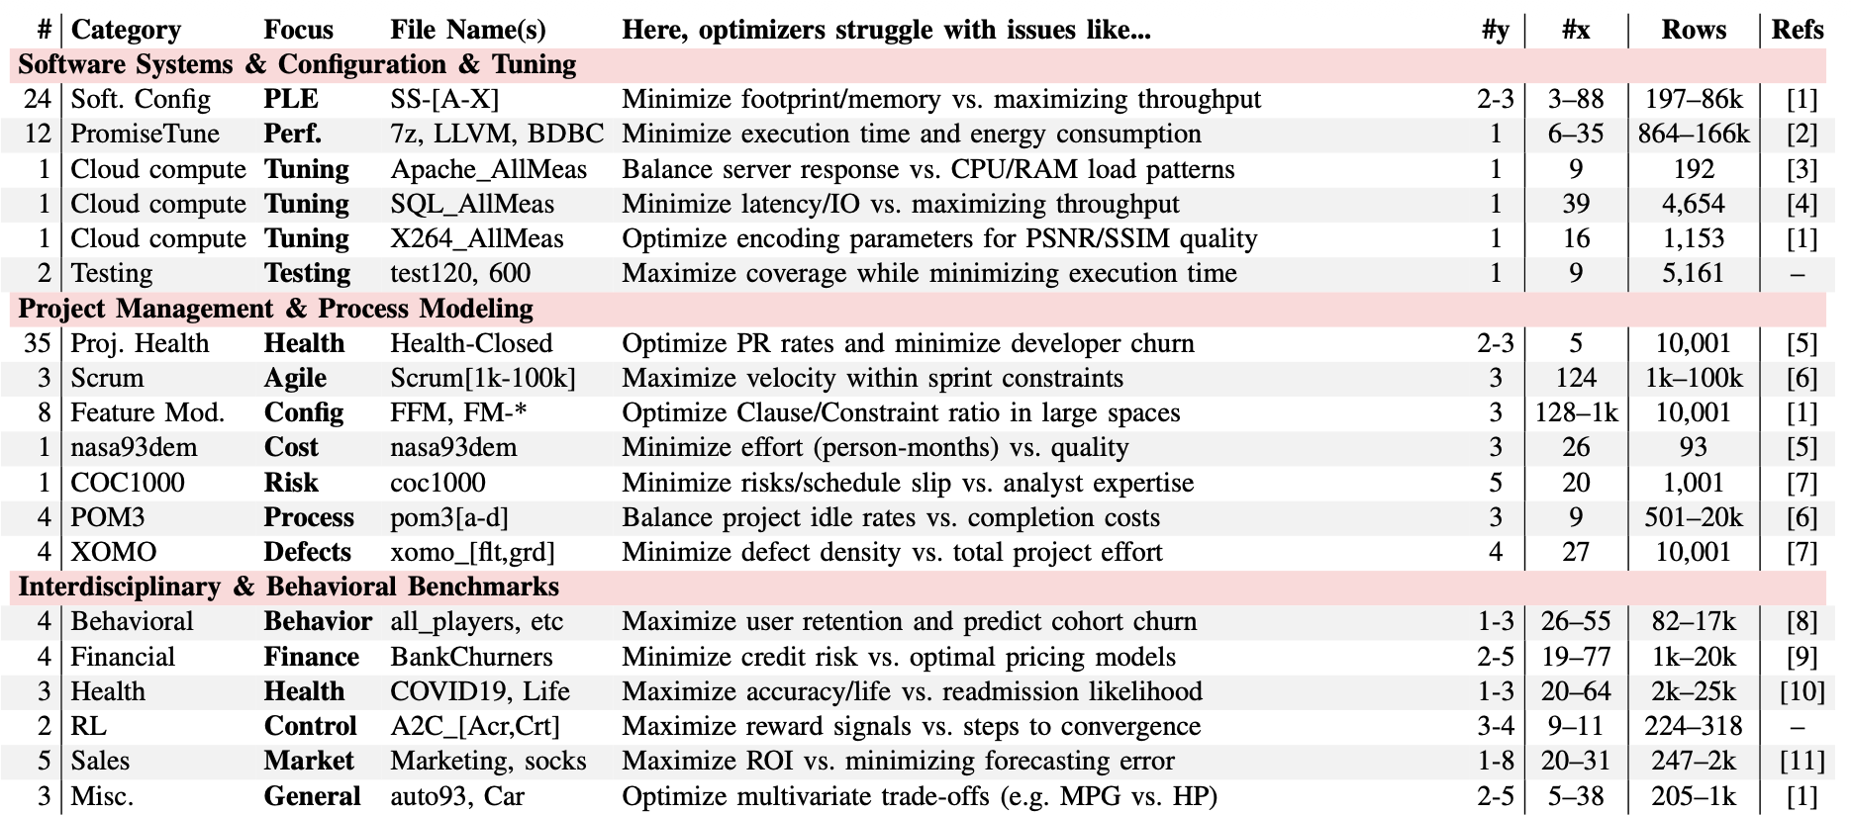
Q: how to test EZR? A: read lots of papers, collect their data [30]
Recent SBSE papers: ICSE, FSE, TSE, IST, EMSE, TOSEM, ASE
127 data sets
3-1044 independent x attributes;
1 to 8 dependent y attributes to be minimized or maximized;
93 to 100,000 rows.
http://tiny.cc/moot
configuration, performance tuning, product lines, project health, defect prediction, testing, cost estimation, cross-domain generalization, and text mining
13
… and a score →

Slide 16
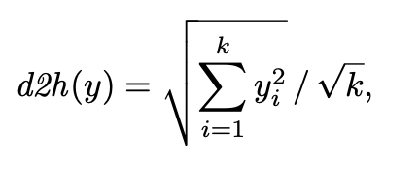

Q: how to score EZR? A: win = 1 - normalize(regret) [31]
Distance to heaven (aggregate n goals to one)
Regret = (d2h – lo) / (mu – lo)
Win = int(100 * (1 – regret))
Win $≤$ 0 ➔ optimizer just finds mu
Failure
Win=100 ➔ found reference optimum
Success
Build regression tree on labeled egs
Splitting rows to minimize 𝝈 of win
Reports what makes you good or bad
win n Lbs- Acc+ Mpg+
8 43 2334.2 16.3 27.4
41 26 2038.7 17.1 30.0. Volume <= 111
71 10 1871.7 18.1 32.0 | Volume <= 83
✅ 85 4 1831.7 19.0 32.5 | | Model <= 73
62 6 1898.3 17.4 31.7 | | Model > 73
22 16 2143.0 16.5 28.7 | Volume > 83
36 7 2098.1 18.0 28.6 | | Model <= 73
12 9 2177.9 15.3 28.9 | | Model > 73
26 4 2210.0 15.7 30.0 | | | Volume > 97
0 5 2152.2 15.0 28.0 | | | Volume <= 97
-41 17 2786.1 15.1 23.5 Volume > 111
-9 5 2279.8 14.6 28.0 | Volume <= 116
-54 12 2997.1 15.3 21.7 | Volume > 116
-44 8 2921.1 15.8 22.5 | | Model > 73
-38 4 2563.0 14.0 25.0 | | | Clndrs <= 4
-50 4 3279.2 17.4 20.0 | | | Clndrs > 4
❌ -75 4 3149.0 14.4 20.0 | | Model <= 73
configuration, performance tuning, product lines, project health, defect prediction, testing, cost estimation, cross-domain generalization, and text mining
14
so how well does it generalize? →

Slide 17
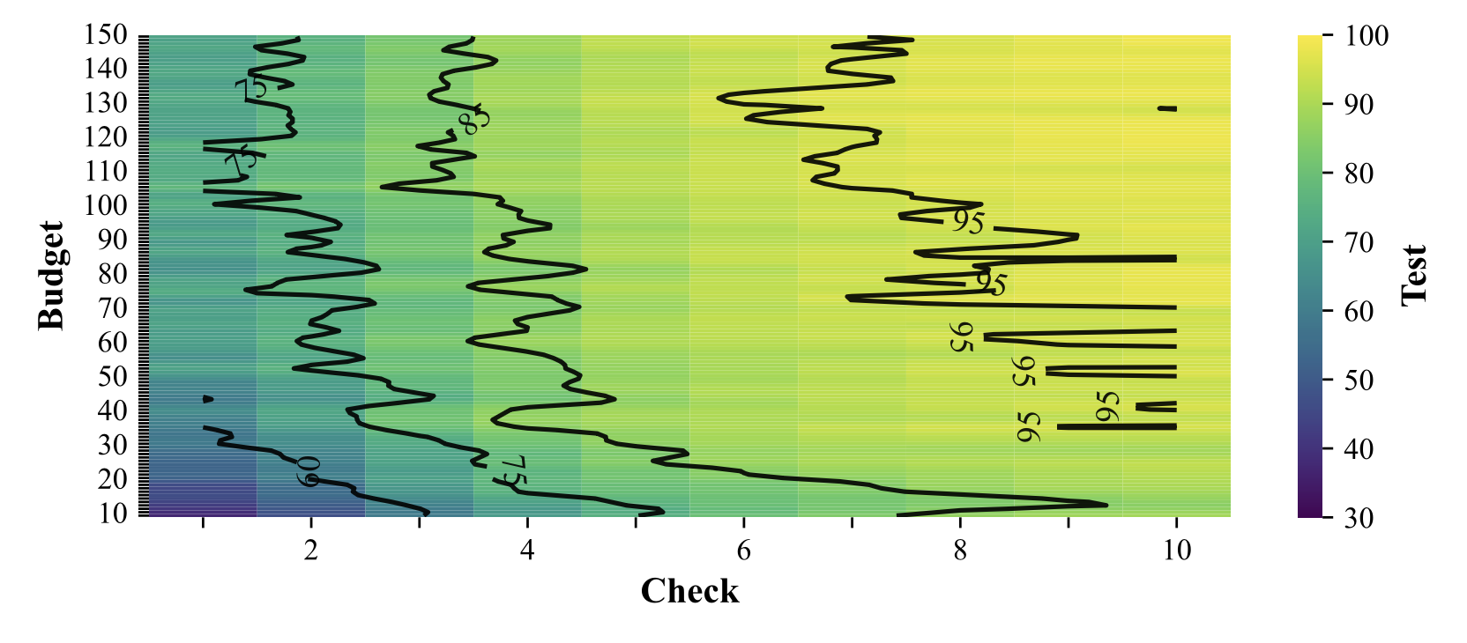
Q: how well does EZR generalize? A: sort holdout via tree, check first few [31]
Win = int(100 * (1 – regret))
100,000 times
pick any MOOT data set
Train:
Active learning, labeling y rows with a limited budget.
Build tree from labels
Test:
Use tree to sort holdout
Check first few
Active learning, very effective
Label 50 rows
Check 5
Achieve 85% of best
This entire 100,000-experiment study: one laptop, 2 hours, no cluster, no cloud bill.
15
and how fast? →

Slide 18
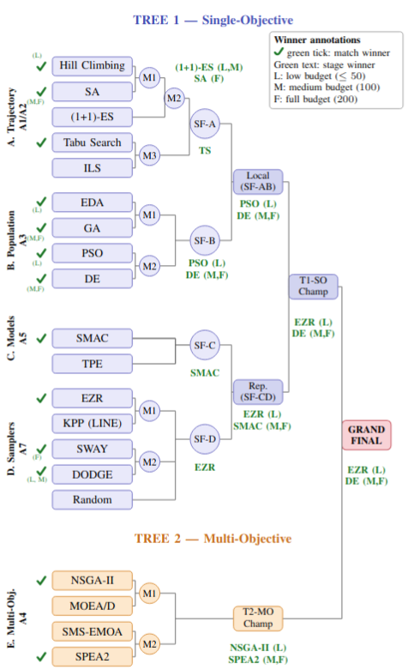
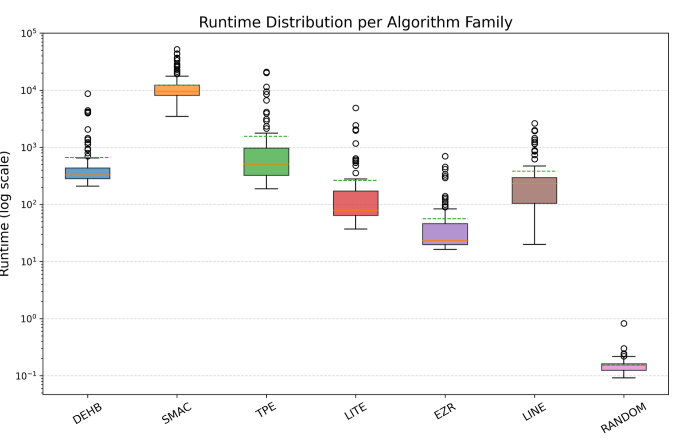
Q: how fast and effective are EZR’s trees? A: very and very [32]
ms
500x less CPU = 500x less energy. every run.
e.g. NSGA-II needs 1000 samples for what EZR reaches in 50
16
and are the models small enough to explain? →

Slide 19
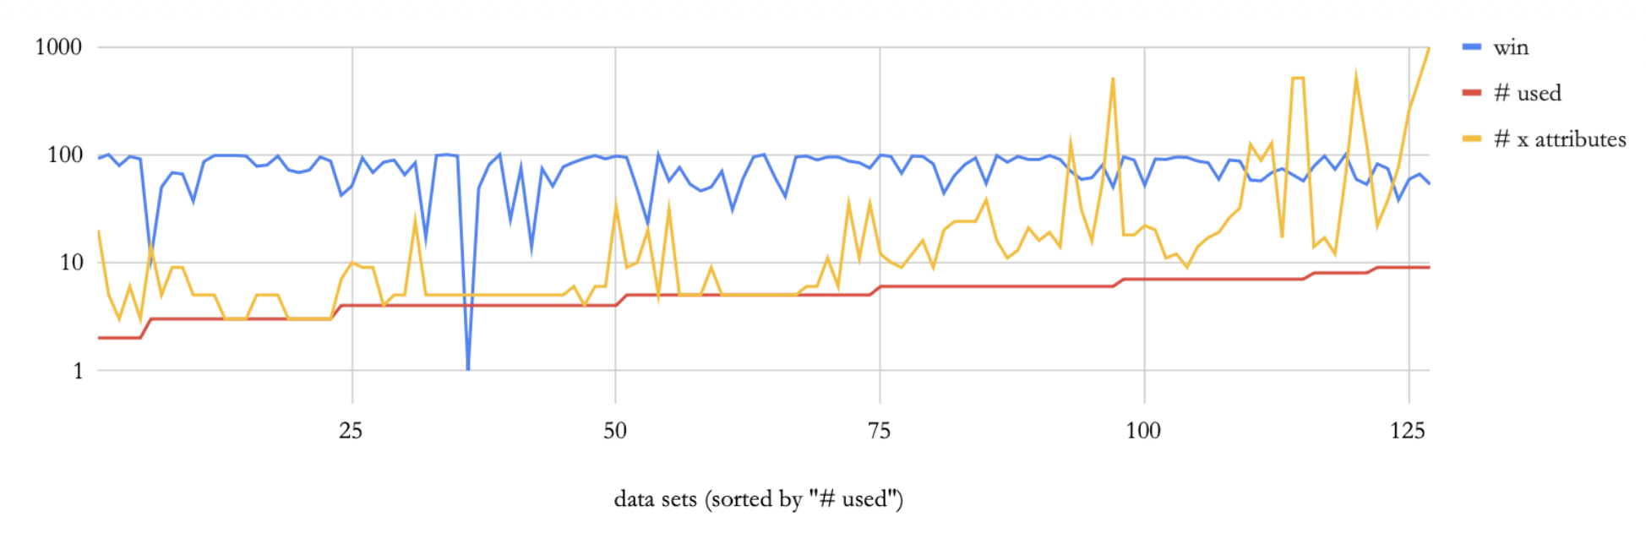
Q: how big are EZR’s models? A: surprisingly small [33]
17
and are the models small enough to explain? →

Slide 20
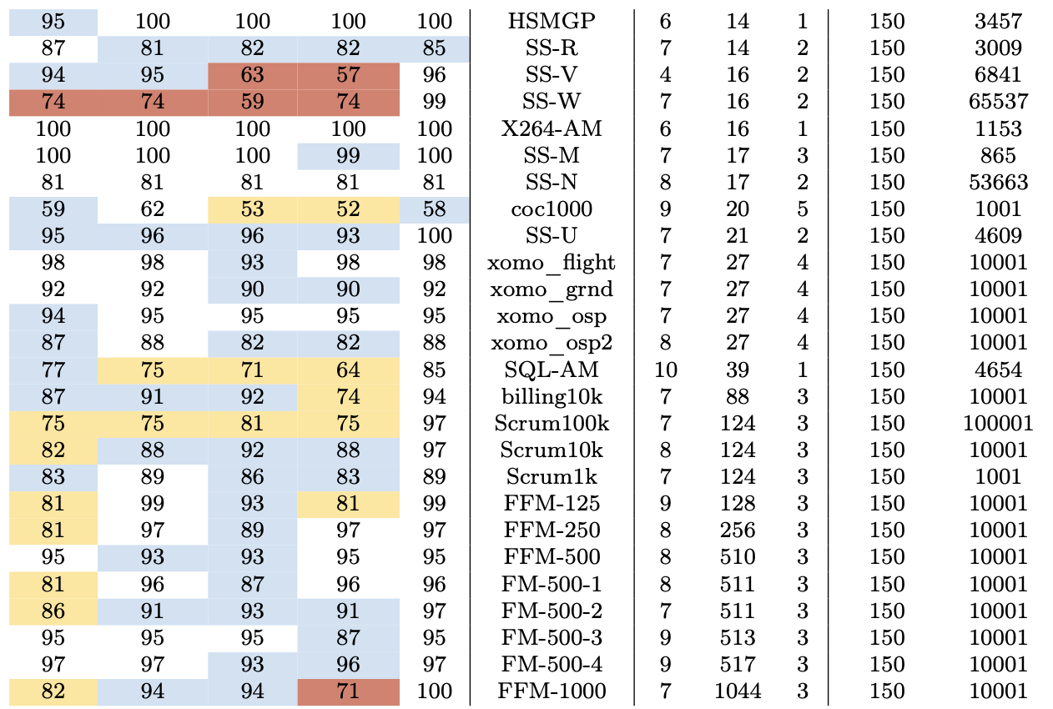
Q: so is EZR useful for explanation? A: EZR’s trees competitive with SOTA [33]
Build trees using N attributes
N= #attributes used in EZR’s tree
Using other tools: select top N attributes
White = tied best
Blue = within top 90%
Yellow = within top 75%
EZR goes a long way
E.g. last row
For a 3 goal task
EZR uses 7 / 1044 attributes
EZR uses 150 rows
Arguably competitive
across 127 datasets: trees use
4–9 of up to 1044 attributes
18
Any way to use all this to help LLMs? →

Slide 21
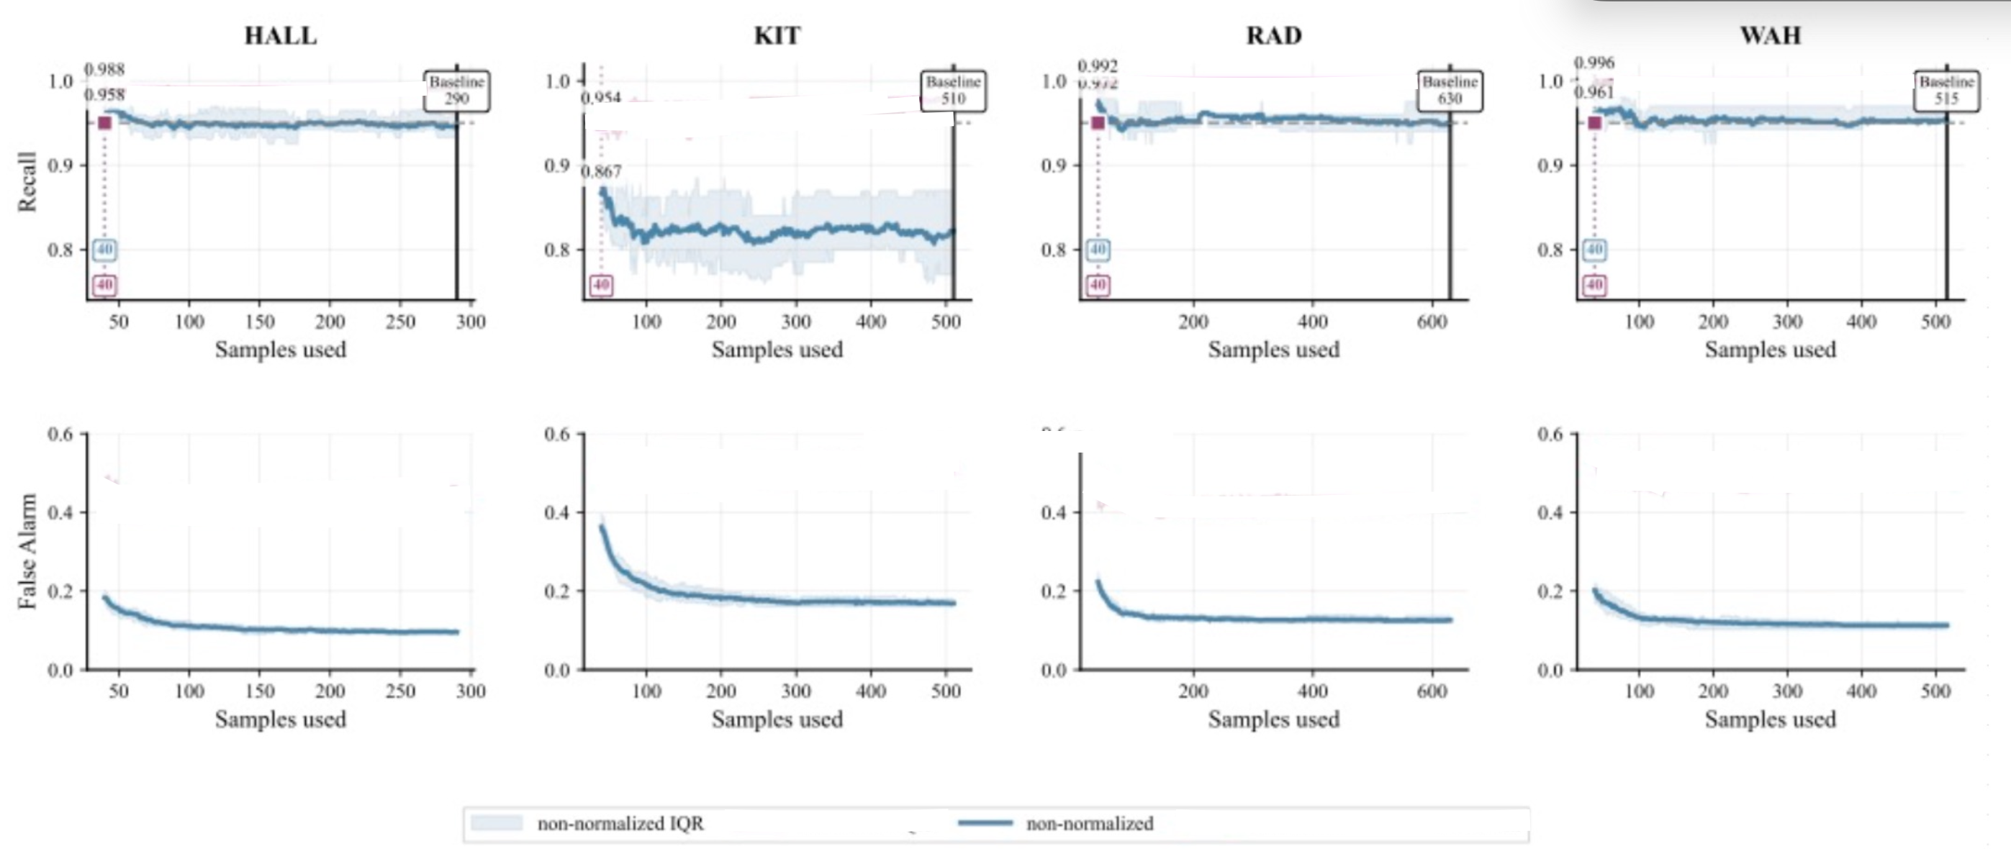
Q: what does EZR say about LLMs? A: LLMs rarely tested against simpler tool [34]
Search google scholar for relevant research
19

Slide 22
why easier AI?
how to do easier AI?
why not more of easier AI?

Slide 23
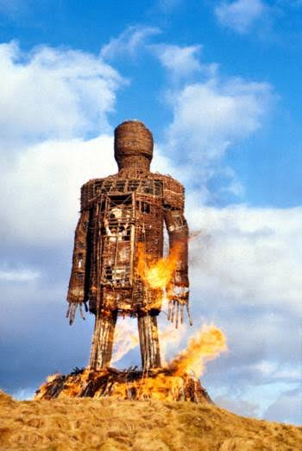
Q: if so good, why not more easier AI? A: (weak) empirical standards [34] [35]
In a survey of 229 SE papers on LLMs in SE
Only 5% compared to simpler approaches
Methodological error
Other methods can produce results that are better and/or faster
(See above)
My career:
Step 1: compare ”it” vs a stupider straw man
Step 2: throw “it” away, use the straw man
21
also, the new toys are seductive →

Slide 24
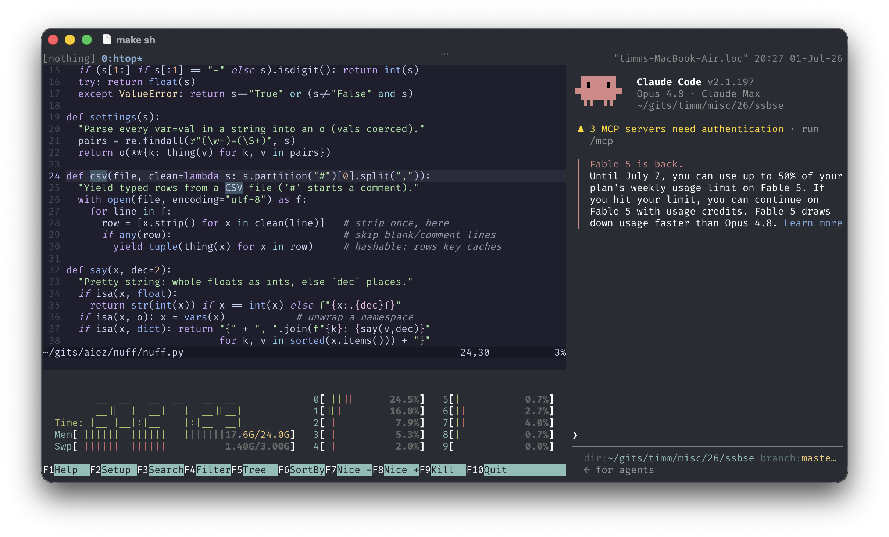

Q: if so good, why not more easier AI?
A: cause “big” sells; prompts/loops are cool [36]
Welcome to my data center
ribbon on the door the mayor can cut
such a spectacle!
Compare that to timm inc.
No special software to sell
you can build it yourself
No special hardware to sell
our algorithms are so fast, they don’t need it
IPO : low evaluation
22
and simplicity is genuinely hard →

Slide 25
Q: if so good, why not easier AI? A: the simplicity paradox
Simplicity needs experience.
“Experience is the name every one gives to their mistakes.” — Lady Windermere’s Fan (1892)
Simplicity is complicated to certify
You have to build and/or run simpler “it” and complex “it”
Needs lot of CPU; e.g. 20 months of CPU
23
and our brains fight us →

Slide 26


Q: if so good, why not more easier AI? A: human cognitive bias [37]
Our simpler methods have not been previously explored
since other researchers were not looking for them.
Why?
Humans are biased to bloat
In studies of 100s of human subjects
Humans favor additive to subtractive changes
1,155 to 297 (about 4:1)
24
so, to conclude →

Slide 27
TL;DR

Slide 28
Lehman’s 2nd law [1]
“as a system evolves, its complexity increases unless work is done to maintain or reduce it”
Q: why / how can we reduce the complexity of AI?
A: we must / we can
do: baseline the simple: pip install ezr + tiny.cc/moot
review:
ask “compared to what simpler?”
teach:
easier AI first; scale only when simple fails
25

Slide 29
An ASE’26 workshop
1 page abstract due July 20

Slide 30
/ (question | comment)* /
code: pip install ezr data: http://tiny.cc/moot

Slide 31
References
[1] Lehman, Meir M. "Programs, Life Cycles, and Laws of Software Evolution." Proceedings of the IEEE, vol. 68, no. 9, 1980, pp. 1060-1076.
[2] Nair V, Menzies T., Chen J. An (Accidental) Exploration of Alternatives to Evolutionary Algorithms for SBSE" presented at SSBSE 2016
[3] Wirth, Niklaus. "A Plea for Lean Software." Computer, vol. 28, no. 2, 1995, pp. 64-68.
[4] Bain & Company. Global Technology Report 2025. Bain & Company, Sept. 2025.
[5] Schwartz, Roy, et al. "Green AI." Communications of the ACM, vol. 63, no. 12, 2020, pp. 54-63.
[6] Xu, Tianyin, et al. "Hey, You Have Given Me Too Many Knobs! Understanding and Dealing with Over-Designed Configuration in System Software." Proceedings of the 10th Joint Meeting on Foundations of Software Engineering (FSE), ACM, 2015, pp. 307-319.
[7] Villalobos, Pablo, et al. "Will We Run Out of Data? Limits of LLM Scaling Based on Human-Generated Data." Proceedings of the 41st International Conference on Machine Learning (ICML), 2024.
[8] Tawosi, Vali, Rebecca Moussa, and Federica Sarro. "Agile Effort Estimation: Have We Solved the Problem Yet? Insights from a Replication Study." IEEE Transactions on Software Engineering, vol. 49, no. 4, 2023, pp. 2677-2697.
[9] Majumder, Suvodeep, Tim Menzies et al. "500+ Times Faster than Deep Learning: A Case Study Exploring Faster Methods for Text Mining StackOverflow." Proceedings of the 15th International Conference on Mining Software Repositories (MSR), ACM, 2018.
[10] Ling, Xiao, Tim Menzies et al. "Trading Off Scalability, Privacy, and Performance in Data Synthesis." IEEE Access, vol. 12, 2024, pp. 26642-26654.
[11] Fu, Wei, and Tim Menzies. "Easy over Hard: A Case Study on Deep Learning." Proceedings of the 11th Joint Meeting on Foundations of Software Engineering (ESEC/FSE), ACM, 2017, pp. 49-60.
[12] Fu, Wei, Tim Menzies, and Xipeng Shen. "Tuning for Software Analytics: Is It Really Necessary?" Information and Software Technology, vol. 76, 2016, pp. 135-146.
[13] Somvanshi, Shriyank, et al. "A Survey on Deep Tabular Learning." arXiv preprint arXiv:2410.12034, 2024.
27

Slide 32
References (cont.)
[14] Grinsztajn, Leo, Edouard Oyallon, and Gael Varoquaux. "Why Do Tree-Based Models Still Outperform Deep Learning on Typical Tabular Data?" Proceedings of NeurIPS Datasets and Benchmarks Track, 2022.
[15] Pearson, Karl. "On Lines and Planes of Closest Fit to Systems of Points in Space." The London, Edinburgh, and Dublin Philosophical Magazine and Journal of Science, vol. 2, no. 11, 1901, pp. 559-572.
[16] Amarel, Saul. "Program Synthesis as a Theory Formation Task: Problem Representations and Solution Methods." Machine Learning: An Artificial Intelligence Approach, Morgan Kaufmann, 1986.
[17] Chang, Chin-Liang. "Finding Prototypes for Nearest Neighbor Classifiers." IEEE Transactions on Computers, vol. C-23, no. 11, 1974, pp. 1179-1184.
[18] Johnson, William B., and Joram Lindenstrauss. "Extensions of Lipschitz Mappings into a Hilbert Space." Contemporary Mathematics, vol. 26, 1984, pp. 189-206.
[19] De Kleer, Johan. "An Assumption-Based TMS." Artificial Intelligence, vol. 28, no. 2, 1986, pp. 127-162.
[20] Crawford, James M., and Andrew B. Baker. "Experimental Results on the Application of Satisfiability Algorithms to Scheduling Problems." Proceedings of the 12th National Conference on Artificial Intelligence (AAAI), 1994, pp. 1092-1097.
[21] Olshausen, Bruno A., and David J. Field. "Emergence of Simple-Cell Receptive Field Properties by Learning a Sparse Code for Natural Images." Nature, vol. 381, 1996, pp. 607-609.
[22] Kohavi, Ron, and George H. John. "Wrappers for Feature Subset Selection." Artificial Intelligence, vol. 97, no. 1-2, 1997, pp. 273-324.
[23] Williams, Ryan, Carla P. Gomes, and Bart Selman. "Backdoors to Typical Case Complexity." Proceedings of the International Joint Conference on Artificial Intelligence (IJCAI), 2003, pp. 1173-1178.
[24] Zhu, Xiaojin. "Semi-Supervised Learning Literature Survey." Computer Sciences Technical Report 1530, University of Wisconsin-Madison, 2005.
[25] Settles, Burr. "Active Learning Literature Survey." Computer Sciences Technical Report 1648, University of Wisconsin-Madison, 2009.
[26] Menzies, Tim. "Shockingly Simple: 'Keys' for Better AI for SE." IEEE Software, vol. 38, no. 2, 2021, pp. 114-118.
28

Slide 33
References (cont.)
[27] Nair, Vivek, Tim Menzies, et al. "Finding Faster Configurations Using FLASH." IEEE Transactions on Software Engineering, vol. 46, no. 7, 2018, pp. 794-811.
[28] Yang, Chuanpeng, et al. "Survey on Knowledge Distillation for Large Language Models: Methods, Evaluation, and Application." ACM Transactions on Intelligent Systems and Technology, 2024.
[29] Lindauer, Marius, et al. "SMAC3: A Versatile Bayesian Optimization Package for Hyperparameter Optimization." Journal of Machine Learning Research, vol. 23, no. 54, 2022, pp. 1-9.
[30] Menzies, Tim, et al. "MOOT: A Repository of Many Multi-Objective Optimization Tasks." Proceedings of the International Conference on Mining Software Repositories (MSR), ACM, 2026.
[31] Ganguly, Kishan Kumar, and Tim Menzies. "How Low Can You Go? The Data-Light SE Challenge." Proceedings of the ACM on Software Engineering, vol. 3, no. FSE, Article FSE185, 2026.
[32] Ganguly, Kishan Kumar, and Tim Menzies. "Which Optimizer, At What Budget? A Tournament of Optimizers for Search-Based SE." 2026, under review.
[33] Rayegan, Amirali, and Tim Menzies. "Minimal Data, Maximum Clarity: A Heuristic for Explaining Optimization." Journal of Systems and Software, vol. 238, 2026, 112897.
[34] Menzies, Tim, and Srinath Srinivasan. "Can AI Be Easy? Lessons Learned from the EZR.py Toolkit." arXiv preprint arXiv:2606.03640, 2026.
[35] Senthilkumar, Lohith, and Tim Menzies. "Can Large Language Models Improve SE Active Learning via Warm-Starts?" ACM Transactions on Software Engineering and Methodology, 2026.
[36] Srinivasan, Srinath, and Tim Menzies. "Better Together, in the Right Order: Classical-then-LLM Optimization for SE." arXiv preprint, 2026.
[37] Adams, Gabrielle S., et al. "People Systematically Overlook Subtractive Changes." Nature, vol. 592, 2021, pp. 258-261.
29

