Slide 1
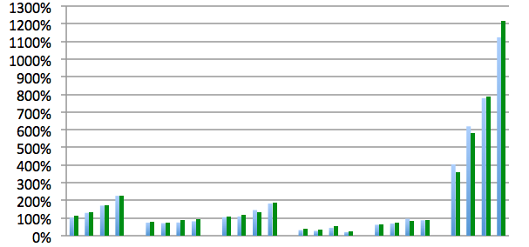
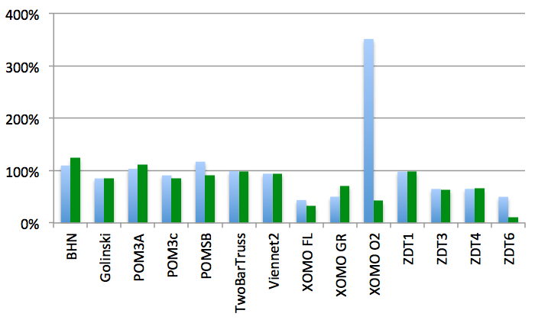
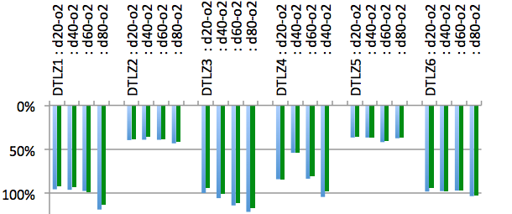
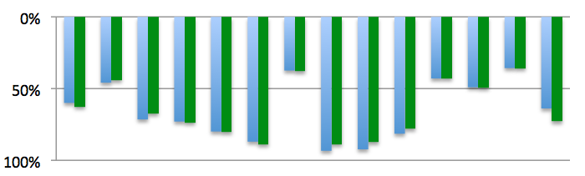
GALE/ NSGA-II
GALE/ SPEA2
GALE/ NSGA-II
GALE/ SPEA2
Hypervolumes
Hypervolumes
Spreads
Spreads

