Slide 1

SE should build its own AI
Better, faster, cheaper: because SE data is simpler than it looks
Tim Menzies · Professor, NC State University · timm@ieee.org
Andre Lustosa · Engineer & Team Lead, Red Hat · alustosa@redhat.com
Banner: ASE 2026; photo by Marek Jankola, CC BY.

Slide 2
For AI software, are you…
Consumer?
Creator!
(me)
Notes:
Thesis: if SE people build our own AI, then AI becomes better, faster and cheaper.
If Meta, OpenAI, Google or Anthropic build our AI:
- Unstable. Models change or retire on their schedule.
- Opaque. Closed weights; we cannot audit or explain.
- Their goals first. SE needs come second.
- We stay consumers, not creators.
- Wrong data. Tuned for web text. SE data is small, local, simple.
- Costly. We pay for compute we do not need.

Slide 3
For AI software, are you…
Consumer?
Creator!
(me)
Why?
How?
So what?

Slide 4

RL-tuned transformer classifier that emits calibrated softmaxes in one forward pass.

Slide 5
When big AI labs build our AI…
…we lose control
…and we do not need them
Unstable. Models change or retire on their schedule.
Opaque. Closed weights; no audit, no explanation.
Their goals first. SE needs come second.
We stay consumers. Only 13 of 229 SE papers on LLMs compared them to anything else [Hou, TOSEM'24]
Wrong data. SE data is small and simple.
• Low intrinsic dimensionality: DODGE wins on most SE data, 6/31 non-SE [Agrawal, TSE'22]
• DRR > 0.35 in 38/50 SE data sets [Lustosa, TSE'26]
Costly. Compute we do not need.
• DODGE: 30 evaluations, not thousands [Agrawal, TSE'22]
• LITE: seconds, not 20+ minutes [Lustosa, TSE'26]
Hou et al., ACM TOSEM 33(8), 2024. Agrawal et al., IEEE TSE 48(8), 2022. Lustosa & Menzies, IEEE TSE, 2026.

Slide 6
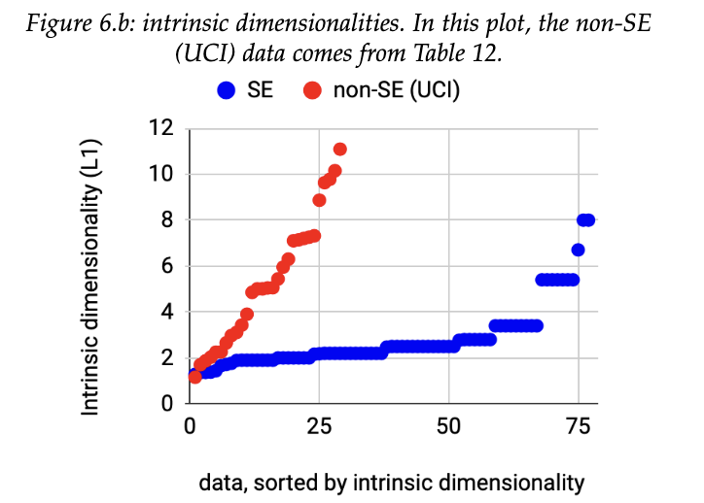
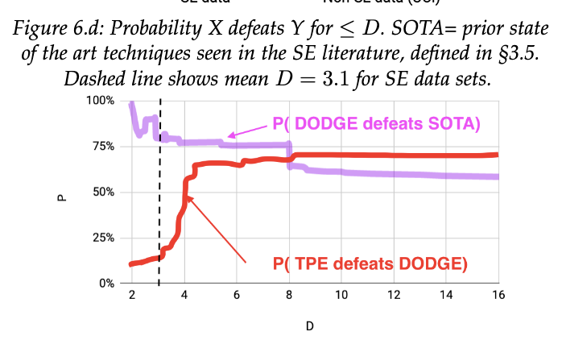
What the red terms mean
Intrinsic dimensionality (I)
DODGE
How many dimensions the data really uses. Rows along a road are 1-D, even in a 20-column table.
Skips settings that score within ε of ones already seen. Stops after 30 evaluations.
Median: SE 3.1, non-SE 5
[Agrawal, TSE'22]
Good on low-I data only
[Agrawal, TSE'22]

Slide 7
What the red terms mean
Intrinsic dimensionality (I)
DODGE
DRR = 1 − I/R
How many dimensions the data really uses. Rows along a road are 1-D, even in a 20-column table.
Skips settings that score within ε of ones already seen. Stops after 30 evaluations.
Share of the R raw columns that the data does not need.
Median: SE 3.1, non-SE 5
[Agrawal, TSE'22]
Good on low-I data only
[Agrawal, TSE'22]
DRR > 0.35: 30 evaluations suffice
[Lustosa, TSE'26]

Slide 8
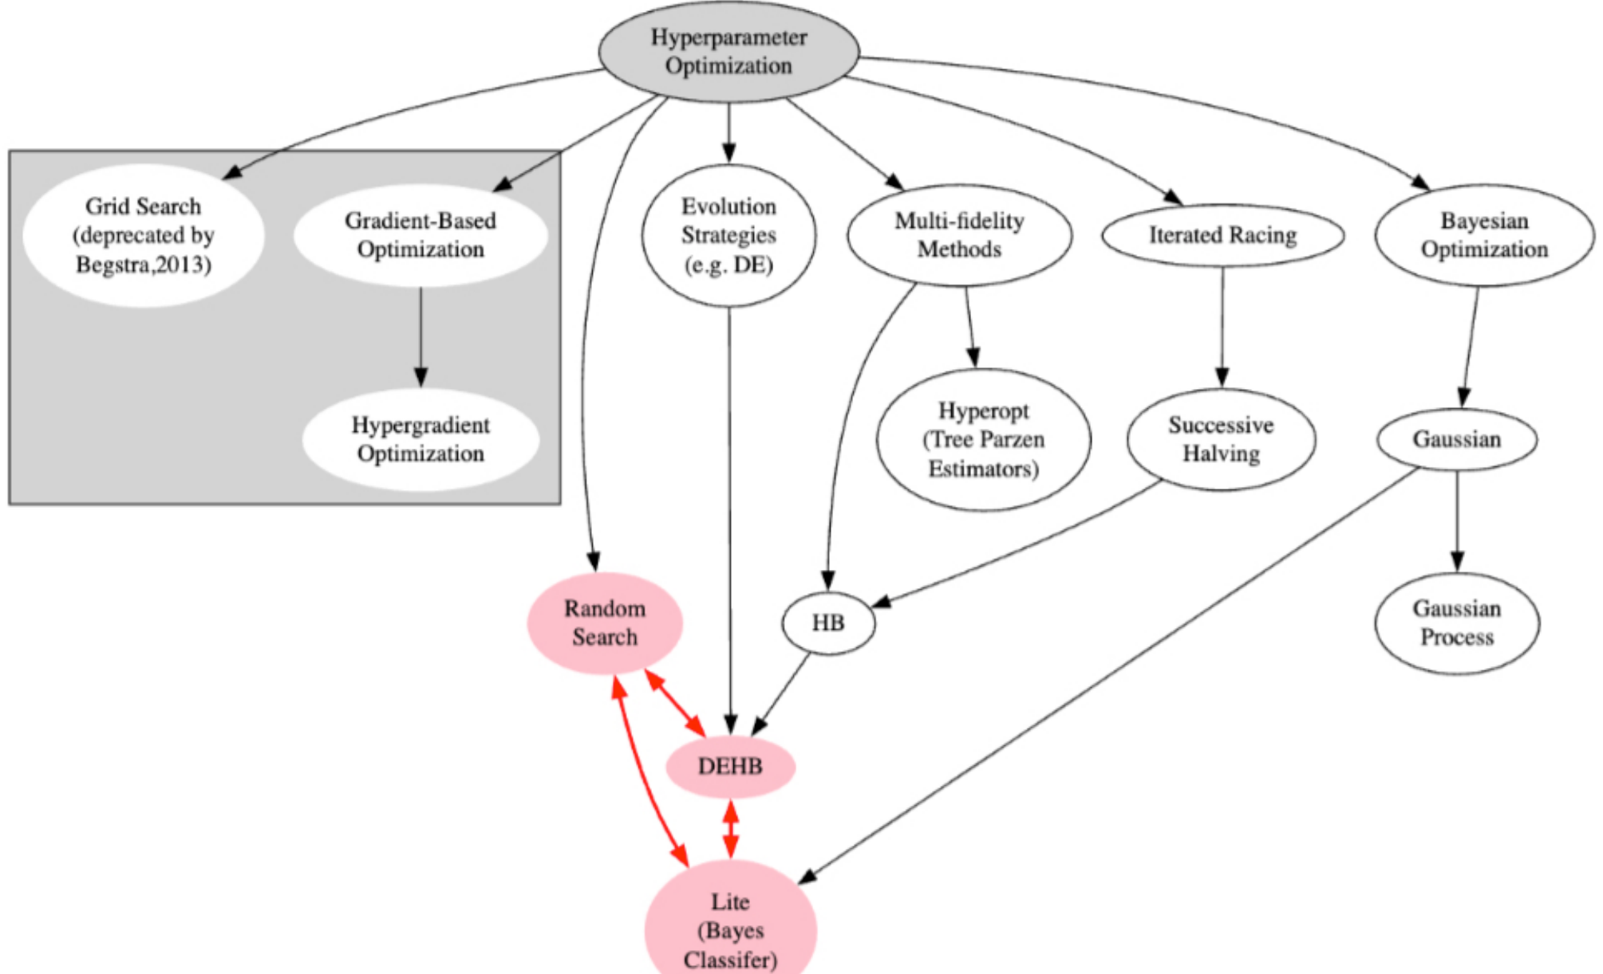
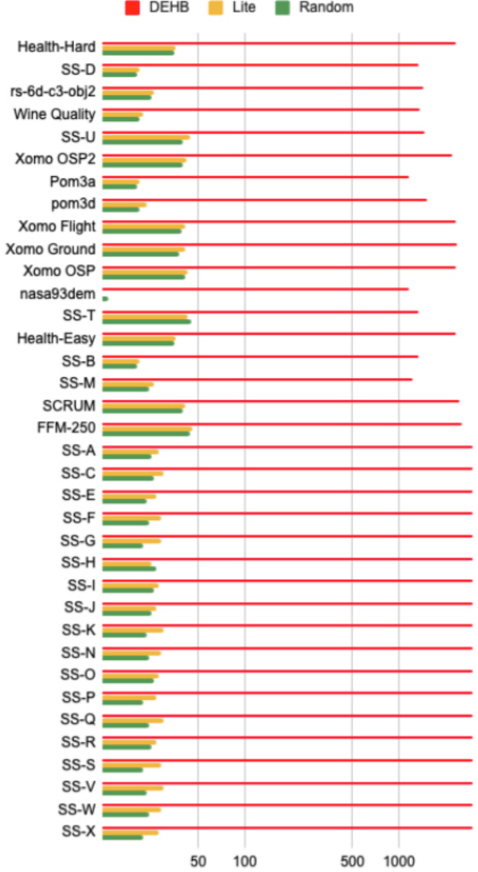
LITE and DEHB come from different families
Optimizer families. Red: the three we compared.
Runtime (s, log scale)
Lustosa & Menzies, IEEE TSE, 2026, Figs. 5 and 6.C. DEHB ≈ 1,000+ s; LITE and random < 50 s.

Slide 9
LITE: 30 lines. DEHB: three AI methods.
LITE simple
DEHB state of the art
Label a few rows; split into "best" and "rest"
Train Bayes: best vs. rest
Label the most "best"-looking row
Stop at 30 labels
Hyperband: try many budgets
Successive halving: drop weak settings
Differential evolution at each budget
~30 lines of Python
30 evaluations · seconds
Beats BOHB and Hyperopt
3,000 evaluations · 20+ minutes
On SE data with DRR > 0.35, both find the same answer.
LITE: Menzies & Lustosa, arXiv:2405.12920; github.com/timm/ezr. DEHB: Awad et al., IJCAI'21.

Slide 10
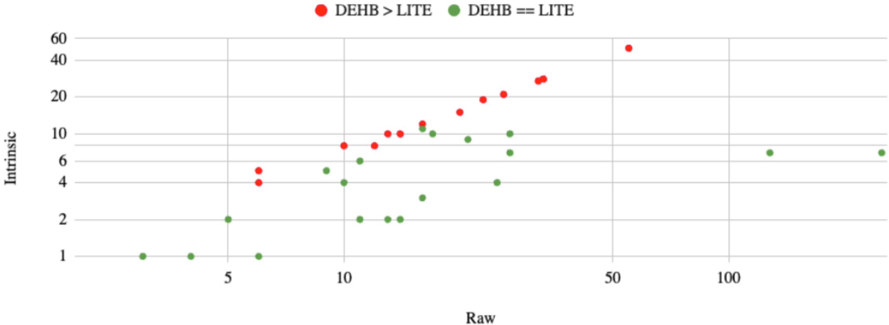
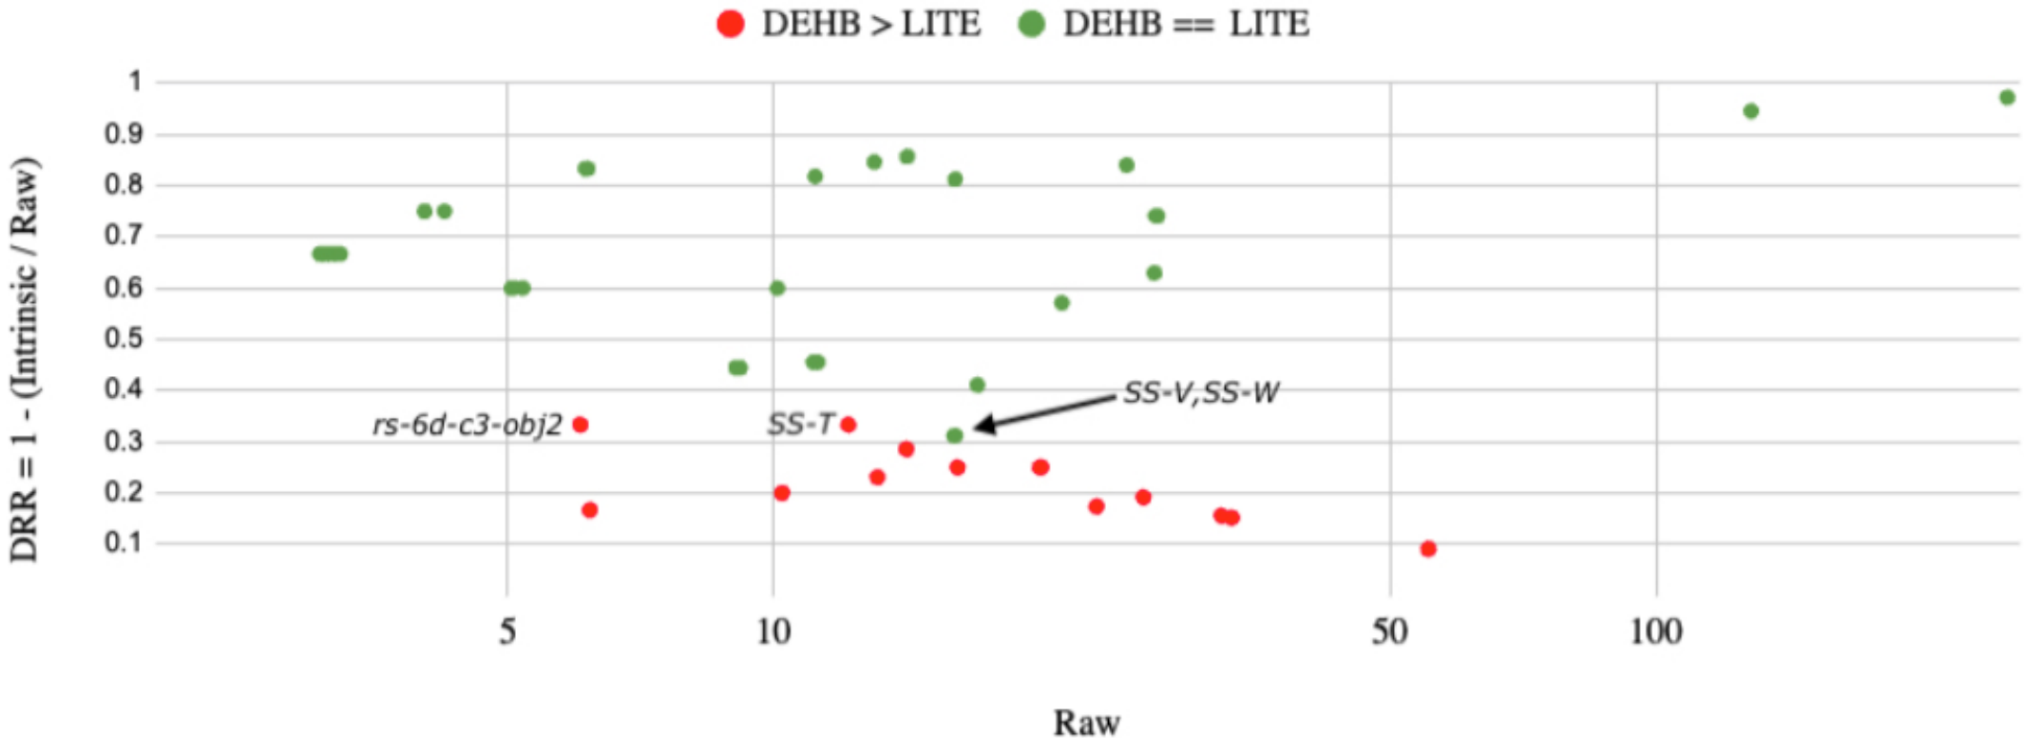
DRR predicts when simple is enough
Each dot is one data set.
Red: DEHB beat LITE.
Green: a tie.
Top: intrinsic dimensionality alone does not split them.
Bottom: DRR does. Above 0.35, every data set is a tie.
Lustosa & Menzies, IEEE TSE, 2026, Figs. 3 and 4.

Slide 11
Check the data before you buy the compute
Why?
How?
So what?
Big-lab AI is unstable, opaque and tuned for other data.
SE data is simpler: DRR > 0.35 in 38 of 50 SE data sets.
Measure DRR first.
If DRR > 0.35, use LITE: 30 labels, ~30 lines of code.
Same results as DEHB, 100× faster.
Data-centre power will double by 2030. Frugal AI matters.
SE data needs SE AI. Be creators, not consumers.
Agrawal et al., TSE'22. Lustosa & Menzies, TSE'26. IEA, Energy and AI, 2025.

Slide 12
Backup

Slide 13
Data-centre power will double by 2030
×2.3
World: 415 TWh (2024) to ~945 TWh (2030)¹
6.7–12%
of US power by 2028, up from 4.4% in 2023²
TWh per year. Grey: reported. Blue: projected.
¹ IEA, Energy and AI, 2025. ² LBNL / US DOE, 2024 US Data Center Energy Usage Report.

Slide 14
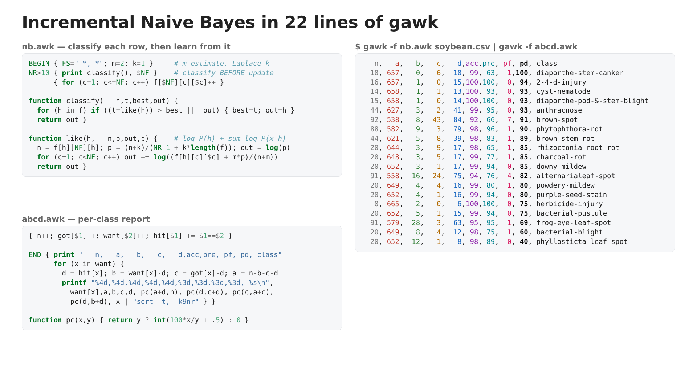
Numeric Xs? Discretize: int(BINS/(1+exp(-1.7·z)))
Numeric Ys? Use kNN.
Few labels? 50–100 random rows work well.
Rare classes? TWCNB [Rennie, ICML'03]

Slide 15
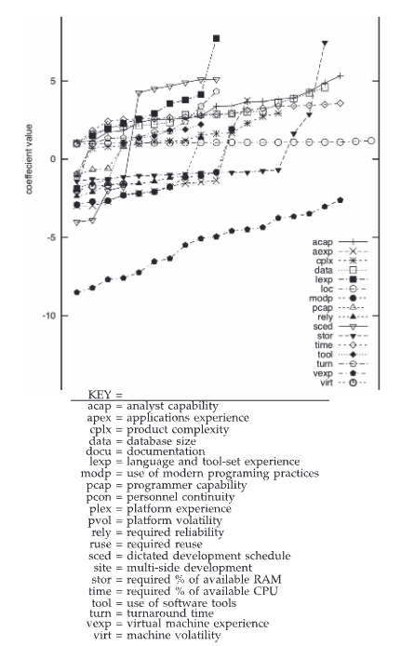
SE data is different
y = b₀ + b₁x₁ + b₂x₂ + …
Naturalness
  People write code for people to read, so code repeats a few known forms [Hindle, CACM'16]
  Far less random than, e.g., EM spikes on the sun
Locality
  Different people, skills, goals and platforms
  More data does not mean less variance

