Slide 1
LLMs + KLAS
"Obtaining state-of-the-art results
can be achieved with smarter
questioning, not planetary-scale
computation."
The Case for
Compact AI
Knowledge-Level Agent Systems
for Software Engineering
— CACM, Sept 2025
Tim Menzies · NC State · timm@ieee.org
45-min talk · CS undergrads + grad students

Slide 2
Road Map
Five acts · 45 minutes
01
The Bigger-is-Better Myth
Problems with LLMs · vibe coding
02
State Spaces & Search
From Tic-Tac-Toe to SE · funneling
03
KLAS: Agents + Tools
Modeling trap · 1989 → 2026 · tools beat agents
04
EZR: Active Learning
Sparsity at every layer · 32 samples → 90%
05
Why Join This Research?
Alien code · open problems · the invitation

Slide 3
ACT 1
The Bigger-is-Better Myth
Why LLMs aren't always the answer

Slide 4
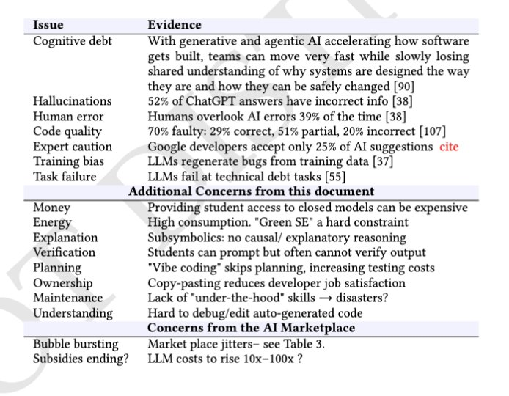
The LLM Problem Table
Evidence from the literature
52%
ChatGPT answers contain incorrect info
70%
AI-generated code is faulty
25%
Google devs accept AI suggestions
100x
LLM costs projected to rise

Slide 5
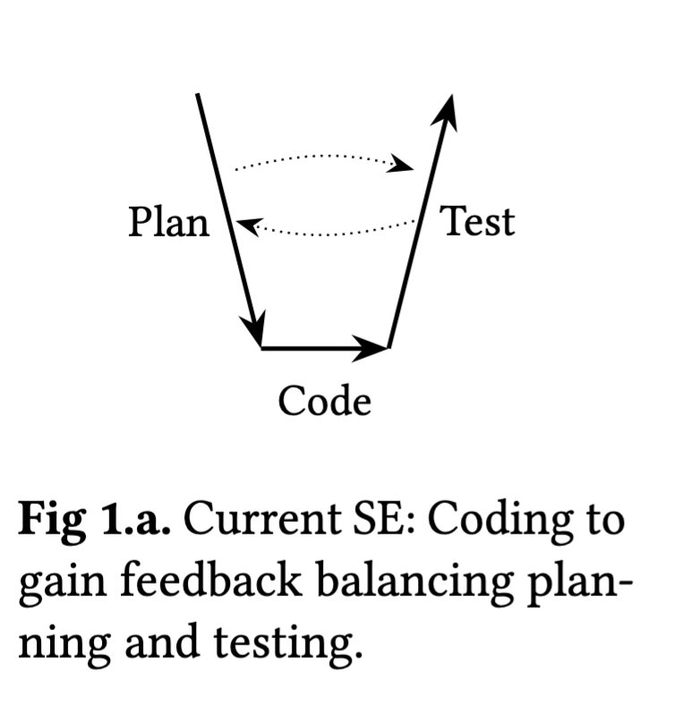
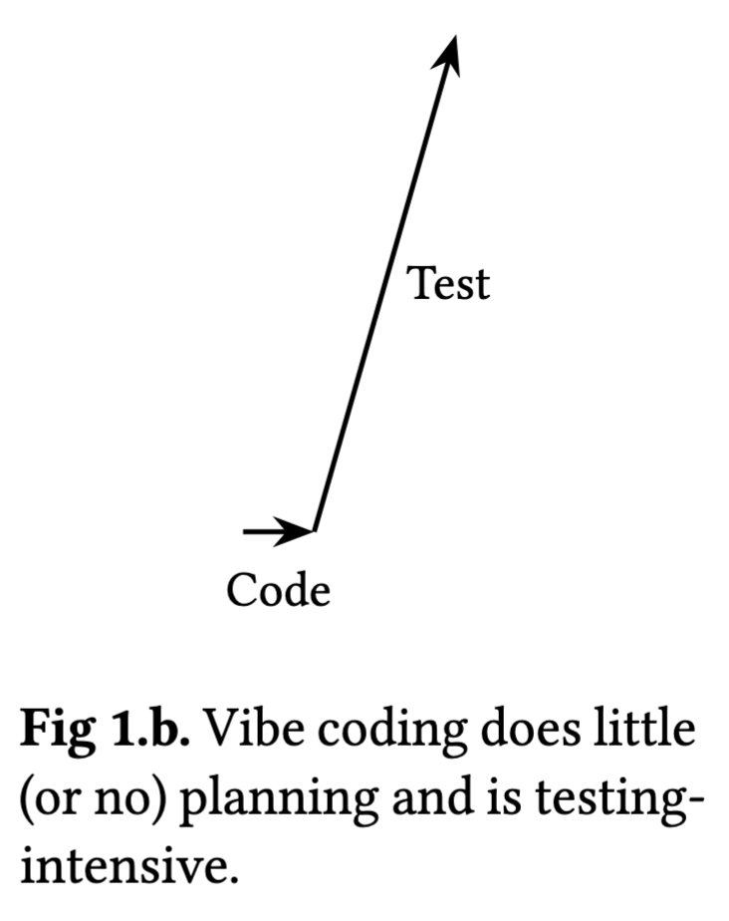
Vibe Coding Breaks SE
Planning disappears — testing debt explodes
Traditional SE
Vibe Coding

Slide 6
Herding vs Verification
A fundamental shift in what testing means
VERIFICATION (old goal)
HERDING (new goal)
∀x ∈ X : Valid(S(x))
Utility(S(x')) > τ
Prove correctness across ALL states.
Cost: exponential (2^|A|)
Fails on modern AI + concurrent systems
→
Find x' that reaches "Heaven" — a satisficing threshold τ.
Cost: ≈32 samples
Works on any black-box system
"Heaven" = zero defects, low latency, minimal cost — whatever your objectives are.

Slide 7
ACT 2
State Spaces & Search
From Tic-Tac-Toe to Software Engineering

Slide 8
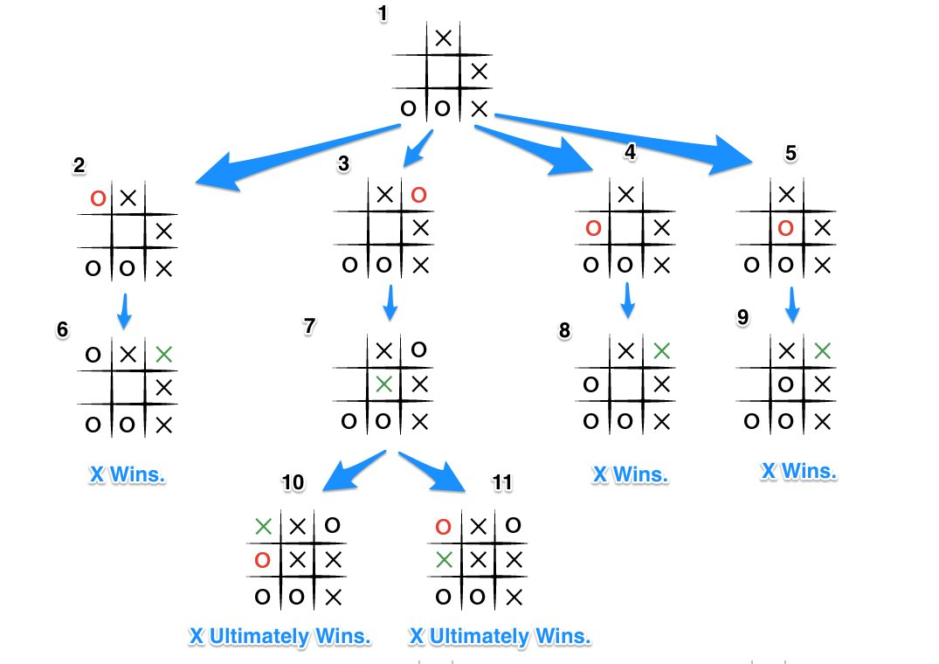
Every AI Problem is a Search
State spaces: visible in Tic-Tac-Toe, infinite in SE
Tic-Tac-Toe
~255,168 possible games.
We can see the whole tree.
SE Decisions
Config spaces: 10^40 options.
The tree is effectively infinite.
The Question
Find best paths without
exhaustive search — how?

Slide 9
The Funneling Effect
Despite complexity, software converges to few outcomes
Huge State Space (10^40 combinations)
Most paths lead nowhere useful
SVM+TF-IDF
beat Big AI
100× faster
better accuracy
Behavior clusters into few patterns
A handful of key decisions matter
✓ 32 samples → 90% optimal

Slide 10
ACT 3
KLAS: Agents + Tools
Knowledge-Level Agent Systems — what's old is new again

Slide 11
The Modeling Trap
ASP and Probabilistic Programming share a fatal assumption
Answer Set Programming
Probabilistic Programming
(Stan, Pyro)
Encodes system as logical rules.
Powerful — but requires full logical encoding of a million-line system.
Specify priors and relationships.
Powerful — but requires a probabilistic model T of the whole system.
⚠ The Common Fatal Assumption:
T is cheaper to build than the software itself.
"In modern SE, the system IS the model. Recreating a logical shadow of it is a boil-the-ocean strategy."

Slide 12
What's Old is New
The 1989 expert system dream — now finally working
1989 — Newell & Yost
2026 — DeepMind
"Subgoals are generated whenever problem solving cannot proceed until another problem space has performed some subtask."
Architecture: Symbolic logic, hand-coded operators
Problem: Brittle, hard to scale
"AI agents need to decompose problems into manageable sub-components and safely delegate their completion across other AI agents."
Architecture: Same — hierarchical delegation
Engine: LLM reasoning swapped in for brittle scripts
40 years
→

Slide 13
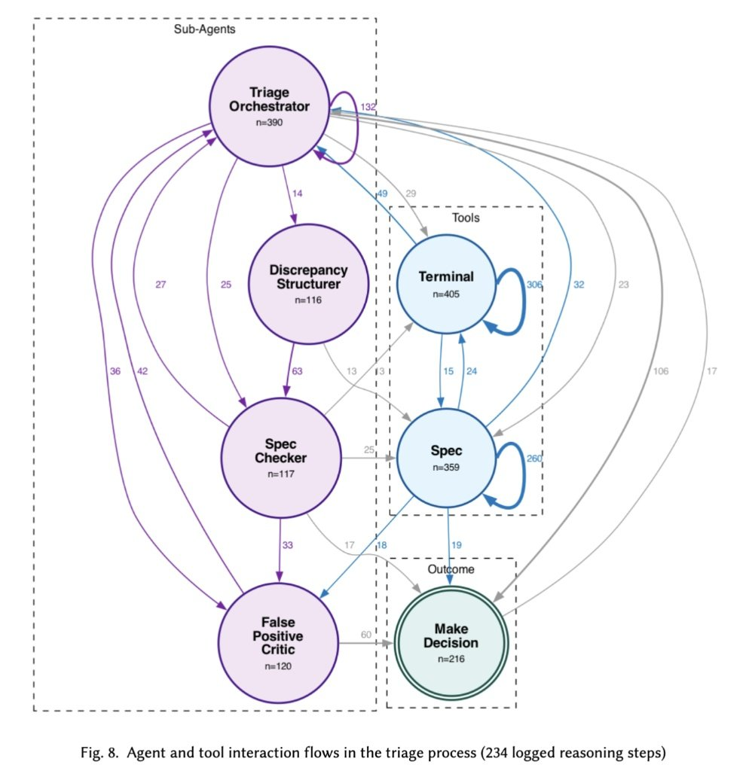
Agents Talk to Tools, Not Each Other
234 logged reasoning steps in a real triage system
Tools have MORE traffic
than agent-to-agent calls
Terminal
n=405 interactions
Spec tool
n=359 interactions
Triage Orch.
n=390 interactions
Agents are orchestrators. Tools do the real work.

Slide 14
Sparsity at Every Layer
A necessary condition — if software weren't sparse, we couldn't build it
1
Logic / SAT
Backdoor variables: 6,750-variable problems solved by just 12 'master key' variables (Selman et al.)
2
Source Code
20% of files contain 80% of bugs. Defects cluster. Power-law distributions throughout (Ostrand et al.)
3
Runtime
Big-data apps process petabytes yet exercise fewer than 50 distinct execution paths (Zhang et al.)
4
Design
NASA deep-space missions: optimization converges on fewer than 12% of decisions (Feather & Menzies)
Why? Miller's Law: humans hold 7±2 chunks in working memory. Software written by humans must be sparse.

Slide 15
ACT 4
EZR: Active Learning
Small data. Big results.

Slide 16
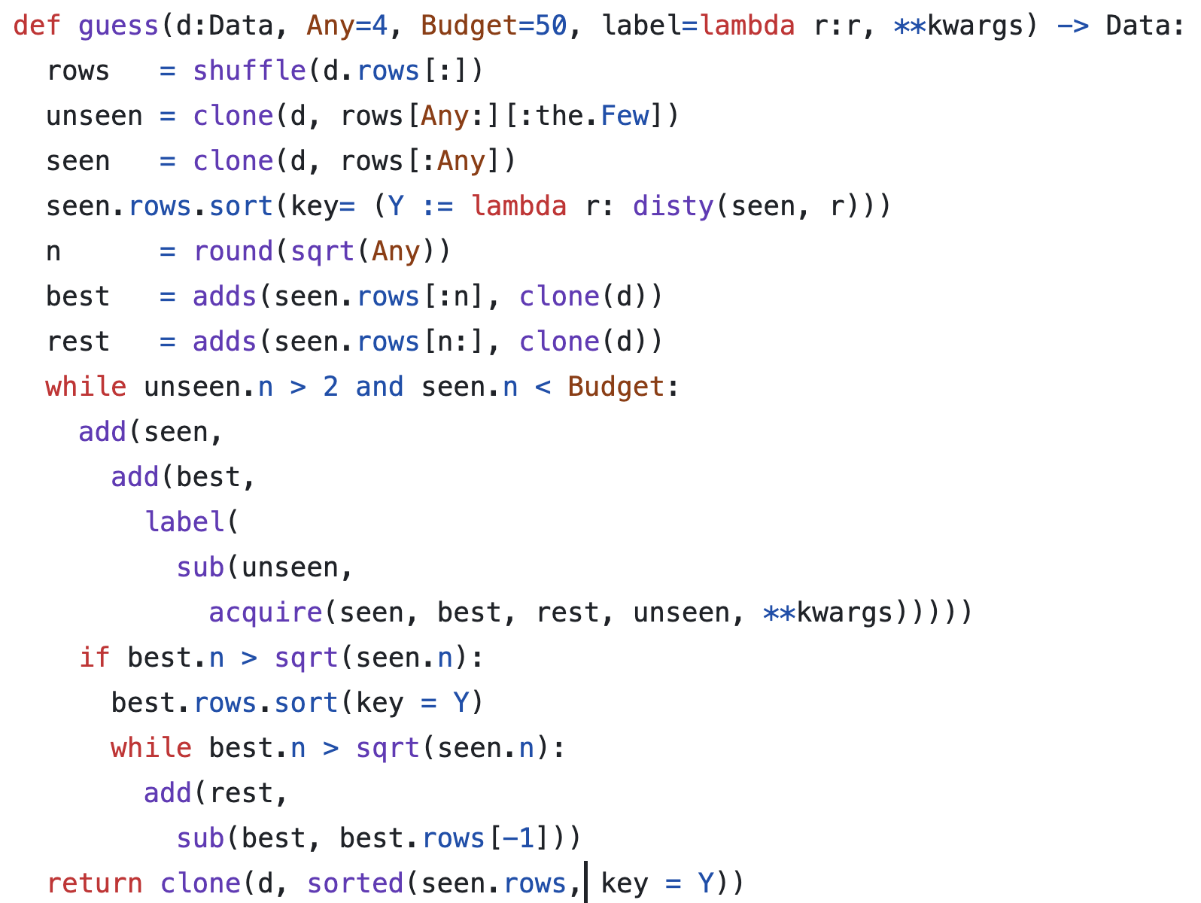
How EZR Works
Partial info · limited labels · exploit sparsity
1
Label
N=4 random examples to start
2
Split
√N best vs N−√N rest
3
Classify
Bayes: which unlabeled looks like best?
4
Acquire
Label the most informative example
5
Loop
Repeat until budget exhausted
6
Return
Tiny explainable regression tree

Slide 17
EZR Results
63 SE tasks · 20 repeated trials · standard laptop
8
labels
→ 62% optimal
32
labels
→ 90% optimal
3 min
on a laptop
63 tasks, 20 trials

Slide 18
ACT 5
Why Join This Research?
The Invitation

Slide 19
Open Problems — Your Chance
We are not building bigger hammers. We are designing smarter architects.
🌍 Sustainability
🤝 Human-AI Partnership
Green SE: compact AI runs in minutes on a laptop,
not weeks on a cluster.
EZR asks only the most informative questions.
AI assists — it does not replace.
🔍 Explainability
🔬 MOOT Repository
Tiny regression trees. Project managers can audit
and trust every decision.
63+ SE tasks. Open data. Real benchmarks.
Join us: add your problem to MOOT.
⚡ Efficiency
SVM+TF-IDF beats Big AI: 100× faster, better accuracy.
Do more with less.

Slide 20
The Open Question:
"Alien Code"
Sparsity exists because human cognitive limits force it. Humans obey Miller's Law: 7±2 chunks of working memory. So the code humans write is necessarily regular and sparse. LLMs face no such constraint. They can generate code with dense, high-dimensional dependencies (|A'| ≫ 10). Will AI code become "unher-dable"? Do we need "Sparsity Constraints"
as a safety requirement for generative AI?
This is YOUR research problem. Nobody has the answer yet.

Slide 21
Come Rediscover
the Future
EZR · MOOT · KLAS · Active Learning
timm@ieee.org · NC State · github.com/timm
"Intelligence requires more than just size."
— The Case for Compact AI, CACM 2025

